Slide 1
Faculty Senate Meeting
October 21, 2021

Slide 2
Meeting procedure
The same rules apply over virtual meetings as over in-person meetings
Only Senators may debate motions
Only Senators can vote
If you are not a Senator, or a proxy, you cannot vote or debate
Do not speak over someone, or out of order
  Raise your hand within the Zoom app
  The President will call on you and then you will have the floor
Unless you have been recognized (been told you have the floor), you may not speak
Per Robert’s Rules, each Senator is entitled to only speak twice on each motion.

Slide 3
Agenda
Call to Order and Roll Call
D. Westenberg, Secretary

Slide 4
Agenda
Approval of Minutes
September 13, 2021

Slide 5
Agenda
III. Campus Reports
  A. Staff Council
  T. Donnell

Slide 6
Agenda
III. Campus Reports
  B. Student Council
  A. Aiken

Slide 7
Agenda
III. Campus Reports
  C. Council of Graduate Students
  M. Nabi

Slide 8

Council of Graduate Students
    CGS/Provost Meeting covered various points including
    1. Health insurance
  2. Ombudsman Office: A survey has already been discussed and the Provost’s Office will send the survey to CGS to get buy in on the wording and to help encourage students to take the survey.
  3. Graduate Student Bill of Rights
  4. Financial Disruption
  5. Facilitate CPT or internship acquisition process
  6. Graduate Student Bill of Rights
We are planning to meet again with the provost in early November.

Slide 9
Council of Graduate Students
The Graduate Council Ad Hoc committee has met to discuss and finalize the Graduate Student Bill of Rights.
There are a couple of clarifications to the updated draft that the Ad Hoc committee are working on (e.g., double checking Title IX language).
The plan is to present the draft on the Graduate Council during the November 3rd meeting and determine future steps

Slide 10
Agenda
IV. President’s Report
K. Homan

Slide 11
President’s Report: UM System
IFC (Intercampus Faculty Cabinet): 06 October 2021 Mtg (Zoom)
  Relation between Annual Review Process and HR 720.
  Review of UM System President
  Shared Governance working group: status report
  From President M. Choi
    Portion of federal COVID funds being used to support NextGen (MU), Manufacturing (S&T), Entrepreneurship (UMSL), and Hospital Health (UMKC) initiatives.
    Significant changes to Title IX

Slide 12

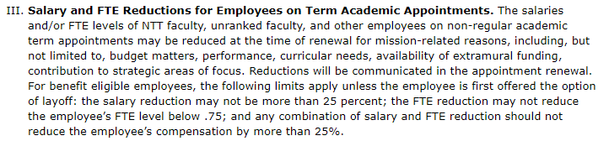
President’s Report: UM System
IFC (Intercampus Faculty Cabinet): Upcoming Meetings
  05 November 2021 – Location: Columbia, MO. Agenda in preparation.
  10 November 2021 – President M. Choi (Zoom)
    Meeting focus: Criteria-based Salary Reductions
    Authority through HR-720 Policy on Salary Reductions for Faculty and Other Academic Appointees (HR-720 created 05/04/2020).
    Policy has been used in MU School of Medicine (12m appointments only)

Slide 13
President’s Report: S&T Campus
2022 Summer Advising
  UM System: mandating summer class registration to begin first Monday in January
  In 2022, first day to register for summer classes is 03 January.
Intersession Courses
  Proposed for consideration by ad-hoc Academic Planning Committee during Spring-Summer 2020.
  Piloted in some English and Technical Communication courses in Fall 2020
  Recent administrative interest in variations on this theme.

Slide 14
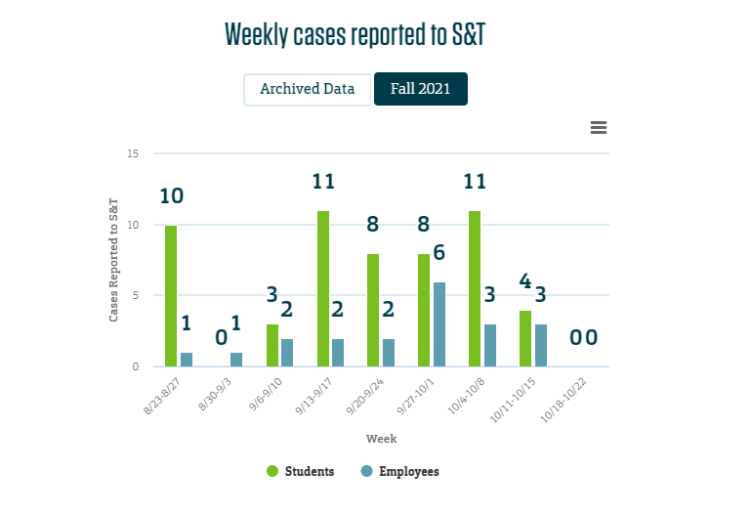
President’s Report: S&T Campus
Mask and Vaccination Policy
  Faculty input via survey – thank you!
  Results provided to Campus Administration and President M. Choi
  Campus policies limited to local municipal policy
  Monitor local cases at:
  https://coronavirus.mst.edu/dashboard/

Slide 15
President’s Report: Faculty Senate
Mining & Explosives Engineering: Name Change
  Faculty Senate approval on 23 Sep 2021 moved process forward
  Administrative documentation being completed
  DSCC and then CCC will consider, bring to full Faculty Senate
  Name change status: unofficial.
Direct Admission for CEC Degree Programs
  Faculty Senate role limited to consideration by Campus Curriculum Committee (CCC)
  Required forms will be received by CCC and brought to Faculty Senate vote
  Other issues related to direct admission, outside Faculty Senate purview

Slide 16
President’s Report: Faculty Senate
Evaluation of Teaching – broken down into three components:
  Policy Principles (cornerstone principles)
    Collecting feedback from Senate and administration
    Potentially, formalize in Chancellor’s Policy
  Student Evaluation of Teaching (SET or SBE) instrument
    End-of-semester course evaluations
    Lead: Committee for Effective Teaching (CET)
  Guidelines for Department-level Best Practices: comprehensive evaluation of teaching (SBE, PBE, ISA)
    Summarize in white paper
    Lead: Campus Working Group – contribute?

Slide 17
Agenda
V. Administrative Reports
A. Chancellor’s Report
M. Dehghani

Slide 18
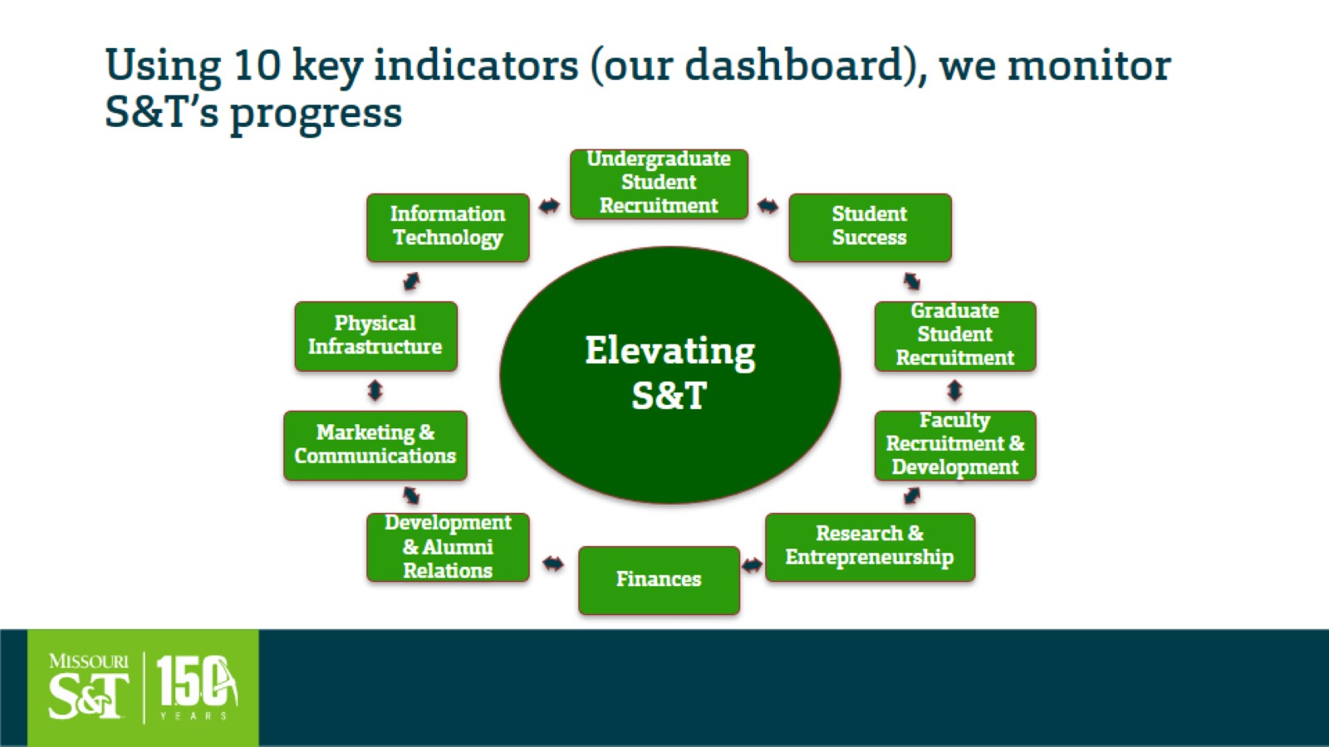
Using 10 key indicators (our dashboard), we monitor S&T’s progress

Slide 19
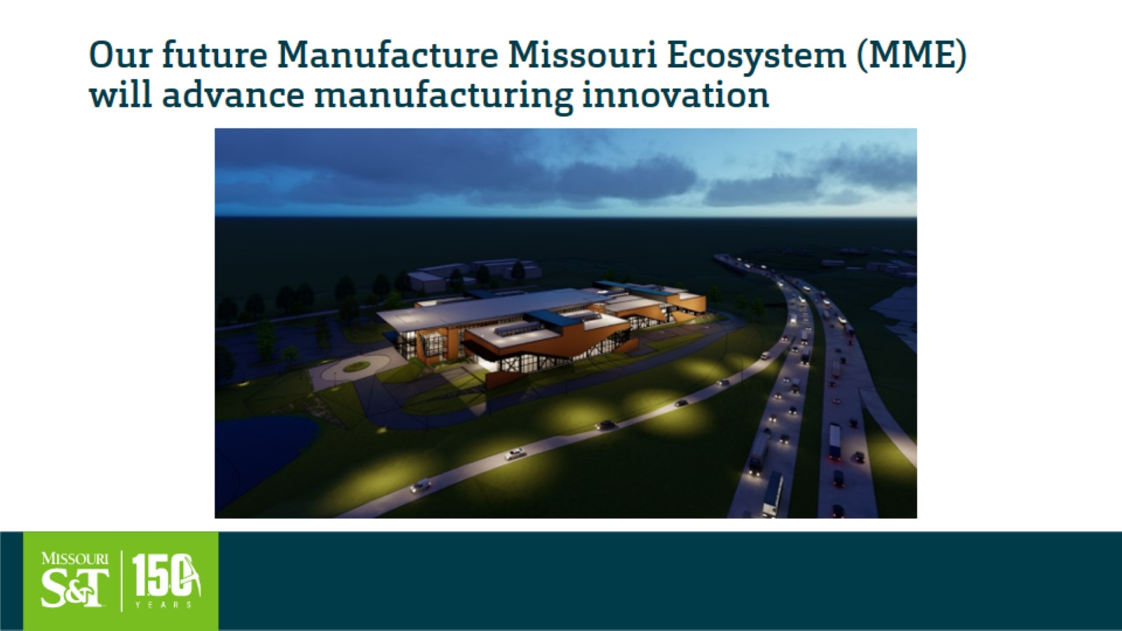
Our future Manufacture Missouri Ecosystem (MME) will advance manufacturing innovation

Slide 20
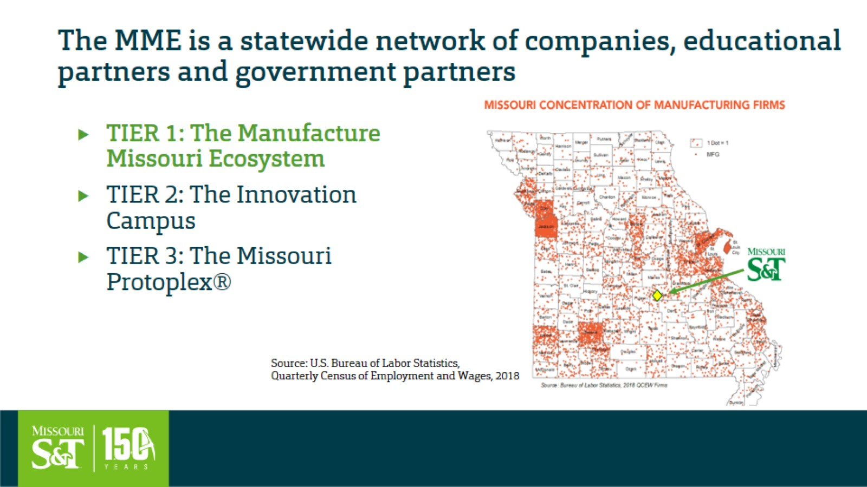
The MME is a statewide network of companies, educational partners and government partners

Slide 21
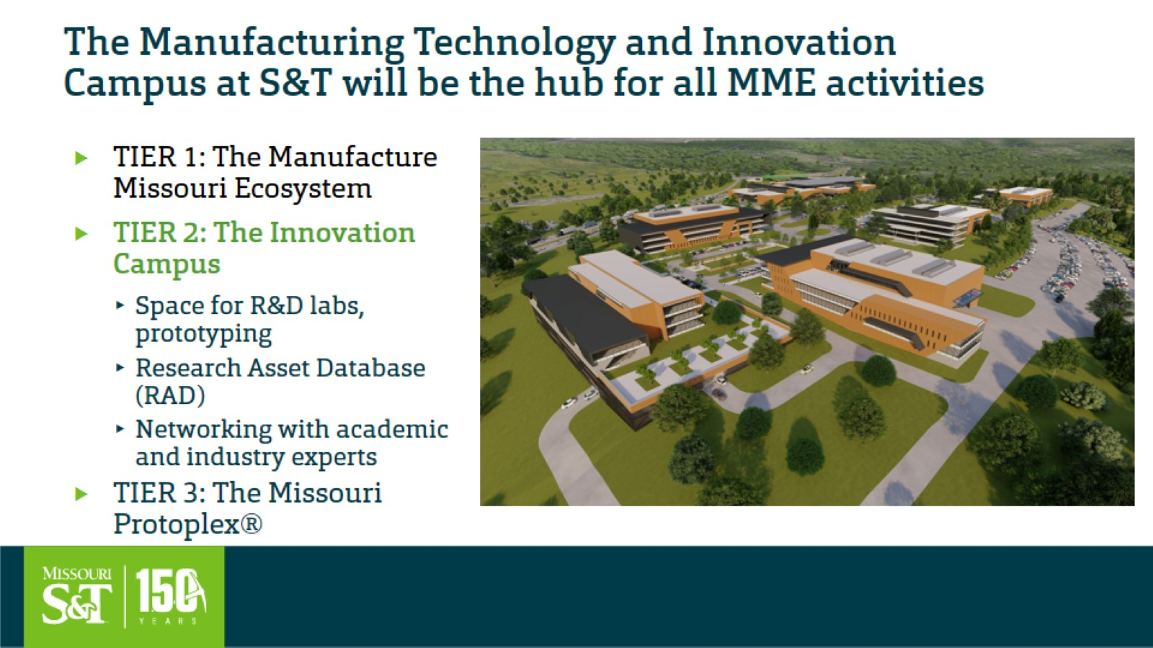
The Manufacturing Technology and Innovation Campus at S&T will be the hub for all MME activities

Slide 22
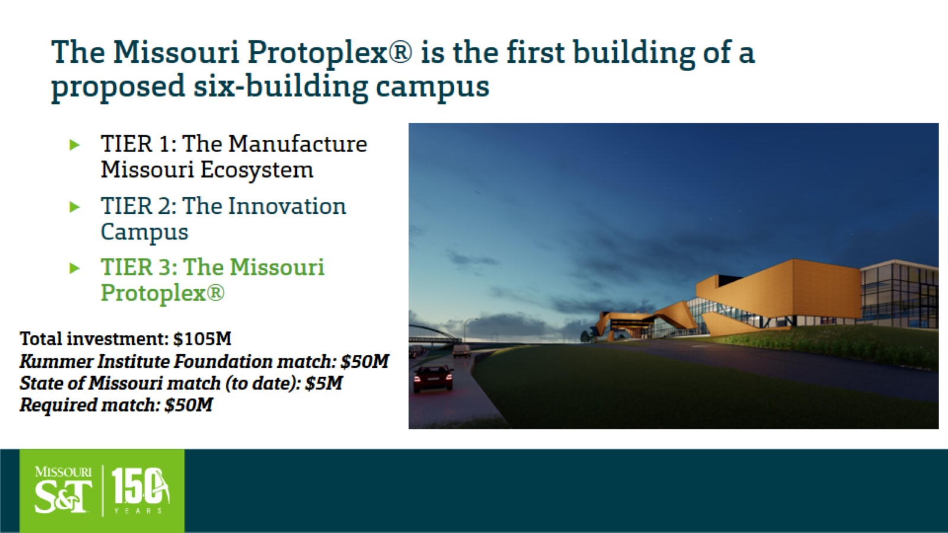
The Missouri Protoplex® is the first building of a proposed six-building campus

Slide 23


Slide 24
Agenda
V. Administrative Reports
B. Provost’s Report
C. Potts

Slide 25


Academic Affairs Update
Colin Potts
S&T Faculty Senate, 10/21/21

Slide 26

In outline.....
Mask requirement update (briefly)
Academic success & retention (briefly)
Consultative model for management of faculty performance
  a.k.a. faculty evaluations
Dean searches

Slide 27
Faculty performance management model for CY 2022
Career planning
Performance management
Faculty eval
Teaching eval
Faculty Affairs
Faculty expertise
Faculty Senate
CET
CAFE
Faculty expertise
Faculty Senate

Slide 28
Dean Searches
Academic dean searches
  KC: dean search failed
  CEC: Rich Wlezien will step down, August 2022
  CAS(B): Interim dean must made permanent
  Searches (prob) assisted by search firm
Library dean search
  Oliver Chen resigned
  Roger Weaver appointed interim
  (prob) search assisted by UM System

Slide 29
Agenda
VI. Guest-VC of Strategic Initiatives and COO of the Kummer Institute
S. Roberts

Slide 30

Kummer Institute for Student Success, Research, and Economic Development
Overview of Faculty Senate
October 2021

Slide 31
Kummer Institute Primary Objectives
Elevate Missouri S&T as an educational and research institution
Create broad outreach and engagement of K-12 communities to improve access to outstanding STEM education
Drive economic development regionally, statewide, and beyond

Slide 32
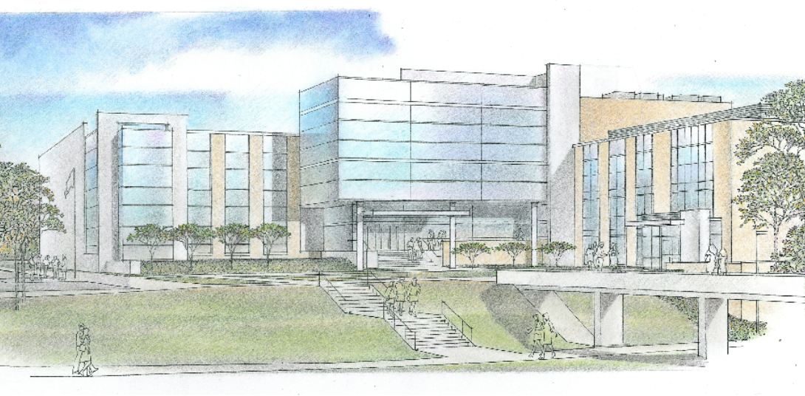
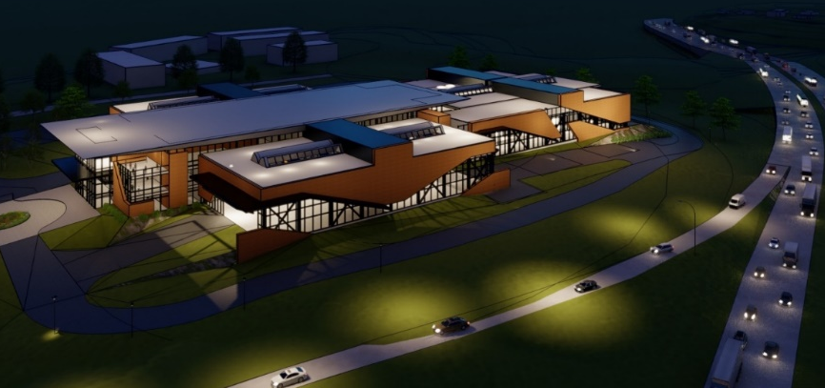
Key Investment Strategy: Research
20 endowed faculty (base funding + research funds)
100 Innovation and Entrepreneurship PhD Fellows
10 annual “Ignite Grants” for research proposal development
Kummer College of Innovation, Entrepreneurship, and Economic Development
Research centers to support, grow, and galvanize existing teams and networks
Business Services Unit to support incubation, acceleration, commercialization
Matching funds for grant proposals
Capital projects: Protoplex; ERL/SJH addition
ERL/SJH Addition
Protoplex

Slide 33
Key Investment Strategy: Student Success
Kummer Vanguard Scholarships ($2K annual support for each)
I&E PhD fellowships
Student academic support services
10 annual “Ignite Grants” for pedagogy innovation (esp digital learning)
Kummer College of Innovation, Entrepreneurship, and Economic Development
Capital projects: Innovation Lab
Innovation Lab

Slide 34
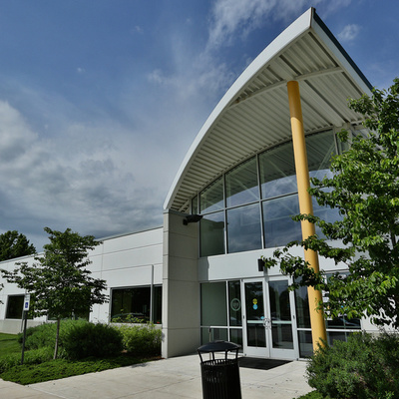
Key Investment Strategy: K-12 Outreach
Center for STEM Education
Summer camps
Student extracurricular activities year-round
Statewide tutoring services
Teacher professional development (institutes, workshops, etc.)
Curriculum development and support
Mobile STEM Lab
Army of Champions

Slide 35
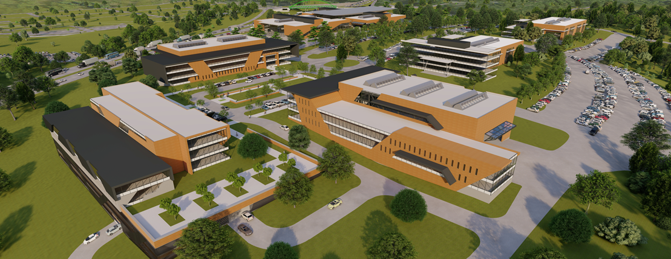
How can you get involved?
Help recruit KI endowed faculty
Help recruit I&E PhD Fellows for your program or department
Help recruit Kummer Vanguard Scholars
Write an Ignite grant for research and/or pedagogical innovation
Write a proposal that aligns with any aspect of KI mission – get match funds
Develop a new degree program in collaboration with the Kummer College
Serve as an Area Leader for the Kummer Vanguard Scholar program
Serve in the STEM Education Center’s programs for K-12 students and teachers
Help plan new facilities
Serve on the KI Campus Advisory Council
S&T Manufacturing Technology and Innovation Campus

Slide 36
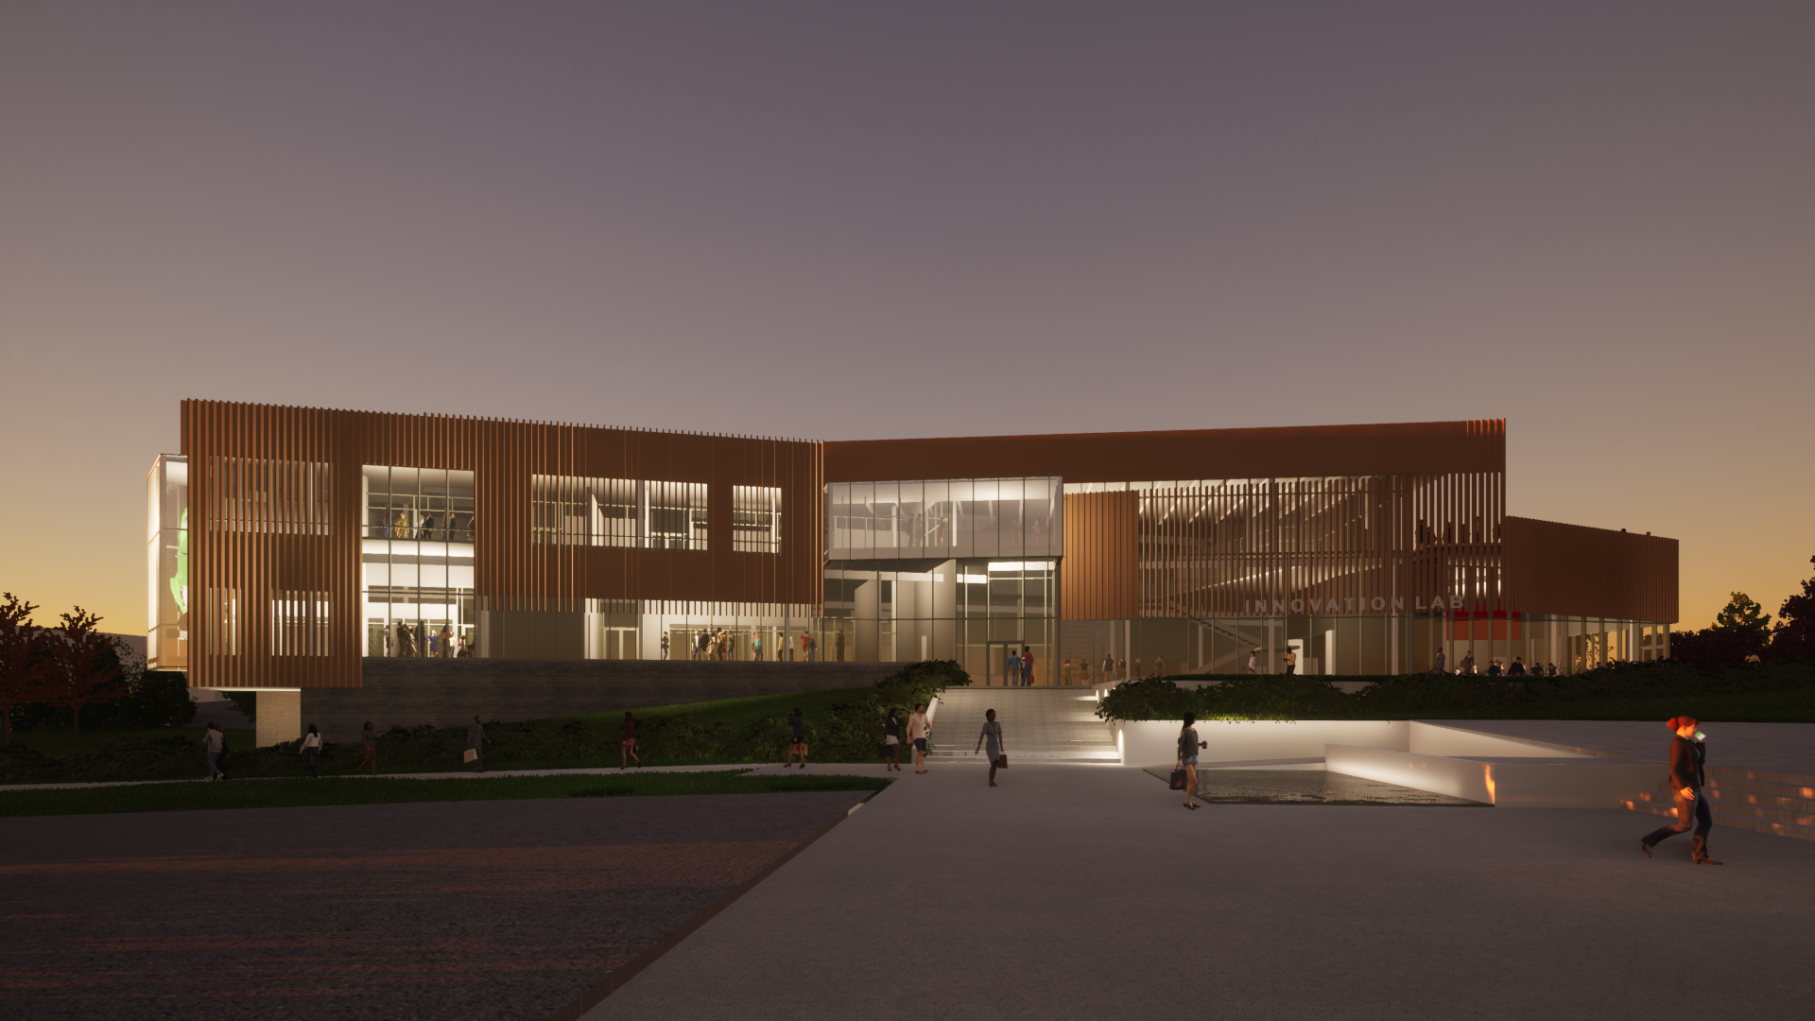
Questions?

Slide 37
Agenda
VII. Reports of Standing Committees
A. Academic Freedom and Standards
K. Kosbar

Slide 38
Academic Freedom & Standards Committee
Status and Draft Resolution
K. Kosbar
AF&S Committee Chair
10/21/21

Slide 39
AF&S Status
Referral on admission procedures and Foundational Engineering and Computing
  On hold, pending action by Curriculum Committee
Coordination of Course Syllabi
  Draft presentation and resolution below
  Plan to make motion at October Faculty Senate meeting
Modes of Instruction
  Committee still discussing

Slide 40
Coordination of Course Syllabi
Concerns
Lack of uniformity in sections with multiple sections, taught by multiple instructors.
Lack of uniformity across different courses within a major
Unreasonable, or varying, policies regarding attendance
Need for boilerplate information in the syllabus
People other than the instructor controlling the syllabus

Slide 41
Scope of Course Syllabi
Course syllabi define and document a wide range of topics including:
  Health and safety issues
  Attendance and missed-work policy
  Methods, metrics, standards and procedures for assessing student performance
  Academic content of course

Slide 42
Board of Curators and Academic Freedom
The Collected Rules and Regulations describes academic freedom, but only as it applies to academic topics covered in the class.
CRR 310.010.A.2.b
“Faculty members are entitled to freedom in the classroom in discussing their subjects, but have the responsibility not to depart significantly from their respective areas of competence or to divert substantial time to material extraneous to the course.”

Slide 43
S&T Academic Regulations - Attendance
Section V of S&T Student Academic Regulations:
“Administration of attendance policy lies with the individual instructor for each course.“
"The individual instructor determines the number and nature of absences allowable in each course.“
"Any work missed for any reason must be made up to the satisfaction of the instructor concerned."
"Instructors make the ultimate decision [regarding attendance]; however, students have the power to appeal to the department chair or dean.“
"Each department may adopt absence regulations in addition to those of the individual instructor."

Slide 44
S&T Academic Regulations - Examinations
Section VII of the S&T Student Academic Regulation:
"Examinations of two hours' duration at the end of a semester may be given at the option of the instructor..."

Slide 45
S&T Academic Regulations – Grading Criteria
Section VIII of the S&T Student Academic Regulations acknowledges the instructor selects the grading criteria
"The grade appeal procedures is ... not ... for questioning the stated grading criteria selected by the instructor."
… is consistent with grading criteria being uniform only over a specific section, rather than all sections of a course…
"Capricious grading, as used here, consists only of any of the following ... The assignment of a semester grade to a particular student by a more extracting or demanding criteria than were applied to other students in the same section..."

Slide 46
Campus Practice
Mizzou and UMKC Provost publish directions as to items which will be in the syllabus of every course taught on that campus.
S&T has a tradition of someone at the Provost level sending an email to instructors prior to the start of a semester, suggesting a “boilerplate” information to be included in course syllabi. Email has also been suggesting topics to be addressed.

Slide 47
Assorted Department / Course Specific Requirements
Department requiring selected courses have common final exams. Problems may be created and graded by individuals other than the instructor.
Department requirement that all courses have a final exam, or similar comprehensive assessment at end of semester
Department insisting that in selected courses, a D/F grade on final exam must lead to D/F grade in course.

Slide 48
Assorted Department / Course Specific Requirements
Department requires that in selected courses, students who fall in specific circumstances must be given two chances to take the final exam, while others are given only one opportunity.
A course coordinator, appointed by department chair, defines entire syllabus for a course. Includes attendance policy, rules for making up missed work, use of calculators, weight given to final exam, etc.
A course coordinator requires a syllabus be used that fails to contain all the boilerplate information suggested at the Provost’s level.

Slide 49
Resolution (Draft)
Best Practices for Coordination of Course Syllabi
Whereas; The university fosters excellence and innovation in education by granting instructors the academic freedom to develop, present, and evaluate courses in the manner they see fit; and
Whereas, There is a reasonable expectation that when multiple sections of a course are taught in a semester, there will be a degree of uniformity across the sections; and
Whereas, Students can benefit when information regarding physical and mental health, safety and other important matters is distributed in course syllabi; and
Whereas, Campus regulations are largely silent on the detailed content of course syllabi; therefor be it
(continues on next page)

Slide 50
Resolution (Draft)
Best Practices for Coordination of Course Syllabi
Resolved, That to balance the academic freedom of individual instructors, while assuring an appropriate level of uniformity in course syllabi, the S&T Faculty Senate endorses the following practices:
A provost / dean / academic department chair may reasonably require specific wording be inserted in course syllabi taught on campus / in their school / in their department, provided the same wording is to appear in all syllabi.
When there are multiple sections of a course taught in a semester, it is reasonable for the department chair to form a coordinating committee to assure a degree of uniformity between the sections. Instructors should feel obligated to use syllabus wording approved by a majority vote of this committee. When there are full-time faculty assigned to teach a course, they should be included on the coordinating committee for the course, as a voting majority.
(end of resolution)

Slide 51
Collected Rules and Regulations Section 310.010
Academic Freedom and Economic Security of Academic Staff
The Board of Curators of the University of Missouri believes that academic freedom and the economic security of its academic staff are indispensable to the success of the University of Missouri in fulfilling its obligations to its students and to society. The Board, therefore, hereby adopts and approves the following principles, the detailed application of which is implemented by the rules and regulations of the Board; and also adopts the following rules and regulations. (Although these rules and regulations cover in some detail certain aspects of the nature of regular academic staff positions, appointments thereto, and the rights of the holders thereof, these rules and regulations do not purport to cover in the same detail the nature of nonregular academic staff positions, appointments thereto, or the rights of the holders thereof, and do not purport to cover in any way non-academic staff.)
A. General Principles of Academic Freedom -- The Board hereby reaffirms the principles of academic freedom in teaching and research for teachers and academic investigators (herein referred to as faculty members). These principles are as follows:
  Institutions of higher education are established and maintained for the common good, which depends upon the free search for truth and its free expression.
  Academic freedom is essential to these purposes and applies to both teaching and research. Freedom in research is fundamental to the advancement of truth. Academic freedom in its teaching aspect is fundamental to the protection of the rights of the faculty member in teaching and of the student in learning. It carries with it duties correlative with rights. The following sections are indicative of these rights and duties.
  …
    Faculty members are entitled to freedom in the classroom in discussing their subjects, but have the responsibility not to depart significantly from their respective areas of competence or to divert substantial time to material extraneous to the course.
  …

Slide 52
Agenda
VII. Reports of Standing Committees
B. Budgetary Affairs
M. Fitch

Slide 53
Budgetary Affairs Committee
Oct 21, 2021
Referrals
How much does research cost?
Continuing referrals:
Report on the “big picture balance sheet”
Current and next FY budget
Non-referrals
(None)

Slide 54
Referral: costs of research
Treated not as “what if”, probably not a useful discussion
Revenue Assumptions: Indirect funds + PhD tuition + Royalties
Cost Assumptions:
  25% of T/TT salaries
  SRI all expended
  Sabbaticals (10 @ 50%)
  EHS, 1/8th
  Facilities maintenance, repair, custodial and utilities are proportional to research lab space, roughly 350,000 ft² of 2 million ft2 total (excludes auxiliaries like dorms)
  VPR, Assoc. Deans, OSP staff, 3 FTE amongst departmental staff
  IT Research group
  16 Technical staff, 60% on research
  Faculty startups = 100% research

Slide 55
Referral: costs of research
Treated not as “what if”, probably not a useful discussion
Revenue Assumptions: Indirect funds + PhD tuition + Royalties
Cost Assumptions:
  25% of T/TT salaries
  SRI all expended
  Sabbaticals (10 @ 50%)
  EHS, 1/8th
  Facilities maintenance, repair, custodial and utilities are proportional to research lab space, roughly 350,000 ft² of 2 million ft2 total (excludes auxiliaries like dorms)
  VPR, Assoc. Deans, OSP staff, 3 FTE amongst departmental staff
  IT Research group
  16 Technical staff, 60% on research
  Faculty startups = 100% research

Slide 56
Cost of Research
FY 2020 Grants and Contracts w/o indirect costs ($25 MM total)
$18,988,684 revenue
$16,215,829 expended
$ 1,772,855 accumulated
$19.0 M
$1.7 M
$16.2 M
Student salaries, tuition, equipment, supplies….

Slide 57
Cost of Research
Revenue
 | Indirect | $ 6,496,343
 | PhD tuition | 4,490,000
 | Royalties | 317,640
 |  | $ 10,986,343
Costs
 | 25% of T/TT faculty salary & benefits | $ 9,534,610
 | SRI | 6,496,343
 | Sabbaticals 10 @ 50% assumed) | 705,075
 | EHS (12.5% assumed) | 97,921
 | M&R + custodial + utilities (20% based on research lab ft²) | 2,831,287
 | VPR, Ass. Deans, OSP staff, 3 staff in dep'ts | 1,832,136
 | IT research group | 911,644
 | Technical staff (60% of time assumed) | 899,425
 | Startup, average annual cost less SRI used | 3,304,402
 |  | $ 26,612,843
Result
 | Net Cost (Costs less revenue) | $ 15,626,500
 | Ratio ($ on research from GO per $ grant) | 1.42

Slide 58
Cost of Research
Revenue
 | Indirect | $ 6,496,343
 | PhD tuition | 4,490,000
 | Royalties | 317,640
 |  | $ 10,986,343
Costs
 | 25% of T/TT faculty salary & benefits | $ 9,534,610
 | SRI | 6,496,343
 | Sabbaticals 10 @ 50% assumed) | 705,075
 | EHS (12.5% assumed) | 97,921
 | M&R + custodial + utilities (20% based on research lab ft²) | 2,831,287
 | VPR, Ass. Deans, OSP staff, 3 staff in dep'ts | 1,832,136
 | IT research group | 911,644
 | Technical staff (60% of time assumed) | 899,425
 | Startup, average annual cost less SRI used | 3,304,402
 |  | $ 26,612,843
Result
 | Net Cost (Costs less revenue) | $ 15,626,500
 | Ratio ($ on research from GO per $ grant) | 1.42
Direct $ 18,988,684
Total $ 29,975,027
Direct $ 16,215,829
Total $ 42,828,672
1.42

Slide 59
Budget
Current FY budget
  Open faculty lines decided by Provost & Deans
  UG enrollment up 77 not 159 = about $820,000 less revenue
  Retention appears down = lowered revenue
  Grad enrollment up 53, fewer than budgeted; waivers lower, revenue loss = cost reduction
  State funding flat next two years due to Federal funding, decline inn FY 25 ( AY 24-25) expected
KI Budget
  “building a plane while flying it”
Distance Revenue
  “Missouri Online is taking over” = dropped balls, numbers down
  Beth Concepcion picking them up

Slide 60
Agenda
VI. Reports of Standing Committees
C. Curricula
M. Davis for S. Raper

Slide 61
Campus Curricula Committee Report
21 October 2021
CCC Meeting
-28 September, 2021
Total Committee Activity
  19 Course Change Requests (CC Forms)
  9 Program Change Form (PC Forms)
  3 Experimental Course Requests (EC Forms)

Slide 62
Campus Curricula Committee Report
21 October 2021
Course Changes (CC) Requested
File: 2564.7 AERO ENG 2861 : Aerospace Vehicle Performance
File: 873.5 AERO ENG 3251 : Aerospace Structures I
File: 835.4 AERO ENG 3613 : Aerospace Mechanics I
File: 7.1 AERO ENG 4253 : Aerospace Structures II
File: 143.1 BIO SCI 5010 : Graduate Seminar
File: 1451.8 CIV ENG 2601 : Fundamentals Of Environmental Engineering And Science
File: 1250.8 GEO ENG 5331 : Subsurface Hydrology
File: 2569.5 GEOPHYS 4231 : Seismic Interpretation
File: 768.9 GEOPHYS 5202 : Exploration and Development Seismology
File: 459.4 HISTORY 4245 : Nazi Germany and the Holocaust
File: 4821 MECH ENG 1761 : Introduction to Computer Aided Design
File: 765.8 MECH ENG 2519 : Thermodynamics
File: 105.3 MECH ENG 2527 : Thermal Analysis

Slide 63
Campus Curricula Committee Report
21 October 2021
Course Changes (CC) Requested
File: 1474.4 MECH ENG 2653 : Introduction To Manufacturing Processes
File: 2099.4 MECH ENG 2761 : Introduction To Mechanical Design
File: 517.5 MECH ENG 3313 : Machine Dynamics
File: 1286.6 MECH ENG 3411 : Modeling and Analysis of Dynamic Systems
File: 617.4 NUC ENG 5428 : Advanced Reactor Laboratory I
File: 1652.4 NUC ENG 5438 : Advanced Reactor Laboratory II

Slide 64
Campus Curricula Committee Report
21 October 2021
Program Changes (PC) Requested
File: 141.33 AE ENG-BS : Aerospace Engineering BS
File: 51.21 EV ENG-BS : Environmental Engineering BS
File: 156.60 GE ENG-BS : Geological Engineering BS
File: 64.59 GL&GPH-BS : Geology and Geophysics BS
File: 86.48 MC ENG-BS : Mechanical Engineering BS
File: 95.29 MI ENG-BS : Mining Engineering BS
File: 108.48 PE ENG-BS : Petroleum Engineering BS
File: 115.45 PHYSIC-BS : Physics BS
File: 352.4 SUB WAT-CT : Subsurface Water Resources Certificate

Slide 65
Campus Curricula Committee Report
21 October 2021
  For Informational Purposes; No Senate Approval Required
  Experimental Courses (EC) Requested
File: 4822 MIN ENG 6001.003 : Computational Rock Mechanics
File: 4807 MS&E 4001.001 : Medical Nanomaterials
File: 4808 MS&E 6001.006 : Advanced Medical Nanomaterials

Slide 66
Campus Curricula Committee Report
23 September 2021
Curriculum committee moves for FS to approve the 19 CC and 9 PC form actions
Discussion: Questions or comments?

Slide 67
To: Faculty Senate
From: Missouri S&T Campus Curricula Committee
Re: November 11, 2021 Meeting
The Missouri S&T Campus Curricula Committee recommends to the Faculty Senate that the course changes requested on the following CC forms be approved:
File: 4752.10 COMP SCI 6407 : Internet of Things with Data Science
File: 4120.3 GEO ENG 5332 : Fundamentals of Groundwater Hydrology
File: 4823 HISTORY 3600 : World History
File: 4824 HISTORY 3625 : Slavery and Abolition in Atlantic World
File: 1630.4 NUC ENG 2406 : Reactor Operations I
File: 1985.6 POL SCI 4510 : The Politics of the Global South
The Missouri S&T Campus Curricula Committee recommends to the Faculty Senate that the course and degree requirement changes requested on the following Program Change forms be approved:
File: 157.35 HIST-BA : History BA
File: 242.15 HISTORY-BS : Bachelor of Science in History
File: 104.27 NU ENG-BS : Nuclear Engineering BS
File: 350.4 GEO HAZ-CT : Geologic Hazards Certificate
For the information of the Faculty Senate, the following EC forms have been submitted by the University departments for an experimental course that will be offered in the near future:
File: 4826 EXP ENG 6001.006 : Simulation of Explosive Detonation and Energetic Events

Slide 68
Agenda
VII. Reports of Standing Committees
D. Information Technology and Computing
D. Stutts

Slide 69
Issues Raised During the Last Faculty Senate Meeting on 9-23-21
Help Desk response time (med to long-term)
Communications between Faculty and IT staff (short-term)
Integration of academic (Canvas, etc.) and IT support (?)
IT staffing (long-term)
Relocation of IT back on campus (short – med-term)
Short-term = < 3 Mos., Med-term = 3 – 6 Mos., Long-term = > 1 year

Slide 70
Issues Discussed During Yesterday’s ITCC Meeting and Answers/Actions Proposed
Significantly increased time to respond to Help Desk tickets. Problem is due to (1) inadequate staffing, (2) non-optimal ticketing system, and (3) IT support staff not on central campus. S&T CIO is working the problem and has it as his highest priority.
Need for better communication between faculty and IT staff, and better understanding on the faculty’s part of the resource constraints imposed on IT. Need for more patience on the part of faculty while our brand new CIO works through some of the current issues. ITCC facilitate this by communicating key issues and actions through the Deans and department chairs. Other conduits will be discussed and considered.
Adequate support for research computing given that this group must now support the both Columbia and Rolla. Something to keep an eye on. May even be an opportunity for S&T. More staff would be necessary to fully support custom systems for individual PIs.
Better communication between UM system and faculty regarding software and policy changes to avoid unintended consequences affecting students, staff, and faculty. Many recent complaints concern Canvas, which falls under eLearning, and not IT. ITCC will invite UM Chief Online Learning Officer, Matthew Gunkel, to discuss this issue.
Adequate support for multiple computing platforms. One size (platform) does not fit all faculty. Windows, Mac, and Linux/Unix. More support will be available as IT staffing resources allow. Multi-platform support is a recognized area of concern but need to improve overall IT support first (see #1).
Faculty desktop enhancement policy: pennywise, pound foolish? The new faculty desktop enhancement program allows replacement every four years, and approximately doubles the amount contributed to the cost by IT.

Slide 71
Agenda
VII. Reports of Standing Committees
E. Committee for Effective Teaching
D. Burns

Slide 72
CET Presentation to Faculty Senate
October 21, 2021
Dr. Devin Burns

Slide 73
Issue #1: Combining Distance and campus evals
Now that Global learning is gone, distance courses have no current mechanism for student evaluations
IT has proposed combining them with on-campus evaluations
  Everything will be same except the communication.
  IT will create both Campus and Distance surveys
  The instructor will receive the course list email including both campus and distance
  The instructor will receive the course response rate including both campus and distance
  Students will receive combined emails (not one from Campus and one from Distance, if they’re taking both campus and distance courses)
  The survey result will stay the same. You can filter on survey type.
  The instructor/department/campus average have always included both on-campus and distance from the very beginning.

Slide 74
Issue #1: Combining Distance and campus evals
Faculty Senate: Decision requested
Motion from CET:
  Faculty Senate requests IT to combine distance and on-campus sections for the end-of-semester course evaluations, such that both use the same evaluation instrument; such that each section of a course shall have a separate number as a result.

Slide 75
Issue #2: Transitional evaluation instrument
Last November the CET voted to approve a new set of questions for the Student Evaluation of Teaching (SET)
The current instrument has:
  4 state mandated items (e.g. I would recommend this instructor)
  The main "overall effectiveness" item
  6 other questions (e.g. rate the instructor's preparation for class)
We retained the 4 state mandated questions and the "overall effectiveness" item, but replaced the other six questions with a new list of 10 from a well developed and validated instrument (the Teacher Behaviors Checklist¹)
1. Keeley, J., Smith, D. & Buskist, W. The Teacher Behaviors Checklist: Factor Analysis of Its Utility for Evaluating Teaching. Teaching of Psychology 33, 84–91 (2006).

Slide 76
Issue #2: Transitional evaluation instrument
These new questions were shared in an email from Misty House yesterday with a mechanism for providing feedback
In order to give faculty experience with the new items, we propose a Transitional Instrument for Fall 2021: adding the 10 new questions as optional at the end of the current survey
These new questions are for faculty informational use only, and not for faculty evaluation
CET will gather feedback and plan to submit our Revised Instrument for Faculty Senate approval early next semester

Slide 77
Issue #2: Transitional evaluation instrument
Faculty Senate: Decision requested
Motion from CET:
  Faculty Senate requests that for Fall 2021 only, IT augment the current evaluation instrument with an optional block of 10 new questions that are planned for the revised Student Evaluation of Teaching instrument

Slide 78
Agenda
VII. Reports of Standing Committees
F. Library and Learning Resouces
M. Bruening

Slide 79
Fiscal Year 2022
Portfolio Review

Slide 80
History of Portfolio Review
Each year the library produces a report of costs, cost per use, and projected costs for all subscription materials.
The library outlines a set of cuts for the LLRC’s review.
The faculty are then notified of proposed cuts and given an opportunity to appeal or to suggest new materials.
The library then reviews their comments to evaluate which appeals to honor.

Slide 81
Fiscal Year 22 Budget
2021 GRA
$1,079,805.00
2022 GRA
$1,079,805.00
Additional Library Funds
$67,770.04
F&A Funds
$126,800.81
Total
$1,274,375.85
2021 Total Expenditures with Inflation
$1,312,560.97
Projected Shortfall
-$38,185.12
Additional library funds are one-time monies.
Projected expenditures are based on projections of inflation based on historical data except when set by contract, FY21 cost is already known, or historical data is unavailable.

Slide 82
FY22 UM System Shared Resources
This summer, the System announced an unanticipated shortfall of $560k, approximately 26% of their materials budget.
Resources identified for potential cancellation included:
  ACM Digital Library
  ABI/Inform Complete
  Business Source Premier
  All JSTOR Arts and Sciences Collections (I-IV)
  MathSciNet
  Proquest Technology Collection
  Education Full Text
  Communication and Mass Media Complete
  Cell Press
  JSTOR General Science
  MLA International Bibliography
  Art Full Text
  JAMA
  New England Journal of Medicine
  Philosopher’s Index
  CINAHL Nursing journal package
  Mergent Archive fee
  Education Index Retrospective Fee

Slide 83
No Cancellations for FY22
In September 2021, all 4 campus provosts agreed to contribute one-time additional funds to cover the shortfall of $560K.
Provost Potts agreed to provide funding to cover the local budget shortfall.
Both agreements are only for one-time funds.

Slide 84
Next Steps
Provost Potts has suggested a three-year budget review for the library.
At the system level, the committee that oversees the expenditures for materials will be reviewing spending and sustainability for the shared budget.

Slide 85
FOLIO: a new library service system at the University of Missouri System
Data migration and implementation beginning Fall 2021
Testing, training and soft-opening for new discovery layer during Spring 2022
Go-live for complete system scheduled for Summer 2022
System details at https://www.ebsco.com/academic-libraries/products/ebsco-folio

Slide 86
Agenda
VIII. Unfinished Business

Slide 87
Agenda
New Business
  a. Teaching Evaluations
87

Slide 88
New Business
Evaluation of Teaching - Overview
Informational Only
Three primary components:
  Policy Principles
  SET/SBE Revisions
  Department-level Best Practices for comprehensive evaluation

Slide 89
New Business
Evaluation of Teaching – Best Practices White Paper
Identify best practices and suggested starting points for Department-level evaluation of teaching
Address roles of (a) student-based evaluation, (b) peer-based evaluation, and instructor self-assessment.
Informed by national norms, but tailored to campus concerns
Working Group lead role: contact FSOs to participate.

Slide 90
New Business
Evaluation of Teaching – Student Evaluation of Teaching
Lead role: Committee for Effective Teaching
Transitional instrument
  Trial run for new questions
  For instructor use only
Revised instrument
  Possible refinement of new questions
  Inclusion/phasout of current “effectiveness” question
  Participation requirement
  CET proposal anticipated in early 2022

Slide 91
New Business
Evaluation of Teaching – Policy Principles
Proposed Cornerstone Principles
  SBE can be used as the basis for CET awards, either in whole or in part
  PBE is necessary and sufficient for Tenure Application and Post-Tenure Review evaluations
  SBE can be included, at individual faculty discretion, for Tenure Application and Post-Tenure Review evaluations
  SBE cannot be used as the sole basis for unsatisfactory evaluation of teaching in a Faculty Annual Review. A concern raised by SBE must be supplemented by PBE before unsatisfactory assigned.
  (SBE=student-based evaluations, PBE=peer-based evaluations, ISA = instructor self-assessment)

Slide 92
New Business
Evaluation of Teaching – Policy Principles
Feedback from 23 Sep 2021 Mtg Survey (32 Senators, 3 Faculty)
  SBE not only mechanism for teaching awards.
  PBE cannot be only evaluation component for P&T
  Majority favorable to the proposed policy principles
Additional feedback being sought from chairs, administration.
How to formalize: Faculty Senate motion, Chancellor Policy

Slide 93
Agenda
X. Adjourn
93

