Slide 1
Faculty Senate Meeting
November 11, 2021

Slide 2
Meeting procedure
The same rules apply over virtual meetings as over in-person meetings
Only Senators may debate motions
Only Senators can vote
If you are not a Senator, or a proxy, you cannot vote or debate
Do not speak over someone, or out of order
Raise your hand within the Zoom app
The President will call on you and then you will have the floor
Unless you have been recognized (been told you have the floor), you may not speak
Per Robert’s Rules, each Senator is entitled to only speak twice on each motion.

Slide 3
Agenda
Call to Order and Roll Call
D. Westenberg, Secretary

Slide 4
Agenda
Approval of Minutes
October 21, 2021

Slide 5
Agenda
III. Administrative Reports
A. Chancellor’s Report M. Dehghani

Slide 6
The Kummer Institute Foundation Board of Directors met Friday, November 5, and approved significant initiatives to move S&T forward

Slide 7
Thank you! Questions?

Slide 8
Agenda
III. Administrative Reports
B. Provost’s Report C. Potts

Slide 9
Provost Report
Dean Searches
Graduate Student Survey
Academic Wellbeing

Slide 10
Agenda
IV. President’s Report
K. Homan

Slide 11
President’s Report: UM System
IFC (Intercampus Faculty Cabinet): 05 November 2021 Mtg (Zoom)
Policies for Faculty Review of Administrators, specifically MU Chancellor and UM System President.
Shared Governance working group: continued progress.
Legislative Update
State-level budget looks good
Interests include transformative projects and Bright Flight for Higher Ed

Slide 12
President’s Report: UM System
IFC (Intercampus Faculty Cabinet): Upcoming Meetings
10 November 2021 – President M. Choi (Zoom)
Meeting focus: Criteria-based Salary Reductions
HR-720 Policy on Salary Reductions for Faculty and Other Academic has been rescinded.
Existing CRR Policy statements in force:
CRR 310.015: Procedures for Review of Faculty Performance
CRR 320.030: Delegation of Authority → F = Criteria–Based Salary Reductions for Tenured Faculty
Most recent refinement of CRR 310.015 in 2017, after wide, deliberate vetting process
Origin of CRR 320.030 dates to 1967.
IFC seeking clarity and linkage between the two issues and clarity of process.

Slide 13
President’s Report: S&T Campus
Student Mental Health
Very important issue at this point in semester
Faculty encouraged to watch for signs and notify appropriate POC
Campus replacement for Tier 3 Funding
Importance and value are recognized
Replacements are being put into place

Slide 14
Agenda
V. Campus Reports
A. Staff Council
T. Donnell

Slide 15
Agenda
V. Campus Reports
B. Student Council
A. Aiken

Slide 16
Agenda
V. Campus Reports
C. Council of Graduate Students
M. Nabi

Slide 17
Agenda
VI. Vice Provost of Academic Support
K. Northcut

Slide 18
Office of Academic Support, and Academic Support Division
Vice Provost Kathy Northcut
academicsupport@mst.edu; 573-341-7276
105 Norwood
Notes:
CP Introduces

Slide 19
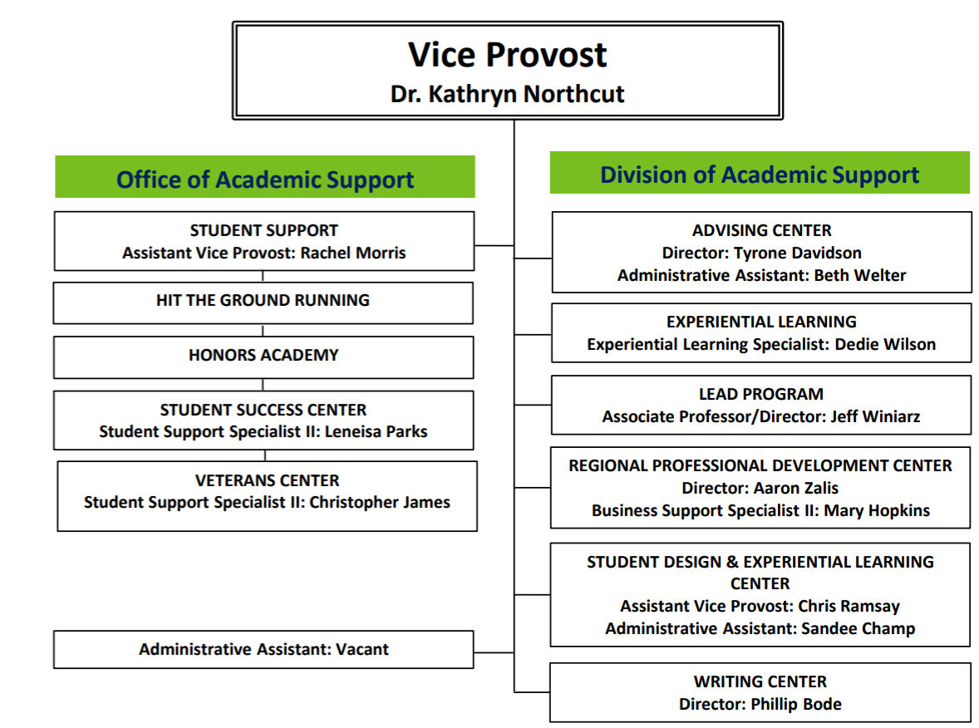
Notes:
Kathy Overviews

Slide 20
VPAS Primary Duties
Propose, implement, support efforts to boost UG retention and grad rate (promote LEAD)
Adjudicate all cases of reported (UG only) academic dishonesty as PAO
Interface with national organizations: APLU, UERU, NCHC, NSSE, HLC, etc.
Provide (UG only) retention updates, proposals, & reports to leadership, BoT, BoC, constituencies, campus, system
Support & advocacy: division office, managers, and staff in departments
Attend, lead, support committees, activities, ceremonies, events, programs on & off campus
Assist other divisions and support campus-wide initiatives (recruiting)
Notes:
Colin discusses

Slide 21
OAS Most Important Contribution?
Inching toward data-informed decision making, programming, interventions, and budgeting
Academic integrity role
Co- and extra-curricular organizations (LEAD, SSC, WC, SVRC, etc.)
Expanding our sense of engagement to a complex model, not binary, for advising, tutoring, coaching, instruction, academic dishonesty
Engagement dimensions: behavioral, cognitive, emotional
Typical faculty emphasis is cognitive/academic
If students lack clear behavioral expectations and calm confidence, effective cognitive processing and academic success are far less likely
Notes:
Colin discusses

Slide 22
Biggest gaps in UG student support?
Transfer intake, advising, and programming – events, opportunities, information
Honors college administration
Coordination of support services
Campus culture that accommodates mature students, minoritized students, student parents, working students, students in crisis, pregnant students, and those who are struggling or needing mentorship and guidance
Notes:
Colin discusses

Slide 23
Retention at S&T
Notes:
Kathy interprets

Slide 24
Graduation at S&T
4 Year graduation rate
2013 2014 2015 2016 2017
23.6% 24.3% 21.6% 24.0% 26.1%
Notes:
Kathy Interprets

Slide 25
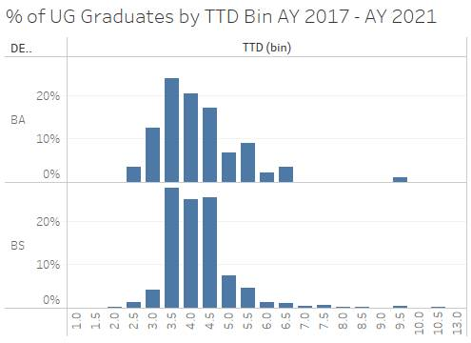
Graduation bell curves: Time to Degree
Notes:
Kathy Interprets

Slide 26
Boyer Report recommendations, ca. 1998
Academic institutions should afford to students these rights:
Opportunities to learn through inquiry rather than simple transmission of knowledge.
Training in the skills necessary for oral and written communication at a level that will serve the student both within the university and in postgraduate professional and personal life.
Appreciation of arts, humanities, sciences, and social sciences, and the opportunity to experience them at any intensity and depth the student can accommodate.
Careful and comprehensive preparation for whatever may lie beyond graduation, whether it be graduate school, professional school, or first professional position.
The student in a research university… has these additional rights:
Expectation of and opportunity for work with talented senior researchers to help and guide the student's efforts.
Access to first-class facilities in which to pursue research laboratories, libraries, studios, computer systems, concert halls.
Many options among fields of study and directions to move within those fields, including areas and choices not found in other kinds of institutions.
Opportunities to interact with people of backgrounds, cultures, and experiences different from the student's own and with pursuers of knowledge at every level of accomplishment, from [first-year] students to senior research faculty.
?
?
?
?
?
?
?
?
Notes:
KN

Slide 27
Challenges to Retention
Personal
Admission
Graduation
Academic
Cultural
Retention
Attrition
Notes:
Colin

Slide 28
Meeting Retention Goals: Support & Recovery
Personnel: Interventional, evidence-based advising and mentoring for all students by trained staff and faculty; faculty are key to retention
Programs: Improved/new programs for transfer and honors students
Policies: Improve sub/waiver and transfer equivalency process and practices; improve awareness of federal requirements (pregnancy)
Processes: Continuous improvement in advising, tutoring, and support including LEAD, WC, SSC
Practices: Consider MIT best-practice model: Pass or “no record” in Year 1 to motivate positive student behavior and reduce stress
Notes:
Colin discusses

Slide 29
Addressing Cultural Retention Factors
Cultivate “whole student” appeal
Become more student-ready as a campus
More diverse, inclusive, welcoming, and fun
Engage students fully in arts and humanistic inquiry
Provide equal opportunity for all minoritized students (including women)
Curate our media and marketing more carefully
Examine policies for potential (accidental) discrimination
Support Student Diversity Initiatives, Child Development Center
Notes:
CP

Slide 30
Personal engagement strategies
Demonstrate appreciation for students in our courses, programs, campus spaces
Assume not every student is doing okay; recognize vulnerability of students throughout educational journey
Be aware of campus life and resources; encourage students to participate, through verbal suggestions as well as extra credit when appropriate
Request feedback from students and respond to it mid-course
Notes:
KN

Slide 31
Holistic Retention From Start to Graduation
Ask & listen; e.g., generate better data about why students leave
Continue to track data about opt-outs, transfer-outs, drop-outs, stop-outs
Advise students of options or resources that might keep them here, before they leave
Learn from attrition and adjust to needs we can provide through programs, policies, resources
Make retention everyone’s job through position descriptions and performance reviews
Full staffing, full service in every corner of campus
Notes:
Kathy

Slide 32
Thanks! Let’s talk about these topics more.
Kathy Northcut
northcut@mst.edu
academicsupport@mst.edu; 573-341-7276
105 Norwood
Notes:
CP Introduces

Slide 33
Example of Female-Friendly Policy, mandated by Dept of Education, that may not be widely known
Does a school have to excuse a student’s absences due to pregnancy or childbirth?
Yes. Title IX requires a school to excuse a student’s absences due to pregnancy or related conditions, including recovery from childbirth, for as long as the student’s doctor deems the absences to be medically necessary. When the student returns to school, she must be reinstated to the status she held when the leave began, which should include giving her the opportunity to make up any work missed. A school may offer the student alternatives to making up missed work, such as retaking a semester, taking part in an online course credit recovery program, or allowing the student additional time in a program to continue at the same pace and finish at a later date, especially after longer periods of leave. The student should be allowed to choose how to make up the work.
Notes:
KN

Slide 34
Agenda
VII. Reports of Standing Committees
A. Administrative Review Committee
K. Homan

Slide 35
Administrative Review Committee
2011-2022 Members
Kelvin Erickson
Wayne Huebner
Bih-Ru Lea
Kelly Liu, Chair
Notes:
The chair was decided on Monday, Nov. 8.

Slide 36
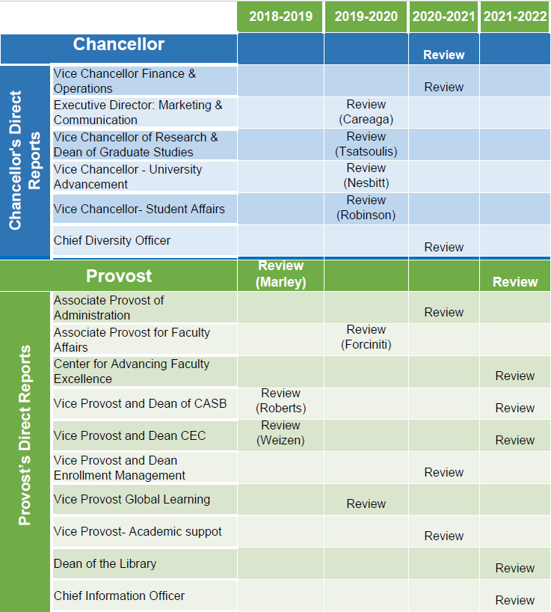
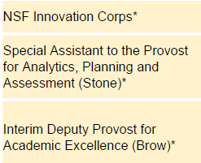
Administrative Review
Schedule
Approved by FS on 06/11/2020
*-Positions not to review
Notes:
Administrative review schedule approved by FS on June 11, 2020. 6 positions are scheduled for review this year, 2021-2022.

Slide 37
Administrative Review Committee
Positions suggested for review
Center of Advancing Faculty Excellence
Vice Provost and Dean of CASB
Positions not for review
Provost: new to the position
Vice Provost and Dean CEC: leaving the position in 2022
Dean of the Library: left the university
Chief Information Officer: new to the position
Notes:
The committee discussed today and decided the review and not for review lists

Slide 38
Administrative Review Committee
Tentative timeline and process
Action | Time
Review list to faculty senate for approval | January 20
Job descriptions | January 28
Development of questionnaires
Questionnaires to FS for review/approval | February 17
Statement of accomplishments due | February 25
Review of administrations | March 7 - March 23
Results to FS officers | April 28
Final report to FS | June 9
Notes:
Tentative review schedule.

Slide 39
Agenda
VII. Reports of Standing Committees
B. Budgetary Affairs
M. Fitch

Slide 40
Budgetary Affairs Committee
Nov 11, 2021
Referrals
Library budget changes – January report
Continuing referrals:
Report on the “big picture balance sheet”
Current and next FY budget
Non-referrals
Arrival District
Hiring

Slide 41
Budget
Current FY budget
October: enrollment revenue $820k lower than budget, 81 fewer undergrads, fewer grads than budgeted but revenue loss = cost reduction
Now: 221 students below budgeted, $2 million deficit
$1 million enrollment contingency, so budget $1 million short
Source: ‘some one-time monies’; FY 21 Revenue> Expend by $8.96 million (

Slide 42
General Revenue Budget
 | FY19 | FY20 | FY 21 (actual*) | FY 22 (planning)
Tuition and Fees | $124,548,154 | $126,853,439 | $119,477,148 | $119,592,4250
Scholarship Allowance | (37,770,678) | (37,848,888) | (36,149,411) | (38,164,248)
Net Tuition & Fees | $86,777,476 | $89,004,551 | $83,327,736 | 81,428,177
State Appropriation | 50,185,510 | 43,543,499 | 45,690,941 | 53,026,096
Grant and Contract | 0 | 0 | 0 | 0
Gift Revenues | 481,131 | 385,737 | 471,909 | 345,000
Recovery of F & A | 6,941,286 | 6,802,499 | 6,496,349 | 6,493,100
Endowment & Investment Income | 1,969,324 | 2,035,737 | 1,935,710 | 3,120,243
Sales & Services Income | 989,382 | 1,177,479 | 709,380 | 1,065,880
Other Incomes | 3,464,299 | 2,872,553 | 2,209,518 | 2,958,389
Revenue Contingency | - | - |  | -
Total Revenues | $150,808,407 | $145,822,055 | $140,841,544 | $148,437,385
30% realized
32% budgeted

Slide 43
General Revenue Budget: costs
Total Revenues | $150,808,407 | $145,822,055 | $140,841,544 | $148,437,385
-2,000,000
Transfers | FY19 | FY20 | FY 21 (actual) | FY 22 (planning)
Intra Unrestricted CurrentFund | $6,755,777 | $4,442,960 | $1,988,391 | $1,581,686
Mandatory Transfers | (3,778,102) | (3,930,896) | (3,483,219) | (3,197,402)
NonMandatory Transfers | (11,607,554) | (6,885,979) | (7,114,077) | (3,446,690)
Total Transfers | ($8,629,879) | ($6,373,915) | ($8,608,905) | ($5,062,406)
Expenditures
Salaries & Wages | $83,651,987 | $80,232,396 | $75,195,068 | $79,426,854
Benefit Expense | 25,475,433 | 25,029,887 | 24,209,899 | 26,626,149
Compensation | $109,127,420 | $105,262,283 | $99,404,966 | $106,053,0030
Other Expenses | 38,416,204 | 33,205,855 | 32,471,617 | 37,256,650
Total Expenditures | $147,543,624 | $138,468,138 | $131,876,584 | $143,309,653
~$3.3 MM vacant staff positions
2% raise, $250K P&T
Return to pre-COVID
-1,000,000 Enrollment contingency
-1,000,000 One-time funds

Slide 44
Arrival District
Element & Funding, $18 million total
Protoplasm, Gift + State (request)
Innovation lab, Gift
Subsurface parking, Gift
Tim Bradley Way, NTE $3.8 million, $2 million Gift
Past property purchases, L.T. $2 million, may have been GO funds

Slide 45
Hiring
Salary & Wages | Budgeted | Actual
FY 21 | $77,824,286 | $75,195,068
FY 22 budget | $79,426,854 | $79,426,854
Increase | $1,602,568 | $4,231,786
2% salary increase | $1,556,486 | $1,503,901
Net | $46,082 | $2,727,885
Positions
Kummer College Dean
Three KI Chairs
Dean of Library
Five Dep’t Chairs (Math, Econ, NERdS, BIT, Comp Sci)
CAS(B) Dean
Five faculty members (ME, MSE, BIT, Physics, Engl TC)

Slide 46
Hiring
Salary & Wages | Budgeted | Actual
FY 21 | $77,824,286 | $75,195,068
FY 22 budget | $79,426,854 | $79,426,854
Increase | $1,602,568 | $4,231,786
2% salary increase | $1,556,486 | $1,503,901
Net | $46,082 | $2,727,885
$2,728k less
$250k P&T
Kummer College Dean: 0
Three KI Chairs: 0
Dean of Library: $100k
Five Dep’t Chairs (Math, Econ, NERdS, BIT, Comp Sci): 5 x $150k
CAS(B) Dean: $200k
Five faculty members (ME, MSE, BIT, Physics, Engl TC): 5 x $100k
Six searches in IT, ‘several’ admissions recruiters
Sum: $1550k faculty + $420k IT + ?
65% of faculty hiring GO$, 55% of positions = administrators

Slide 47
Agenda
VI. Reports of Standing Committees
C. Curricula S. Raper

Slide 48
Campus Curricula Committee Report
11 November 2021
CCC Meeting -19 October, 2021
Total Committee Activity
6 Course Change Requests (CC Forms)
4 Program Change Form (PC Forms)
1 Experimental Course Request (EC Form)

Slide 49
Campus Curricula Committee Report
11 November 2021
Course Changes (CC) Requested
File: 4752.10 COMP SCI 6407 : Internet of Things with Data Science
File: 4120.3 GEO ENG 5332 : Fundamentals of Groundwater Hydrology
File: 4823 HISTORY 3600 : World History
File: 4824 HISTORY 3625 : Slavery and Abolition in Atlantic World
File: 1630.4 NUC ENG 2406 : Reactor Operations I
File: 1985.6 POL SCI 4510 : The Politics of the Global South

Slide 50
Campus Curricula Committee Report
11 November 2021
Program Changes (PC) Requested
File: 157.35 HIST-BA : History BA
File: 242.15 HISTORY-BS : Bachelor of Science in History
File: 104.27 NU ENG-BS : Nuclear Engineering BS
File: 350.4 GEO HAZ-CT : Geologic Hazards Certificate

Slide 51
Campus Curricula Committee Report
11 November 2021
For Informational Purposes; No Senate Approval Required
Experimental Courses (EC) Requested
File: 4826 EXP ENG 6001.006 : Simulation of Explosive Detonation and Energetic Events

Slide 52
Campus Curricula Committee Report
11 November 2021
Curriculum committee moves for FS to approve the 6 CC and 4 PC form actions
Discussion: Questions or comments?

Slide 53
Agenda
VII. Reports of Standing Committees
D. CET D. Burns

Slide 54
CET Presentation to Faculty Senate
November 11, 2021
Dr. Devin Burns

Slide 55
Issue #1: Transitional evaluation instrument
Never mind about adding the new questions to this semester's survey, it didn't work out
Instead, we plan to share the proposed questions with students to get their feedback
We have already incorporated feedback from some of you, cutting out controversial items regarding up-to-date texts and fair grading, and shortening the items
Feel free to continue submitting feedback!

Slide 56
Issue #2: Supervisor access to Open responses
Current practice keeps open response comments from the Student Evaluation of Teaching (SET) private to instructors
Such comments could provide valuable evidence for assessing teaching effectiveness by chairs
Some students feel like their complaints aren't being heard
This policy puts us at odds with the other system campuses
Our committee will be discussing this next semester, feel free to share your opinions with your representative

Slide 57
Agenda
VII. Reports of Standing Committees
E. Library
K. Homan

Slide 58
Library & Learning Resources Committee
Dean of Library position is currently vacant
Opportunity to evaluate library role for faculty and students
Provost is interested in forward-looking vision for Library
Suggestions and/or interest in contributing to discussion?
Contact Provost Potts via email.
Notes:
The committee discussed today and decided the review and not for review lists

Slide 59
Agenda
VII. Reports of Standing Committees
F. Public Occasions
S. Sedigh Sarvestani

Slide 60
Public Occasions Committee Report
Dr. Sahra Sedigh Sarvestani, Chair
Motion 1: Homecoming date for 2022
Motion 2: Change to Fall 2021 commencement

Slide 61
Motion 1
The Public Occasions committee moves that October 22 be adopted as the date of Homecoming 2022.

Slide 62
Motion 2
The Public Occasions committee moves that a separate commencement ceremony be held for Fall 2021 PhD graduates on December 17, 2021.
The academic calendar currently reflects the following:
December Commencement - 10 a.m. December 18, Saturday
Graduate and Undergraduate Degrees in Designated Departments
December Commencement - 3:30 p.m. December 18, Saturday
Graduate and Undergraduate Degrees in Designated Departments
The separate PhD ceremony has already been announced by the university. The Public Occasions committee was asked for approval after the fact.

Slide 63
Agenda
VIII. Unfinished Business

Slide 64
Agenda
New Business
64

Slide 65
Agenda
X. Adjourn
65

