Slide 1
Faculty Senate Meeting
January 20, 2022

Slide 2
Meeting procedure
The same rules apply over virtual meetings as over in-person meetings
Only Senators may debate motions
Only Senators can vote
If you are not a Senator, or a proxy, you cannot vote or debate
Do not speak over someone, or out of order
Raise your hand within the Zoom app
The President will call on you and then you will have the floor
Unless you have been recognized (been told you have the floor), you may not speak
Per Robert’s Rules, each Senator is entitled to only speak twice on each motion.

Slide 3
Agenda
Call to Order and Roll Call
D. Westenberg, Secretary

Slide 4
Agenda
Approval of Minutes
November 11, 2021

Slide 5
Agenda
III. President’s Report
K. Homan

Slide 6
President’s Report: UM System
IFC (Intercampus Faculty Cabinet): 06 Dec 2021 Mtg (Zoom)
UM System Libraries funding (Christopher Dames, UMSL)
Journal and database subscriptions have seen near 10% year-over-year cost increases
Integrated Library System expected to yield $1.5M cost savings
IFC Working Group on Shared Governance
WG has members focusing on CRR view and AAUP view of shared governance, separately.
The WG is planning a focused survey, to be administered in Spring 2022 to faculty across all campuses, on perceptions of shared governance

Slide 7
President’s Report: UM System
IFC (Intercampus Faculty Cabinet): 10 Jan 2022 Mtg (Zoom)
Research Board Tier 3 Funding
Funds have not been distributed since at least 2020.
Funds have been retained in Weldon Spring endowment, according to Eric Vogelweid (UM Assistant VP and Controller).
President Choi has committed to working out distribution model and releasing funds to individual campuses.
Special Meeting of Board of Curators was to be held on 11 Jan.
President Choi indicated BoC had taken authority away from him as Chancellor to make a mandate decision (such as for masks).
2022 Legislative Priority for Missouri S&T: Missouri Protoplex, $50M state request to match $50M from S&T (private support).

Slide 8
President’s Report: S&T Campus
Campus Chapter of AAUP chartered in Fall 2021
AAUP = American Association of University Professors
Chapter intends advocacy role for faculty and shared governance
POC: Ulrich Jentschura (Phys), email: ulj@mst.edu.

Slide 9
President’s Report: Faculty Senate
Ad-Hoc Committee on Assessment of Campus Climate
Committee formation initiated by Faculty Senate leadership.
In response to concerns related to faculty and staff morale on campus.
Ideally, will provide annual quantified feedback on the health of the campus community
Charge to committee:
Identify, and modify as appropriate, nationally-recognized assessment instrument to gauge campus climate. Desire emphasis on identifying positives, negatives and actionable suggestions for improvement.
Identify standing Fac Senate committee to be charged with annual administration and summary of the survey results, as well as Bylaw changes, if necessary.
Committee membership: Megan Fowler (Staff Council), Claire Reynolds Keuny (Psych Sci), Devin Burns (Psych Sci), Dave Westenberg (Bio), and Kelly Homan (MAE).
Ad-Hoc Committee will bring proposal to Faculty Senate for consideration within 2 months.
The survey will be separate from Administrative Reviews to avoid bias.

Slide 10
President’s Report: Faculty Senate
Special Topics for remaining Faculty Senate Meetings (tentative).
Faculty Senate Meeting | Special Topic
January 2022 | Online, Distance and Continuing Education
February 2022 | FY 2023 Budget and Budget Priorities
March 2022 | Graduate student initiatives
April 2022 | (Annual Elections)
June 2022 | Carnegie R1 and Campus Initiatives

Slide 11
Agenda
IV. Administrative Reports
A. Chancellor’s Report M. Dehghani

Slide 12
Missouri Gov. Mike Parson has released his proposed budget, including $41,250,000 for the Missouri Protoplex®.
The Protoplex will connect industry, state/federal leaders and academia to develop new manufacturing processes, further elevating S&T‘s standing as a national leader in manufacturing engineering.
Protoplex R&D will create and sustain manufacturing jobs and streamline getting lab research to the marketplace.
Every $1 spent in the U.S. on manufacturing generates $1.48 in the economy, the highest of any sector.
Manufacturing in Missouri accounts for 12% of GDP and 86% of exports.
S&T has secured $50M in private support (from the Kummer gift) and $5M in state funding (allocated in FY22).
The Protoplex is a critical component of the Manufacture Missouri Ecosystem (MME).

Slide 13
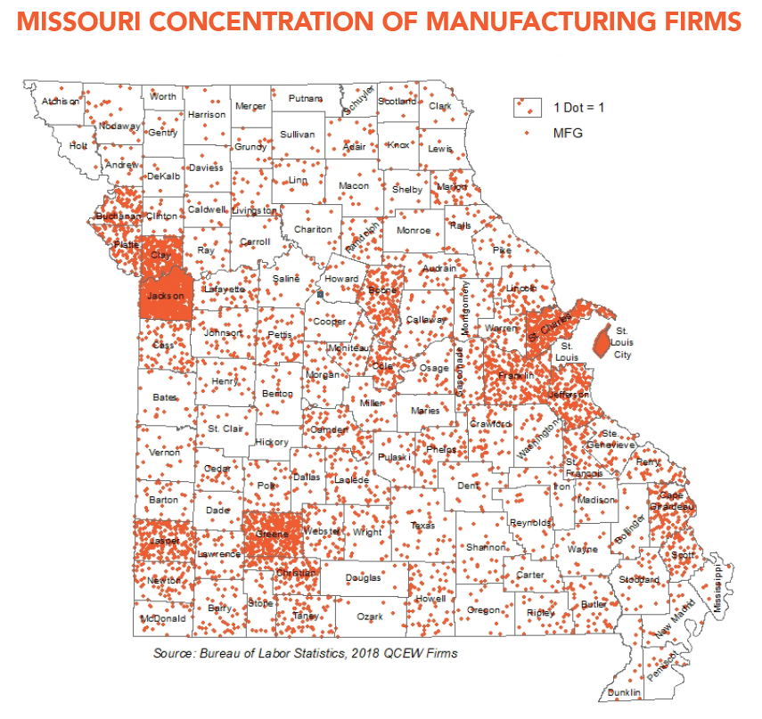
The MME is a statewide network of companies, educational partners and government partners.
TIER 1: The Manufacture Missouri Ecosystem
TIER 2: The Innovation Campus
TIER 3: The Missouri Protoplex®
Source: U.S. Bureau of Labor Statistics,
Quarterly Census of Employment and Wages, 2018

Slide 14
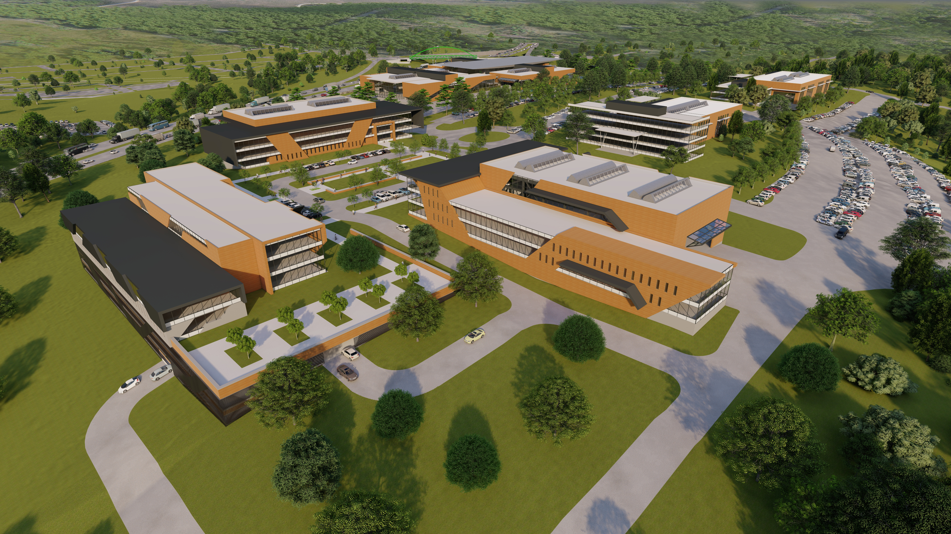
The Manufacturing Technology and Innovation Campus at S&T will be the destination of choice for MME members.
TIER 1: The Manufacture Missouri Ecosystem
TIER 2: The Innovation Campus
Space for R&D labs, prototyping
Research Asset Database (RAD)
Networking with academic and industry experts
TIER 3: The Missouri Protoplex®

Slide 15
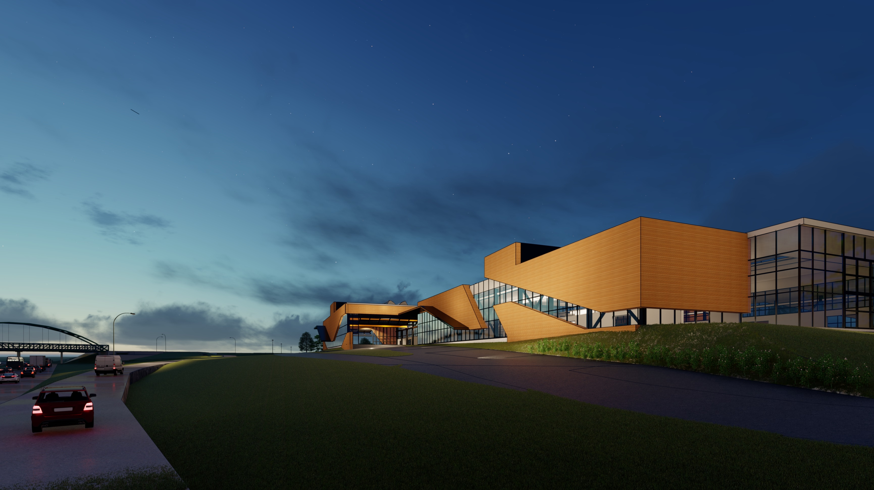
The Missouri Protoplex® is the first building of a proposed six-building campus.
TIER 1: The Manufacture Missouri Ecosystem
TIER 2: The Innovation Campus
TIER 3: The Missouri Protoplex®
Total investment: $105M
Kummer Institute Foundation match: $50M
State of Missouri match (to date): $5M
Needed match: $50M
(Governor Parson’s budget includes the $41.2M match.)

Slide 16
What will Missouri S&T become over our next 150 years?
Phase 1 (1870) – Land-grant institution, established as a school of mines and metallurgy to meet state and national needs of the Industrial Revolution.
Phase 2 (1915) – Expansion into an undergraduate engineering school with the addition of new engineering degree programs provided through passage of the Buford Act.
Phase 3 (late 1950s-early 1960s) – Space Race-era transition from “School” to “University” with addition of non-STEM degree programs, graduate education, Graduate Center for Materials Research, nuclear reactor.
Phase 4 (today) – Transformation into a research university of national stature, with a major initiative to grow research and graduate education.

Slide 17
The start of a new semester can be a challenging time for our students.
The first four or five weeks of a semester are when students may be most at risk – especially first-year students.
If your students are struggling academically, please notify them of available tutoring.
Use the Academic Alert System via Canvas.
If you suspect students are struggling with their emotional or mental well-being, advise them to visit our counseling office.
If you see something, say something!

Slide 18
Thank you! Questions?

Slide 19
Agenda
IV. Administrative Reports
B. Provost’s Report C. Potts

Slide 20
Academic Affairs Update (1)
Students
Fall-Spring undergraduate retention ~94% (same as previous years) –higher for KVS
New nomination & selection process for KDF
Student Support
Welcome Amy McMillen: interim dir. Advising
Welcome Rachel Kohman: Kummer Inst. (KVS/I&EF)
Writing Center moving to Library mid-semester
Project to streamline student-facing policies & practices
Library
Self-check system in full operation

Slide 21
Academic Affairs Update (2)
Programs
Coutelle/dual PhD planned/underway with Silesian UT & Wuhan UT (Civil Eng)
Joint MS w/WUSTL (Health Informatics)
Alignment of KVS & HP in planning stages
Faculty Recruiting
Havener Chair Math & Statistics: Announcement forthcoming
Kummer Chair BIT: Finalist interviews scheduled
Steinmeyer Chair Econ: Interviews pending
Dean searches underway. Committees meeting with search firm. Intended offer dates early April.
Please reach out to your networks

Slide 22
Agenda
V. Campus Reports
A. Staff Council
M. Fowler

Slide 23
Staff Council Update
Membership Changes
Staff Appreciation Day
May 25th
Recruitment Initiative
Staff Excellence Awards

Slide 24
Agenda
V. Campus Reports
B. Student Council
A. Aiken

Slide 25
Student Body President Packets will be available starting on January 31st
If you have any suggestions of motivated student please send their names my way ama7gr@mst.edu
Our regular meetings will take place every other week starting on January 25th in Carver/Turner
MLK Day of Service went well and we had 50+ participants
Starting the planning of Gonzo Gives Back to take place in March
Leadership Conference with SwiftKick is taking place January 29th

Slide 26
Agenda
V. Campus Reports
C. Council of Graduate Students
M. Nabi

Slide 27
Agenda
Special Topic
Future of Online, Distance and Continuing Education
B. Concepción

Slide 28
Corporate and Professional Education
Partnerships that achieve mutual goals
Cultivate, execute and promote educational programs
Serve as liaison between S&T and Missouri Online
Work with/support faculty to ensure strength of distance programs
Key issues
Course creation
Revenue sharing
Program development

Slide 29
Corporate and Professional Education
Launching face-to-face programs in St. Louis Spring 2022
Civil Engineering
Electrical Engineering
Mechanical Engineering
GEER grant (management and workforce development)
Online, noncredit, four-week courses starting in February
Credential in Systems-level Project Management
Credential in Human Resource Management

Slide 30
Agenda
VII. Reports of Standing Committees
A. Administrative Review Committee
K. Liu

Slide 31
Administrative Review Committee
2011-2022 Members
Kelvin Erickson
Wayne Huebner
Bih-Ru Lea
Kelly Liu, Chair

Slide 32
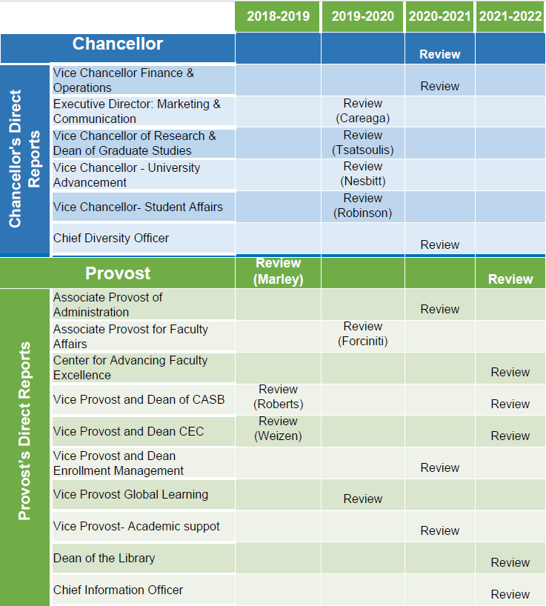
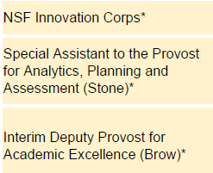
Administrative Review
Schedule
Approved by FS on 06/11/2020
*-Positions not to review
Notes:
Administrative review schedule approved by FS on June 11, 2020. 6 positions are scheduled for review this year, 2021-2022.

Slide 33
Administrative Review Committee
Positions for review
Provost
Center of Advancing Faculty Excellence
Chief Information Officer
Positions not for review
Vice Provost and Dean of CASB: search ongoing
Vice Provost and Dean CEC: leaving the position in 2022
Dean of the Library: left the university
Notes:
review and not for review lists

Slide 34
Administrative Review Committee
Tentative timeline and process
Action | Time
Review list to faculty senate for approval | January 20
Job descriptions | January 28
Development of questionnaires
Questionnaires to FS for review/approval | February 17
Statement of accomplishments due | February 25
Review of administrations | March 11 - March 25
Results to FS officers | April 28
Final report to FS | June 9
Notes:
Tentative review schedule.

Slide 35
Administrative Review Committee
Review Participants
All ranked tenure/tenure-track (TT) and ranked non-tenure-track (NTT) faculty, including those holding administration positions, are eligible to participate in the surveys.

Slide 36
Agenda
VII. Reports of Standing Committees
B. Budgetary Affairs
M. Fitch

Slide 37
Budgetary Affairs Committee
Jan 20, 2022
Referrals
Library budget changes
Continuing referrals:
Report on the “big picture balance sheet”
Current and next FY budget
Non-referrals
Salary increases/raises

Slide 38
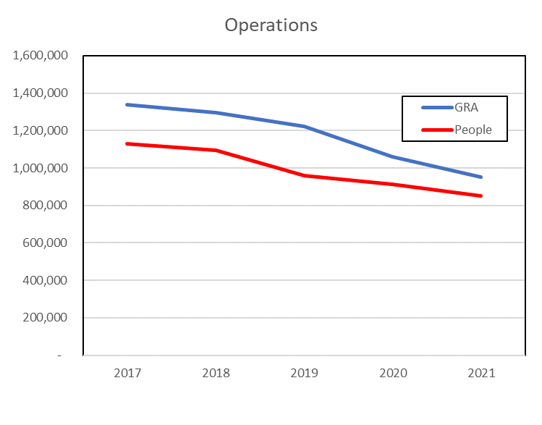
Library
Two Finds: Operations, Acquisitions
Operations
29% decrease in GRA, 2017-2021; 24% cut in S&W, which is 80-90% of costs
2019: Staff Support myVITA & “pay to Maggie”, +63K
2020: Negative Major Project balance, -$55K
2% cut to Provost
From carry forward balance

Slide 39
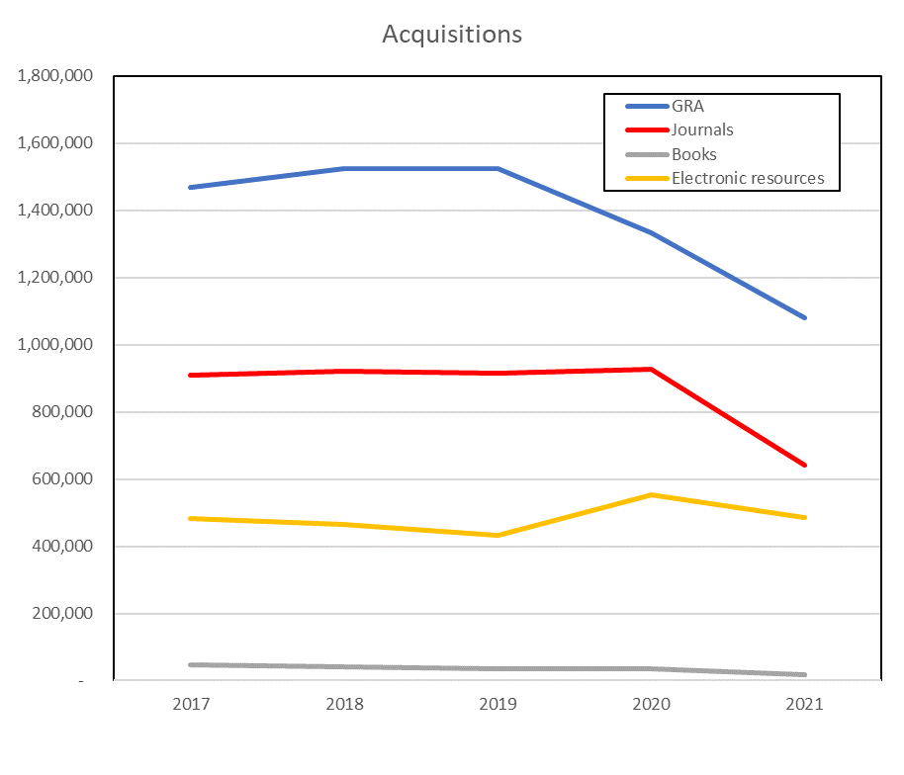
Library
Acquisitions
26% decrease in 5-yr GRA; 29% cut in Journals, 52-66% of costs
Transfers (each yr ; Safari from IT at 13-16 K):
2017 Provost money for Bepress, Web of Science and journals
2018
2019 Provost money and mini grant
2020 Discretionary fund
2021 F&A
Staff Resources: Catalogers Desktop, Classification Web, GOBI charges, LibGuides, Marcive, RDA Toolkit (cancelled)

Slide 40
Budget = no change
Current FY budget
Enrollment revenue $820k below budgeted
$2 million deficit = $1 million enrollment contingency, $1 million from one-time monies
FY 2023
Beginning to plan
Expecting no decline in State support
Tuition increase likely if State support not increased

Slide 41
General Revenue Budget
 | FY19 | FY20 | FY 21 (actual*) | FY 22 (planning)
Tuition and Fees | $124,548,154 | $126,853,439 | $119,477,148 | $119,592,425
Scholarship Allowance | (37,770,678) | (37,848,888) | (36,149,411) | (38,164,248)
Net Tuition & Fees | $86,777,476 | $89,004,551 | $83,327,736 | 81,428,177
State Appropriation | 50,185,510 | 43,543,499 | 45,690,941 | 53,026,096
Grant and Contract | 0 | 0 | 0 | 0
Gift Revenues | 481,131 | 385,737 | 471,909 | 345,000
Recovery of F & A | 6,941,286 | 6,802,499 | 6,496,349 | 6,493,100
Endowment & Investment Income | 1,969,324 | 2,035,737 | 1,935,710 | 3,120,243
Sales & Services Income | 989,382 | 1,177,479 | 709,380 | 1,065,880
Other Incomes | 3,464,299 | 2,872,553 | 2,209,518 | 2,958,389
Revenue Contingency | - | - |  | -
Total Revenues | $150,808,407 | $145,822,055 | $140,841,544 | $148,437,385
118,772,425
80,608,177
147,617,385

Slide 42
General Revenue Budget: costs
Total Revenues | $150,808,407 | $145,822,055 | $140,841,544 | $148,437,385
-2,000,000
Transfers | FY19 | FY20 | FY 21 (actual) | FY 22 (planning)
Intra Unrestricted CurrentFund | $6,755,777 | $4,442,960 | $1,988,391 | $1,581,686
Mandatory Transfers | (3,778,102) | (3,930,896) | (3,483,219) | (3,197,402)
NonMandatory Transfers | (11,607,554) | (6,885,979) | (7,114,077) | (3,446,690)
Total Transfers | ($8,629,879) | ($6,373,915) | ($8,608,905) | ($5,062,406)
Expenditures
Salaries & Wages | $83,651,987 | $80,232,396 | $75,195,068 | $79,426,854
Benefit Expense | 25,475,433 | 25,029,887 | 24,209,899 | 26,626,149
Compensation | $109,127,420 | $105,262,283 | $99,404,966 | $106,053,0030
Other Expenses | 38,416,204 | 33,205,855 | 32,471,617 | 37,256,650
Total Expenditures | $147,543,624 | $138,468,138 | $131,876,584 | $143,309,653
~$3.3 MM vacant staff positions
2% raise, $250K P&T
Return to pre-COVID
-1,000,000 Enrollment contingency
-1,000,000 One-time funds

Slide 43
Raises
“Raise” includes
raise,
merit,
market,
counter-offer, and
temporary pay increase (e.g. Dep’t Chair, almost always lost at end of service)
Excludes:
promotion (Prof $10K, Teach Prof $6K, Assoc Prof $5K, Assoc Teach Prof $3K)
Shift from/to administration (i.e. Khayat to VCR)

Slide 44
Notes and Oddities
Admin = Chancellor and Provost and direct reports, as positions
Exclude retiree continuing pay (e.g. Chancellor’s prof = 1/3 previous)
CEC 10 departments, 6 interim chairs (Frimpong, Cawlfield, Alajo, Watkins, Moats, Awuah-Offei (“interim director”))
CASB 11 departments, 4 interim chairs (Bruening, Singler, Davis, Hilgers)
Dep’t Chair usually +10% TPI, two interim in CASB greater?
Market and merit increases previously unusual, now common (base raise was ‘raise’, remainder was ‘market’ or ‘merit’)

Slide 45
Chancellor positions
Position | AY 21-22 |  | AY 20-21 |  | AY 19-20 |  | AY 18-19
Chancellor | Dehghani | +15% | Dehghani | +11% | Dehghani | +39% | Maples | +1.8%
Provost | Potts | +41.2 | Roberts | +1.7 | Roberts | +20 | Marley | -0.66
VC R | Khayat | +18.3 | Tsatsoulis |  | Tsatsoulis | +1.7 | Tsatsoulis | +30.50
VC Adv | Nesbitt¹ | +3.7 | Nesbitt |  | Nesbitt | +1.9 | Nesbitt | +4.92
VC F&O | O’Neil | +7.0 | Plain |  | Plain | +1.3 | Plain | +1.75
VC SA | Robinson | +2.9 | Robinson |  | Robinson | +2.1 | Robinson | +1.5
VC (KI) | Roberts | +100
CDO | Rivera² | -20.6 | Rivera²/Outar | -9.0 | Outar | +23.6 | Outar* | +1.16
CIO | Tang | +9.4 | Bookout | +9.4 | Bookout | -7.4 | Uetrecht | +1.93
aVC | Careaga | +15 | Careaga | +16.1 | Careaga | +3.7 | Careaga | +4.77
SUM | $2,565,181 | +28.8 | $2,000,622 | +3.5 | $1,933,128 | +7.5 | $1,797,679 | +5.7
¹Departure announced
²Not official title; official title Director II

Slide 46
Provost positions
Position | AY 21-22 |  | AY 20-21 |  | AY 19-20 |  | AY 18-19
Provost | Potts | +41.2 | Roberts | +1.7 | Roberts | +20 | Marley
CEC Dean | Wlezien |  | Wlezien |  | Wlezien | +1.0 | Wlezien
CASB Dean | Drowne | +0.5 | Drowne |  | Drowne | -1.6 | Roberts
Dep Prov^{a,b} | Brow | +0.9 | Brow | +2.6 | Brow | +100
VP Enroll | Sivadasan | +2.1 | Sivadasan |  | Sivadasan | +36.6 | Albers
VP Acad | Northcut | +1.6 | Northcut |  | Northcut | -21 | Cawlfield
VP | Concepcion | +100
VP DGS | Tsatsoulis | +100
VP Int’l Af | Hofer | +0.6 | Hofer |  | Hofer | +1.5 | Hofer
AP Admin |  | -100 | Moore |  | Moore | +5.0 | Moore
AP Fac Af^{a,b} | Forciniti | +1.0 | Forciniti |  | Forciniti | +1.7 | Forciniti
Spec Asst^{a,b} | Stone | +1.2 | Stone | -2.3 | Stone | +136.8 | Stone
SUM | $1,919,301 | +36.1 | $1,410,250 | +0.38^{c} | $1,404,888 | +5.22 | $1,335,145
ªNot official title; official title Professor
^{b}Fractional appointment
^{c}Summer 10% cut artefact

Slide 47
Chairs
AY 21-22
1.32, 1.50, 1.50. 1.51, 1.52, 1.59, 1.78, 2.21, 2.55, 2.63, 6.11
AY 20-21 no increases except
Congratulations, Kwame to Professor (officially MNE no Chair last 4 yrs)
AY 19-20, 1.5 – 2.6% except: 1 of 11 in CASB and 4 of 9 in CEC:
ALP: + 6.6% AY 20-21
CArE: +4.1% Merit, AY 19-20
ECE: +3.3% Merit, AY 19-20
GGPE: +5.5% AY 19-20
MNE: +5.6% AY 19-20
Ignores chairperson changes in last two years (History, Math x 2, ChE x 2, Comp Sci x 2, ECE, GGPE, MAE, MSE, NERdS)
Ignores ROTC commanders, not S&T funded

Slide 48
Faculty*
*Did not include Lecturers, Research NTT, Chancellor’s profs, or administrators in numbers
AY 2021-2022
Dep’ts varied, 1.13 – 5.74% raise, two groupings = 2.0-2.6 % and 3.3-3.5%
Faculty range wide (several charts)
AY 2020-2021
0% raise, few merit, several promotions, eight non-zero cases
AY 2019-2020
Dep’ts varied, instructed to use 1.5% for all, then 0.5% to top quarter
Dominant model was 1-1.5% for many, 3-6% for the rest
All 1.5% except one/few below 1% and one/two above 5% (ChE, MAE)
0% for a few, 2-4% for the rest (ALP)
0.5-1.5% for most, 5-8% a few (Emgt, GGPE, MNE)
1.5% several, 2.0% several, 5% one, 30% one (CS, much churn)

Slide 49
AY 21-22
*Did not include Lecturers, Research NTT, Chancellor’s profs, or administrators in numbers
Department
Engl &TC
Psych
Econ
Bio Sci
Math
MAE
CArE
EMgt
MSE
NucE
ALP
CS
TEC
ChE
0
1
2
ECE
3
4
5
6
Physics
Chem
GGPE
MinE
Hist & PS
BIT
Econ 1.29 CS 3.14
Engl & TC 2.01 GGPE 3.25
Physics 2.04 Emgt 3.34
MAE 2.16 Hist & PS 3.39
Chem 2.38 BIT 3.40
CArE 2.41 Math 3.41
ECE 2.48 TEC 3.54
Psych 2.50 MSE 3.98
Bio Sci 2.57 Che 4.08
MinE 2.57 NucE 5.74
ALP 2.61
ChE 3.0% w/o counter offer
NucE 4.6% w/o aTP to aP
MSE 3.3% w/o counter offer

Slide 50
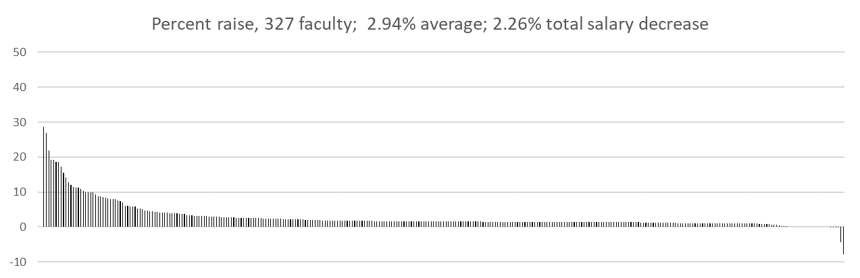
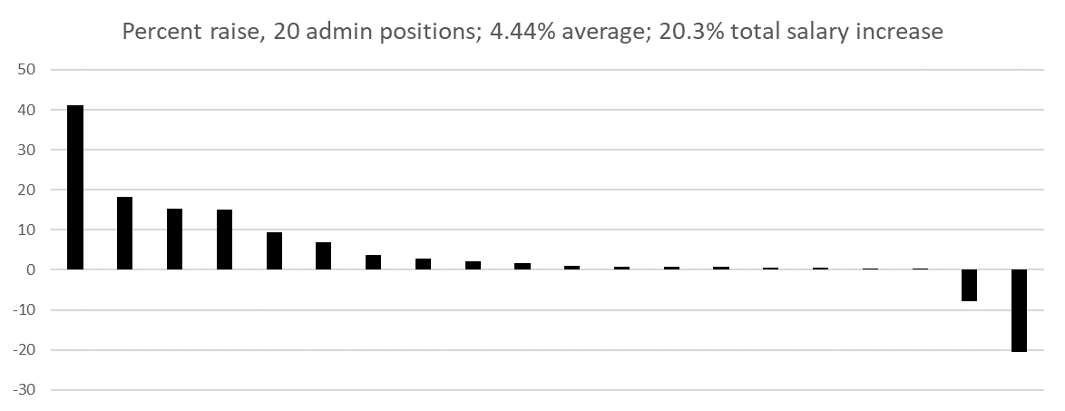
Added VC KI,
Added VP Grad
Added VP KI
Deleted VPGL
*
*
*
*
*
*
* Change in person

Slide 52
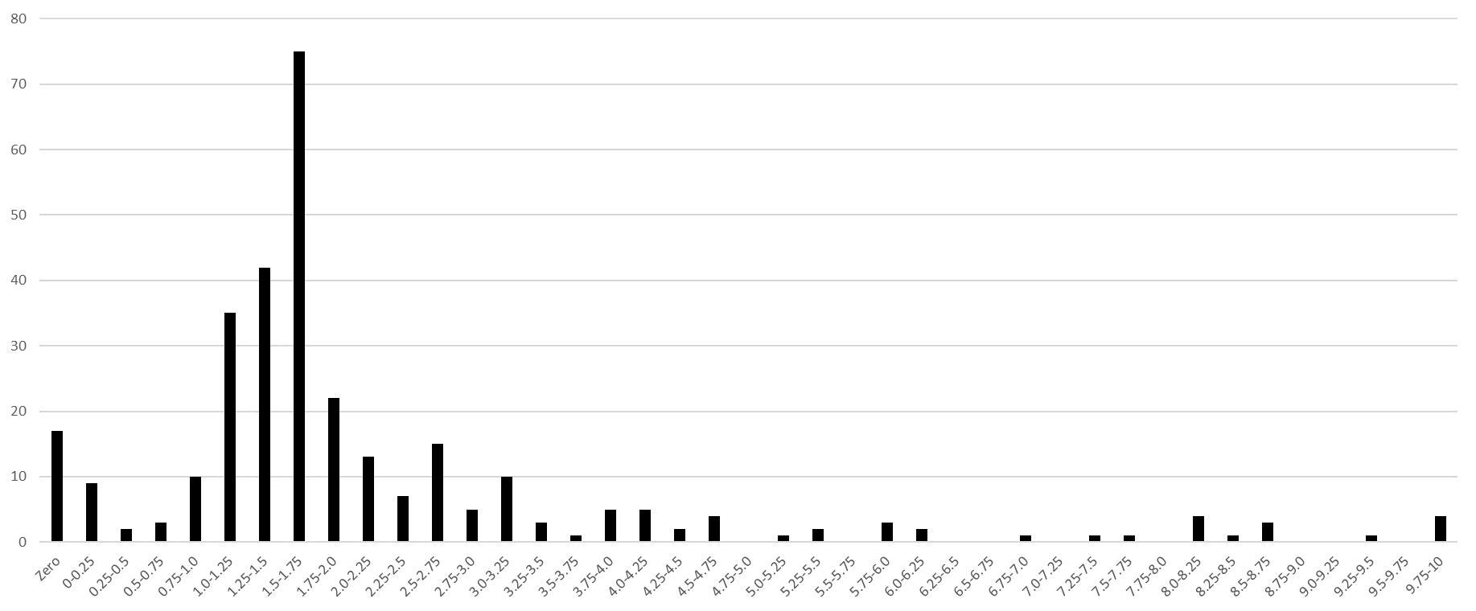
Faculty number per ¼ percent bin
17 faculty members above 10% not shown, influenced by counter-offer (5), TPI (7), or additional duties (4) and one converted from NTT
1.5% or less,
118 faculty
1.5% - 3%,
136 faculty
3% or more,
73 faculty
To increase salary:
Get an offer somewhere else
Become an administrator
Merit it

Slide 53
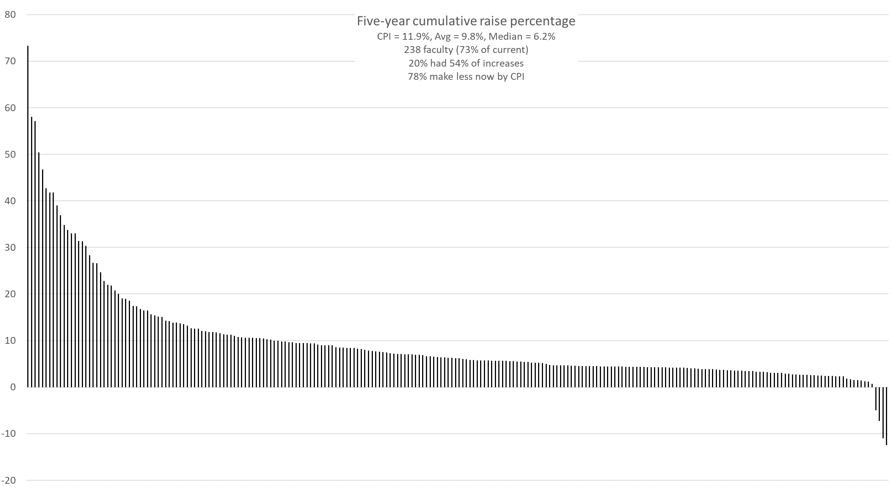

Slide 54
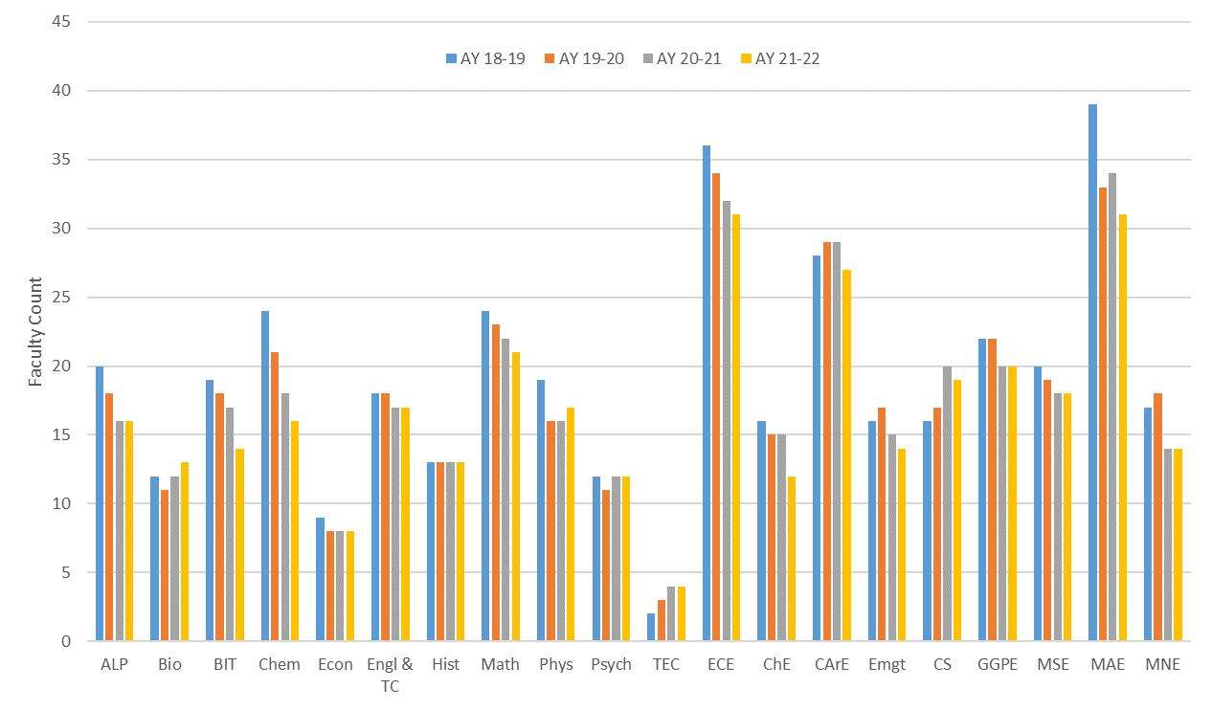
Faculty headcount
382 364 352 337 (~4% fewer per year)

Slide 55
Faculty*
*Did not include Lecturers, Research NTT, Chancellor’s profs, or administrators in numbers
Dept | ALP | Bio | BIT | Chm | ChE | CArE | CS¹ | Econ | ECE | EMgt | Engl | GPE | Hist | Mth | MSE | MAE | MNE | NE | Phys | Psych | TEC
Net | -4 | +2 | -4 | -8 | -4 | -2 | +3 | -1 | -5 | -2 | +1 | -2 | 0 | -3 | -2 | -8 | -1 | -2 | -3 | 0 | +2
’18 | 20 | 11 | 18 | 24 | 16 | 28 | 16 | 9 | 36 | 16 | 18 | 22 | 13 | 24 | 20 | 39 | 9 | 8 | 19 | 12 | 2
’19 | 18 | 10 | 17 | 21 | 15 | 29 | 17 | 8 | 34 | 17 | 18 | 22 | 13 | 23 | 19 | 33 | 9 | 9 | 16 | 11 | 3
‘20 | 16 | 11 | 16 | 18 | 15 | 29 | 20 | 8 | 32 | 15 | 17 | 20 | 13 | 22 | 18 | 34 | 8 | 6 | 16 | 12 | 4
’21 | 16 | 13 | 14 | 16 | 12 | 26 | 19 | 8 | 31 | 14 | 19 | 20 | 13 | 21 | 18 | 31 | 8 | 6 | 17 | 12 | 4
¹Frimpong in MNE
2018-19 AY, 382 faculty, 45 fewer now (-12%)

Slide 56
Agenda
VI. Reports of Standing Committees
C. Curricula S. Raper

Slide 57
Campus Curricula Committee Report
20 January 2022
CCC Meeting -07 December, 2021
Total Committee Activity
11 Course Change Requests (CC Forms)
4 Program Change Form (PC Forms)
4 Experimental Course Request (EC Form)

Slide 58
Campus Curricula Committee Report
20 January 2022
Course Changes (CC) Requested
File: 132.1 BIO SCI 2223 : General Genetics
File: 4828 BIO SCI 4369 : Freshwater Ecology Laboratory
File: 4835 BIO SCI 5443 : Population and Conservation Genetics
File: 92.3 ENG MGT 1210 : Economic Analysis of Engineering Projects
File: 1393.2 ENG MGT 2310 : Introduction to System Engineering
File: 4833 ENGLISH 3236 : Tolkien & Lewis
File: 4838 ENV SCI 1110 : Environmental Science Freshman Seminar
File: 4839 ENV SCI 4028 : Environmental Science Senior Capstone
File: 4605.4 GEOLOGY 6100 : Advanced Professional Geoscience Skills
File: 1126.5 GEOLOGY 6611 : Advanced Palynology
File: 931.2 MECH ENG 4480 : Control System Laboratory

Slide 59
Campus Curricula Committee Report
20 January 2022
Program Changes (PC) Requested
File: 382 PROPOSED : Environmental Sciences BS
File: 385 PROPOSED : Foundations of Supply Chain Integration Systems CT
File: 383 PROPOSED : Modeling and Simulation for Decision Systems CT
File: 384 PROPOSED : Systems of Human Capital Management CTate

Slide 60
Campus Curricula Committee Report
20 January 2022
For Informational Purposes; No Senate Approval Required
Experimental Courses (EC) Requested
File: 4832 COMP SCI 6001.008 : High-Performance Computing
File: 4830 COMP SCI 6001.009 : Industrial Control Systems for Computer Scientists
File: 4837 MECH ENG 5001.006 : Applied Computational Fluid Dynamics
File: 4829 MS&E 5001.004 : Scientific Challenges to Hypersonic Flight

Slide 61
Campus Curricula Committee Report
20 January 2022
Curriculum committee moves for FS to approve the 11 CC and 4 PC form actions
Discussion: Questions or comments?

Slide 62
Agenda
VII. Reports of Standing Committees
D. CET D. Burns

Slide 63
CET Presentation to Faculty Senate
January 20, 2022
Dr. Devin Burns

Slide 64
Plans for improving Assessment of teaching
Plan to vote on new Student Evaluation of Teaching (SET) survey instrument during the February senate meeting
IT said they can implement it for this semester
The CET committee will continue developing recommendations for complementary methods of assessment such as peer observation and self-reflection

Slide 65
New Student Evaluation of Teaching (SET) Instrument
Please rate your instructor on the frequency that they have exhibited these qualities and behaviors," with the response options "never," "rarely", "sometimes", "often", and "always":
Knowledgeable About Subject Matter (e.g. appropriately answers students’ questions; provides value beyond required texts)
Engaging and Interesting (e.g. uses technology to support and enhance lectures; uses interesting, relevant, and/or personal examples)
Receptive to feedback (e.g. requests course feedback from students; responds to student suggestions)
Attentive to Student Learning (e.g. asks questions to check student understanding; reinforce information when necessary)

Slide 66
New Student Evaluation of Teaching (SET) Instrument
Please rate your instructor on the frequency that they have exhibited these qualities and behaviors," with the response options "never," "rarely", "sometimes", "often", and "always":
Provides Constructive Feedback (e.g. provides useful, timely feedback on returned work)
Respectful (e.g. is considerate and polite, encourages students )
Accessible (e.g. posts/attends office hours, gives contact information, responds in a reasonable amount of time)
Establishes Learning Objectives (e.g. prepares/follows the syllabus; has clear learning objectives)
Uses Relevant Assessments (e.g. assessments target key learning objectives)

Slide 67
Old Items which we will retain:
The below use a 5-point agree-disagree response scale:
I would tell other students that the instructor was effective in communicating the content of the course.
I would tell other students that the instructor described and consistently followed course and grading policies.
I would tell other students that the instructor was prepared for class.
I would recommend this instructor to other students.
This instructor was an effective teacher

Slide 68
Agenda
VIII. Unfinished Business

Slide 69
Agenda
New Business
69

Slide 70
Agenda
X. Adjourn
70

