Slide 1
Faculty Senate Meeting
February 17, 2022

Slide 2
Meeting procedure
The same rules apply over virtual meetings as over in-person meetings
Only Senators may debate motions
Only Senators can vote
If you are not a Senator, or a proxy, you cannot vote or debate
Do not speak over someone, or out of order
Raise your hand within the Zoom app
The President will call on you and then you will have the floor
Unless you have been recognized (been told you have the floor), you may not speak
Per Robert’s Rules, each Senator is entitled to only speak twice on each motion.

Slide 3
Meeting Minutes
Robert's Rules of Order say that meeting minutes are simply a summary of what happened at the meeting.
They are not a play by play of everything that happened or what members said.
We will be using Robert's Rules to guide our recording of minutes.
If needed, Faculty Senators may request access to the audio recording of the meeting. Please email facsenate@mst.edu with justification.

Slide 4
Agenda
Call to Order and Roll Call
D. Westenberg, Secretary

Slide 5
Agenda
Approval of Minutes
January 20, 2022

Slide 6
Agenda
III. President’s Report
K. Homan

Slide 7
President’s Report: UM System
IFC (Intercampus Faculty Cabinet): 07 Feb 2022 Mtg (Zoom)
ASUM student representative – exploring possibility of making election day a no-class day in UM System (even-year falls, each spring).
IT (UM system) contemplating an end to granting admin rights on University PCs for faculty (and staff).
Expressed immediate concern.
Confirmed other campuses are equally concerned.
Advance Notice: may need to query campus faculty and staff to demonstrate the scale of negative impact on productivity
Resignation of Matt Gunkel announced on February 7, 2022. Accepted AVC/CIO position at UC-Riverside.

Slide 8
President’s Report: S&T Campus
Missouri Board of Curators meeting on campus 21 April 2022.
Faculty Senate organizing student luncheon with Curators
Planning underway for the event.
Faculty Senate officers will be reaching out to Departments (and Senators) to identify candidate students.

Slide 9
President’s Report: Faculty Senate
Ad-Hoc Committee on Assessment of Campus Climate
Draft survey and summary description prepared
Review underway within the Committee
Endorsement will be sought from Staff Council and Faculty Senate Personnel Committee.
24 March 2022 Faculty Senate Meeting: Personnel Committee expected to bring to Senate body for endorsement.
Special topic calendar confirmed
February: FY 2023 Budget and Priorities (A. O’Neil).
March: Graduate student initiatives (C. Tsatsoulis)
June: Carnegie R1 and campus initiatives (M. Dehghani)

Slide 10
President’s Report: Faculty Senate
Proposal for Revised SET Instrument
First Step: Motion from CET in today’s meeting
Narrow decision on revised SET instrument (education-research based instrument)
Revised instrument provides new questions encompassing objective to subjective aspects of instruction, retaining prior effectiveness score and open-ended comment
Critical: allows for calibration from new questions to prior effectiveness score, in addition to richer feedback to enabling meaningful formative and summative use.
Uniquely opportune moment – CET membership not only committed to promotion of teaching quality, but also its evaluation as research focus
Subsequent Steps
SET issues such as response rate, potential for composite score
Instructor-Based and Peer-Based Evaluation instruments to complement Student-Based Evaluation (via SET instrument).
Goal: tools for faculty to refine, demonstrate and document teaching effort

Slide 11
Agenda
IV. Administrative Reports
A. Chancellor’s Report M. Dehghani

Slide 12
Proposed Missouri Protoplex® will elevate S&T’s standing as a national leader in manufacturing engineering, stimulate economy.

Slide 13
The MME is a network of companies, educational partners and government partners that will benefit the entire state.

Slide 14
Thank you! Questions?

Slide 15
Agenda
IV. Administrative Reports
B. Provost’s Report C. Potts

Slide 16
Academic Affairs Update
Faculty & Staff Awards
Education Awards
Faculty Searches
Online Certificate Programs

Slide 17
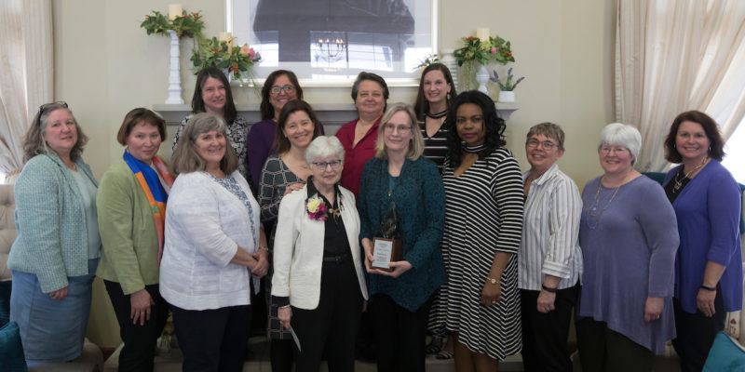
Recognizing Support for Women on campus
Woman of the Year Award
Recognizes T/TT female-identifying faculty for advocacy work
Initiated by alumna Cynthia Tang
Women’s Advocacy Award
Full-time staff or faculty member, not necessarily female-identifying
Initiated by Dr. Elizabeth Cummins, Professor Emerita
Nominations are live now

Slide 18
Ignition Grants for Sustainable Educational Transformation
Three Categories
Research Incubation Awards
Programmatic Start-up Funding
Infrastructure Enablement
Kummer–funded
Up to $500,000 total
Status
10 submissions across categories.
Decisions by end of month
Possible second round in Fall

Slide 19
Faculty Searches
Kummer Center Directors
Advanced Manufacturing
Rick Billo
Resource Sustainability
Negotiating
AI & Autonomous Systems
Two finalists
Advanced and Resilient Infrastructure
Ongoing
Academic Deans
- Soft deadline Feb 14
- But NOT too late to reach out
to your networks
- Solid, deep/broad diverse pools
- Next steps
- Down-selections next 3 weeks
- Two-stage interviews
- Confidential: late March
- Public: April
Department Chairs
- Math/Statistics
- Announcement soon
BIT
- Visits ongoing
Econ
- Visits forthcoming
Comp Sci
- Visits forthcoming
NERS
- Re-thinking

Slide 20
GEER Grant courses launched
Systems-level Project Management
Systems Thinking, February 14-March 13
Organizational Behavior, Feb. 28-March 27
Project Management, March 14-April 10
Human Resource Management
Training and Workforce Development, Feb. 28-March 27
Communication for Managers, March 14-April 10
Language as Key for Diversity and Inclusion, March 28-April 24
go.mst.edu/leadership.

Slide 21
Agenda
V. Campus Reports
A. Staff Council
M. Fowler

Slide 22
Staff Council
Staff Milestone Awards
UM System issues printed certificates to recognize years of service
Supervisor responsibility to present certificate in meaningful way
Advocacy Initiatives
Partnership with Human Resources to offer ePerformance training through Staff Success Center
Anonymous Survey to solicit feedback
Earth Day Event – April 22nd
200 trees and crafting workshop
Spring Staff Appreciation Day
Summertime Activities (camping, BBQ, kayaking, etc.)
May 25, 2022

Slide 23
Agenda
V. Campus Reports
B. Student Council
A. Aiken

Slide 24
Student Body President Packets have been turned in and we have 2 students on the ballot
Our regular meetings take place every other week with our next meeting on February 22nd in Carver/Turner
We have started the planning of Gonzo Gives Back to take place in March
If you have any suggestions for community partners please let me know

Slide 25
Agenda
V. Campus Reports
C. Council of Graduate Students
M. Nabi

Slide 26
Agenda
Special Topic
Budget Planning for Fiscal Year 2023
A. O’Neil

Slide 27
The Tree Analogy
Auxiliary Operations
Gifts
Grants & Contracts
Core Operations
State Support
Tuition & Fees

Slide 28
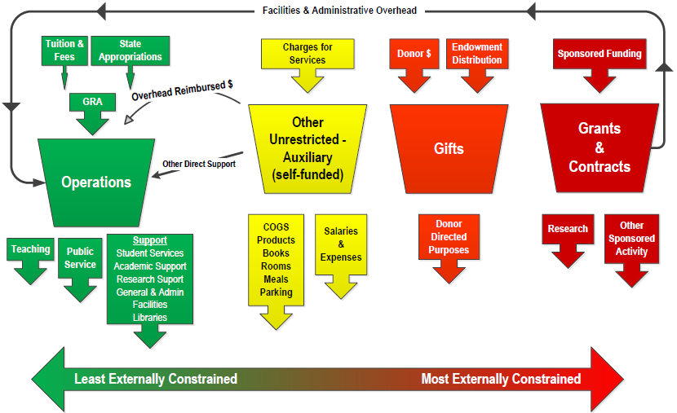
Funds: Colors of Money

Slide 29
Funding Sources
Fiscal Year 2022 Original Budget
Missouri S&T Current Funds
Operations Funds – General Revenue | $165,827,810 |  | 57.7%
Operations Fund – Dedicated Revenues | 20,773,823 |  | 7.2%
Service Operations/ Continuing Education | 661,115 |  | 0.2%
Auxiliary Operations | 20,831,509 |  | 7.2%
Gifts, Endowment & Investment Income | 24,075,366 |  | 8.4%
Grants & Contracts | 55,253,620 |  | 19.2%
Total Revenues | $287,423,243
Notes:
Scholarship allowance shifted down from reduction of revenue to be included in expenses
Gift & Endowment includes $11M in Kummer operations budget
G&C includes CARES funding, Pell grants, and State funded aid (Bright Flight, Missouri Access, etc)
Source: Hyperion BB1G – original budget FY22

Slide 30
Operations Fund Sources $186.6 million
Fiscal Year 2022 Original Budget
 | General Revenue | Dedicated | Total
State Appropriations | $53.0M | - | $53.0M
Gross Tuition & Fees | $112.8M | $6.8M | $119.6M
Recovered F&A | - | $6.5M | $6.5M
Other Income | - | $7.5M | $7.5M
Total Sources | $165.8 | $20.8 | $186.6M
Notes:
$7.5M Contingency reserve; $1.4M new in FY22 and will be allocated in FY23
NonGRA Tuition & Fees:
MSU 1,123,618
Distance outside GRA 1,240,150
A&F fees 4,248,443
Misc student fees - dept charged - 178,500
3) F&A Distribution: 70% VCR; 20% Colleges; 8% Facilities; 2% Library
4) Other Income
GRA: UMSYS General Investment Pool Distr 1,255,590
Endowment Admin Fee & Gift Fee 1,682,500
Misc Rev 106,000
Full Costing 36,730
NonGRA: Gifts 345,500
Misc Rev - Depts 2,815,659
Unrestricted Endowment Income 182,153
Sales & Service Inc (Athletics, COER)- 1,065,880
GRA tie back in file

Slide 31
Change in Operating Funding Sources
31%
69%
TUITION & FEES
STATE SUPPORT

Slide 32
Funding per Student FTE
$32,352
$26,062
$21,195
Notes:
All Tuition and Fees (excluding auxiliary funds)
June CPI rates

Slide 33
FY2021 State Appropriations for Higher Ed Per $1,000 in Personal Income
*Information obtained from the Grapevine Report published by Illinois State University

Slide 34
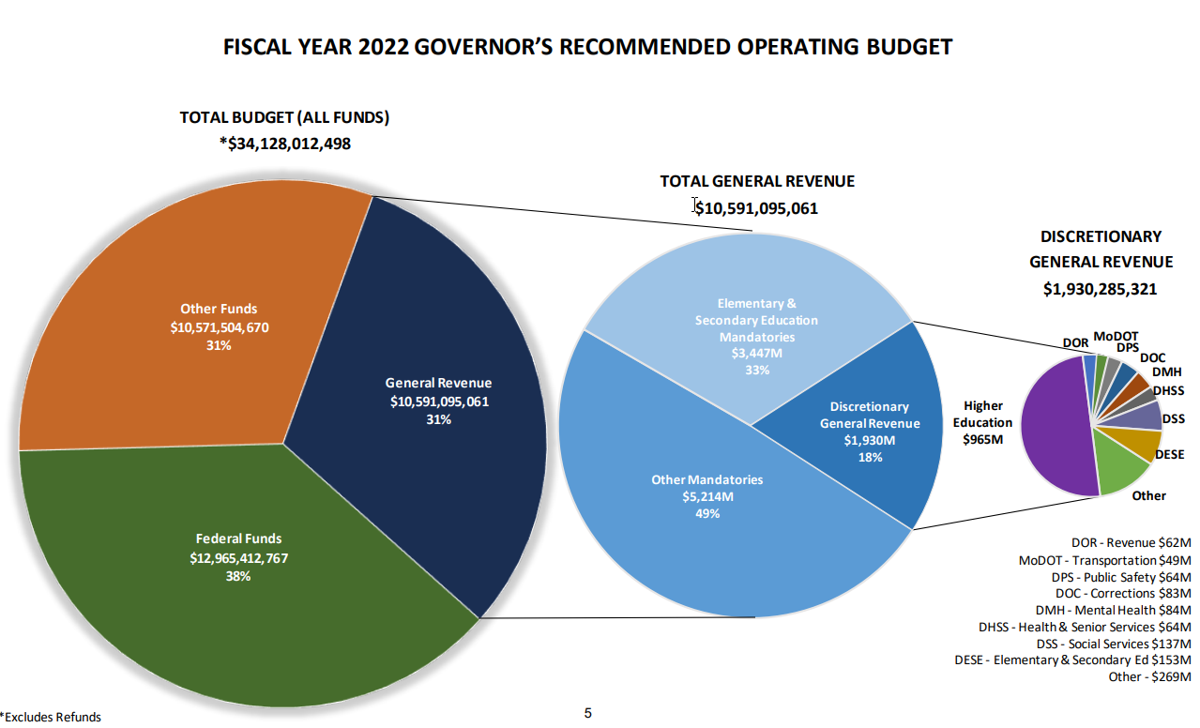
Higher Education is a large portion of the discretionary budget
Higher Education is 50% of Discretionary General Revenue
4-year Institutions are 79% of HE
UM is 48% of 4-years
S&T is 13% of UM
The University of Missouri is 1/5th of the discretionary budget

Slide 35
Financial update – FY22
Enrollment fell short of target: $2.4M
Enrollment contingency - $1M
Unallocated state appropriations core increase: $1.35M
State core increase to be included in FY23 budget: $1.35M

Slide 36
FY23 – Revenue assumptions
Governor recommendations
Core state appropriation increase of 5.4% ($2.92M)
Plus $41.25M in one-time capital funds for the Protoplex
Enrollment expected to increase
FTC: +59 to 1,247
Undergraduate students: -66 to 5,485
Graduate students: +62 to 934
Tuition increase likely given inflationary environment: 3-5%
Tuition rates will be approved at a special Board meeting in May

Slide 37
FY23 – Expense side challenges
Highest inflation in 40 years: 7.5% for the past 12 months ending in January
Governor recommendations for state employees
5.5% cost of living increase
$15 minimum wage (20% of workforce impacted)
House approved $15 min for some employee groups
High turnover and extended fill rates for many staff positions
Strategic needs and mandatory cost increases
Notes:
Tenure & Promotion
NTT increases
Tenure awards
Gradescope
IT position to support SAP
OSP staffing

Slide 38
FY23 – Planning process
New financial modeling tool
Investments made in accordance with North Star Objectives
Data informed decision making
FTC deposits
Turnover and fill rates
CUPA faculty salary analysis
Salary increases – Merit and Market/equity adjustments likely
FY23 Kummer Institute budget process is underway

Slide 39
Agenda
VII. Reports of Standing Committees
A. Administrative Review Committee
K. Liu

Slide 40
Administrative Review Committee
2021-2022 Members
Kelvin Erickson
Wayne Huebner
Bih-Ru Lea
Kelly Liu, Chair

Slide 41
Administrative Review Committee
Positions Approved for Review
Provost (Potts)
Center of Advancing Faculty Excellence (Ivliyeva)
Chief Information Officer (Tang)

Slide 42
Administrative Review Committee
The Qualtrics survey system will be used for the surveys.
From the cover letter of the surveys:
IP addresses and email addresses are blocked and no identifying information will be collected. Faculty Senate might decide to disclose comments. If you wish to protect your confidentiality, make sure your comments do not identify you.

Slide 43
Administrative Review Committee
Survey questions were developed from the job descriptions provided by the administrator being reviewed.
For each of the survey questions the following scale will be used:
Strongly Agree, Agree, Disagree, Strongly Disagree, Insufficient Information/Unsure
For each administrator the last survey question is:
Administrator X should be retained in the position as Z.
Yes / No

Slide 44
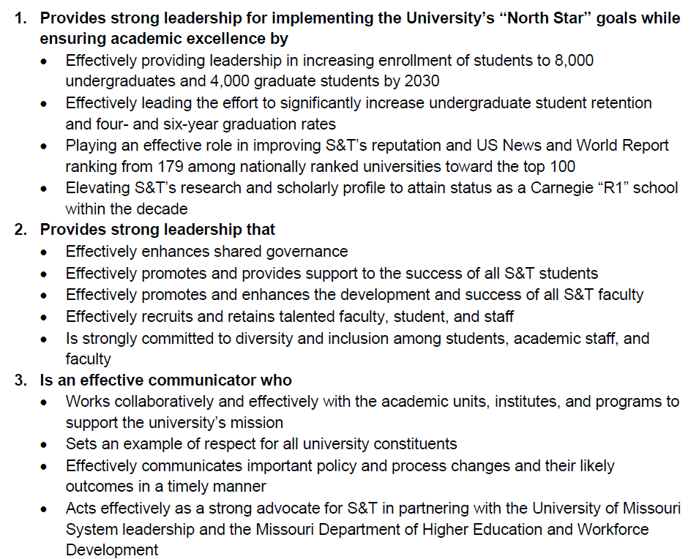
Colin Potts
Provost

Slide 45
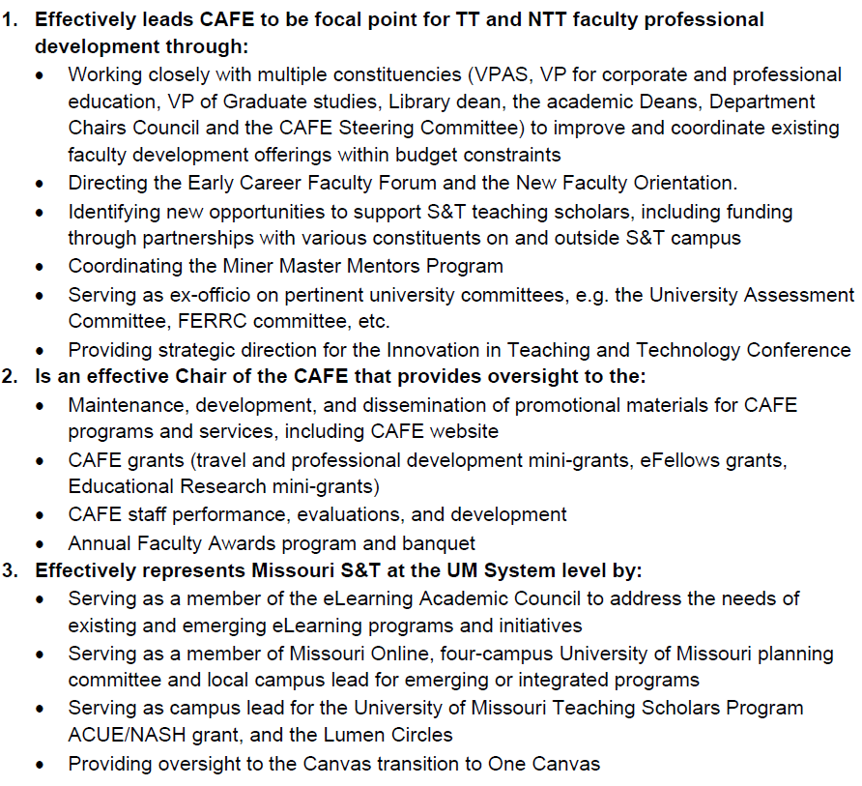
Irina Ivliyeva
CAFÉ Chair

Slide 46
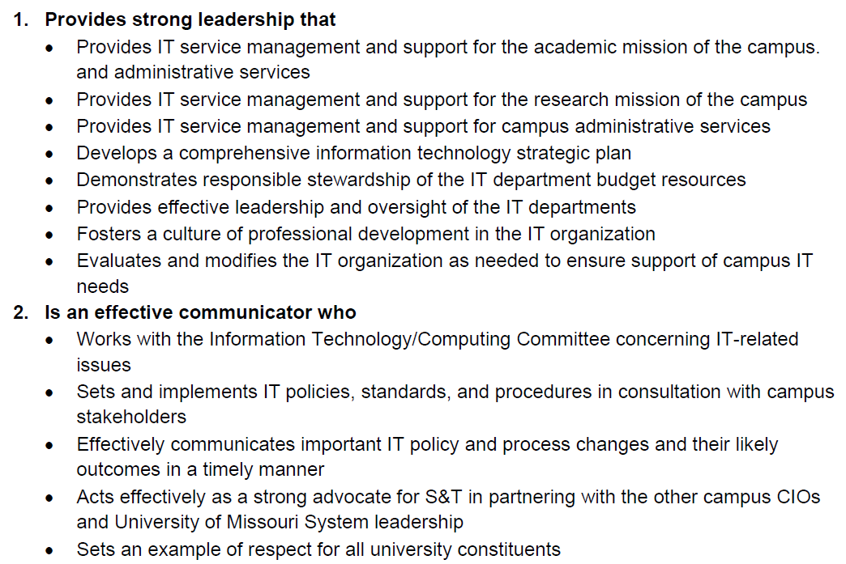
Danny Tang
COI

Slide 47
Agenda
VII. Reports of Standing Committees
B. Public Occassions
S. Sedigh-Sarvestani

Slide 48
Public Occasions Committee Report
Dr. Sahra Sedigh Sarvestani, Chair
Proposal for separate PhD commencement ceremony

Slide 49
The Office of the Provost has proposed that the PhD commencement ceremony be held a week earlier than the ceremonies for undergraduate and master’s degrees.
This change was implemented for Fall 2021 and has been announced for Spring 2022.
Faculty Senate approval is being sought for a permanent change, effective Fall 2022.

Slide 50
Please solicit feedback from your department colleagues and share with the Public Occasions committee.
Depending on feedback, a motion may be forthcoming at the March 24 Faculty Senate meeting.

Slide 51
Agenda
VI. Reports of Standing Committees
C. Campus Curricula S. Raper

Slide 52
Campus Curricula Committee Report
17 February 2022
CCC Meeting -25 January 2022
Total Committee Activity
31 Course Change Requests (CC Forms)
4 Program Change Form (PC Forms)
1 Name Change Form (NC Form)
2 Experimental Course Requests (EC Form)

Slide 53
Campus Curricula Committee Report
17 February 2022
Course Changes (CC) Requested
File: 72.1 ARCH ENG 2803 : Architectural Design I
File: 1722.1 ARCH ENG 4097 : Senior Design Project
File: 2321.1 ARCH ENG 5850 : Residential Renewable Energy -PV Fundamentals
File: 4844 BIO SCI 5020 : Data Analysis and Presentation
File: 266.1 CIV ENG 2401 : Fundamentals Of Surveying
File: 642.4 CIV ENG 3116 : Construction Materials, Properties And Testing
File: 641.4 CIV ENG 3715 : Fundamentals of Geotechnical Engineering
File: 287.1 CIV ENG 4097 : Senior Design Project
File: 841.3 CIV ENG 4448 : Fundamentals Of Contracts And Construction Engineering & Management
File: 4653.7 CIV ENG 5451 : Information Technology Applications in the Construction Industry
File: 110.10 COMP SCI 1200 : Discrete Mathematics for Computer Science

Slide 54
Campus Curricula Committee Report
17 February 2022
Course Changes (CC) Requested
File: 4038.6 COMP SCI 1972 : Introduction to MATLAB Programming
File: 2507.10 COMP SCI 2500 : Algorithms
File: 1996.1 ENV ENG 4097 : Senior Design Project
File: 1876.1 GEOLOGY 2731 : Introduction to Planetary Science
File: 4760.3 MATH 1210 : Calculus I-A
File: 4761.2 MATH 1211 : Calculus I-B
File: 940.1 MATH 3304 : Elementary Differential Equations
File: 950.1 MATH 5302 : Intermediate Differential Equations
File: 967.1 MATH 5325 : Partial Differential Equations
File: 971.1 MATH 5351 : Introduction To Complex Variables
File: 974.1 MATH 5483 : Operational Calculus

Slide 55
Campus Curricula Committee Report
17 February 2022
Course Changes (CC) Requested
File: 4757.3 MATH 5601 : Introduction to Numerical Analysis
File: 952.1 MATH 5603 : Methods of Applied Mathematics
File: 4103.1 MATH 5604 : Introduction to Numerical Methods for Differential Equations
File: 285.4 PET ENG 4097 : Capstone Design
File: 1260.7 PET ENG 4210 : Drilling and Well Integrity
File: 1238.1 PET ENG 4410 : Production Engineering
File: 1233.1 PET ENG 4590 : Subsurface Energy Economics
File: 919.4 PET ENG 4720 : Reservoir Geomechanics
File: 1429.1 STAT 6841 : Stochastic Processes

Slide 56
Campus Curricula Committee Report
17 February 2022
Program Changes (PC) Requested
File: 30.8 A&E BIO-MS : Biological Science MS
File: 192.45 PSYCH-BA : Psychology BA
File: 193.46 PSYCH-BS : Psychology BS
File: 126.2 PSYMETR-MI : Psychometrics Minor

Slide 57
Campus Curricula Committee Report
17 February 2022
Name Change (NC) Requested
7 : Department of Mining & Explosives Engineering

Slide 58
Campus Curricula Committee Report
17 February 2022
For Informational Purposes; No Senate Approval Required
Experimental Courses (EC) Requested
File: 4820 ARCH ENG 5001.003 : Renewable Energy – Storage Systems for Buildings
File: 4843 STAT 5001.009 : Causal Data Science

Slide 59
Campus Curricula Committee Report
20 January 2022
Curriculum committee moves for FS to approve the 31 CC and 4 PC and 1 NC form actions.
Discussion: Questions or comments?

Slide 60
Agenda
VII. Reports of Standing Committees
D. Committee for Effective Teaching D. Burns

Slide 61
Revisions to SET Proposal
Keep the "overall effectiveness" item first, to ensure that it cannot be influenced by the new items
Change the highest response anchor from "always" to "consistently"
Reorder the nine new items to reflect a progression from content-oriented to delivery-oriented questions
Replace "e.g." with "for example," for greater clarity
Change the wording on the "engaging and interesting" item to clarify that use of technology is not the primary concern
Add "promotes an inclusive environment" as one example of being Respectful
Replace the word "assessments" with "assignments/tests" to clarify for students
Add an open response question for this semester only that seeks feedback from students on the revision
Stipulate that responses from the nine new items are not to be used for the purpose of faculty evaluation during the Spring 2022 semester

Slide 62
Student Evaluation of Teaching (SET)
Revision Proposal
The proposed instrument will retain five questions from the previous instrument: the overall effectiveness question, and the four questions whose data is shared with students in accordance with state law. Each of these questions offer responses on a five-point agree-disagree scale:
This instructor was an effective teacher
I would tell other students that the instructor was effective in communicating the content of the course.
I would tell other students that the instructor described and consistently followed course and grading policies.
I would tell other students that the instructor was prepared for class.
I would recommend this instructor to other students.

Slide 63
New Items
The revised SET instrument would also include the following new questions, with the instruction to "Please rate your instructor on the frequency that they have exhibited these qualities and behaviors," and response options "never," "rarely", "sometimes", "often", and "consistently":
Knowledgeable About Subject Matter (e.g. appropriately answers students’ questions; provides value beyond required texts)
Establishes Learning Objectives (e.g. prepares/follows the syllabus; has clear learning objectives)
Uses Relevant Assessments (e.g. assignments/tests target key learning objectives)
Provides Constructive Feedback (e.g. provides useful, timely feedback on returned work)

Slide 64
New Items (continued)
Please rate your instructor on the frequency that they have exhibited these qualities and behaviors, with response options "never," "rarely", "sometimes", "often", and "consistently":
Accessible (e.g. posts/attends office hours, gives contact information, responds in a reasonable amount of time)
Attentive to Student Learning (e.g. asks questions to check student understanding; reinforce information when necessary)
Engaging and Interesting (e.g. uses relevant examples; supports and enhances lectures with educational tools and/or technology)
Receptive to feedback (e.g. requests course feedback from students; responds to student suggestions)
Respectful (e.g. is considerate and polite, encourages students, promotes an inclusive environment)

Slide 65
Open Response Items
With regards to teaching, what are the strengths of the instructor?
What suggestions do you have for improving the quality of instruction?
Please share any feedback you have concerning this new revision of the survey. (For Spring 2022 only)

Slide 66
Motion
The CET Committee moves that the Faculty Senate adopt the 17 questions below, referred to as the Proposed SET Instrument, with the indicated response options, to serve as the Student Evaluation of Teaching (SET) instrument administered at the end of each semester, replacing in whole, the prior SET instrument. The change will take effect beginning with the assessments to occur at the end of the Spring 2022 semester, with the 17th question dropped after one use. For the Spring 2022 semester, the nine new items (#6-14) are not to be used for purposes of instructor evaluation.
Accepted friendly amendment: The faculty senate encourages the CET to develop additional measures of faculty teaching effectiveness beyond SETs in order to prevent unintended consequences for faculty (including NTTs) due to the potential biases and subjective nature of Student evaluations of teaching.

Slide 67
Agenda
VII. Reports of Standing Committees
E. Budgetary Affairs
M. Fitch

Slide 68
Budgetary Affairs Committee
Feb 17, 2022
Referrals
Change orders for roundabout
Christmas tree
Continuing referrals:
Report on the “big picture balance sheet”
Current and next FY budget

Slide 69
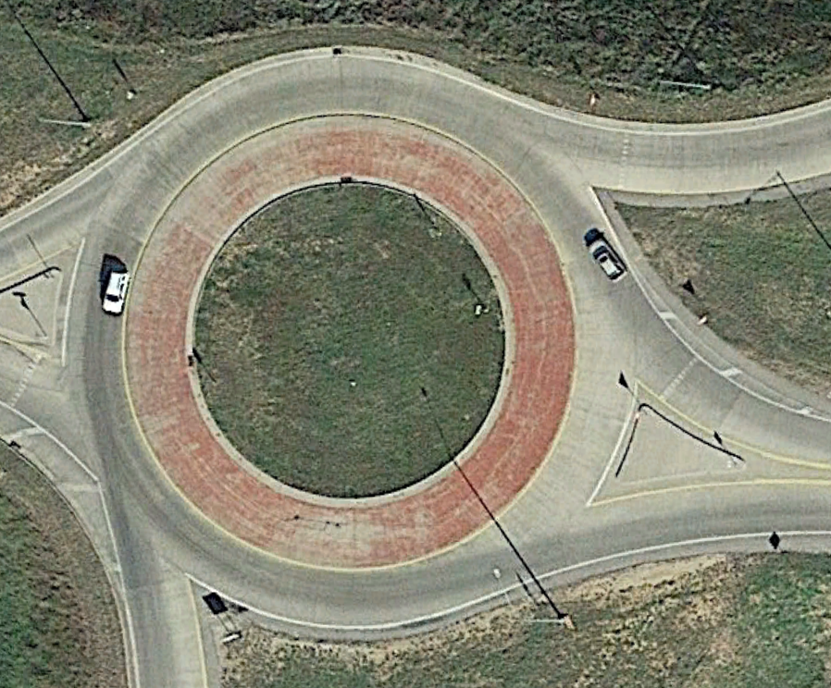
Time Bradley Way/Roundabout = $530K
1. S&T paying from general operating funds $260,898 for street lighting and irrigation on Tim Bradley Way (University Dr)
2. S&T paying from general operating funds $269,778 for roundabout aesthetics:

Slide 70
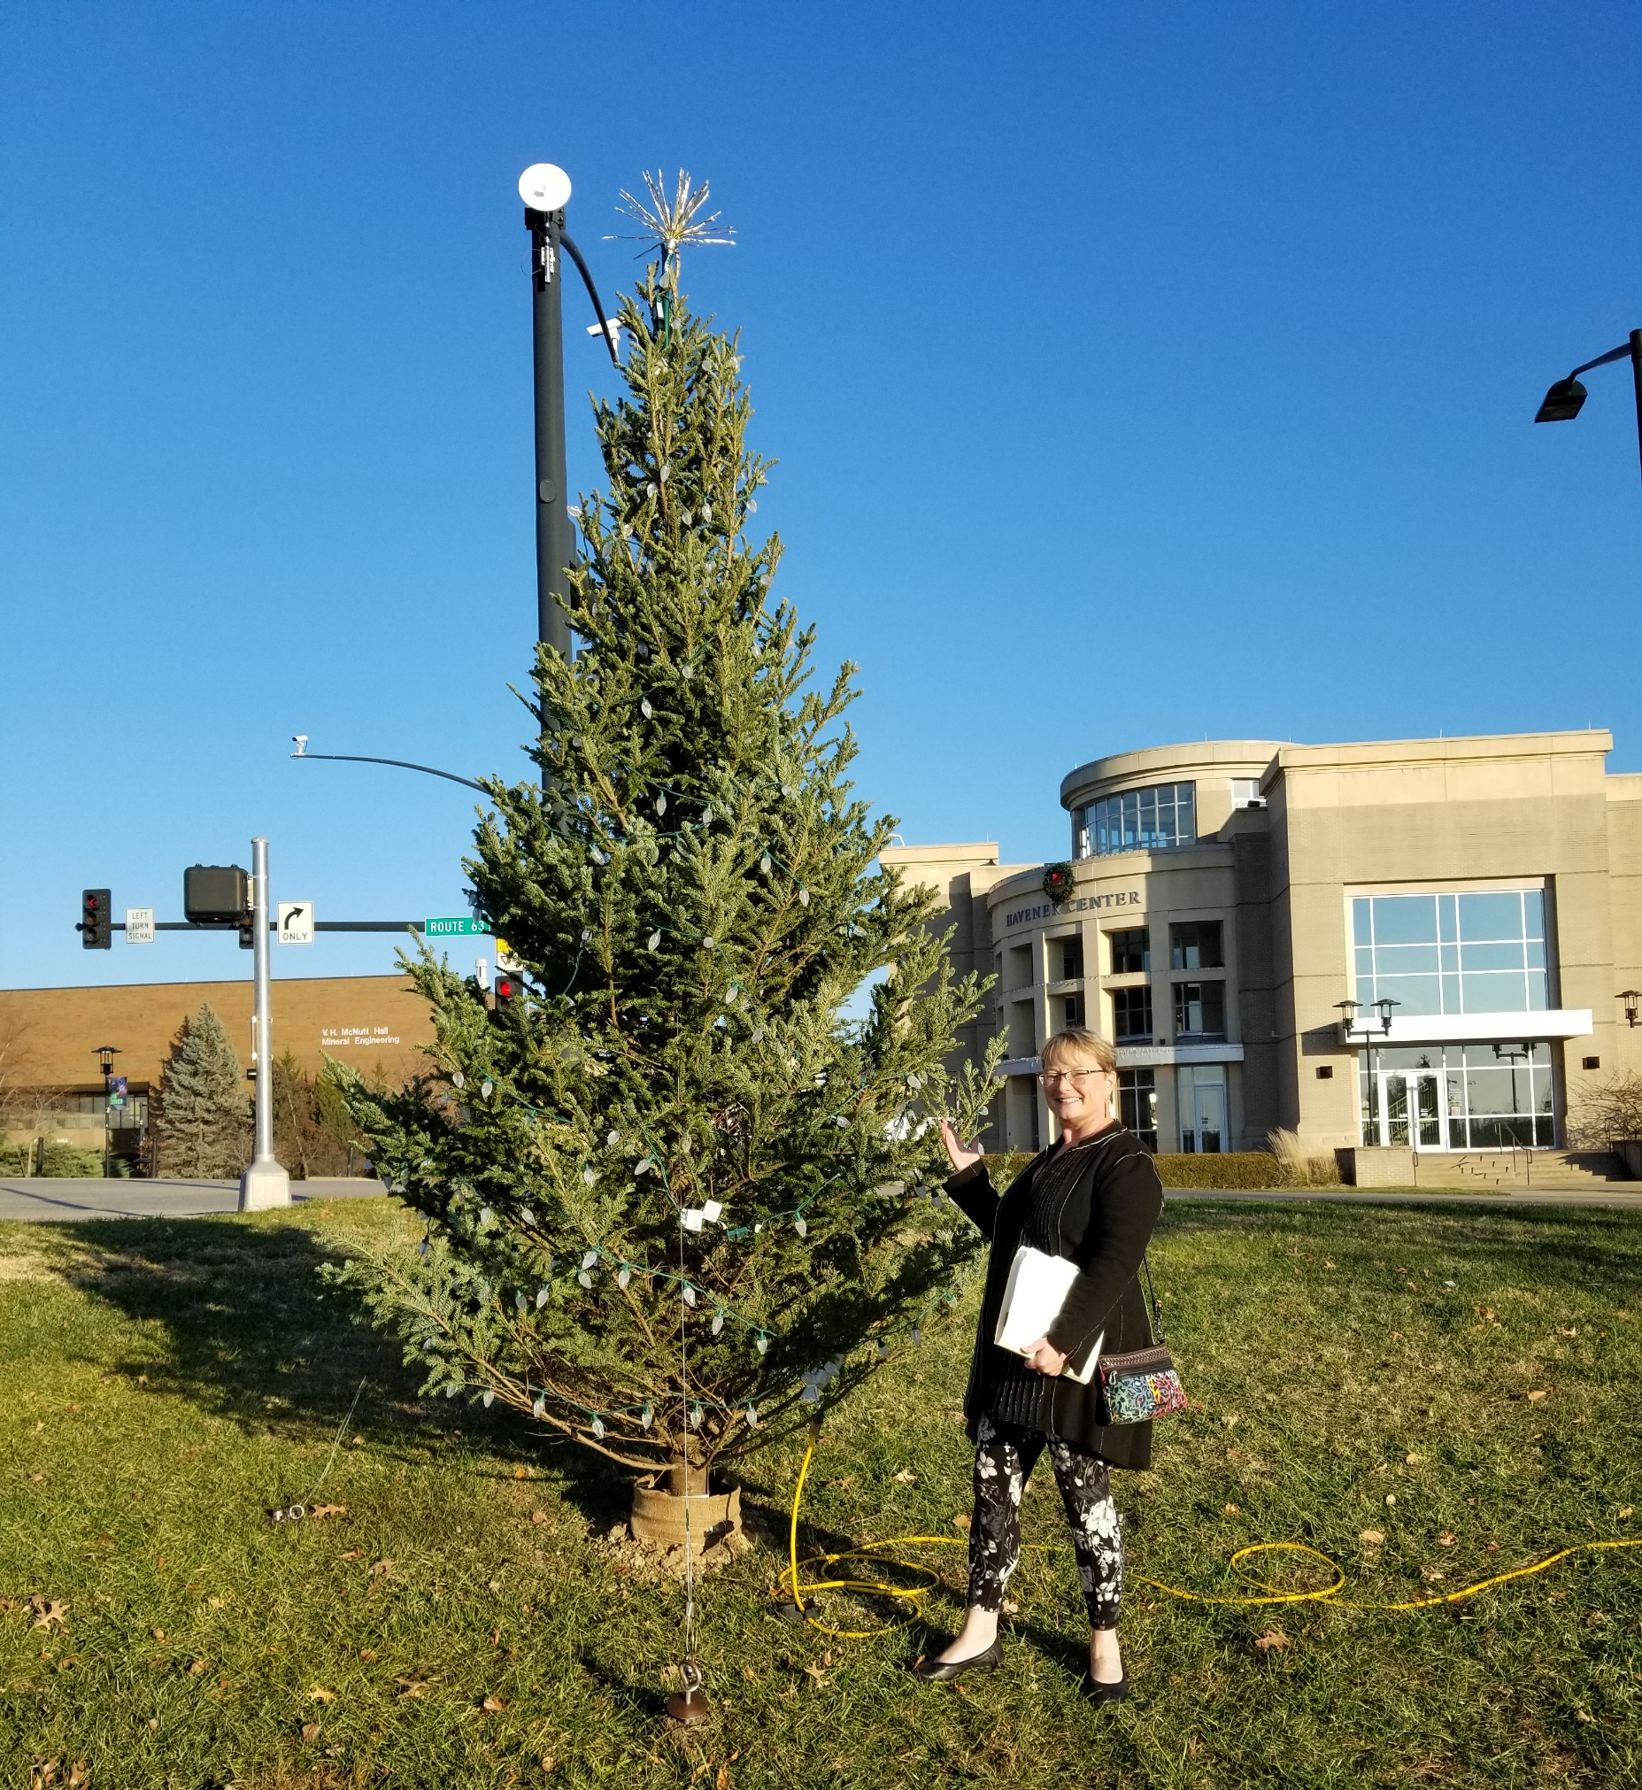
O, Christmas Tree
$925 from Chancellor’s unrestricted gift funds for 18-foot live tree (now dead and gone)
Lights for tree in front of Parker Hall, Havener, this tree, and others total cost $4900 , will be reused.

Slide 71
Budget = negligible change
Current FY budget
Enrollment revenue $820k below budgeted
$2.2 million deficit = $1 million enrollment contingency, $1.35 million from unallocated State appropriation we expected to be withheld but hasn’t been
FY 2023 planning
Governor recommended increase 5.9% = $2.92 million (with 1.35 MM used for shortfall current year = $4.27 MM increase)
Tuition increase of 3-5% expected; student count slight increase expected
7.5% inflation in past year
Governor pushing 5.5% salary increase and $15/hr minimum wage; meeting $15/hr cost = $4.5-5 M (20% of workforce is below $15/hr)
S&T no cost of living raises, only merit and targeted market/equity
IT and OSP targeted for investments

Slide 72
Budget = negligible change
Current FY budget
Enrollment revenue $820k below budgeted
$2.2 million deficit = $1 million enrollment contingency, $1.35 million from unallocated State appropriation we expected to be withheld but hasn’t been
FY 2023 planning
Governor recommended increase 5.9% = $2.92 million (with 1.35 MM used for shortfall current year = $4.27 MM increase)
Tuition increase of 3-5% expected; student count slight increase expected
7.5% inflation in past year
Governor pushing 5.5% salary increase and $15/hr minimum wage; meeting $15/hr cost = $4.5-5 M (20% of workforce is below $15/hr)
S&T no cost of living raises, only merit and targeted market/equity
IT and OSP targeted for investments

Slide 73
Agenda
VIII. Unfinished Business

Slide 74
Agenda
New Business A. Curricula Revisions for CEC Direct Admissions
B. RP&A Referral: St. Louis Graduate Programs
74

Slide 75
Agenda
X. Adjourn
75

