Slide 1
Faculty Senate Meeting
March 24, 2022

Slide 2
Meeting procedure
The same rules apply over virtual meetings as over in-person meetings
Only Senators may debate motions
Only Senators can vote
If you are not a Senator, or a proxy, you cannot vote or debate
Do not speak over someone, or out of order
  Raise your hand within the Zoom app
  The President will call on you and then you will have the floor
Unless you have been recognized (been told you have the floor), you may not speak
Per Robert’s Rules, each Senator is entitled to only speak twice on each motion.

Slide 3
Meeting Minutes
Robert's Rules of Order say that meeting minutes are simply a summary of what happened at the meeting.
They are not a play by play of everything that happened or what members said.
We will be using Robert's Rules to guide our recording of minutes.
If needed, Faculty Senators may request access to the audio recording of the meeting. Please email facsenate@mst.edu with justification.

Slide 4
Agenda
Call to Order and Roll Call
D. Westenberg, Secretary

Slide 5
Agenda
Approval of Minutes
February 17, 2022

Slide 6
Agenda
III. President’s Report
K. Homan

Slide 7
President’s Report: UM System
IFC (Intercampus Faculty Cabinet): 04 Mar 2022 Mtg (Zoom)
  Shared Governance WG – draft survey has been piloted with limited pool on each of the four campuses. White paper in preparation.
  UM-system IT
    Admin rights implementation – campus driven.
    Email inbox – purge for age > 5 years. Nominally scheduled for June 2022. How-to details will soon be provided by campus IT for preserving messages.
    Not an IT decision, either at campus or at system level.
    ITCC report will include additional details.

Slide 8
President’s Report: S&T Campus
Missouri Board of Curators meeting on campus 21 April 2022.
  Faculty Senate officers organizing student luncheon with Curators
  Thank you to those who have provided names of student participants.
April 25 Faculty Senate Meeting
  Annual Elections meeting – Senators in person
  Special Topic: Campus IT and Computing (D. Tang)

Slide 9
President’s Report: Faculty Senate
Ad-Hoc Committee on Assessment of Campus Climate
  Initial announcement of effort at Jan Faculty Senate Mtg
  Survey has now been reviewed and revised by the Ad-Hoc Cmte, by Faculty Senate Personnel Cmte and by Staff Council.
  Both Personnel Cmte and Staff Council endorse in current form.
  Provost and Chancellor have been fully supportive from the start.
  Motion to implement, by RP&A, on today’s agenda.
  Critical: minimal changes to the validated sections to allow for meaningful analysis of initial survey results.
  Fundamental intent: provide Faculty Senate with accurate view of the local S&T work climate as perceived by faculty and staff.

Slide 10
President’s Report: Faculty Senate
Graduate, Distance and Continuing education (GDCe) Cmte
  Arose out of resolution from Graduate Faculty Council
  Intent: provide direct mechanism for closer coordination between Faculty Senate and Graduate Faculty Council, including attention to matters that straddle the two bodies.
  Proposal: institute as a Standing Committee of Faculty Senate.
  Supported by leadership of Faculty Senate and Graduate Faculty Council, as well as Provost and Chancellor.
  Further details provided in the attachment provided to Faculty Senate via email of 23 Mar 2022 (ProposedGDCeCmte.pdf).
  Motion expected in April Meeting of Faculty Senate.

Slide 11
President’s Report: Faculty Senate
Direct Admissions Working Group
  Initiated in coordination with, and support of, Provost.
  Charge: identify policy and process changes necessary to implement the new direct admission model in CEC.
  Based on recognition that impacts extend across colleges and administrative units.
  WG Lead: Steve Raper (EngMgmt)
  Contact Steve Raper if interested in participating, or if you have specific issues that will need to be addressed.

Slide 12
President’s Report: Faculty Senate
Referral: Graduate offerings in St. Louis
  Referral asked if the offerings comprised new programs.
  Tasked to Steve Raper as Campus Curriculum Cmte (CCC) chair.
  Finding: the planned offerings are part of existing programs.
  The finding was communicated to the referral source and accepted.
CET is implementing revised instrument for Spring 2022 administration and developing resources for multi-modal evaluation.
Administrative Review Surveys
  Surveys close tomorrow, March 25, at 11:50pm.
  As of Tuesday, responses less than 75 for any individual position.

Slide 13
Agenda
IV. Administrative Reports
A. Chancellor’s Report
M. Dehghani

Slide 14
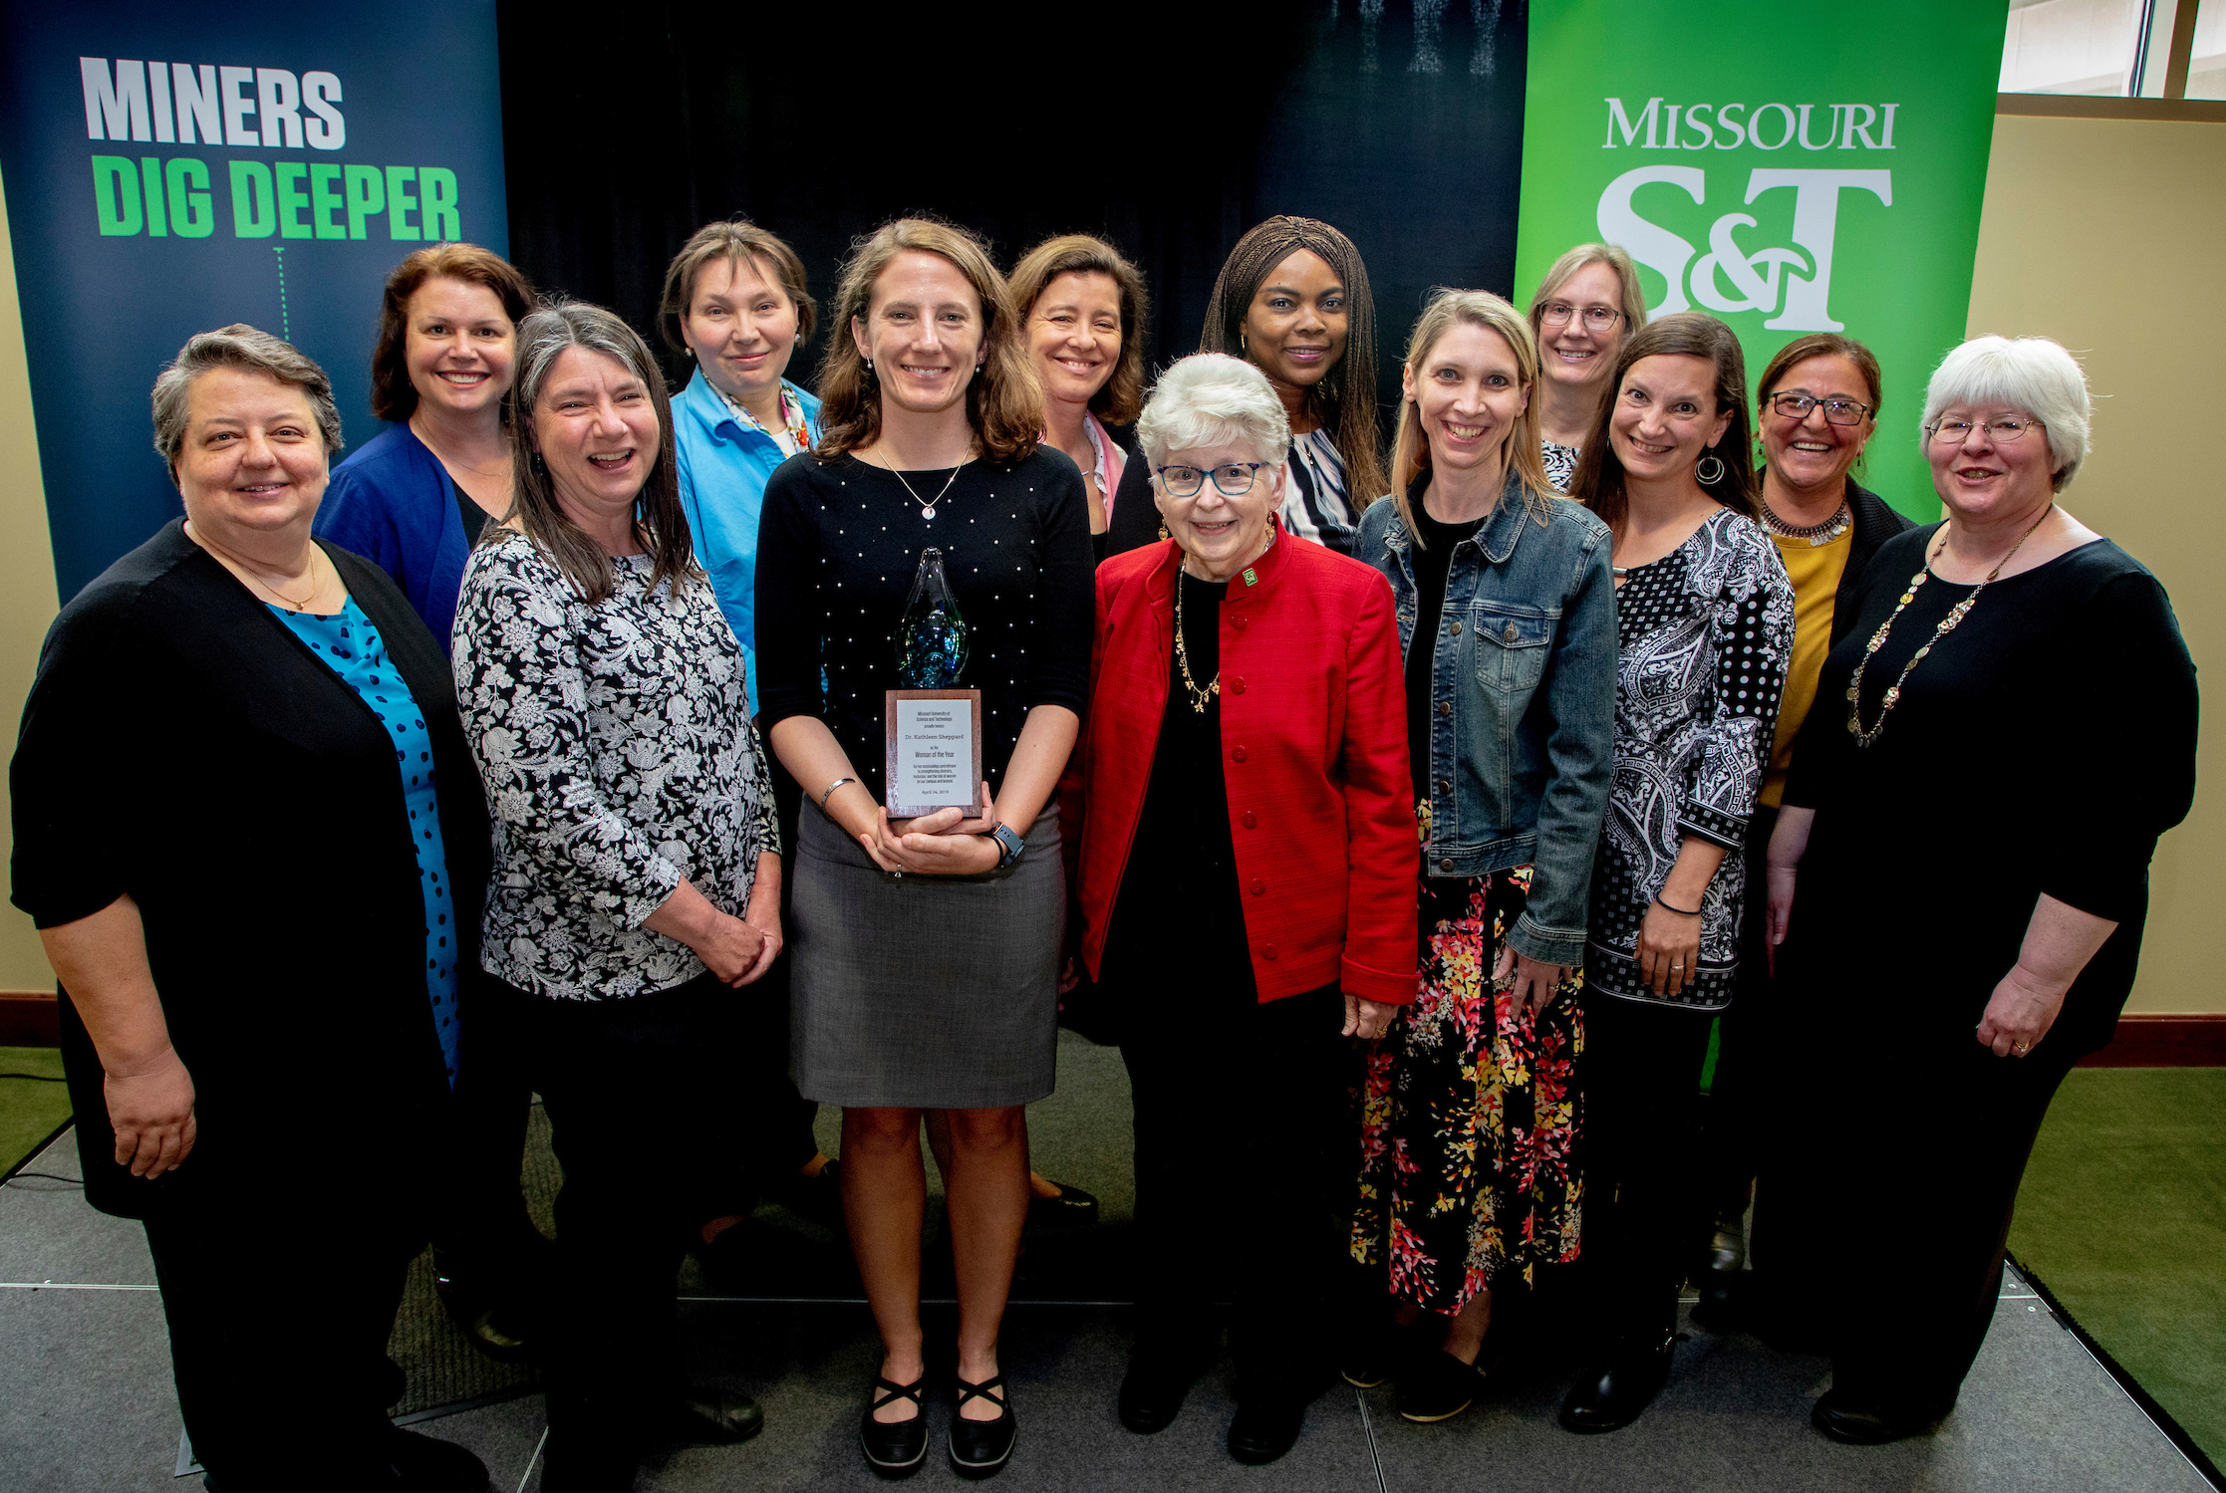
We’re returning to in-person events; 2019 was the last time many of these upcoming events were held in person on campus!
Board of Trustees, April 7
Academies meetings, April 7-8
Miner Alumni Association Board, April 9
Board of Curators, April 21
Woman of the Year and Women’s Advocate of the Year Luncheon, April 27
Kummer Institute Board of Directors, May 6
2019 Woman of the Year Kate Sheppard with previous Woman of the Year awardees

Slide 15
New tuition and fee models for the UM System universities will be presented at the Board of Curators meeting next month.
Primary Drivers
Student-friendly
  Transparent and predictable cost
  Easy to understand student bill
  Provide opportunity to reduce cost with faster graduation
    Encourage students to enroll in full course loads
    Improve retention, time to graduation and graduation rates
Long-term financial stability for S&T
  New model provides greater flexibility to adjust rates due to market conditions

Slide 16
New tuition and fee models for the UM System universities will be presented at the Board of Curators meeting next month.
New structure would take effect Fall 2023
Move from base tuition plus course fees to a differential tuition approach by program
Undergraduate
  Plateau rate for 12-18 hours per semester
  Three tiers
    Tier 1a – First-year rate
    Tier 1b – Humanities/Math/Education/Psychology (same cost as Tier 1a)
    Tier 2 – Laboratory Sciences/Business/IST/Economics/Engineering Management
    Tier 3 – Engineering/Computing
Graduate
  Program tiers will align with current course fees
  No plateau

Slide 17
Current Structure (per SCH)
 | Fall 2021
Undergraduate
Resident | $ 316.40
NonResident | $ 985.00
Supplemental Fees
Engineering & Computing | $ 226.30
Sciences | $ 225.50
Business | $ 109.40
IT Fee | $ 16.20

Slide 18
Proposed New Structure – Fall 2023
Undergraduate Resident Rates
Tier | Plateau Rate (12-18 SCH) | Cost/hour 15hr Load | Per Hr Under/Over Plateau
Tier 1 – Freshmen/ Humanities/Math/Education/Psychology | $6,500 | $433 | $542
Tier 2 - Laboratory Sciences/Business/IST/Econ/ Engr Mgmt | $7,500 | $500 | $625
Tier 3 – Engineering & Computing | $8,400 | $560 | $700

Slide 19
Proposed New Structure – Fall 2023
Undergraduate Non-Resident Rates
Tier | Plateau Rate (12-18 SCH) | Cost/SCH 15hr Load | Per Credit Hr Under/Over Plateau
Tier 1 – Freshmen/ Humanities/Math/ Education/Psychology | $14,300 | $953 | $1,192
Tier 2 – Laboratory Sciences/ Business/IST/Econ/Engr Mgmt | $15,300 | $1,020 | $1,275
Tier 3 – Engineering & Computing | $16,200 | $1,080 | $1,350

Slide 20
Graduate Tuition – Fall 2023
  Program tiers will align with current course fees

Slide 21
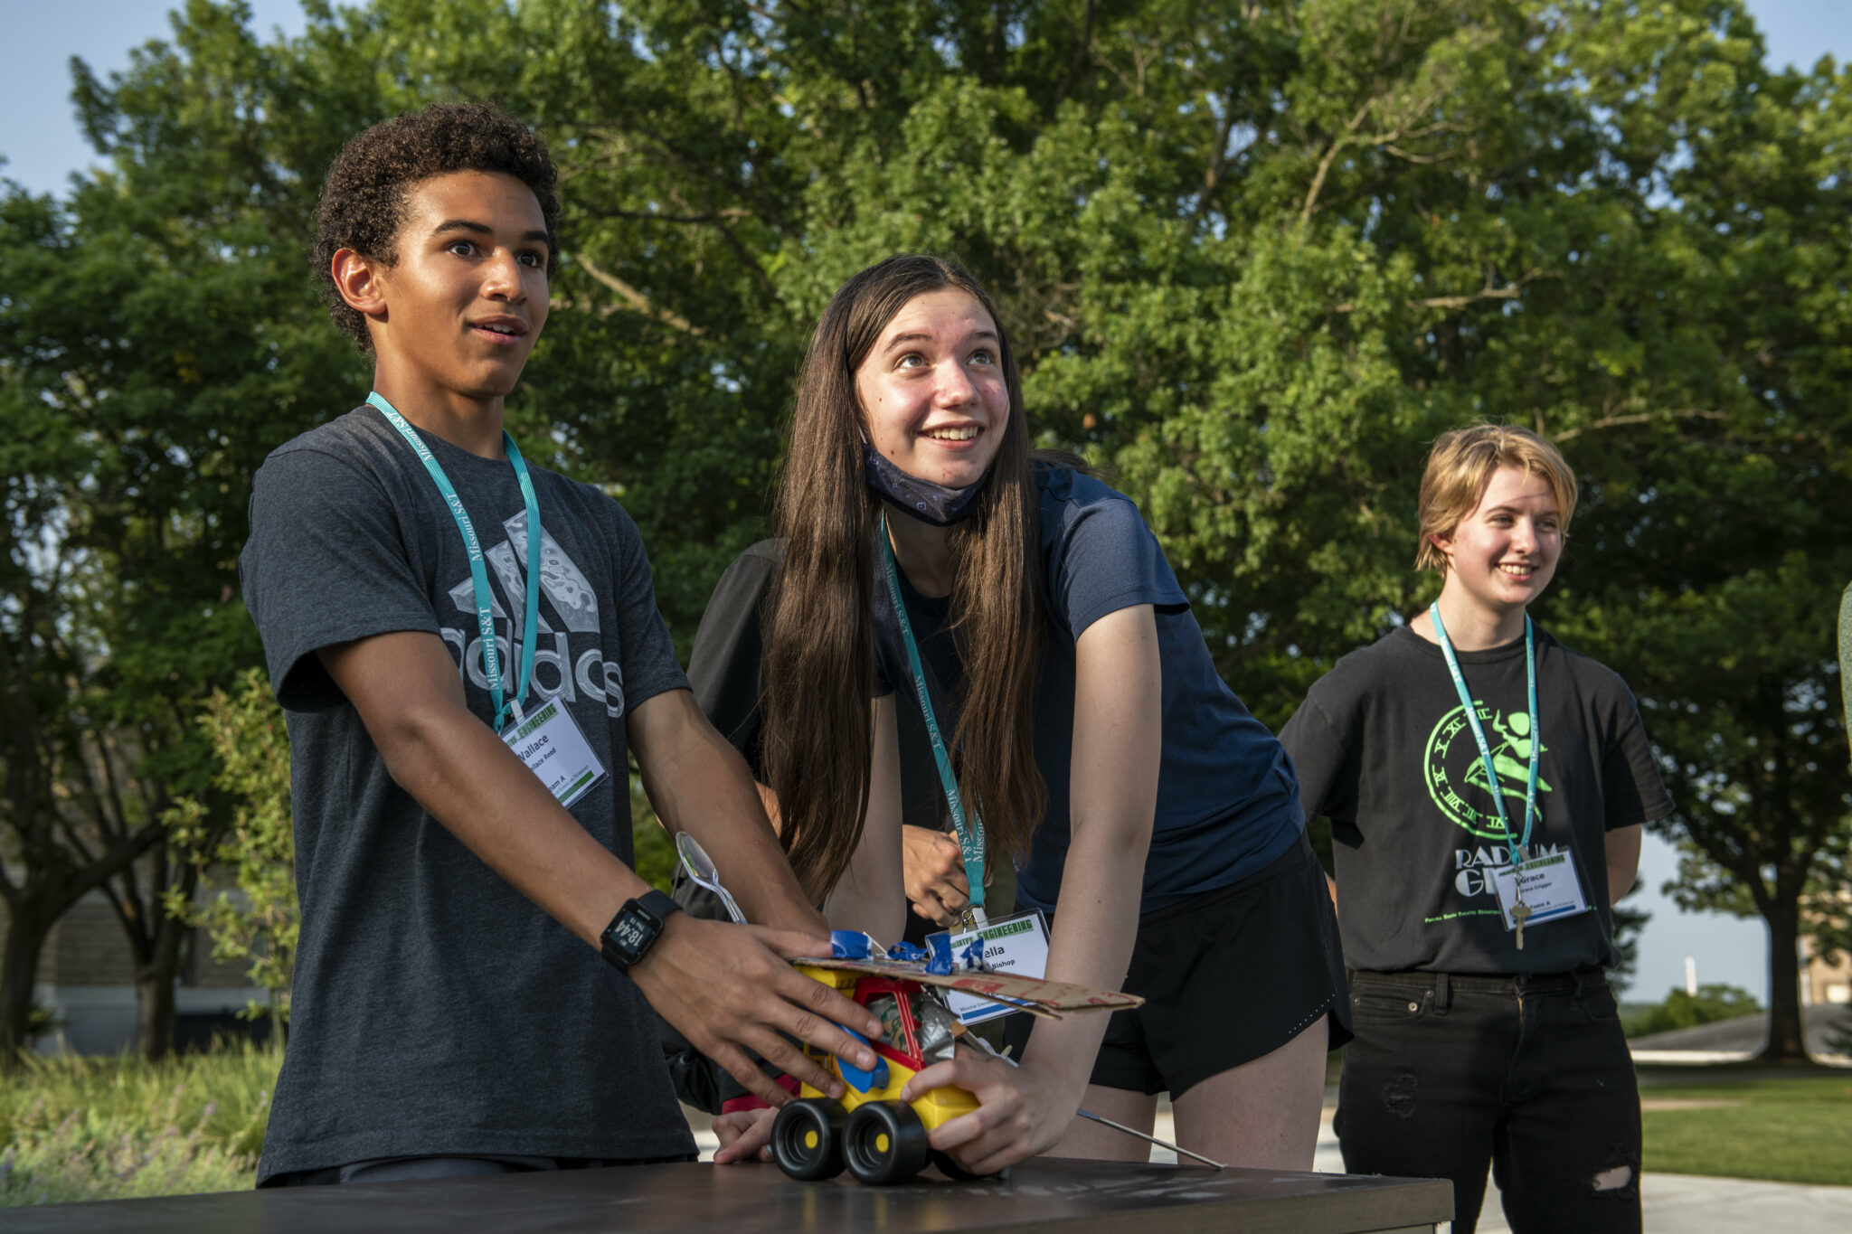
Our summer camps will return to in-person and full capacity camps for students in grades 5-12
Aerospace
Art of Science
CyberMiner
Exploring Materials in Your World
Explosives
Formula SAE Electric Car
Jackling Introduction to Engineering
Nuclear Engineering
Robotics
Space – The Final Frontier

Slide 22
Thank you!
Questions?

Slide 23
Agenda
IV. Administrative Reports
B. Provost’s Report
C. Potts

Slide 24
Notable Faculty Achievements
Dr. Leslie Gertsch, associate professor of geological engineering, will lead a team in a NASA research project to extract minerals from lunar soil for manufacturing. Missouri S&T is one of three universities chosen for different aspects of the project to make it possible for people to live on the Moon.
Dr. Anthony Convertine, the Roberta and G. Robert Couch Assistant Professor of Materials Science and Engineering, has been elected to the National Academy of Inventors (NAI) 2022 class of senior members in recognition of his work in biomedicine and biomaterials.
2019, 2020, 2021 Fourteen Teaching eFellows recognized at Innovation in Teaching and Learning conference last week.

Slide 25
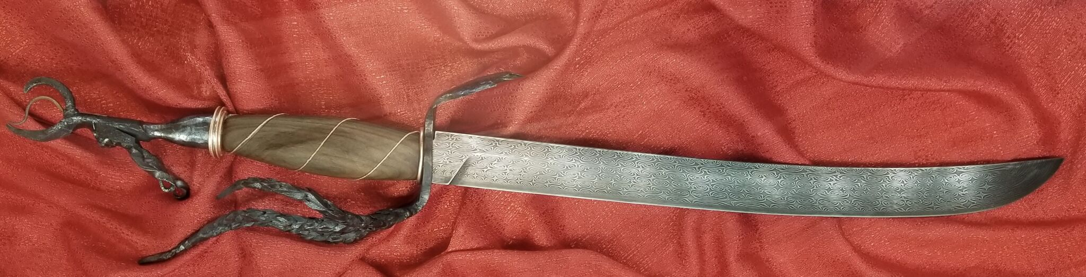
Notable Student Achievements
    The Minerals, Metals & Materials Society annual Bladesmithing competition. S&T's Bladesmithing team advised by Joe Newkirk won the Grand Prize at Bladesmithing 2022 held by The Minerals, Metals, and Materials Society.
    Army ROTC Stonehenge Batallion. Army Ranger Challenger team (rifle marksmanship, land navigation, emergency medical treatment, and counter improvised explosive devices, etc.) placed second in this year’s regional competition; the 10-member team will head to the Sandhurst Military Skills Competition at the U.S. Military Academy at West Point, New York, to compete during the week of April 25-29, 2022.

Slide 26
Ongoing Searches
CASE Dean: Two finalists interviewed, third withdrew
KC Dean: Four finalists to be interviewed, one withdrew
CEC Dean: Several finalists to be interviewed
Math chair: Dr. Xiaoming Wang appointed (SUSTech, ex-FSU)
CompSci & Econ chairs: Finalists interviewed. Should make offers soon
BIT, NERS chairs: Suspended, but promising leads being followed

Slide 27
Reorganizations and Relocations
Admissions departments and VP Enrollment Management have moved to Centennial Hall; Admissions Visit Center in G-8 Norwood Hall
Jeanie Hofer (International Affairs is moving to Development). Susan Potrafka and Amy Gillman are joint interims for the operational and strategic aspects of IA.
(DS -2019 processing for China scholars is curtailed)
Institutional Research & Data Management has moved to Technology Development Center
Announcements for searches for organization of Student Success, CAFÉ, IA forthcoming
We are addressing the challenge of retaining and hiring staff.
Thanks to Kathy Northcut, Irina Ivliyeva and Jeanie Hofer for service

Slide 28
Agenda
V. Campus Reports
  A. Staff Council
  M. Fowler

Slide 29
Staff Council
Spring Staff Appreciation Day
  “Chillin’ and Grillin’
  Cornhole Tournament
  May 25, 2022
Additional Requests
  Volunteers needed to serve on Staff Excellence Awards Review Committee
  Volunteers for Staff Appreciation Day
    Serve Lunch
    Auctioneer
    Email circulated requesting department/center participation in Staff Day events
      Raffle Basket donation, Opening Ceremony Video, Scavenger Hunt

Slide 30
Agenda
V. Campus Reports
  B. Student Council
  A. Aiken

Slide 31
Agenda
V. Campus Reports
  C. Council of Graduate Students
  M. Nabi

Slide 32
Agenda
Special Topic
Graduate Education
C. Tsatsoulis

Slide 33
VISION
Missouri S&T will redefine the purpose and value of graduate education in STEM and STEM-adjacent fields, and will be recognized as a world leader in graduate education with a top return on student investment.

Slide 34
STRATEGIC GOALS
Grow our graduate student population to 4000
Serve our research mission by growing our PhD numbers to 900
Make progress towards R1 by growing our STEM PhD graduates and by introducing non-STEM doctoral degrees
Serve the needs of the region and the State
Grow S&T’s reach to the whole nation through distance learning
Positively impact our financial bottom line

Slide 35
PHILOSOPHY
In partnership with the Provost, deans, chairs, faculty, and other leaders across campus, the Vice Provost will reimagine the future of graduate and professional education at S&T
The Vice Provost will assist in the alignment of resources with evidence of demand
The Vice Provost will work closely with deans, department chairs, and other leaders across campus to:
  strengthen existing graduate and professional programs
  grow new ones that are academically excellent and financially sustainable
  evaluate our emphasis on continuing students and cater to non-traditional populations
Enhance graduate student success, research priorities, and well-being

Slide 36
New Degree Programs
Hold planning and decision making workshop to determine new graduate programs
Attract new on-campus and distance students
Engage Deans, Chairs, faculty, major corporate partners, and Missouri On-Line,
    What programs, at what level (MS, PM, cert, etc.), to what audience, through what delivery method
Continue work on new degrees already identified through KC, CASE, CEC

Slide 37
Growth in Doctoral Degrees
Current research volume will not accommodate an additional 300-400 GRAs
    Double research expenditures
    Priority with Advancement to raise Fellowship funds through philanthropy
    NSF GRF, GAAN, SMART, etc. must be pursued aggressively
    Faculty commitment to use KDF to add 100 PhD students

Slide 38
Growth in Master Programs
Reach 3+2 agreements with bachelor degree-offering institutions. Create 3+2 agreements to offer the students a S&T MS
Introduce professional Master degrees in the sciences, humanities, and social sciences
Shift to greater focus on on-line education
    Missouri On-Line has identified existing programs to market
    Guiding Principles for Distance Education generated

Slide 39
Retention
Aggressively address issues identified in recent graduate student survey
  Committee changes
  Bill of Rights
  Timely tuition and stipend payments
Identify impediments to timely graduation and reasons for drop-outs
    Especially for certificate and distance students
    Drop/revise policies that delay graduation or inhibit student flexibility

Slide 40
RETENTION ACTIONS
Immediate/On-going Actions
    Annual Evaluation of graduate students – Ensure retention and timely graduation
    Graduate Council to address student concerns by April

Slide 41
RETENTION ACTIONS
Longer-Term Actions
    Working group to :
      identify bottlenecks to timely graduation and retention
      review current graduate policies, processes, and practices (admission, on-boarding, pay, milestones, requirements, learning objectives, professional development, etc.)

Slide 42
Reactions and Feedback

Slide 43
Agenda
VII. Reports of Standing Committees
A. Public Occasions
S. Sedigh-Sarvestani

Slide 44
Public Occasions Committee Report
Dr. Sahra Sedigh Sarvestani, Chair
Changes to academic calendar for 2022-2023
  Addition of a separate PhD commencement (Fall and Spring)
  Removal of Transfer Transitions
  Postponement of Fall Break by one week

Slide 45
FALL SEMESTER 2022
International Student Orientation August 9, Tuesday
Freshman Orientation Begins August 15, Monday
Transfer Transitions August 18, Thursday
New Graduate Student Orientation August 19, Friday
Open Registration Ends August 21, Sunday
Fall semester opens 8:00 am August 22, Monday
Classwork begins 8:00 am August 22, Monday
Labor Day Holiday September 5, Monday
Career Fair September 27, Tuesday
Fall Break Begins 8:00 am September 29, Thursday
Fall Break Begins 8:00 am October 6, Thursday
Fall Break Ends 8:00 am October 3, Monday
Fall Break Ends 8:00 am October 10, Monday
Mid-Semester October 15, Saturday
Thanksgiving vacation begins 8:00 am November 20, Sunday
Thanksgiving vacation ends 8:00 am November 28, Monday
Last Class Day December 9, Friday
Final Examinations begin 7:30 am December 12, Monday
Final Examinations end 5:00 pm December 16, Friday
December Commencement – 6:00 pm December 16, Friday
PhD Degrees in all Departments
December Commencement – 10:00 am December 17, Saturday
Graduate and Undergraduate Degrees in Designated Departments
December Commencement – 3:30 pm December 17, Saturday
Graduate and Undergraduate Degrees in Designated Departments

Slide 46
SPRING SEMESTER 2023
International Student Orientation January 9, Monday
New Graduate Student Orientation January 13, Friday
Open Registration Ends January 16, Monday
Martin Luther King, Jr. Recognition Holiday January 16, Monday
Spring semester opens 8:00 am January 17, Tuesday
Classwork begins 8:00 am January 17, Tuesday
Career Fair February 21, Tuesday
Spring Recess begins 8:00 am March 16, Thursday
Mid-Semester March 18, Saturday
Spring Recess ends 8:00 am March 20, Monday
Spring Break begins 8:00 am March 26, Sunday
Spring Break ends 8:00 am April 3, Monday
Last Class Day May 5, Friday
Final Examinations begin 7:30 am May 8, Monday
Final Examinations end 5:00 pm May 12, Friday
Spring Semester closes 6:00 pm May 12, Friday
May Commencement – 6:00 pm May 12, Friday
PhD Degrees in all Departments
May Commencement – 10:00 am May 13, Saturday
Graduate and Undergraduate Degrees in Designated Departments
May Commencement – 3:30 pm May 13, Saturday
Graduate and Undergraduate Degrees in Designated Departments

Slide 47
Agenda
VI. Reports of Standing Committees
B. Campus Curricula
S. Raper

Slide 48
Campus Curricula Committee Report
24 March 2022
CCC Meeting
-01 March 2022
Total Committee Activity
  6 Course Change Requests (CC Forms)
  8 Program Change Form (PC Forms)
  2 Experimental Course Requests (EC Form)

Slide 49
Campus Curricula Committee Report
24 March 2022
Course Changes (CC) Requested
File: 4851 BIO SCI 3363 : Ecophysiology
File: 1741.5 COMP SCI 6600 : Formal Methods in Computer Security
File: 4861 HISTORY 4792 : Historical Representation in Video Games
File: 4846 PET ENG 6801 : Advanced Petroleum Data Analytics
File: 1300.1 PHYSICS 4333 : Nuclear and Particle Physics
File: 4854 PHYSICS 4343 : Atomic Physics

Slide 50
Campus Curricula Committee Report
24 March 2022
Program Changes (PC) Requested
File: 143.36 ARC ENG-BS : Architectural Engineering BS
File: 150.88 CH ENG-BS : Chemical Engineering BS
File: 149.28 CR ENG-BS : Ceramic Engineering BS
File: 344.23 EDUC-BS : Education BS
File: 44.34 ENG MG-BS : Engineering Management BS
File: 90.33 MT ENG-BS : Metallurgical Engineering BS
File: 115.49 PHYSIC-BS : Physics BS
File: 122.8 PRE MBA-MI : Pre MBA Minor

Slide 51
Campus Curricula Committee Report
24 March 2022
  For Informational Purposes; No Senate Approval Required
  Experimental Courses (EC) Requested
File: 4850 COMP SCI 5001.014 : Probability and Its Applications in Computing
File: 4852 ERP 4001.001 : Introduction to Enterprise Resource Planning (ERP) Software Development

Slide 52
Campus Curricula Committee Report
20 January 2022
Curriculum committee moves for FS to approve the 6 CC and 8 PC form actions.
Discussion: Questions or comments?

Slide 53
Agenda
VII. Reports of Standing Committees
C. Rules, Procedure & Agenda
K. Homan

Slide 54
RP&A Committee Report: FS Climate Survey
Annual S&T Faculty-Staff Climate Survey
Motion.
The Faculty Senate hereby authorizes the annual administration of a validated
climate survey, with participation by faculty and staff, to assess the Missouri
S&T campus work environment. The administration of the survey and the
summary of its results are assigned to the Faculty Senate Personnel Committee.
Survey Design.
  Less than 15m to complete full survey.
  Two-week participation window at end of April.
  Results analyzed and to be presented to Senate (and Staff Council) at June Meetings.
  Composed of validated sections from published literature and a closing open-ended question section.
Motivation: provide Faculty Senate with accurate view of the local S&T work climate as perceived by faculty and staff, as well as to provide mechanism for actionable suggestions.

Slide 55
Agenda
VII. Reports of Standing Committees
D. Budgetary Affairs
M. Fitch

Slide 56
Budgetary Affairs Committee
Mar 24, 2022
Referrals
Snake Invasion Grass Costs
Kummer Foundation/Institute spending (April)
Continuing referrals:
Report on the “big picture balance sheet”
Current and next FY budget
Just because
MU “to increase faculty salary over the next five years by $500 million.”

Slide 57
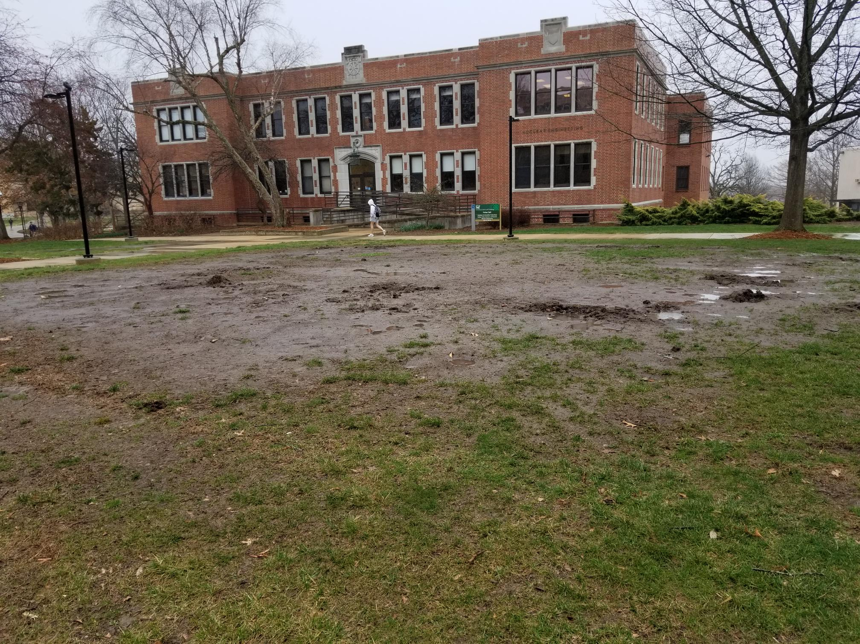
Snake Pit
Contractor seed and straw:
$2000
Plan to ask St. Pats Board to contribute

Slide 58
Budget this year (little change)
Current FY budget
Enrollment revenue $820k below budgeted
$2.2 million deficit = $1 million enrollment contingency, $1.35 million from unallocated State appropriation we expected to be withheld but hasn’t been

Slide 59
Budget next year
Revenue
Governor recommended 5.4% = $2.92 million (+ $1.35 million used for shortfall current year = $4.27 million increase)
Tuition increase of 3-5% expected; student count slight increase expected
Revenue increase of ~4% likely
Costs
Significant inflation continues
Faculty and Staff
  Staff have high turnover rates and long fill times (e.g. $11.50/hr with benefits, or Dairy Queen at $14/hr?)
  Governor pushing 5.5% State salary increase, but not explicitly for universities
  Governor also pushing $15/hr minimum wage; 20% of S&T workforce is below $15/hr. Meeting $15/hr cost > revenue gain, gradual increase planned
  S&T no cost-of-living raises, only merit and targeted market/equity
IT and OSP targeted for investments

Slide 60
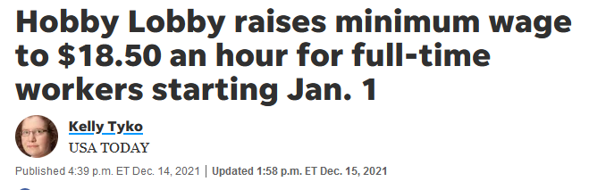
Staff salaries
Staff
Salary pool last year 1%; Faculty 1.5%, “executive” level 20% [BAC January report].
20% of staff below $15/hr, some below $12/hr.
Budgetary Affairs suggested
Top administrative salary increases at zero,
Faculty salary tale lower salary increases,
that staff may have more significant increase

Slide 61
Chancellor positions
From January Report
Position | AY 21-22 |  | AY 20-21 |  | AY 19-20 |  | AY 18-19
Chancellor | Dehghani | +15% | Dehghani | +11% | Dehghani | +39% | Maples | +1.8%
Provost | Potts | +41.2 | Roberts | +1.7 | Roberts | +20 | Marley | -0.66
VC R | Khayat | +18.3 | Tsatsoulis |  | Tsatsoulis | +1.7 | Tsatsoulis | +30.50
VC Adv | Nesbitt¹ | +3.7 | Nesbitt |  | Nesbitt | +1.9 | Nesbitt | +4.92
VC F&O | O’Neil | +7.0 | Plain |  | Plain | +1.3 | Plain | +1.75
VC SA | Robinson | +2.9 | Robinson |  | Robinson | +2.1 | Robinson | +1.5
VC (KI) | Roberts | +100
CDO | Rivera² | -20.6 | Rivera²/Outar | -9.0 | Outar | +23.6 | Outar* | +1.16
CIO | Tang | +9.4 | Bookout | +9.4 | Bookout | -7.4 | Uetrecht | +1.93
aVC | Careaga | +15 | Careaga | +16.1 | Careaga | +3.7 | Careaga | +4.77
SUM | $2,565,181 | +28.8 | $2,000,622 | +3.5 | $1,933,128 | +7.5 | $1,797,679 | +5.7
¹Departure announced
²Not official title; official title Director II

Slide 62
Provost positions
From January Report
Position | AY 21-22 |  | AY 20-21 |  | AY 19-20 |  | AY 18-19
Provost | Potts | +41.2 | Roberts | +1.7 | Roberts | +20 | Marley
CEC Dean | Wlezien |  | Wlezien |  | Wlezien | +1.0 | Wlezien
CASB Dean | Drowne | +0.5 | Drowne |  | Drowne | -1.6 | Roberts
Dep Prov^{a,b} | Brow | +0.9 | Brow | +2.6 | Brow | +100
VP Enroll | Sivadasan | +2.1 | Sivadasan |  | Sivadasan | +36.6 | Albers
VP Acad | Northcut | +1.6 | Northcut |  | Northcut | -21 | Cawlfield
VP | Concepcion | +100
VP DGS | Tsatsoulis | +100
VP Int’l Af | Hofer | +0.6 | Hofer |  | Hofer | +1.5 | Hofer
AP Admin |  | -100 | Moore |  | Moore | +5.0 | Moore
AP Fac Af^{a,b} | Forciniti | +1.0 | Forciniti |  | Forciniti | +1.7 | Forciniti
Spec Asst^{a,b} | Stone | +1.2 | Stone | -2.3 | Stone | +136.8 | Stone
SUM | $1,919,301 | +36.1 | $1,410,250 | +0.38^{c} | $1,404,888 | +5.22 | $1,335,145
ªNot official title; official title Professor
^{b}Fractional appointment
^{c}Summer 10% cut artefact

Slide 63
MU $500 million
Reports
“committing an eye-popping $500 million toward performance-based salary increases for faculty and staff members over the next five years at the Columbia flagship.”
“committed to $500 million in faculty salary increases over 10 years.” But also “The plan includes $550 million to hire new tenured and tenure-track faculty.”
“to increase faculty salary over the next five years by $500 million.”

Slide 64
1) MU $500 MM for faculty and staff
Fiscal Year | Faculty and Staff $ | Increase % | Increase $ | Cumulative
2022 (now) | 1900 | n/a | - | -
2023 | 1995 | 5% | 95 | 95
2024 | 1995 | 0% | 0 | 190
2025 | 1995 | 0% | 0 | 285
2026 | 1995 | 0% | 0 | 370
2027 | 1995 | 0% | 0 | 465

Slide 65
2a) MU $500 MM for faculty over 10 yrs
Fiscal Year | Faculty Staff $ | Increase % | Increase $ | Cumulative
2022 (now) | 424 | n/a | - | -
2023 | 445 | 5% | 21.2 | 21.2
2024 | 452 | 1.5% | 6.7 | 49.1
2025 | 459 | 1.5% | 6.8 | 83.7
2026 | 465 | 1.5% | 6.9 | 125.3
2027 | 472 | 1.5% | 7.0 | 173.8
2028 | 479 | 1.5% | 7.1 | 229.4
2029 | 487 | 1.5% | 7.2 | 362.3
2030 | 494 | 1.5% | 7.3 | 439.8
2031 | 501 | 1.5% | 7.4 | 524.9
2032 | 509 | 1.5% | 7.5 | 617.5

Slide 66
2b) MU $550 MM new faculty 10 yrs
Fiscal Year | Faculty Staff $ | Turnover % | New $ | Cumulative
2022 (now) | 424 | n/a | - | -
2023 | 445 | 7.5% | 33.4 | 33.4
2024 | 452 | 7.5% | 33.9 | 69.8
2025 | 459 | 7.5% | 34.4 | 109.4
2026 | 465 | 7.5% | 34.9 | 152.5
2027 | 472 | 7.5% | 35.4 | 199.4
2028 | 479 | 7.5% | 35.9 | 250.2
2029 | 487 | 7.5% | 36.5 | 305.5
2030 | 494 | 7.5% | 37.1 | 365.5
2031 | 501 | 7.5% | 37.6 | 430.5
2032 | 509 | 7.5% | 38.2 | 500.9
Includes 1.5% assumed salary increases
Long-term turnover over faculty is ~ 5%

Slide 67
3) MU faculty salary increase by $500 MM
Fiscal Year | Faculty $ | Increase % | Increase $ | Cumulative
2022 (now) | 424 | n/a | - | -
2023 | 446 | 7.2% | 30.5 | 30.5
2024 | 469 | 7.2% | 32.7 | 93.8
2025 | 494 | 7.2% | 35.1 | 192.1
2026 | 519 | 7.2% | 37.6 | 328.1
2027 | 546 | 7.2% | 40.3 | 504.3

Slide 68
Agenda
VII. Reports of Standing Committees
E. Information Technology & Computing
D. Stutts

Slide 69
Issues Raised During Faculty Senate Meeting
9-23-21
Help Desk response time (medium to long-term)
Communications between Faculty and IT staff (short-term)
Integration of academic (Canvas, etc.) and IT support (?)
IT staffing (long-term)
Relocation of IT back on campus (short – med-term)
Short-term = < 3 Mos., Med-term = 3 – 6 Mos., Long-term = > 1 year

Slide 70
Issues Discussed During 10/20/2021 ITCC Meeting and Answers/Actions Proposed
Significantly increased time to respond to Help Desk tickets. Problem is due to (1) inadequate staffing, (2) non-optimal ticketing system, and (3) IT support staff not on central campus. S&T CIO is working the problem and has it as his highest priority.
Need for better communication between faculty and IT staff, and better understanding on the faculty’s part of the resource constraints imposed on IT. Need for more patience on the part of faculty while our brand new CIO works through some of the current issues. ITCC facilitate this by communicating key issues and actions through the Deans and department chairs. Other conduits will be discussed and considered.
Adequate support for research computing given that this group must now support the both Columbia and Rolla. Something to keep an eye on. May even be an opportunity for S&T. More staff would be necessary to fully support custom systems for individual PIs.
Better communication between UM system and faculty regarding software and policy changes to avoid unintended consequences affecting students, staff, and faculty. Many recent complaints concern Canvas, which falls under eLearning, and not IT. ITCC will invite UM Chief Online Learning Officer, Matthew Gunkel, to discuss this issue.
Adequate support for multiple computing platforms. One size (platform) does not fit all faculty. Windows, Mac, and Linux/Unix. More support will be available as IT staffing resources allow. Multi-platform support is a recognized area of concern but need to improve overall IT support first (see #1).
Faculty desktop enhancement policy: pennywise, pound foolish? The new faculty desktop enhancement program allows replacement every four years, and approximately doubles the amount contributed to the cost by IT.

Slide 71
Update from Danny on his/our progress towards IT goals and problem solutions
Progress is being made but not as swiftly as desired – in part due to institutional red tape, funding, etc.
  Move IT responsibility back to the campus with assigned staff located within departments.
  S&T IT currently understaffed, but backfilling – current job openings are being aggressively filled.
  Danny is aware that service is still unsatisfactory.
  Backlog of tickets from August 2021 to date has been dramatically reduced
  New Cherwell instance form to be released April 1st should improve user experience.
  Long-term goal: each department to have dedicated IT support staff. Will move in that direction slowly if resourcing to IT increases.
  Will require multi-year process – will not be immediate.
Better communications between faculty and IT staff:
  Danny wrote five-page document which is included in current survey that highlights the issues, current progress, and what is needed.
  Danny will attend faculty meetings upon invitation to address each department’s issues.

Slide 72
Progress towards IT goals and problem solutions (continued)
Support for research computing:
  Danny will address individual concerns to the extent possible under current staffing constraints.
Better communication between UM system and faculty regarding software and policy changes to avoid unintended consequences affecting students, staff, and faculty:
  ITCC met with Matt Gunkel on November 17, where he addressed most of our concerns, and projected greater communication and coordination in the future.
    Matt has left the university, and has been replaced by Stephani McClelland; she is currently visiting with stakeholders to gather information and concerns.
    There are currently no plans to move Canvas support back locally.
Adequate support for multiple computing platforms:
  Greater support will come with increased staffing. We are currently moving in the right direction.
Faculty desktop enhancement policy:
  Unchanged since the last report, but improved from a year ago.

Slide 73
Recent Issues
Pending revocation of admin privileges on UM campuses:
  Done as part of chancellor’s group – not a system wide mandate
  Goal to reduce the vulnerability to ransomware attacks
  Chancellor’s collectively agreed to move forward to remove admin rights on machines. Chancellor Choi wanted done ASAP at Columbia – however S&T will work on own timeline
  Solution: default admin rights are not allowed; however authorization can be elevated on Windows in a manner similar to MacOS and Linux – a relatively painless process
  Tentative rollout – unit-by-unit engagement, complete by December, 22
  S&T IT recognizes that we at S&T live in “exception” zone in supporting research at high level
  We do not have discretion of WHETHER to implement
  We do have discretion of HOW to implement
  The plan is to create something that minimizes faculty burden.
  Options include: “Make-Me Admin” and Home-grown “Access Management System”
  Will select a department to pilot the solution.
  Threat profile of Linux and Mac operating systems is significantly lower at S&T

Slide 74
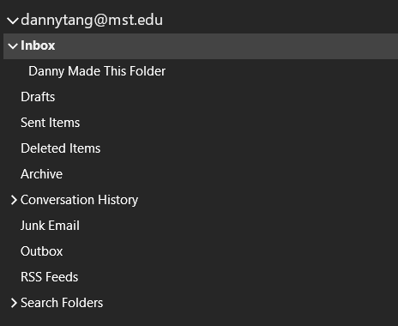
Email Sweep (Quick and Dirty slides from Danny)
Inbox will be swept.
Sent Items will be swept.
Swept = moved to Deleted Items
Anything older than 30 days removed from Deleted Items permanently. Can not be recovered.

Slide 75
Email Sweep (Quick and Dirty slides from Danny)
All other folders such as custom folders and other default folders will not be swept

Slide 76
Email Sweep (Quick and Dirty slides from Danny)
Important: Not a one-time event. This is a continual sweep. Inbox and Sent Items will be checked daily for anything older than 5 years.
Instructions on how to automate moving old mail items coming soon.
  Unfortunately, IT cannot programmatically do this for you on the back end. (We looked into it.)

Slide 77
Email Sweep (Quick and Dirty slides from Danny)
Why are we doing this?
  Compliance with UMSystem Records Retention Policy
  Records Retention Authorizations | University of Missouri System (umsystem.edu)
Does Danny agree with this? No.
  I wouldn’t choose to do this, at least not in this way.
  I would have preferred a more flexible, people centric approach.
  Decision was made Spring 2021.

Slide 78
Agenda
VIII. Unfinished Business

Slide 79
Agenda
X. Adjourn
79

