Slide 1
+/- Grading Issue
21 February 2019
K. Kosbar
Chair, Academic Freedom & Standards Committee

Slide 2
Motion

Slide 3
Motion from Academic Freedom & Standards
Starting with fall semester 2020, S&T will expand its current A through F course grading system, to include the use of + and - modifiers, as described below.
Courses can use either an A through F system, or a satisfactory / unsatisfactory (S/U) system. The A through F grading system is appropriate for those subjects and situations that allow discrimination in quality of achievement and performance. The S/U system is more appropriate for students wishing to take elective courses in a subject matter field in which they will be competing with majors, for mastery learning situations, and for courses graded primarily on the basis of attendance.
The grades available in the expanded A through F system, and their effect on grade point average calculations, will be: A (4.0), A- (3.7), B+ (3.3), B (3.0), B- (2.7), C+ (2.3), C (2.0), C- (1.7), D+ (1.3), D (1.0), D- (0.7), F (0.0).
Graduate students will not be allowed to earn grades of D+, D or D-.
(Continued on next page)

Slide 4
Motion from Academic Freedom & Standards
(Continued from previous page)
The S and U grades will not be incorporated in the grade point average calculations.
All courses which currently specify a prerequisite with a grade of “C or better” will be changed to “C- or better". This change to “C- or better” may be subsequently altered through the normal curriculum modification process.
All regulations currently tied to a specific grade average will be interpreted to mean the numerical average currently associated with that specific grade. Hence, a required C average or better on all courses will be a 2.000 average or better.
(Continued on next page)

Slide 5
Motion (for Feb 2019 Faculty Senate Meeting)
(Continued from previous page)
Students will be allowed to replace grades in all courses in which they have obtained a C- or lower. The first sentence of Section VIII.G of the S&T Student Academic Regulations will be changed from:
“Effective with Missouri S&T coursework repeated Fall of 2001 or later, when a grade of "D" or "F" is received in a Missouri S&T course, the grade may be replaced in the calculation of the GPA if the course is repeated at Missouri S&T.”
to:
“When a grade of C-, D+, D, D- or F is received in a Missouri S&T course, the grade may be replaced in the calculation of the GPA if the course is repeated at Missouri S&T.”

Slide 6
Motivation

Slide 7
AF&S Motivation
Use well recognized grading system to protect perceived integrity of course grades and GPA calculations
Use grading scheme that allows instructors to describe student performance as accurately as possible
Any new system must be backwards compatible with existing grades, so there is no need to modify any existing course grade or GPA

Slide 8
History

Slide 9
History
Spring 2018
FS officers request AF&S consider two issues
Removing transfer course grades from cumulative GPA
Adding +/- modifiers to course grades
June 2018
AF&S makes motion at FS to implement +/- grades
FS debates, but does not vote on motion
FS refers matter Student Affairs committee
September 2018
Faculty Senate sends referral back to AF&S
Solicit more comments
Remove dependence on Mizzou policy

Slide 10
History
January 2019
AF&S reports to FS
Similar to June 2018 motion, with changes in C- grades, D+ and D- grades, and grade replacement policy
Motion not put on floor for debate
February 2019
AF&S modifies motion to clarify C- grade issue

Slide 11
Feedback

Slide 12
Student Affairs Committee
Received written comments
Generally, but not universally, in favor of +/- grades
Freshman Engineering
In favor of +/- grades

Slide 13
Student Council
Strongly opposed to summer 2018 AF&S motion at FS in October 2018
Strongest objections seemed to be that C- would not satisfy the “C or better” prerequisite requirement
Concerned about impact on academic standing
Concerned that +/- grades create a barrier to graduation
Passed resolution on 2/19/19 opposing AF&S motion

Slide 14
Student Council Resolution (2/19/19, paraphrased)
Whereas, the Faculty Senate is considering a plus/minus grading system proposed by the AF&S committee
Whereas, a grade of C- would be a 1.7 GPA, which is not good enough to remain in good academic standing
Whereas, the imbalance of pluses and minuses is felt to negatively impact GPA
Whereas, when polled at a general body meeting, the majority of representatives of the S&T student body were not in favor of the motion

Slide 15
Student Council Resolution (2/19/19, paraphrased)
Whereas, the student body does not feel that sufficient research has been done on possible impact on GPA
Whereas, the student body would feel it fair and balanced should an A+ option be added which correlates to a 4.3 grade points, while capping cumulative GPA at 4.0
Therefore be it resolved: the S&T student body does not support the plus/minus system for implementation as currently proposed

Slide 16
Council of Graduate Students
Mixed comments
More opposed to change than favoring it
Concerned about cost of implementation
Concerned that +/- grades may lower average GPA

Slide 17
S&T Athletics
Opposes +/- grades
Concerned about lowering GPA
May impact
Eligibility to compete
Eligibility for some awards
Financial assistance
Failed to show how change will positively impact student outcomes

Slide 18
Registrar
Difficult to implement new system prior to fall 2020
Primary cost of implementation would be C- grade policy
Estimate 200 person-hours to implement
+/- grades may lower long-term software development and maintenance costs, as they would bring us in line with other UM system campuses
Recommends not using A+ grades

Slide 19
Popularity of Grading Systems

Slide 20
Widely Recognized Grading Systems
Reviewed grading policies at approximately 160 colleges and universities
Top 100 national universities, as defined by US News & World Report (USN&WR) in Sept 2018
Top 100 engineering (doctorate) universities
Top 10 engineering (non-doctorate) universities
Mizzou, UMSL, UMKC, Wash U., SLU
Missouri State universities
Missouri community colleges

Slide 21
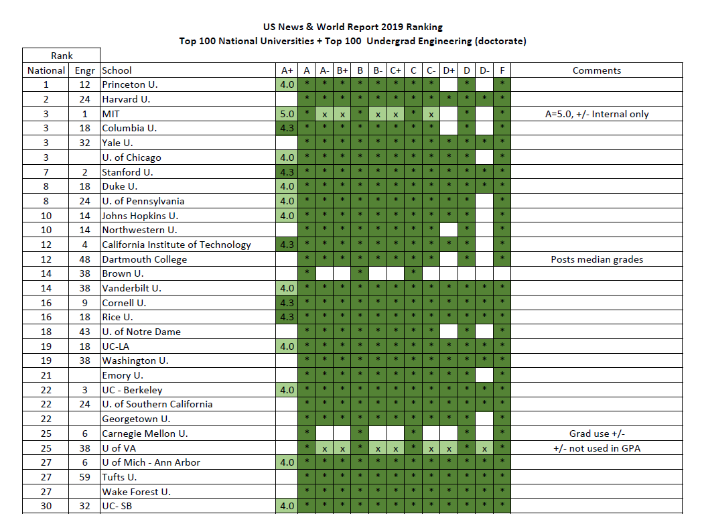

Slide 22
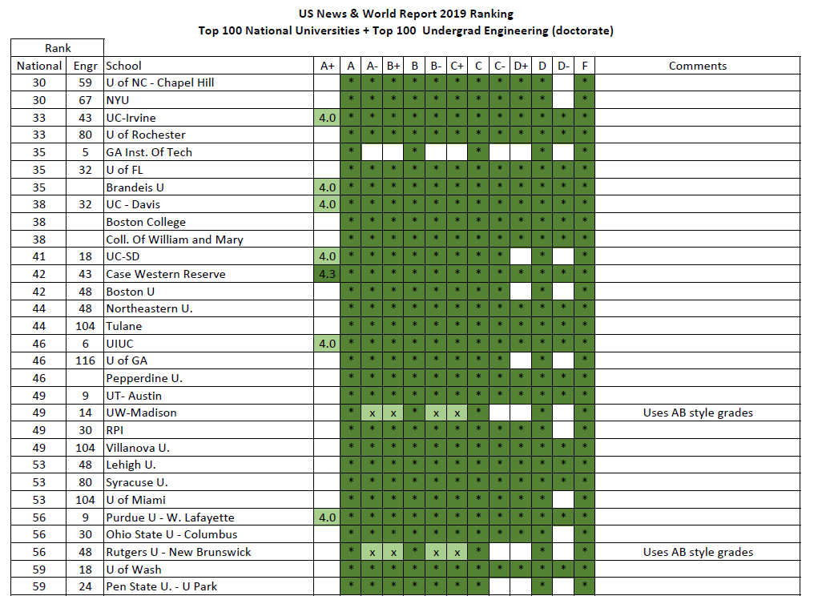

Slide 23
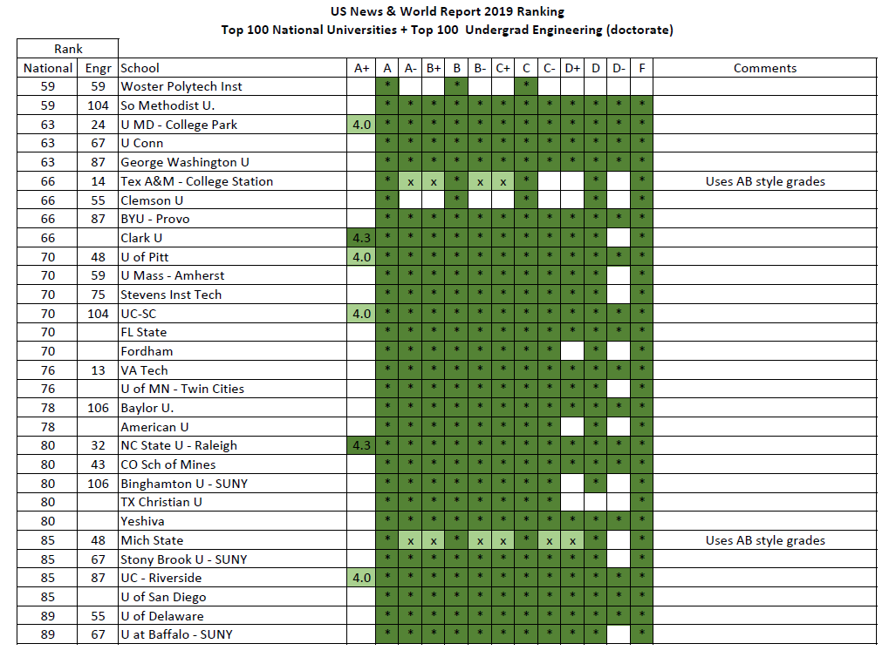

Slide 24
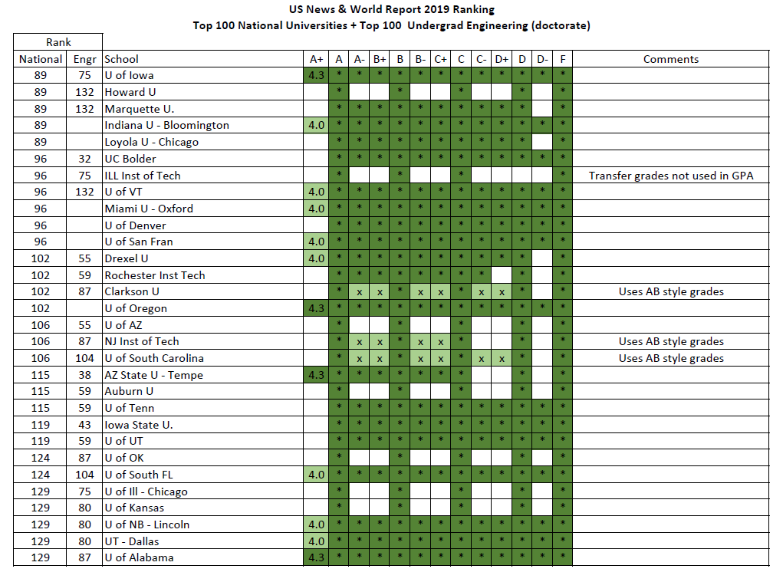

Slide 25
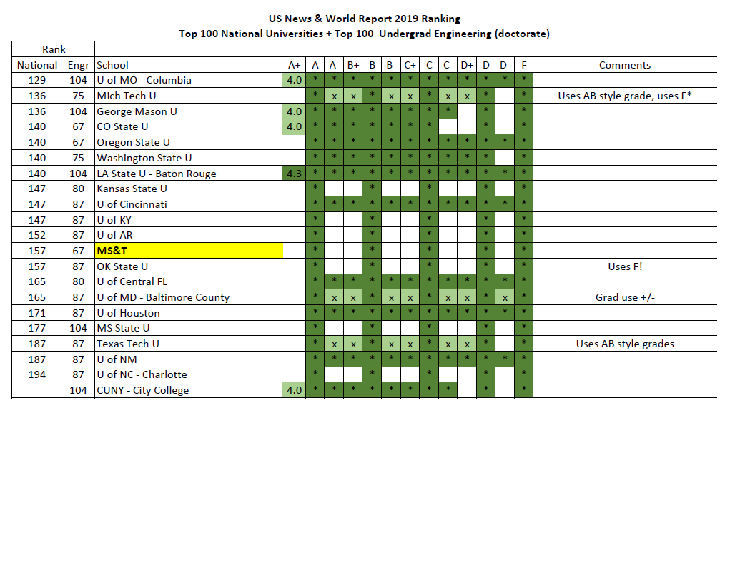

Slide 26
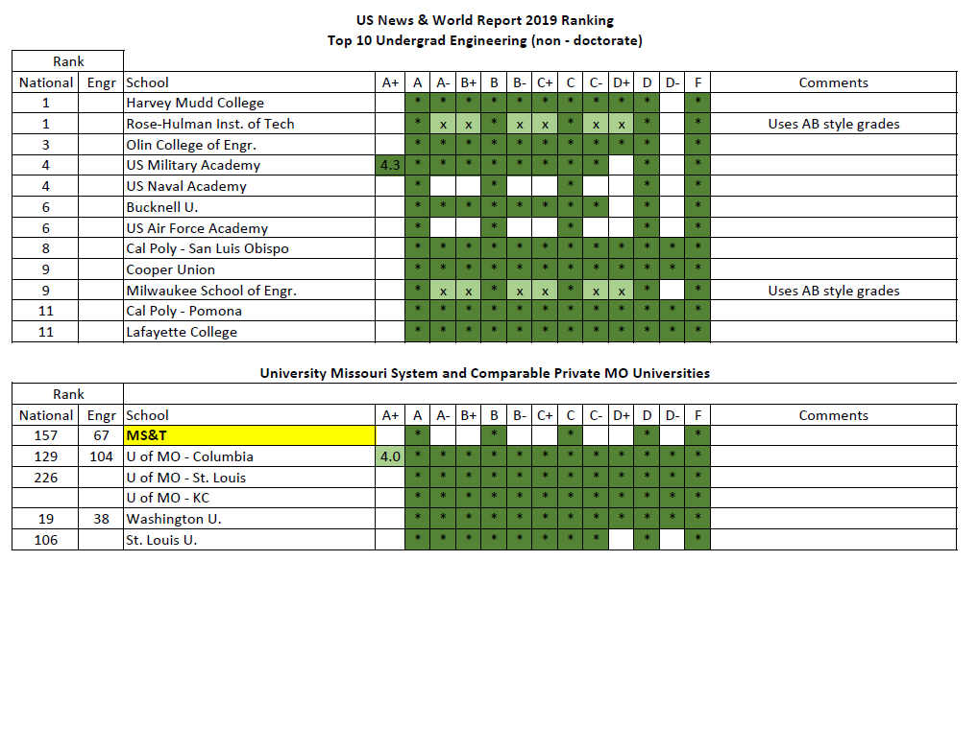

Slide 27
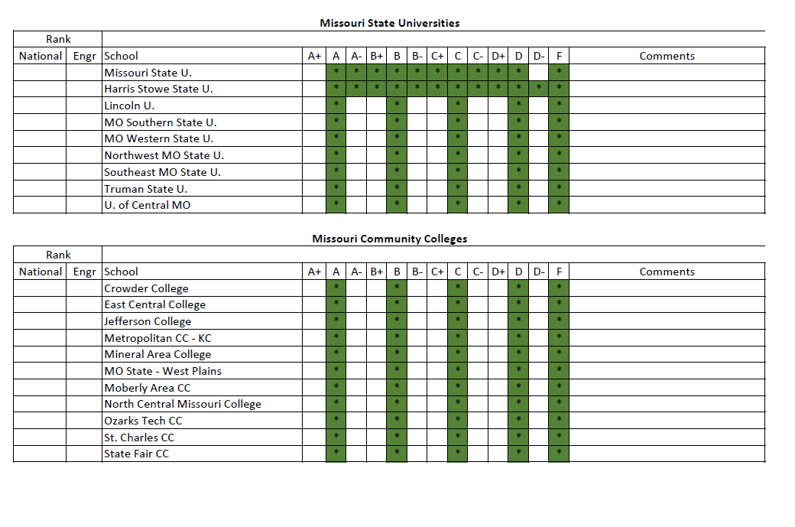

Slide 28
Other Universities and Colleges - Summary
Top 100 national + top 100 Engineering (doctorate)
86% Use finer granularity in grades than S&T
78% use +/- grades from A through at least C-
33% use A+ grades
72% of A+ grades have same numeric value as A grade
Top 11 Engineering non-doctorate
9 use +/- grades
UM System, Wash U, SLU
All use +/- grades, except S&T
Missouri State Universities
Most do not use +/- grades (MSU, Harris Stowe exceptions)
Missouri Community Colleges
None use +/- grades

Slide 29
Comments

Slide 30
Definition of Grades
S&T does not specify how a percentage grade in a class should be translated to a letter grade.
Letter grades are defined by a single word
A = Excellent
B = Superior
C = Medium
D = Inferior
F = Failure
AF&S does not propose changing this

Slide 31
No Requirement to Use +/- Modifiers
S&T does not currently require, encourage, or discourage the use of any grades
AF&S does not propose changing this
Under a +/- grading scheme, instructors who believe the current grading system is most appropriate, would be welcome to continue using it
Instructors who like their grading system, can keep their grading system (sorry, I couldn’t resist)

Slide 32
C or Better
Motion mandates all course prerequisites currently listed as “C or better” would be changed to “C- or better”
Maintains the current practice that performance closer to C than D is sufficient for advancement to next course
Departments can petition to have individual prerequisites changed in future
Changes will require submission of CC form to Curriculum Committee, and ultimately approval by Faculty Senate

Slide 33
Grade Replacement
Students may currently replace up to 15 credit hours of D or F grades in GPA calculations by retaking the course(s) at S&T
A, B, C grades may not be replaced in GPA calculations
Under AF&S proposal, students may replace C-, D+, D, D-, F grades, but not A, A-, B+, B, B-, C+ or C grades
Maintains concept that grade replacement is intended to help students with GPAs below 2.0

Slide 34
+/- Grades Not In Proposal
Symmetry would suggest allowing A+, F+ and F- grades
Found no schools which use F+ and F- grades
Modifiers on F grades sometimes indicate unethical behavior
There is no clear standard on the use of A+ grades
Approximately 30% of schools surveyed allow an A+ on the transcript
Approximately 70% of schools that allow an A+ give it the same weight in GPA calculations as their A grade

Slide 35
A+ Conundrum
Some perceive the AF&S proposed system as creating a negative bias, since it introduces A- grades at 3.7 grade points, but no A+ grade at 4.3 grade points
An A+ at 4.3 grade points would allow students to achieve a 4.0 GPA even if they have a few grades below A.

Slide 36
A+ Conundrum
The way students, or the university, describes the impact of A+ grade on GPA calculations may negatively impact the integrity of the GPA calculation if we use a 4.3
What does a GPA of 4.2/4.0 mean?
If a 4.3 can be obtained, should existing GPA statements be changed from 3.9/4.0 to 3.9/4.3?
Some schools cap GPA at 4.0, while allowing 4.3 course grades. The GPA is then no longer a conventional “average”
GPA calculations are always documented, but…
People using GPA tend to make snap judgements
May not take time to read documentation, and dismiss our GPA as odd, unconventional, or manipulative

Slide 37
Impact of +/- Grades on Average Student GPA
AF&S has collected some data on how +/- grades have impacted average student GPA at other universities
Summary of data is available upon request, but prefer not to discuss. It is not comprehensive or peer reviewed
Want to avoid discussions of the nature: I trust my statistically insignificant data more than your statistically insignificant data

Slide 38
Impact of +/- Grades on Average Student GPA
In recent memory, AF&S and the Faculty Senate have not tracked, or set targets for
Average GPA at graduation
Average GPA by class (Freshmen, Sophomore, etc.)
Average GPA by major, degree objective, instructor, semester, etc.
Even if we could determine if/how +/- grades would impact mean GPA, we have no basis to say if the effect is desirable or undesirable

Slide 39
Number of Students Graduating with 4.0 GPA
Having A- without an A+ will probably lower the number of students graduating with a 4.0 GPA
AF&S committee and Faculty Senate
Do not track
Have not set a target
Do not evaluate policies to see if they move a statistic we do not measure closer to a target we have not set

Slide 40
Costs
There is some cost to changing grading system, current estimate from Registrar is 200 person-hours
There is some cost to maintain our current system, or any system, that is different from the other three UM campuses

Slide 41
Sharing / Transferring Courses
Some students transfer courses to S&T from schools that have +/- grades. Since community colleges do not use +/- grades, this is probably not a large number of students.
S&T students could have more opportunities if the UM system offers more cross-campus course
Having all UM system students graded on the same scale helps facilitate cross-campus course sharing
Is it fair to give a Mizzou student a B+ in a class where an S&T student performed slightly better, but is receiving a B?

Slide 42
Motion
Starting with fall semester 2020, S&T will expand its current A through F course grading system, to include the use of + and - modifiers, as described below.
Courses can use either an A through F system, or a satisfactory / unsatisfactory (S/U) system. The A through F grading system is appropriate for those subjects and situations that allow discrimination in quality of achievement and performance. The S/U system is more appropriate for students wishing to take elective courses in a subject matter field in which they will be competing with majors, for mastery learning situations, and for courses graded primarily on the basis of attendance. The grades available in the expanded A through F system, and their effect on grade point average calculations, will be: A (4.0), A- (3.7), B+ (3.3), B (3.0), B- (2.7), C+ (2.3), C (2.0), C- (1.7), D+ (1.3), D (1.0), D- (0.7), F (0.0). Graduate students will not be allowed to earn grades of D+, D or D-. The S and U grades will not be incorporated in the grade point average calculations. All courses which currently specify a prerequisite with a grade of “C or better” will be changed to “C- or better". This change to “C- or better” may be subsequently altered through the normal curriculum modification process. All regulations currently tied to a specific grade average will be interpreted to mean the numerical average currently associated with that specific grade. Hence, a required C average or better on all courses will be a 2.000 average or better. Students will be allowed to replace grades in all courses in which they have obtained a C- or lower. The first sentence of Section VIII.G of the S&T Student Academic Regulations will be changed from: “Effective with Missouri S&T coursework repeated Fall of 2001 or later, when a grade of "D" or "F" is received in a Missouri S&T course, the grade may be replaced in the calculation of the GPA if the course is repeated at Missouri S&T.” to: “When a grade of C-, D+, D, D- or F is received in a Missouri S&T course, the grade may be replaced in the calculation of the GPA if the course is repeated at Missouri S&T.”

Slide 43
Impact on GPA

Slide 44
Disclaimer
The following slides contain excerpts from documents describing the impact +/- grades have on cumulative GPA calculations.
Note that many of the comments are second-hand, and reference non-archived source documents
Most comments are from committees who appear to have been charged with evaluating the impact of using plus/minus grades in college settings
Emphasis was given to comments that appear to be based on measurements rather than speculation and simulations. However raw data for those observations is typically not available

Slide 45
University of Oklahoma
“At most universities that have switch to a plus/minus system, there has not been a substantial decline in GPA’s”
Univ. of OK Grading Task Force, 2/3/07
“…at other universities that have implemented the plus/minus system…not all of the A-’s under the plus/minus system would have been A’s under the regular system; some reflect B’s that faculty move up to an A-”
Univ. of OK Grading Task Force, 2/3/2007

Slide 46
American Journal of Pharmaceutical Education
“The type of grading scale used did not affect the mean cumulative GPA”
The Effect of Various Grading Scales on Student Grade Point Averages, K. Barnes and S. Buring, American Journal of Pharmaceutical Education, 2012; 76 (3) Article 41

Slide 47
Rensselaer Polytechnic Institute
“Will there be a negative impact on student GPAs? The general answer to this concern is a clear no. A number of studies at other universities, as well as our own data, indicate that the impact on GPAs will be small… a few one hundreds of a point…”
Plus/Minus Grading, Ch. Steinbruchel, Chair, RPI Faculty Senate Curriculum Committee, 2/19/2004

Slide 48
University of California, Los Angeles
University of Maryland
“Based on a quarter century of experience with +/- grading, UCLA administrators have suggested that over time, say ten years or more, the effect of plus/minus grading on overall grade distribution patterns is inflationary, or uplifting.”
Report to the Faculty Senate, Office of the Registrar, University of Maryland, 11/2003, referencing email received from UCLA Registrar, 5/7/2002

Slide 49
Seton Hall University
“…the data tends [to show] a drop in overall GPA will occur in the year following the introduction of minus grades. However in the second year of the +/- change we note a surprising result. The grades have not only remained stable, or risen slowly, but have returned to at least to where they were before the grading system change. … [after 4 years of study] Further research is required to verify what the overall trends and interactions are…”
Y. Wilamowsky et. al., The Effect of Plus/Minus Grading on the GPA, Journal of College Teaching & Learning, vol 5, No. 9, 9/2008

Slide 50
Washington State University
“…after the implementation of +/- grading [at Washington State University], the overall GPA essentially decreased on average by 0.012 … in the first year … the overall drop in GPA was 0.026…”
A. Bressette, Arguments for Plus/Minus Grading: A case Study, Educational Research Quarterly, Vol 25.3, 2002
(Prior to implementation of +/- grading the GPA variation per year was on the order of 0.02 to 0.06)

Slide 51
North Carolina State University
“…after the implementation of +/- grading [at North Carolina State University], the overall GPA increased on average only 0.01 … per year.”
Prior to implementation of +/- grading the GPA was increasing an average of 0.029 per year.
A. Bressette, Arguments for Plus/Minus Grading: A case Study, Educational Research Quarterly, Vol 25.3, 2002
“One third of the undergraduates saw a decline in their GPA … almost 23% of NCSU undergraduates saw an increase in their GPA”
Report to the Academic Senate of Arizona State University, Ad Hoc Committee on Plus/Minus Grading, 11/25/2002

Slide 52
MIT
“One-third of the undergraduates saw a decline in their GPA [after switching to a +/- system], albeit typically not much of one. At MIT only 4% saw an increase of 0.1 or more”
Report to the Academic Senate of Arizona State University, Ad Hoc Committee on Plus/Minus Grading, 11/25/2002

Slide 53
University of Idaho
“Might some students’ overall cumulative GPAs be affected negatively under a plus/minus system? … studies vary a bit on this question, with some institutions showing now shift in the mean GPA following a change to plus/minus grading, another study showed a slight shift downward (-0.03) that was not statistically significant, while another study also showed a very slight decline.”
Proposal to Adopt Plus/Minus Grading, Teaching and Advising Committee, University of Idaho, 10/31/2018

Slide 54
Western Kentucky University
“During the six semesters of this grading trial… the majority of students (57%) would see a loss in their cumulative GPA, 16% would see a gain, and 26% would see no difference … Students who had a gain … recognized a 0.02 positive change, while students who had a loss would post a -0.03 change … Overall, the majority of students had no change in their financial aid eligibility status of the result of signed grades. Only five students [out of 1,140] would lose eligibility (<1%) as a result of signed grading.”
Report on Plus and Minus Grading, Office of Institutional Research, Western Kentucky University, Fall 2006

Slide 55
Dale Bumpers College of Agricultural, Food and Life Sciences at the University of Arkansas
“Analyses of same-course same-instructor grade data indicated … a significant decrease (-0.12) occurred in courses where instructors switched to plus/minus grading.”
E. Leslie et. al., Grading and Its Effect on Course Grade Point Averages, College Student Journal, 2014

Slide 56
Clemson, Duke, Kansas State, Mississippi State, Oregon State, Univ. of Colorado-Boulder, Univ. of Georgia, Vanderbilt, Virginia Tech, Univ. of Connecticut
“The majority of comparable Universities considered [listed above] currently employ suffix grading scales. Based on available information, use of a suffix grading scale would have negligible effects on GPA, grade distribution and credentialing.”
Final Report, Ad Hoc Committee on Plus/Minus Grading, Louisiana State University, 4/27/2012

Slide 57
American Association of Collegiate Registrars and Admissions Officers (AACRAO)
“In a 1992 national study … The AACRAO did find a very slight decline in average GPA among the colleges and universities studied from 1972 to 1982 [that use +/- grading] but stated that the implementation of plus/minus was not separated from an effort to curb grade inflation. This interpretation means that one could not necessarily predict a decline if curbing grade inflation was not the primary goal.”
Plus and Minus Grading Options: Toward Accurate Student Performance Evaluations, The Academic Senate for California Community Colleges, Spring 1996

