Slide 1
Academic Freedom & Standards Committee
Status Report on +/- Grading Issue
24 January 2019
K. Kosbar, Chair 2018-19 AF&S Committee

Slide 2
History
Spring 2018
Two referrals sent to AF&S
Consider +/- grading system
Consider removing transfer courses from cumulative GPA
Summer 2018
AF&S makes motion at Faculty Senate to implement +/- grades
Faculty Senate does not vote on motion
Faculty Senate sends referral to Student Affairs Committee
Fall 2018
Faculty Senate sends referral back to AF&S
Solicit more comments
Remove dependence on Mizzou policy
February 2019
AF&S plans to make revised motion at Faculty Senate

Slide 3
Data and Comments Collected From
Approximately 160 universities and colleges
Student Affairs Committee
Student Council
Council of Graduate Students
Registrar
Athletics
Freshman Engineering

Slide 4
Other Universities and Colleges
Surveyed grading policies from following institutions
Top 100 national universities (as defined by US News & World Report)
Top 100 engineering (doctorate) universities (USN&WR)
Top 10 engineering (non-doctorate) universities (USN&WR)
Mizzou, UMSL, UMKC, Wash U., SLU
Missouri State Universities
Missouri community colleges
Data on Following Pages
Top 100 national + top 100 engineering (doctorate), sorted by national ranking. 5 pages
Top 100 of previous list, sorted by engineering ranking. 3 pages
Top 10 engineering (non-doctorate). ½ page
Missouri schools. 1 ½ pages

Slide 5
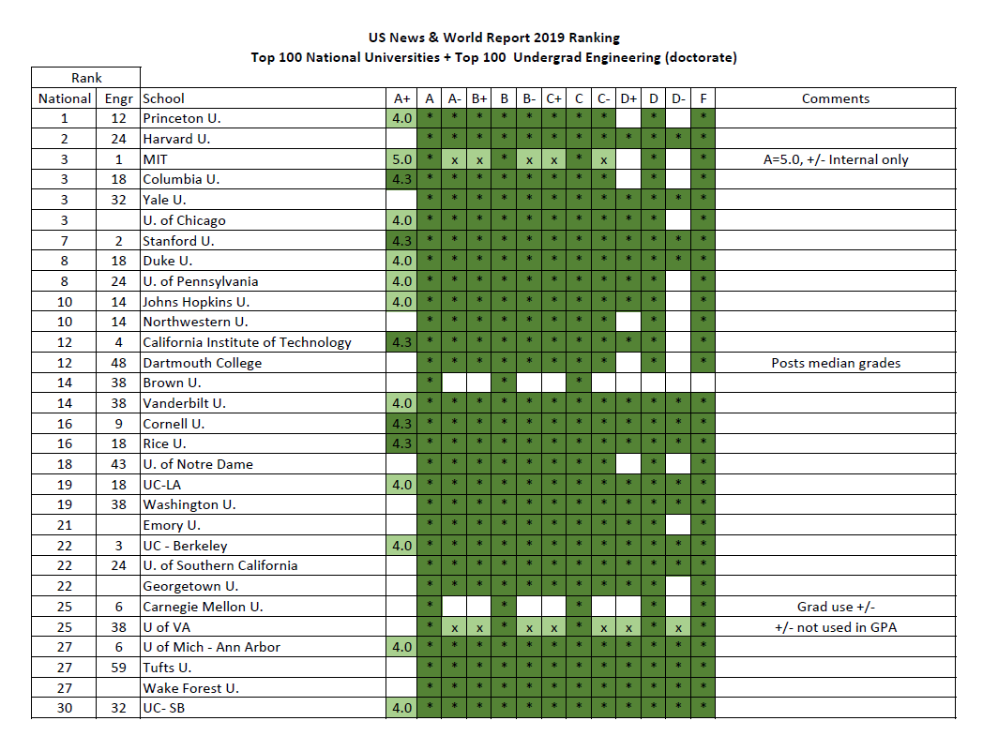

Slide 6
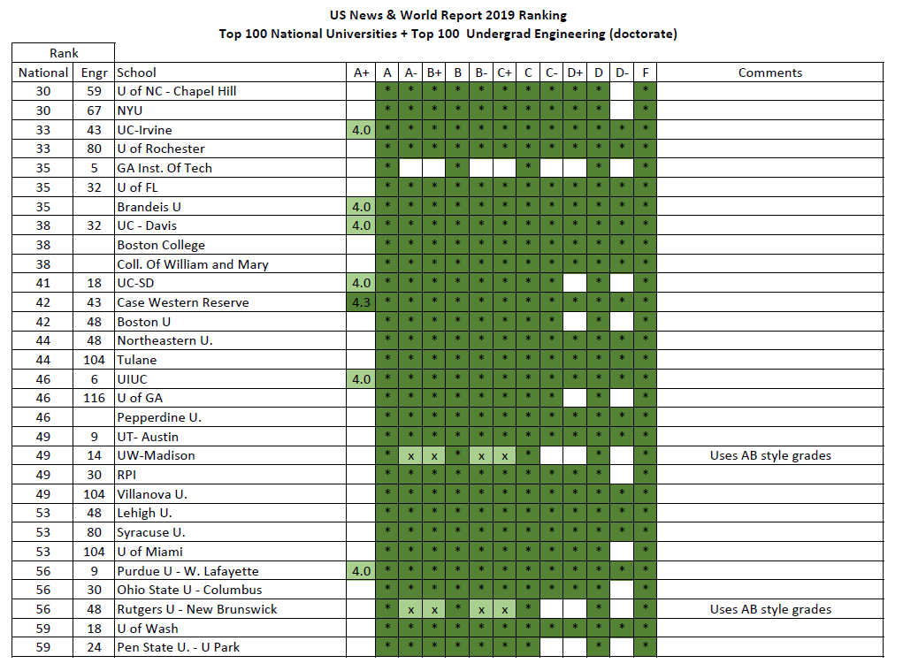

Slide 7
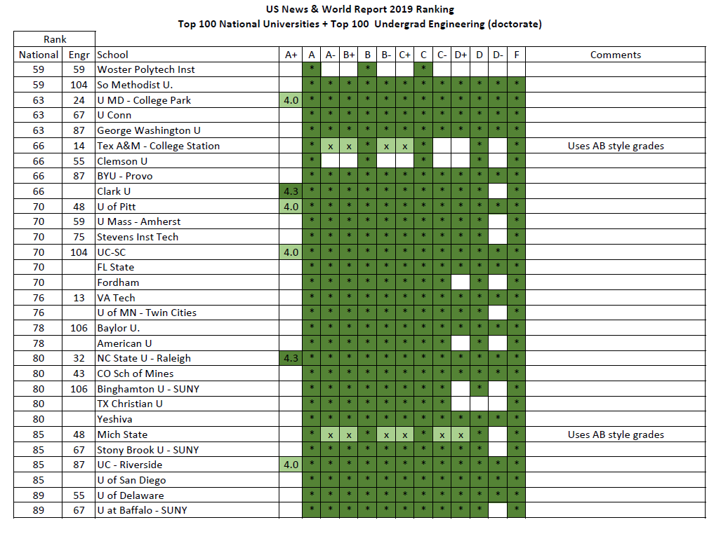

Slide 8
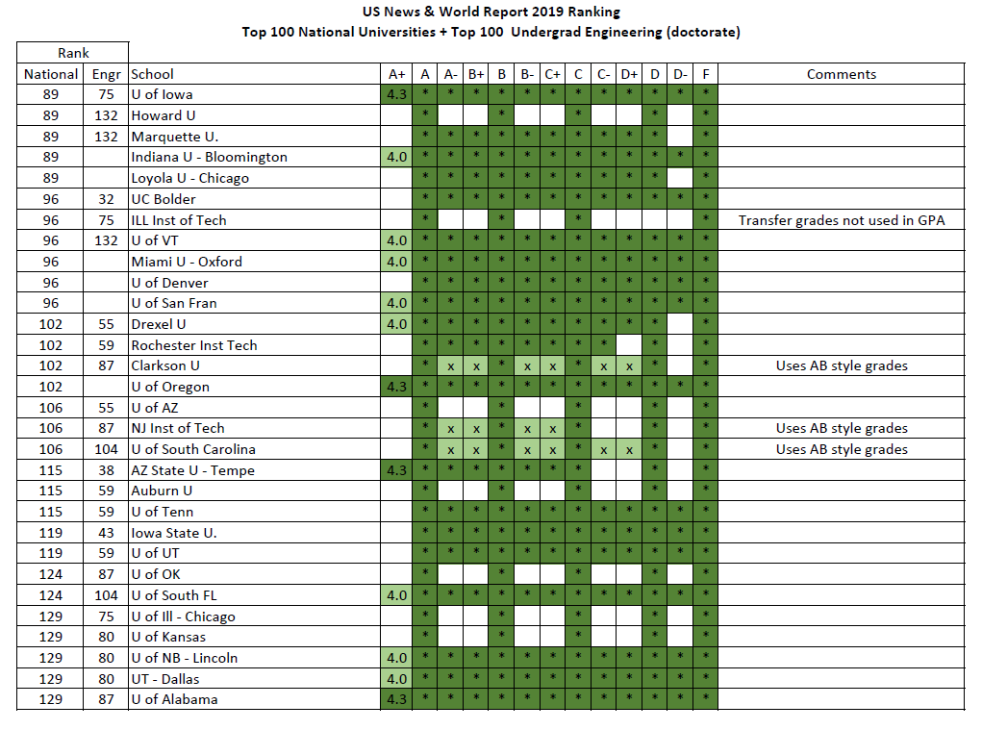

Slide 9
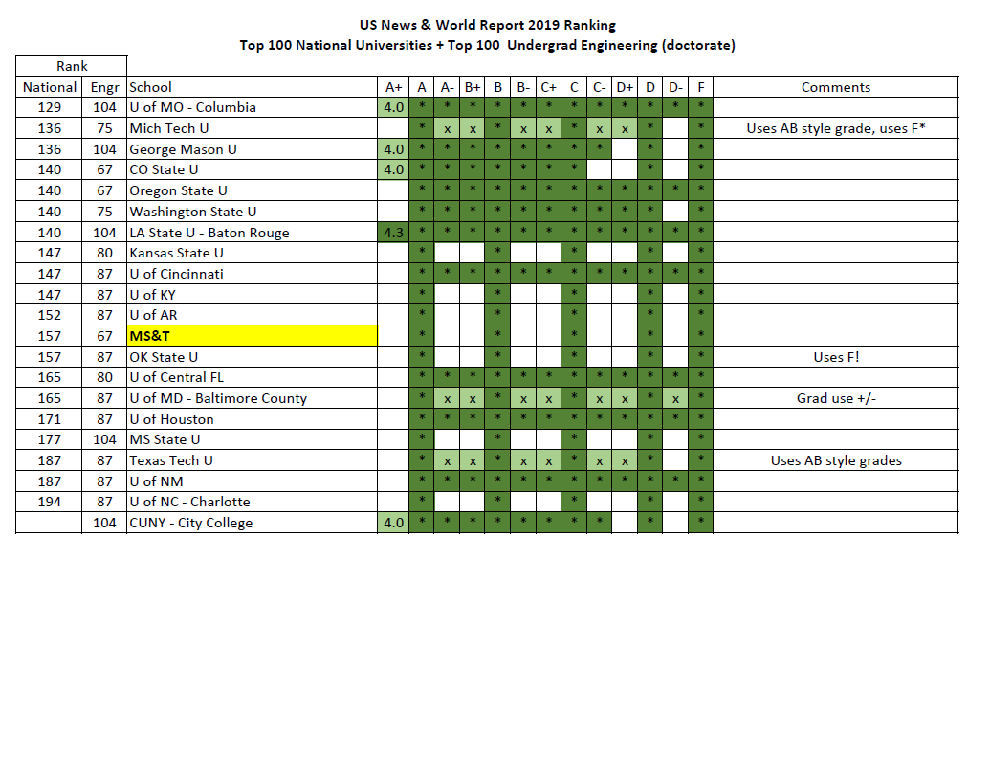

Slide 10
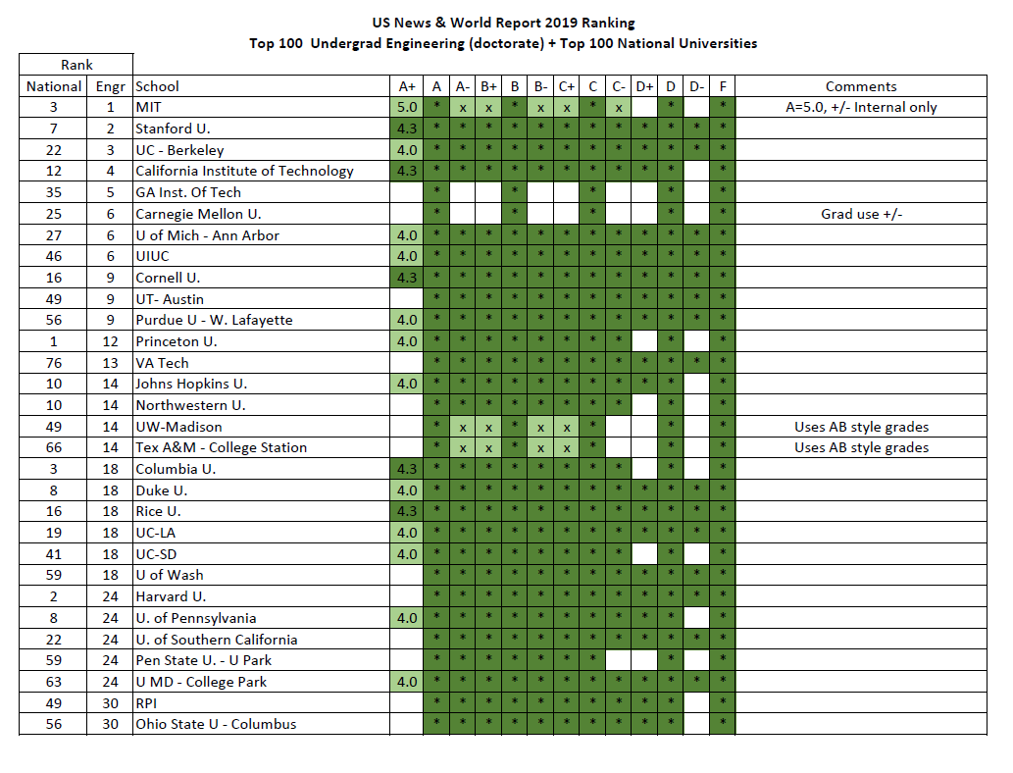

Slide 11
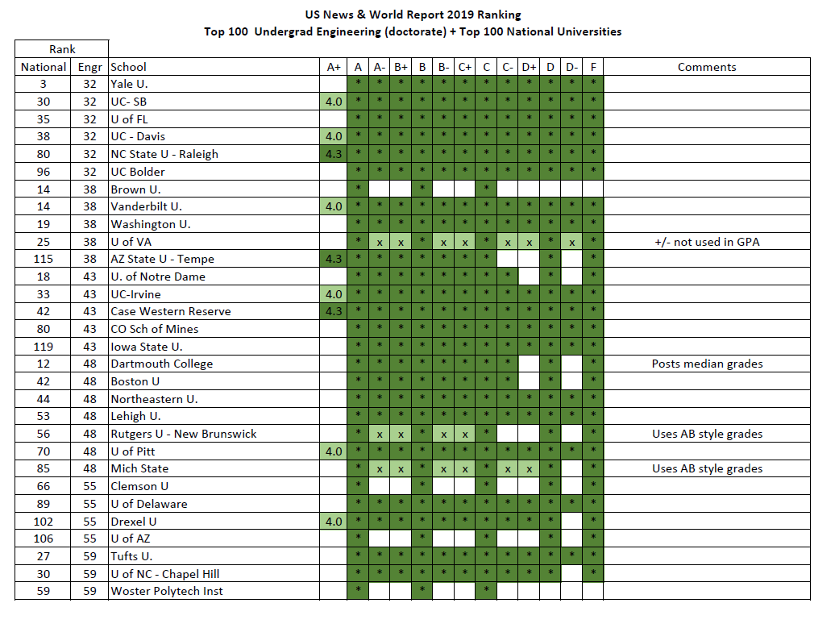

Slide 12
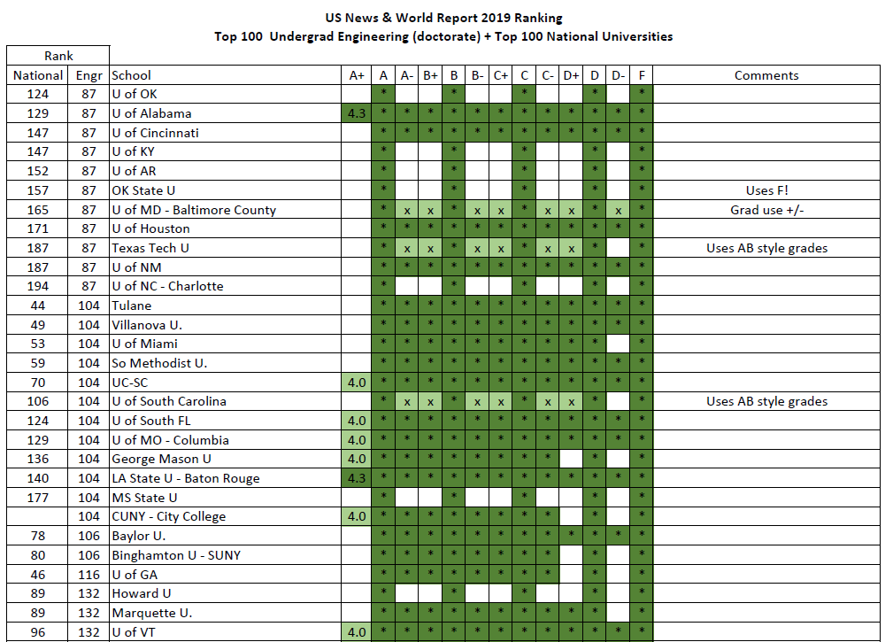

Slide 13
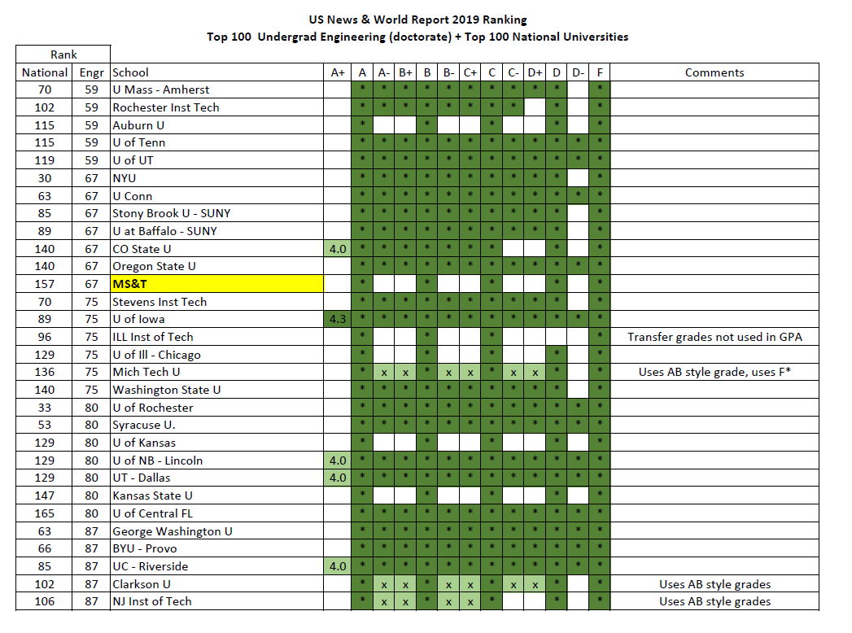

Slide 14
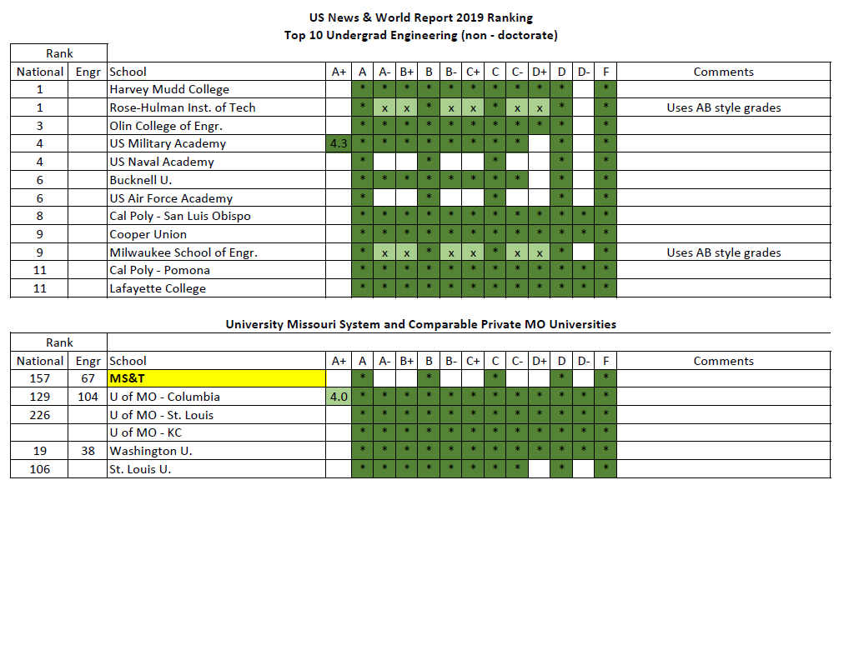

Slide 15
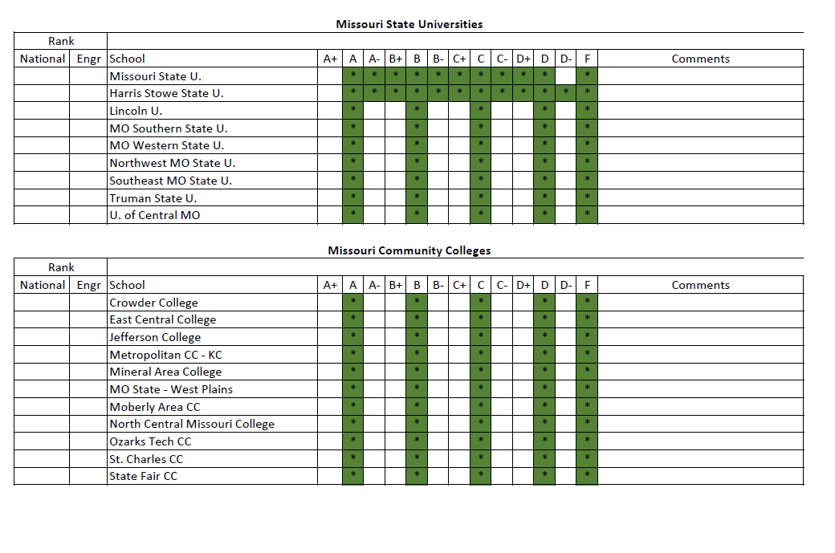

Slide 16
Other Universities and Colleges - Summary
Top 100 national + top 100 Engineering (doctorate)
86% Use finer granularity in grades than S&T
78% use +/- grades from A through at least C-
33% use A+ grades
72% of A+ grades have same numeric value as A grade
Top 11 Engineering non-doctorate
9 use +/- grades
UM System, Wash U, SLU
All use +/- grades, except S&T
Missouri State Universities
Most do not use +/- grades (MSU, Harris Stow exceptions)
Missouri Community Colleges
None use +/- grades

Slide 17
Student Affairs Committee
Received written comments
Generally, but not universally, in favor of +/- grades
Freshman Engineering
In favor of +/- grades

Slide 18
Student Council
Strongly opposed to summer 2018 AF&S motion at FS
Strongest objections seemed to be that C- would not satisfy the “C or better” prerequisite requirement
Concerned about impact on academic standing
Concerned that +/- grades create a barrier to graduation

Slide 19
Council of Graduate Students
Mixed comments
More opposed to change than favoring it
Concerned about cost of implementation
Concerned that +/- grades may lower average GPA

Slide 20
S&T Athletics
Opposes +/- grades
Concerned about lowering GPA
May impact
Eligibility to compete
Eligibility for some awards
Financial assistance

Slide 21
Registrar
Difficult to implement new system prior to fall 2020
Primary cost of implementation would be C- grade policy
Estimate something over 100 person-hours to implement
+/- grades may lower long-term software development and maintenance costs, as they would bring us in line with other UM system campuses

Slide 22
Impact of +/- Grades on Average Student GPA
In recent memory, AF&S and the Faculty Senate have not tracked average student GPA
AF&S and the Faculty Senate have not set a target for average student GPA
AF&S has not previously reviewed policy decisions to see if they will move a metric we don’t measure toward a target we have not set
Did not find comprehensive, peer reviewed, analysis – or meta analysis – of how +/- grading policy impacts mean student GPA
Many anecdotal studies

Slide 23
Impact of +/- Grades on Number of 4.0 Graduates
Same issues as average GPA
AF&S / FS do not track this metric
AF&S / FS have not set targets for this metric
Discussed, but did not select, using A+ grade.

Slide 24
C- Grades
AF&S has changed its position since summer 2018
Now recommend that C- grades satisfy “C or higher” prerequisite requirements
All GPA calculations (cumulative, campus, major, academic status) would still have 2.000 requirements.
Added clarification that C- grades could be replaced in GPA calculations if a student repeated the course at S&T
Considered omitting C-, D+ and D- grades. Did not select that option.

Slide 25
AF&S Discussion and Proposal
Many on committee concerned that current system forces instructors to assign the same grade to students with substantially different levels of performance
Proposed system would allow instructors who prefer the current grading system to continue using it
Final vote on motion
7 in favor
1 opposed
0 abstentions

Slide 26
Motion (for Feb 2019 Faculty Senate Meeting)
Starting with fall semester 2020, S&T will expand its current A through F course grading system, to include the use of + and - modifiers, as described below.
Courses can use either an A through F system, or a satisfactory / unsatisfactory (S/U) system. The A through F grading system is appropriate for those subjects and situations that allow discrimination in quality of achievement and performance. The S/U system is more appropriate for students wishing to take elective courses in a subject matter field in which they will be competing with majors, for mastery learning situations, and for courses graded primarily on the basis of attendance.
The grades available in the expanded A through F system, and their effect on grade point average calculations, will be: A (4.0), A- (3.7), B+ (3.3), B (3.0), B- (2.7), C+ (2.3), C (2.0), C- (1.7), D+ (1.3), D (1.0), D- (0.7), F (0.0).
Graduate students will not be allowed to earn grades of D+, D or D-.
(Continued on next page)

Slide 27
Motion (for Feb 2019 Faculty Senate Meeting)
(Continued from previous page)
The S and U grades will not be incorporated in the grade point average calculations.
All regulations applicable on a course-by-course basis, and tied to a specific letter grade, will be interpreted to mean a specific letter grade range. Hence, if current regulations specify a student must achieve a C in one course in order to proceed to another course, under the new grading system, the student must achieve a grade in the C range, which includes the grade of C-.
All regulations currently tied to a specific grade average will be interpreted to mean the numerical average currently associated with that specific grade. Hence, a required C average or better on all courses will be a 2.000 average or better.
(Continued on next page)

Slide 28
Motion (for Feb 2019 Faculty Senate Meeting)
(Continued from previous page)
Students will be allowed to replace grades in all courses in which they have obtained a C- or lower. The first sentence of Section VIII.G of the S&T Student Academic Regulations will be changed from:
“Effective with Missouri S&T coursework repeated Fall of 2001 or later, when a grade of "D" or "F" is received in a Missouri S&T course, the grade may be replaced in the calculation of the GPA if the course is repeated at Missouri S&T.”
to:
“When a grade of C-, D+, D, D- or F is received in a Missouri S&T course, the grade may be replaced in the calculation of the GPA if the course is repeated at Missouri S&T.”

