Slide 1
COUNCIL OF GRADUATE STUDENTS Faculty Senate Meeting – April 18, 2013

Slide 2
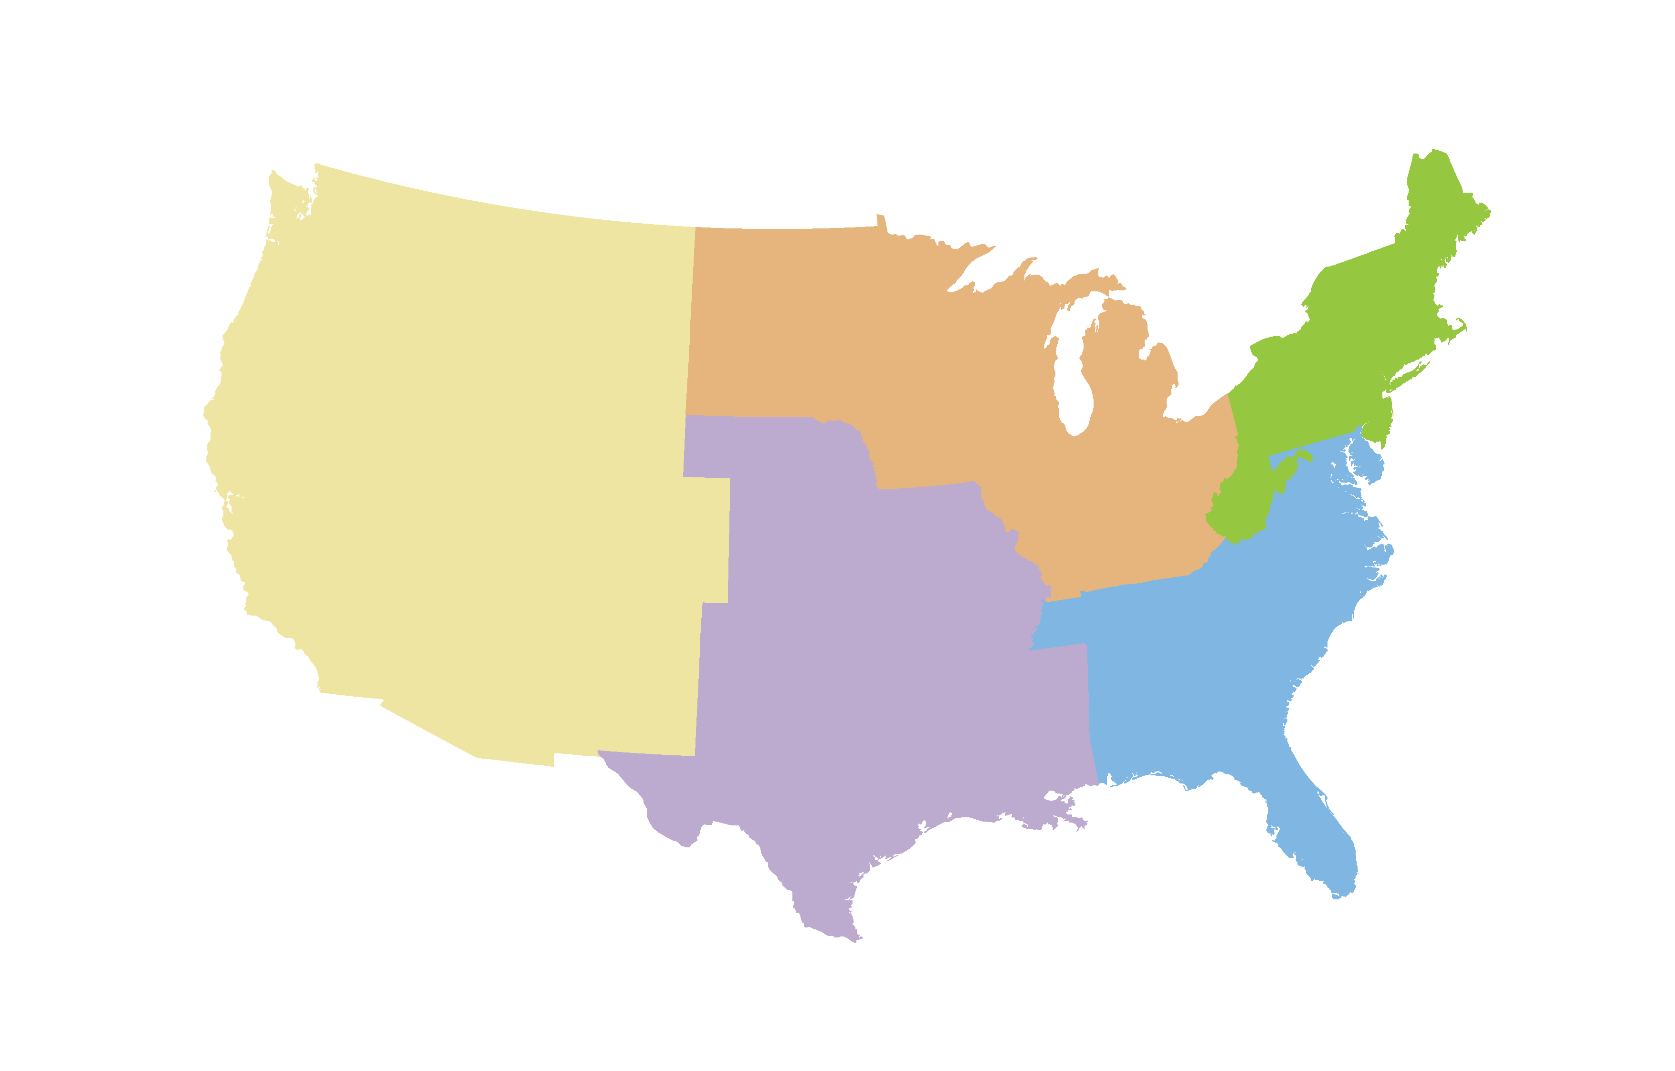
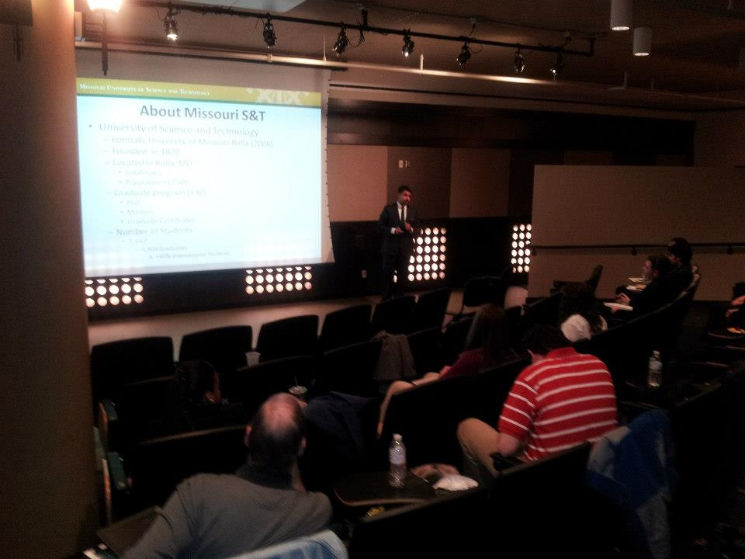
National Association of Gradutate-Proffesional Students (NAGPS )
South Central Regional Conference
University of Missouri-Columbia
March 8-10, 2013
CGS Presentation
Advocacy
Graduate student leadership
Professional development
Strategic Planning
Communications
Achievement/Challenges

Slide 3
Third General Meeting
March 13, 2013
Kandis Rodgers, Program Administrator
Leadership and Cultural Programs (MS&T)
“Leadership and knowing your strength test”
Kandis Rodgers
www.mst.edu

Slide 4
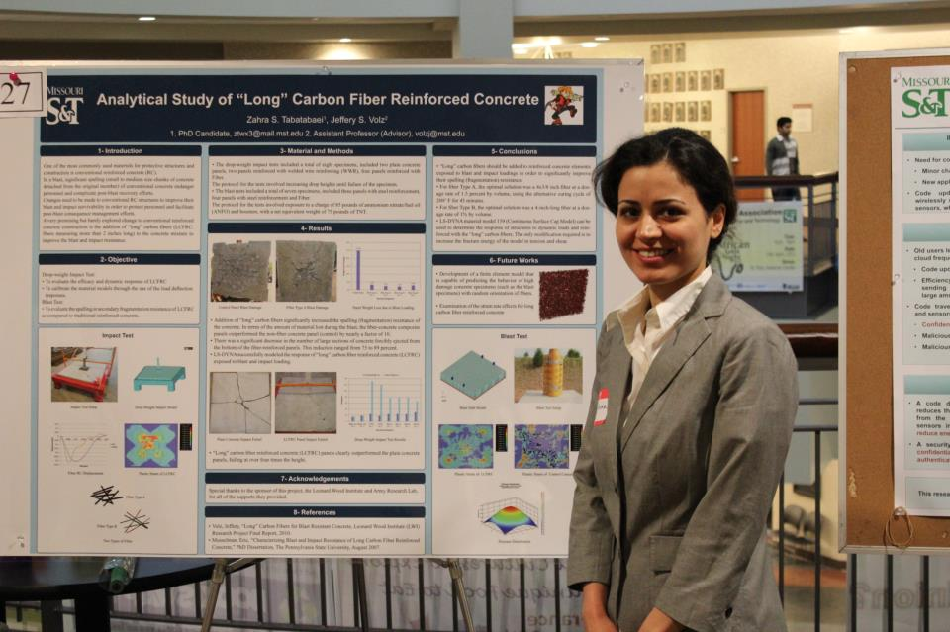
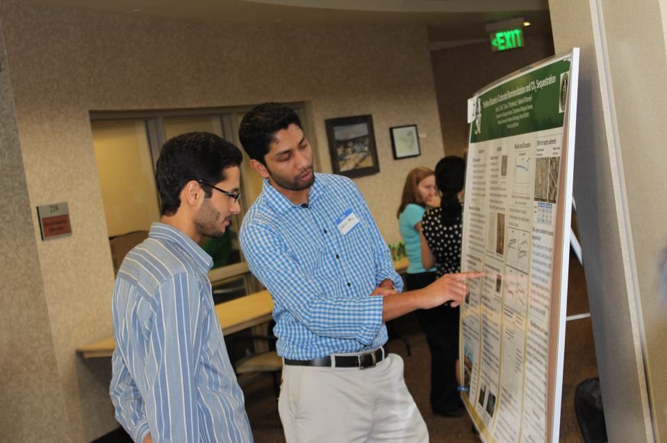
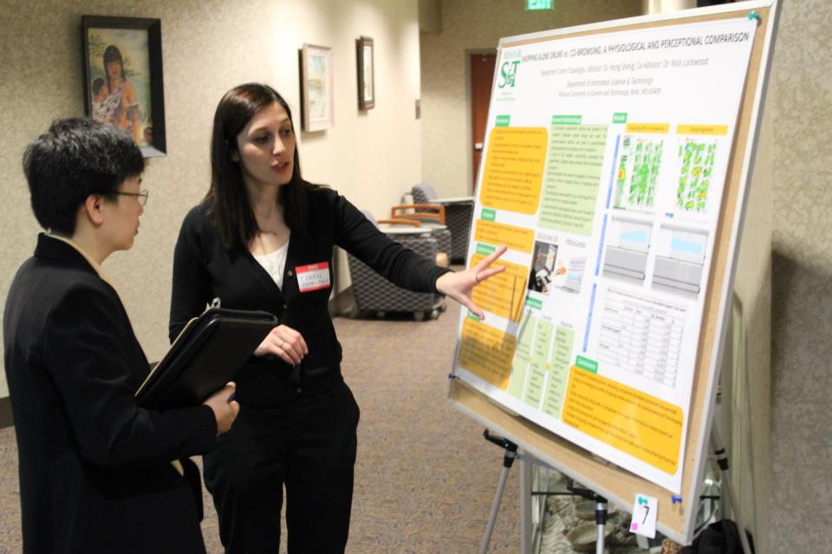
Annual Graduate Research Showcase
Wednesday April 10, 2013
Havener Center 2nd floor Main Atrium
Two sessions
52 Graduate Students
18 Faculty Judges

Slide 5
Annual Graduate Students Banquette
Jason Neidrich, Director of Advanced Packaging -Brewer Science
Graduate showcase winners
Top 3 + honorable (each session)
Travel Grant
Six winners
April 29, 2013
Chancellor Schrader and President Wolfe
CGS advisor, Executive Committee, and Showcase winners.

