Slide 1
Ignite Rolla
“enlighten us, but make it quick”
Wednesday Feb 26, 6pm
~12 speakers with 5 minute talks
Students, staff, faculty, and community members
Engage the S&T and Rolla community
Research and technology focus, but the talk can be about anything the speaker is passionate about: work, interests, or hobbies

Slide 2
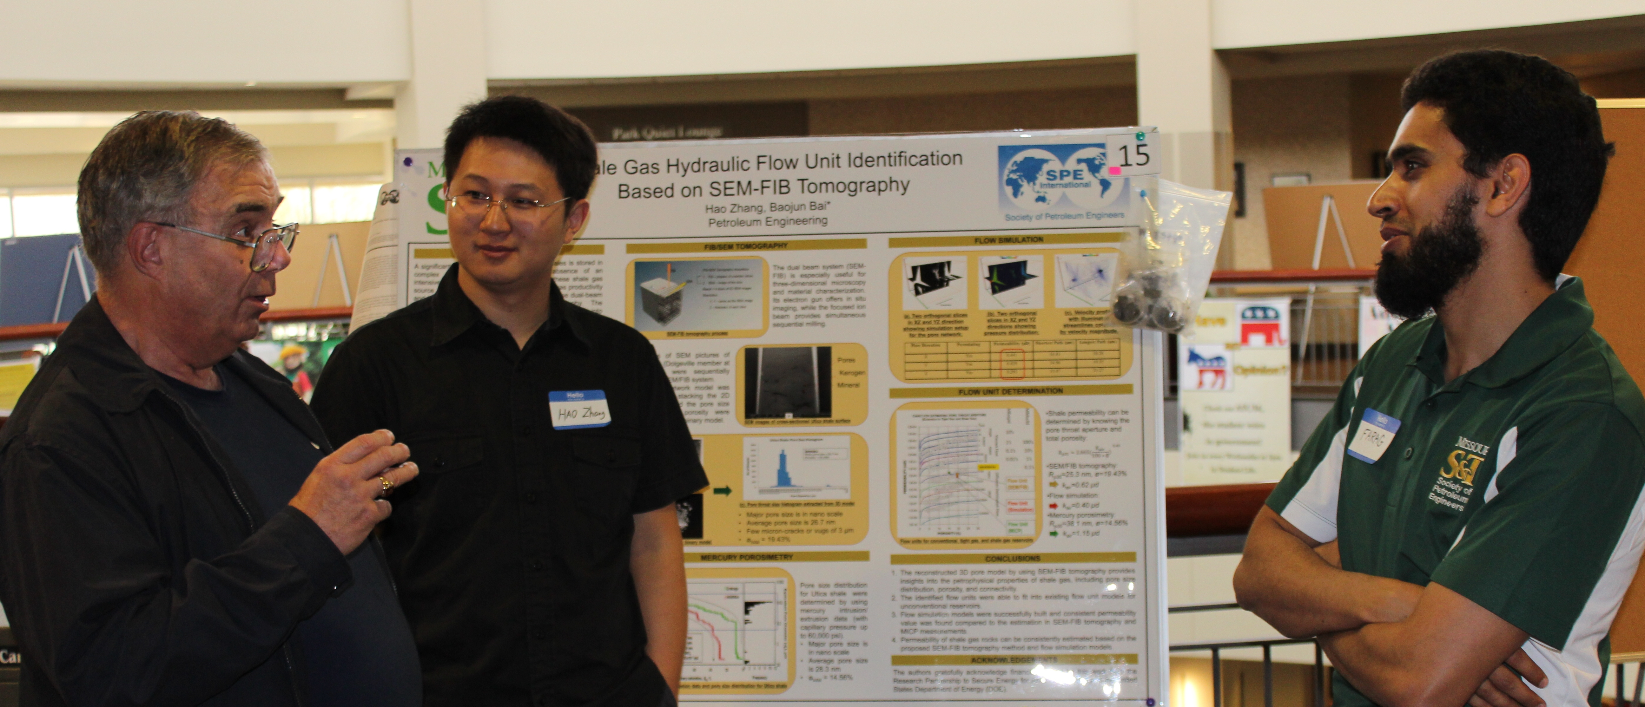
Graduate Education Week in Missouri
April 5-12, 2014
Graduate Research Showcase
Thursday April 10
Requesting Faculty Judges (March)

