Slide 2
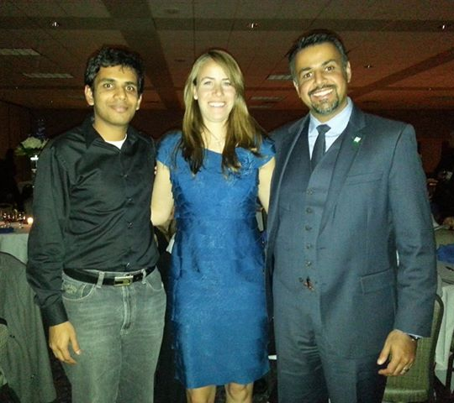
NAGPS 27th Annual National Conference
Mohammad Alkazimi was elected to serve on the Board of Directors as the International Student Concerns Committee Chair
Mizzou and S&T won the joint bid to host the 28th National Conference!

