Slide 1
Faculty Senate Meeting:
Sichuan Missouri University
Warren K. Wray, Ph.D., P.E.
November 17, 2011

Slide 2
What is Proposed?
Partner with a Chinese university to create a new university
  Located in Chengdu, China
  Enrollment: 4,000 – 8,000 students
  A “Tier 1” Chinese university
First cohort enters in Fall 2013

Slide 3
Why Us?
Chinese government’s desire to model Western higher education structure and results
Chinese university must partner with an American or Western Europe university
Dr. Paul Pai’s tenure at community college in St. Louis.
Approached UMSL to be a partner
UMSL recommended S&T as the engineering partner

Slide 4
Proposed Degree Programs at SMU
Missouri S&T
  Mining Engineering
  Metallurgical Engineering
  Ceramic Engineering
  Engineering Management
UMSL
  Business
  Nursing
  Graphic Design
  Social Work and Gerontology

Slide 5
Opportunity in China
Rapid growth of China’s economy – 10% annual growth over two decades
New middle/upper middle class in China - as many as 250 million people
High level of personal savings is part of China’s culture

Slide 6
Opportunity in China
One child per family policy and high ability to invest in the education of a single child – our target audience
Strong commitment to education translates into a strong desire to secure international (U.S.) education for the child
U.S. educational credential is the second preference after admission to a very small number of elite Chinese universities

Slide 7
Our Proposed Partner
Tianfu College (TC) is a private college founded under the auspices and academic leadership of the Southwestern University of Finance and Economics (SWUFE)
TC-SWUFE is one of the top 100 independent colleges of China
Recognized in 2010 for excellent graduates by Sichuan Province and received the “21st Century Innovation Demonstration Site of Education Reform” national award

Slide 8
Our Proposed Partner
The main campus at China Science & Technology Park in Mianyang (2nd largest city in Sichuan Province) houses freshman through junior year students on a 112-acre campus
The Chengdu campus in the capital city of Sichuan (former Guanghua campus of SWUFE) houses senior year and career/technical students on 83 acres, 1.5 hours drive from main campus. A new Chengdu campus, close to the proposed SMU campus, is under construction

Slide 9
Why Chengdu, Sichuan Province?
Sichuan Province has a population of 80 million people
Greater Chengdu has a population of 14 million people
Chengdu City has a population of 6 million people
Chenghua District (one of five districts of Chengdu’s urban core) has a population of one million

Slide 10
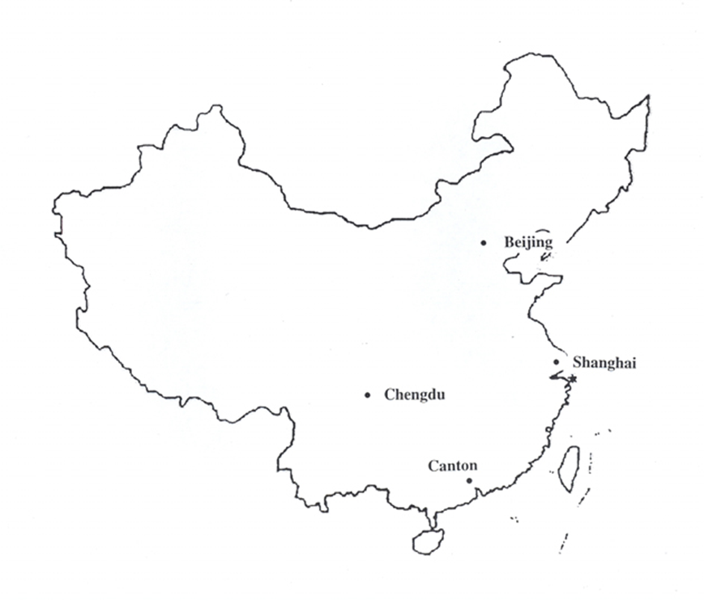
Campus Location

Slide 11
Longtan Economic Zone
Located in the northeast quadrant of Chengdu
3.14 square miles of land (> 2,000 acres)
Largest industrial development area in Chengdu and one of three in Sichuan
Five east-west, six north-south, and one belt roads
Goal: headquarters for 5,000 companies
Focused on attracting R&D, administration centers of high tech, value-added, high-end brand headquarters with accompanying up- and down-stream industries

Slide 12
Opportunity
The development of Sichuan Missouri University presents the opportunity to link the University of Missouri and the economy of the state of Missouri to one of the most dynamic and rapidly growing economies in today’s global economy.

Slide 13
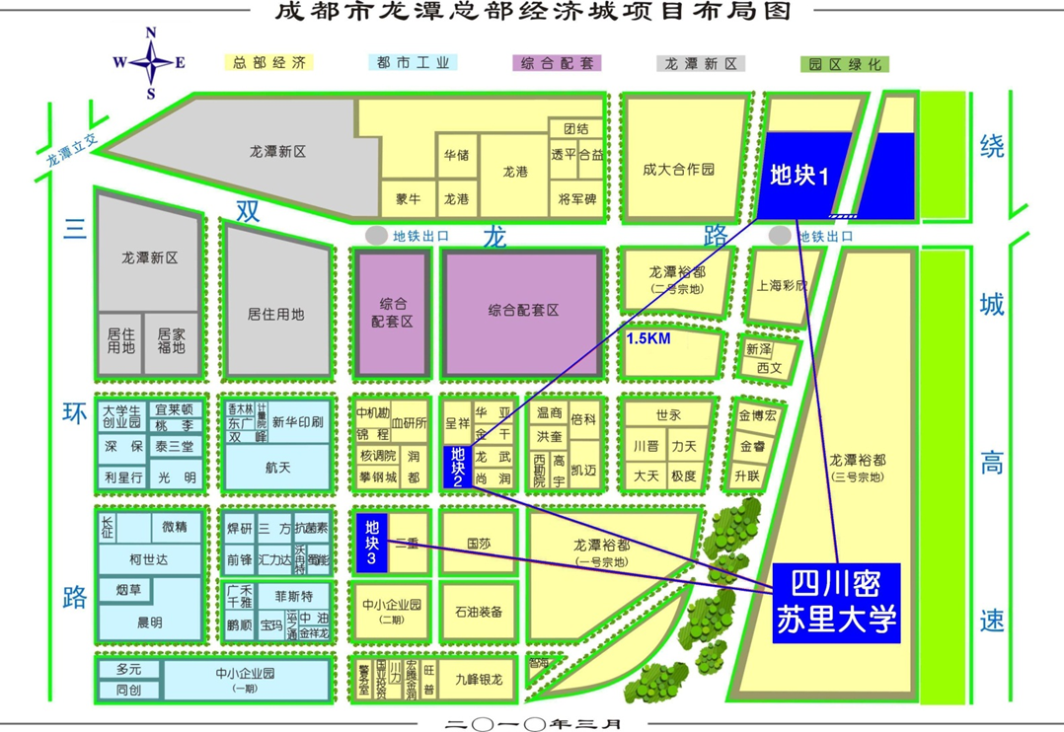
Campus Location in Longtan Economic Zone (3 blue parcels)
1
2
3
SMU

Slide 14
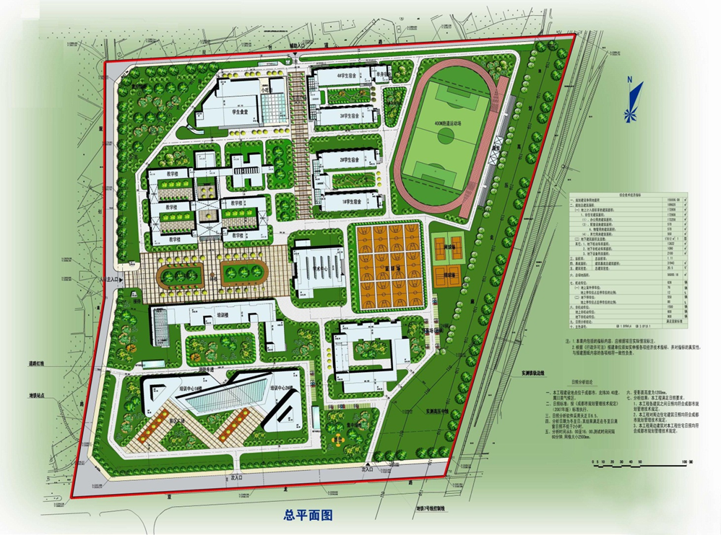
Campus Layout
(parcel 1)

Slide 15
The
Academic
Task

Slide 16
What We Will Do
Degree-specialized academic facilities
  Laboratories
  Select lab equipment
  IT system
Design a Foundation Year Program
  Emphasizing academic readiness to study in English and mathematics
  Satisfy Chinese government course requirements

Slide 17
What We Will Do
Design a general education program
  Meets UM degree requirements
  Meets HLC accreditation requirements
Design degree programs in eight disciplines
  Meets discipline specific accreditation requirements
    Engineering
    Nursing
    Business

Slide 18
What We Will Do
Degree programs and courses will mirror those at S&T and UMSL
Students can study abroad at SMU without losing any time towards degree at S&T or UMSL

Slide 19
What We Will Do
Select faculty (hired by SMU) to staff SMU
  Phased in by year and need
  Searches will be international
  Terminal degrees received from North American or Western European universities
  Must be proficient in English
  Paid at the prevailing wage in their discipline
Acclimate the new SMU faculty by having them spend one semester at UMSL or S&T before joining SMU

Slide 20
What We Will Do
Provide ongoing quality assurance
  Validate the quality of instruction
  Certify that the courses satisfy UMSL and S&T degree requirements
  Ensure accreditation requirements are met
  UMSL and S&T faculty members to spend a semester at SMU
Work with SMU faculty
  Develop discipline appropriate internships and clinical experiences
  Develop collaborative research projects

Slide 21
Timeline
September 2011
  UM Board of Curators approved agreements
October 2011
  Application/proposal submitted to Sichuan Province Board of Education and Provincial officials
March 2012
  Additional land to be acquired
  Application to be submitted to Chinese Ministry of Education
May 2012
  S&T and UMSL chancellors to be interviewed by Ministry of Education officials

Slide 22
Timeline
June 2012
  License to be issued by Ministry of Education
March 2013
  Ministry of Education to approve proposed degree program curricula
September 2013
  First cohort of students to enter SMU

Slide 23
The
Business
Plan

Slide 24
How We Will Do It
SMU will pay all costs associated with
  Facilities
  Laboratory equipment
  Start-up
  Recruiting faculty
  Faculty and staff salaries and benefits
  Travel costs associated with S&T and UMSL faculty spending a semester at SMU
  Operating costs (e.g., E&E expenses)
UM (S&T and UMSL) investment will be limited to intellectual capital and “know-how”

Slide 25
How We Will Do It
One S&T or UMSL faculty member (or 1.0 FTE) will be engaged to develop each degree program/curriculum
  When Ministry of Education approves license application
S&T and UMSL technicians will supervise installation of equipment
S&T and UMSL staff will train SMU-hired technical staff to operate equipment

Slide 26
How We Will Do It
SMU will fund a full-time senior administrator at S&T and at UMSL to coordinate work on the SMU and S&T/UMSL campuses
UM (S&T and UMSL) to be responsible for all academic activities
An Executive Vice President will provide leadership for academic programs from Chinese side of SMU

Slide 27
What’s in it for UM (S&T and UMSL)?

Slide 28
What’s In It For Us?
Increased visibility and enhanced brand image in largest higher education market
Further enhance UM reputation as a leader in international education
Increased ability to recruit top students from China
Enrollment increases from SMU students who want to complete their degrees in Missouri
Income generated by providing our intellectual capital and “know-how” (10% of tuition collected or a minimum of $1000/student/year)

Slide 29
What’s In It For Us?
No requirement for UMSL or MS&T to invest capital in the project
Serve as a bridge between rapidly growing regional economy (#5 regional economy in China) and the state of Missouri, possibly providing clients for proposed China Air Cargo hub in St. Louis

Slide 30
What’s In It For Us?
Significant opportunity to deliver non-credit training programs and contract research from co-located companies in Chengdu and Sichuan
Significant opportunity to deliver distance courses
S&T degree programs’ projected enrollment at “steady state” is 2,500 students resulting in new revenue of $2,500,000 per year

Slide 31
What’s In It For Us?
Will create increased study abroad opportunities in China for UM students, in a situation where they will be able to take major courses taught in English and following the course outline of their home campus
Will create faculty development opportunities for UM faculty who will have open invitations to teach at SMU

Slide 32
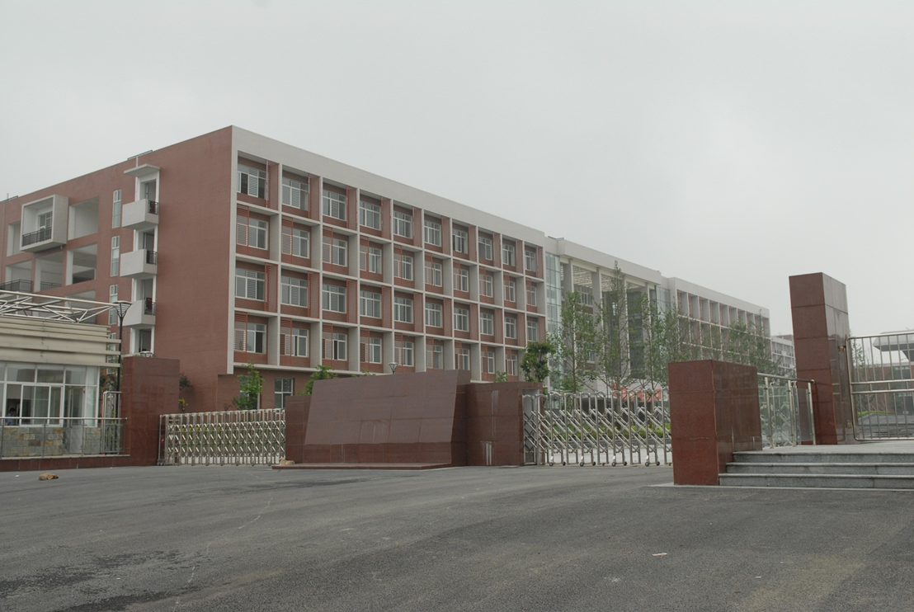
SMU Front Gate

Slide 33
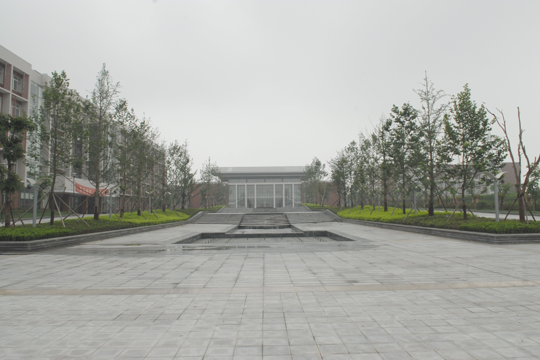
Inside Gate Court Yard

Slide 34
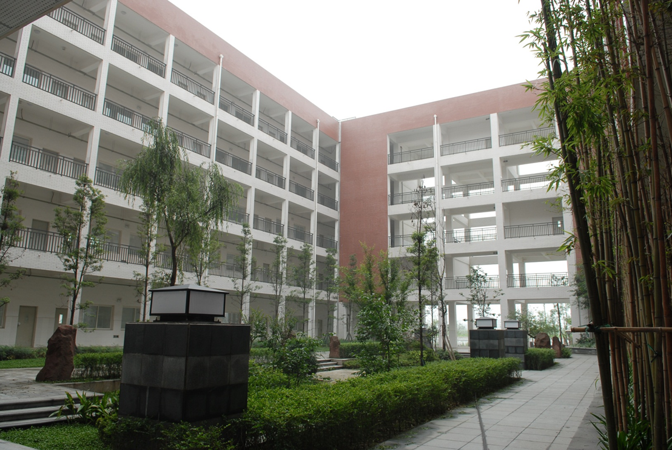
SMU Classroom Building Interior Court

Slide 35
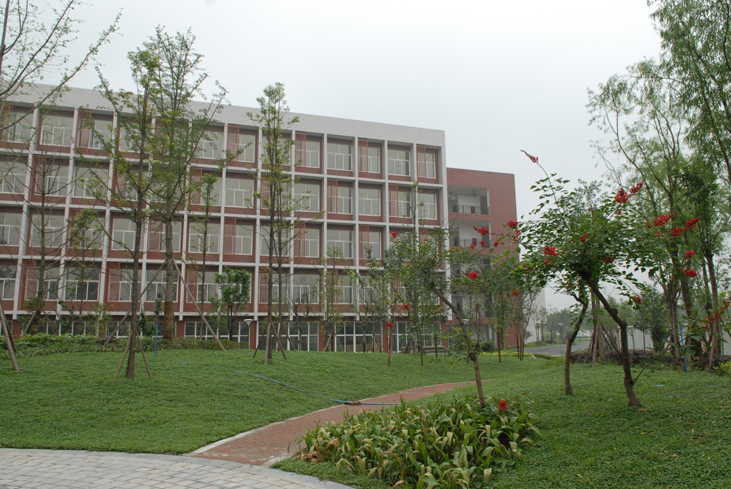
SMU Lab Building

Slide 36
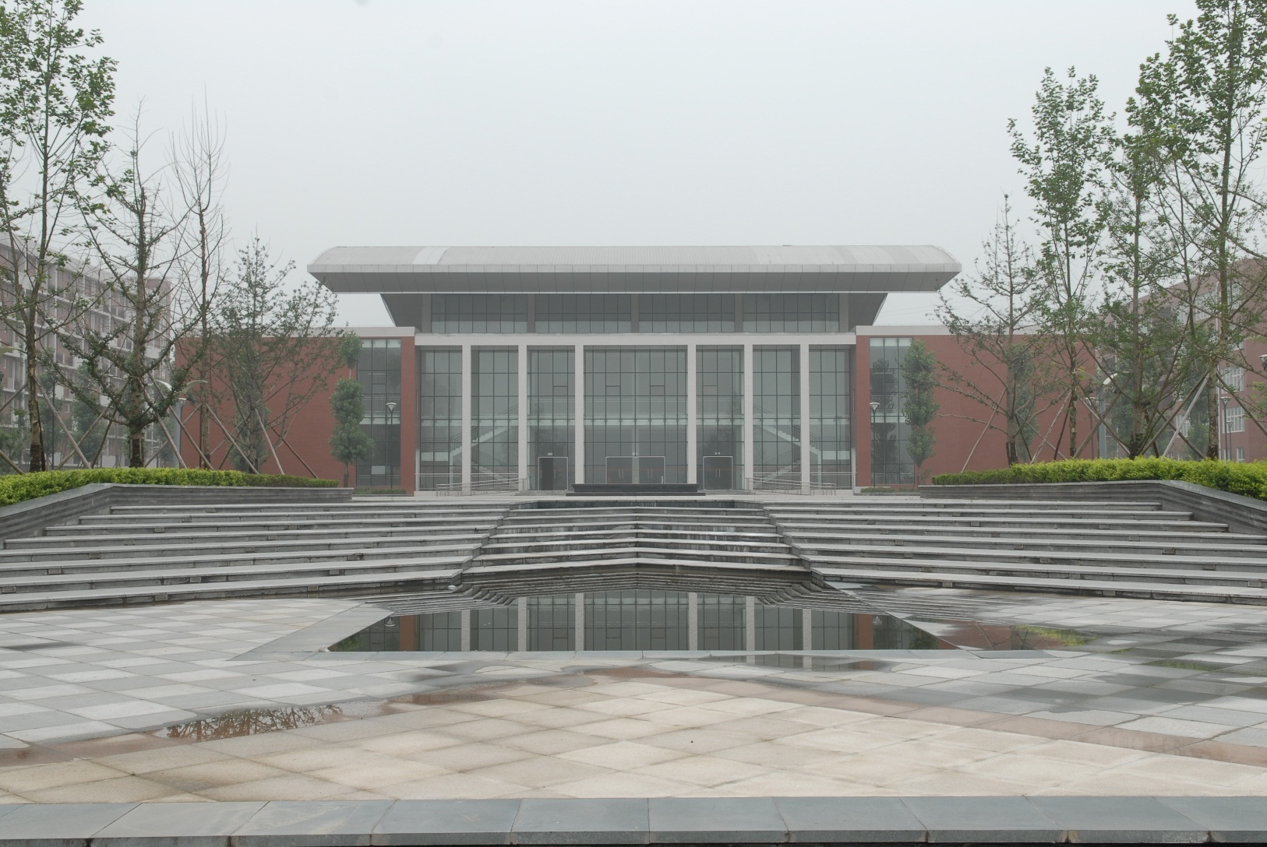
SMU Learning Resource Center

Slide 37
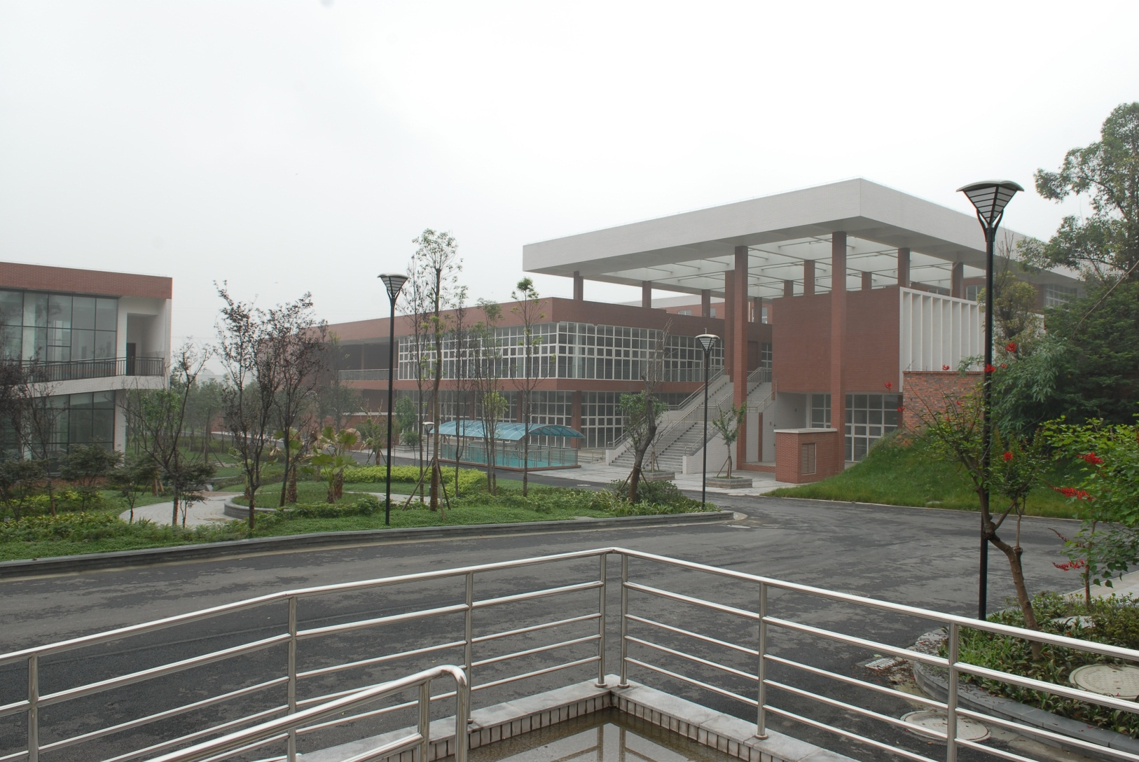
SMU Support Center

Slide 38
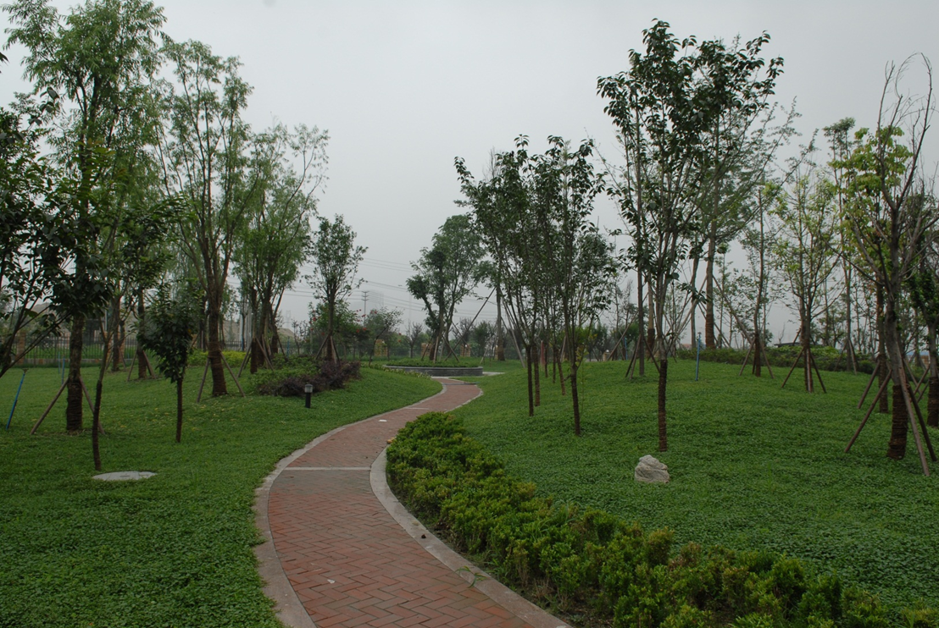
SMU Landscaping

Slide 39
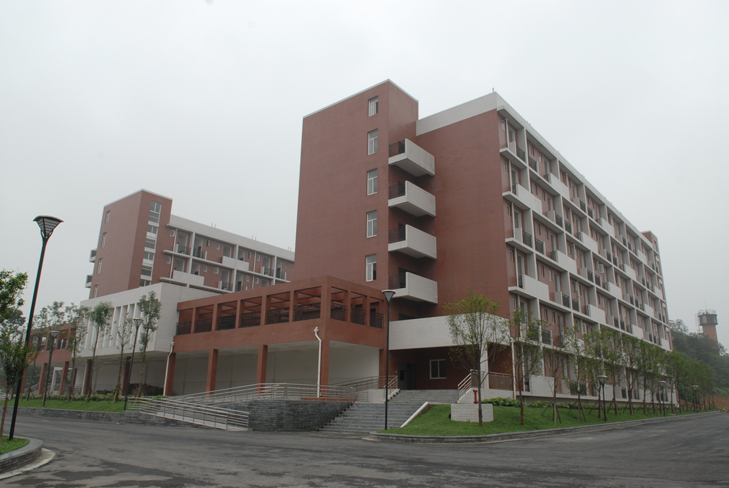
SMU Residence Halls

Slide 40
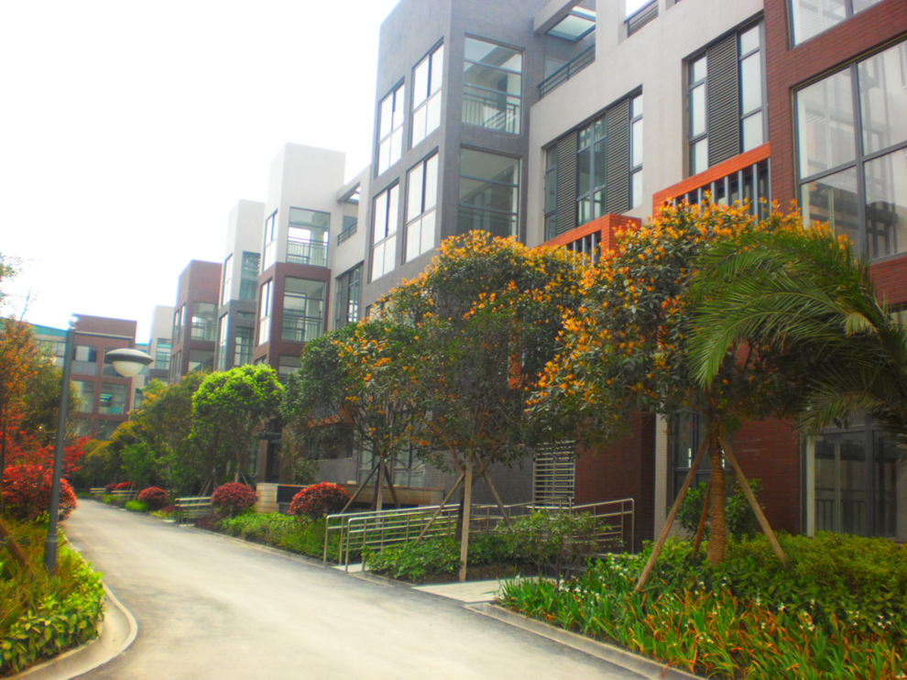
Parcel 3 Building 1

Slide 41
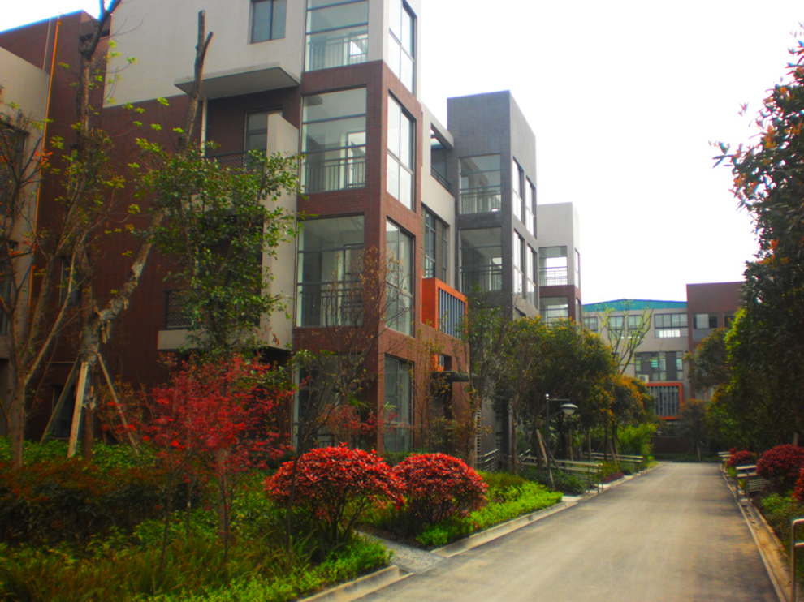
Parcel 3 Building 2

Slide 42
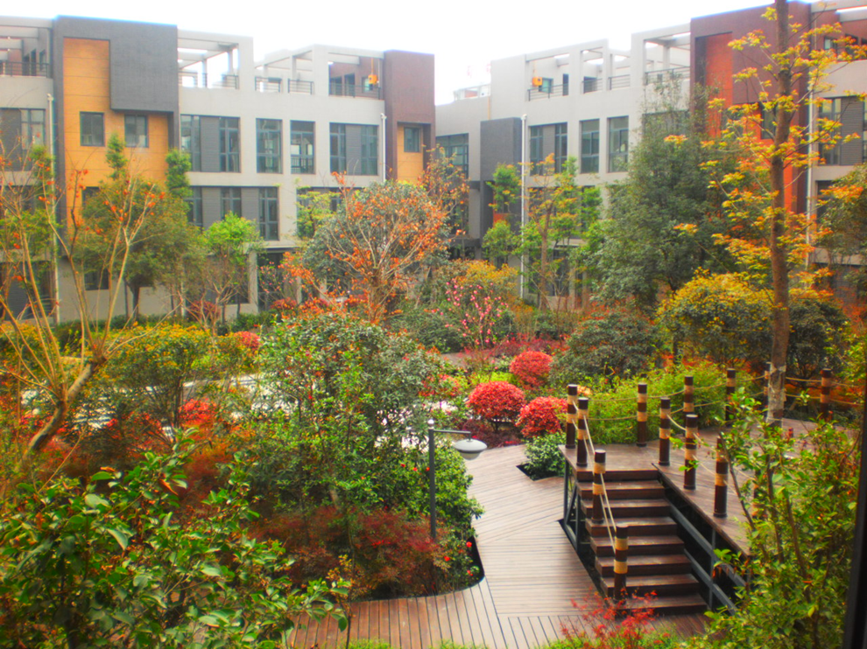
Parcel 3 Interior Garden

