Slide 1
CAMPUS UPDATE

Slide 2
THE STATE OF U.S. HIGHER EDUCATION

Slide 3
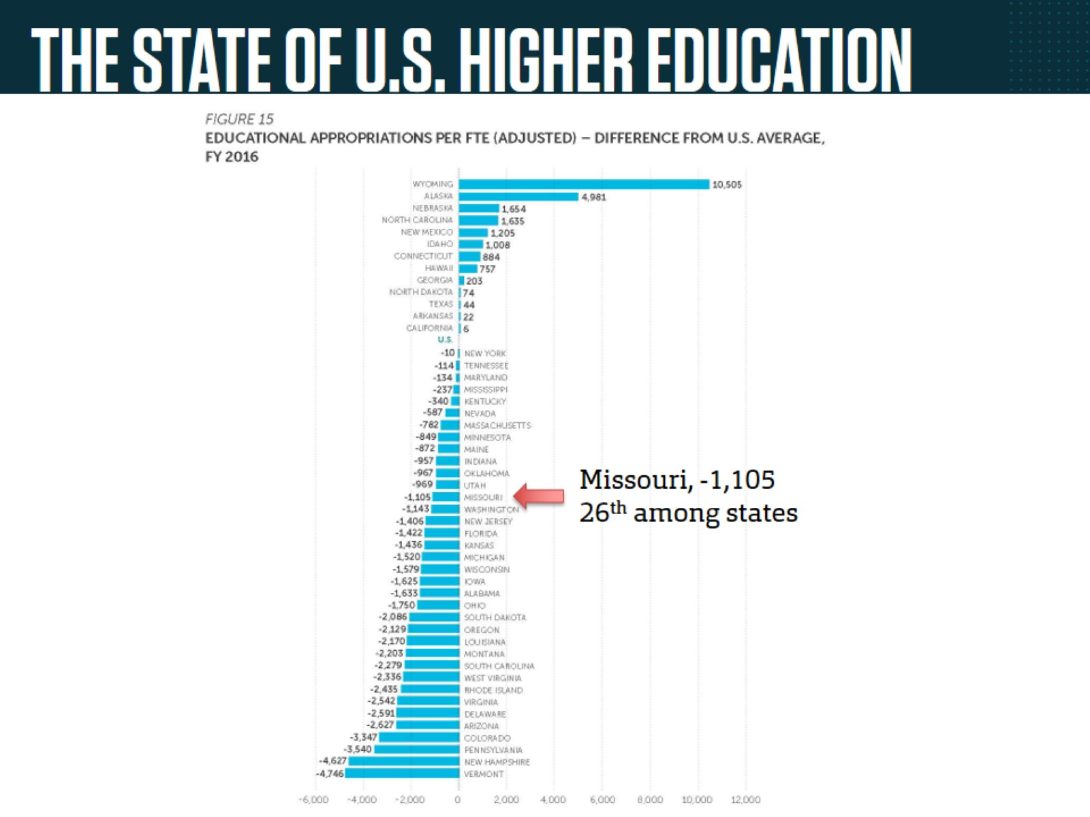
THE STATE OF U.S. HIGHER EDUCATION

Slide 4
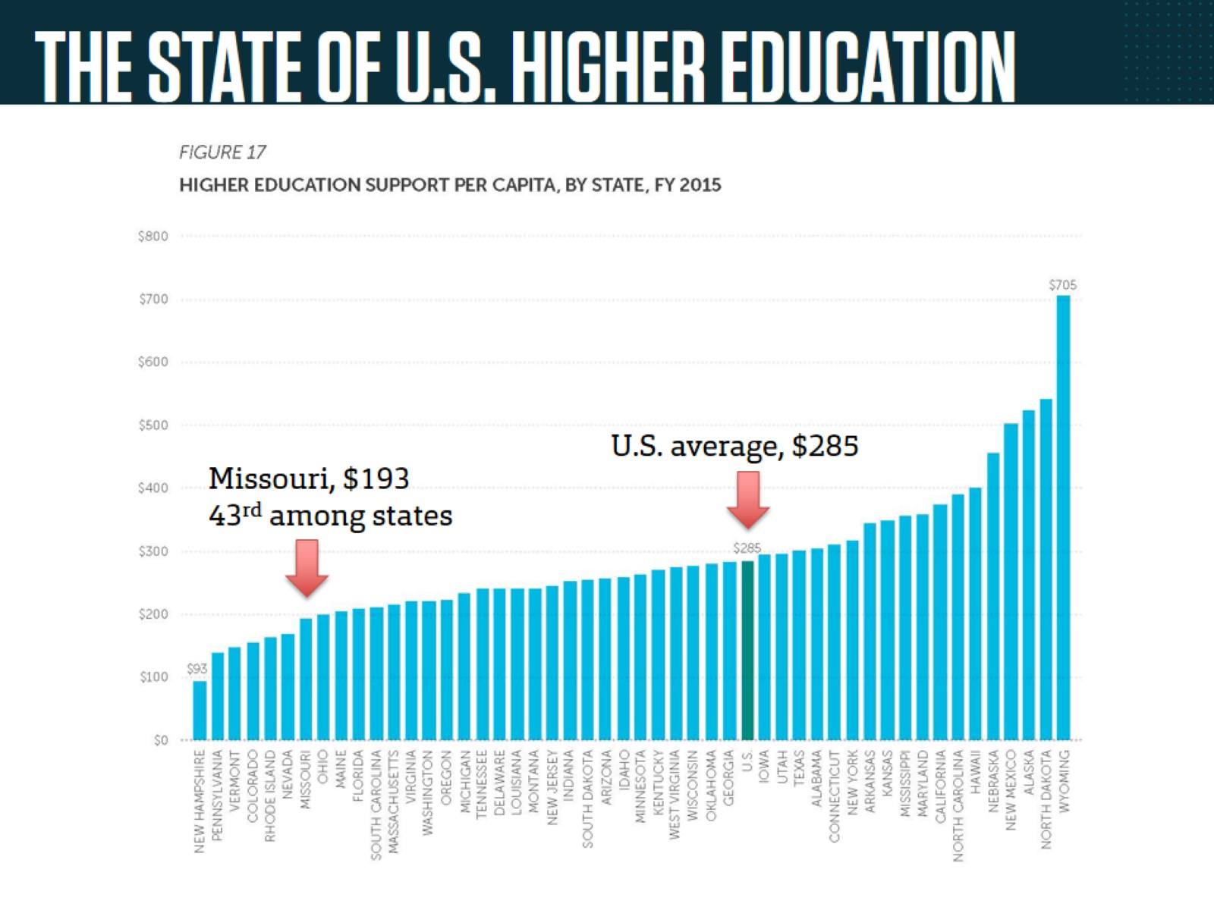
THE STATE OF U.S. HIGHER EDUCATION

Slide 5
THE STATE OF U.S. HIGHER EDUCATION

Slide 6
GOVERNOR’S BUDGET PROPOSAL

Slide 7
IMPORTANT LEGISLATION

