Slide 1
CAMPUS UPDATE

Slide 2
HIGHLY SELECTIVE STATUS

Slide 3
HIGHLY SELECTIVE STATUS

Slide 4
HIGHLY SELECTIVE STATUS

Slide 5
SELECTIVE STATUS

Slide 6
SELECTIVE STATUS

Slide 7
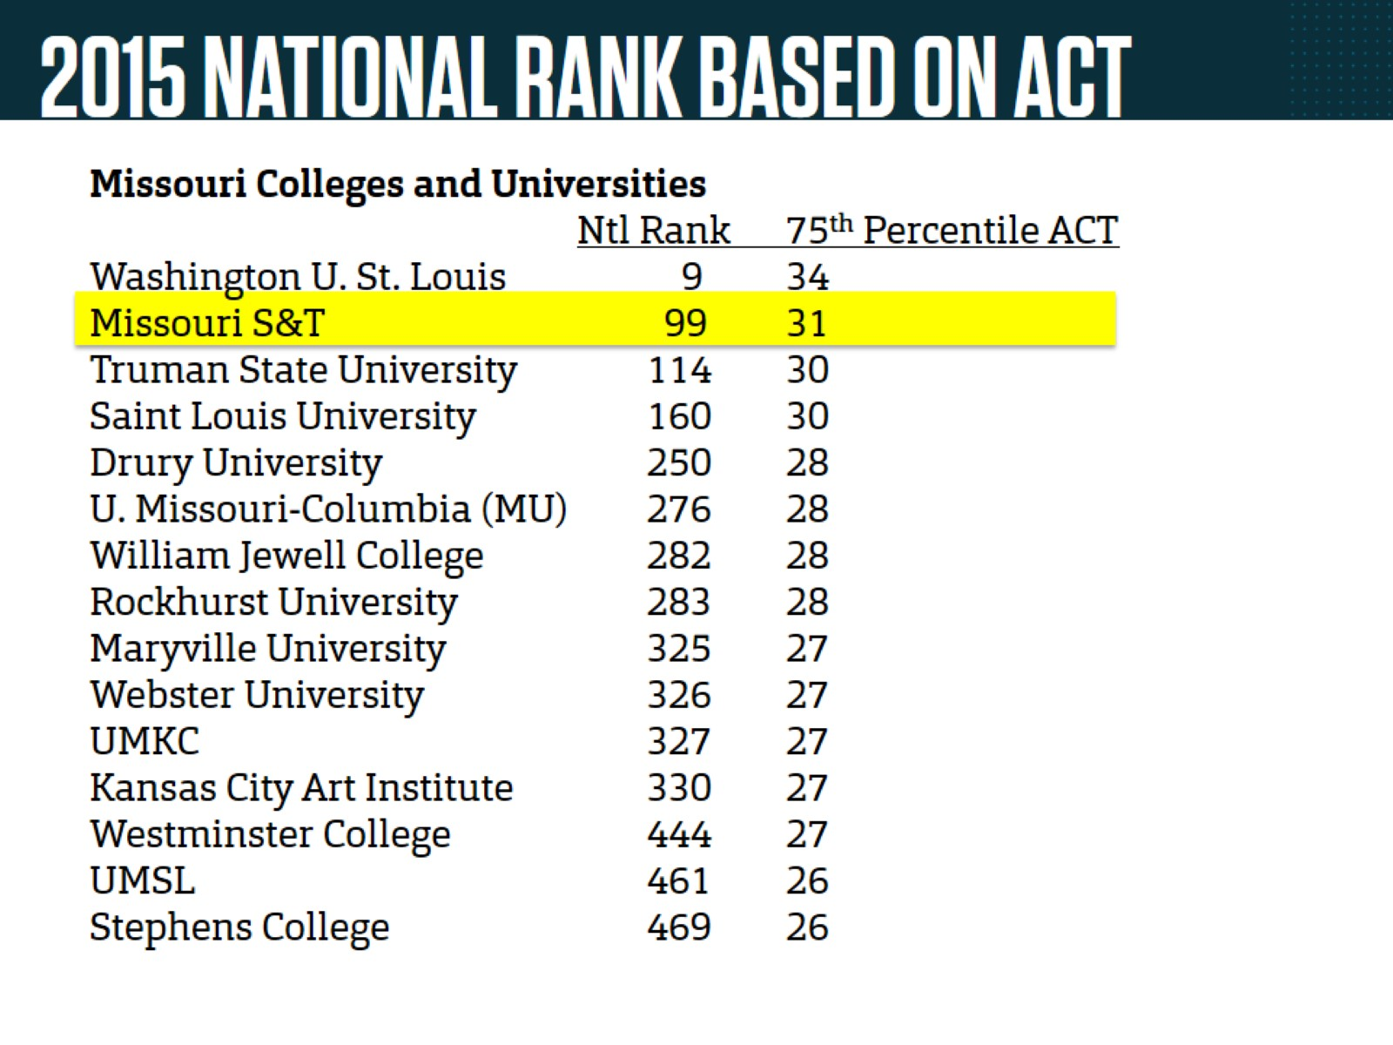
2015 NATIONAL RANK BASED ON ACT

Slide 8
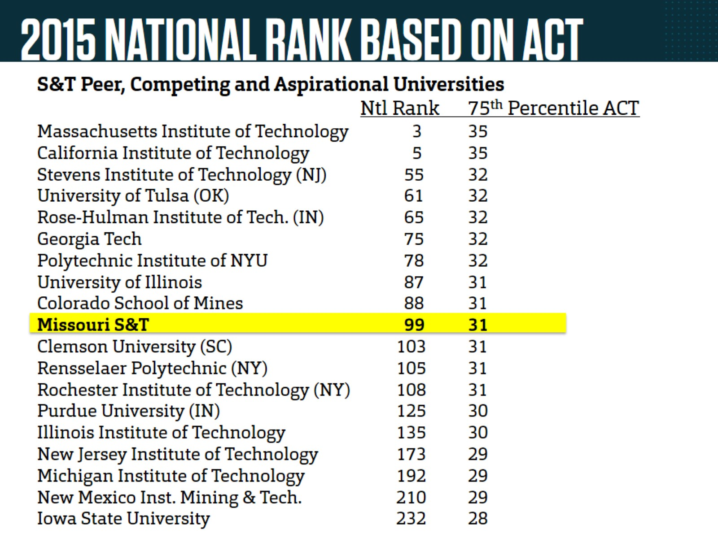
2015 NATIONAL RANK BASED ON ACT

Slide 9
COLLECTED RULES AND REGULATIONS

Slide 10
UM SYSTEM ACTIVITY ANALYSIS SURVEY

