Slide 1
CAMPUS UPDATE

Slide 2
‘HIGHLY SELECTIVE’ DESIGNATION

Slide 3
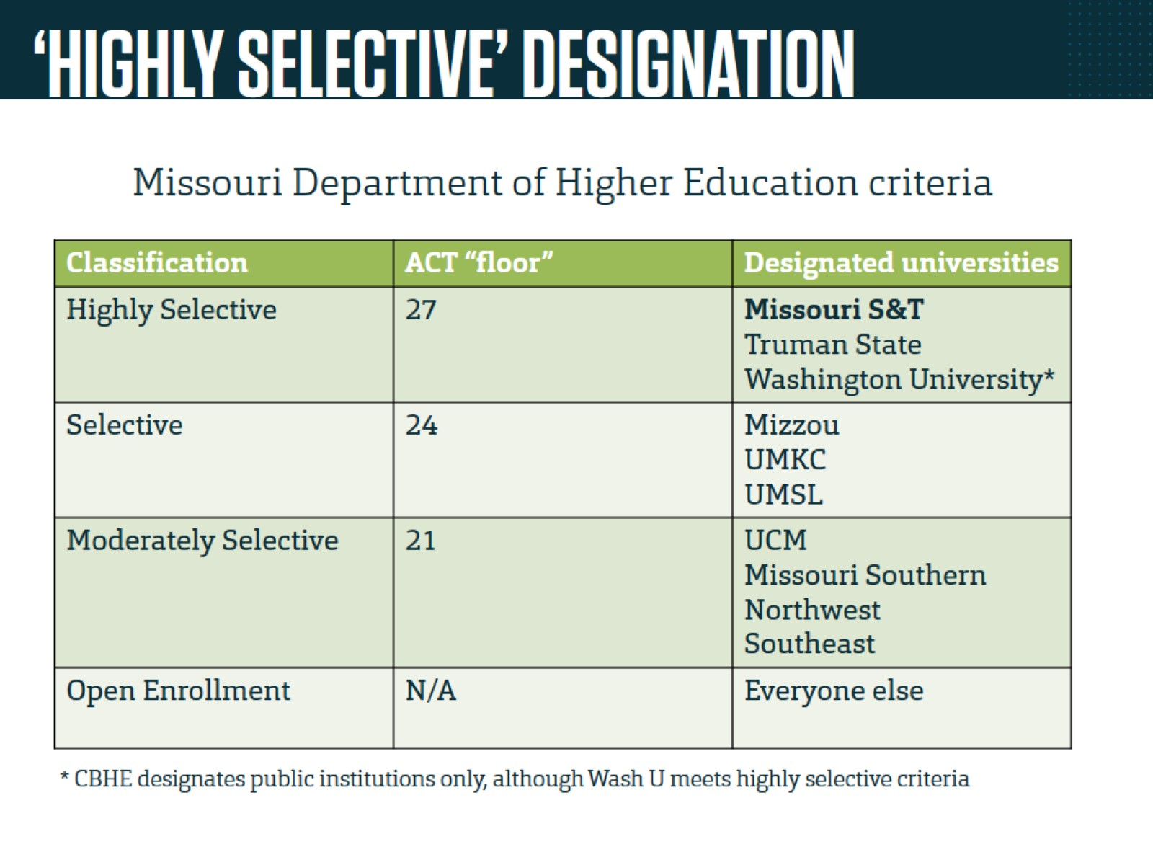
‘HIGHLY SELECTIVE’ DESIGNATION

Slide 4
FY19 BUDGET PLANNING

