Slide 1
Faculty Senate Update
Christopher G. Maples, Interim Chancellor
March 21, 2019

Slide 2
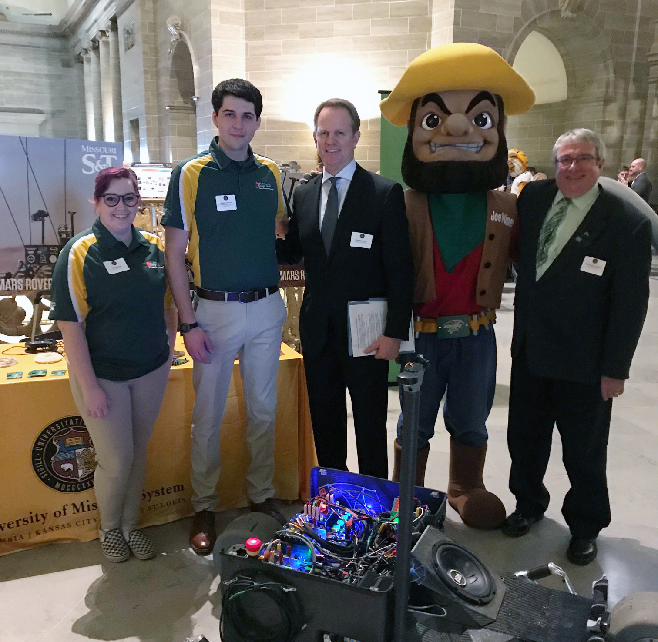
LEGISLATIVE SHOWCASE: FEBRUARY 21
Mars Rover Design Team members Téa Thomas (Business) and Andrew Rausch (Mechanical Engineering) with Curator Jon Sundvold, Joe Miner and Interim Chancellor Chris Maples

Slide 3
UPCOMING EVENTS
March 27 – Chris Maples Memphis recruitment trip
April 1-30 – Philanthropy Month
April 2 – 150th anniversary open forum
April 11 – Board of Curators
April 24 – Woman of the Year
April 25 – Board of Trustees
April 25 – Fitness Center Dedication
April 26 – Kummer Student Design Center Expansion Dedication
May 6-10 – D.C. recruitment
May 7 – General Faculty meeting

Slide 4
UPCOMING EVENTS

Slide 5
THANK YOU!
QUESTIONS?

