Slide 1
CCC Calendar
CCC Meetings
12 August
7 October (upcoming)
Total Committee Activity
10 Degree change request (DC forms)
20 Course change requests (CC forms)
10 Experimental course requests (EC forms)

Slide 2
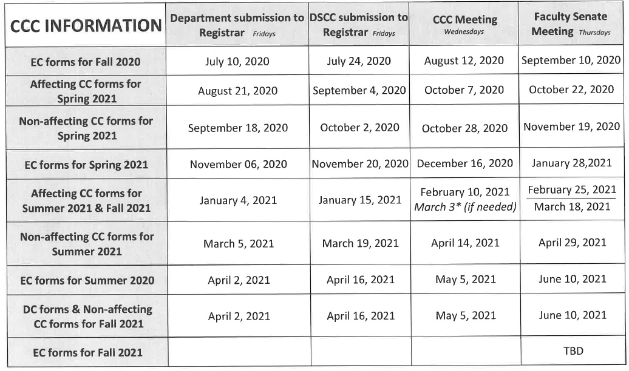
CCC Calendar

Slide 3
Degree Program Changes (DC) Requested
File: 145.11 BIOINFO-MI : Bioinformatics Minor
File: 11.6 BUS&MS-MI : Business Minor
File: 28.65 CMP SC-BS : Computer Science BS
File: 40.6 E&S COM-MI : Elect & Social Commerce Minor
File: 155.55 EL ENG-BS : Electrical Engineering BS
File: 50.7 ENTPRNS-MI : Entrepreneurship Minor
File: 138.12 MGMT-MI : Management Minor
File: 190.1 MUSIC-MI : Music Minor
File: 359 PROPOSED : Aggregates Management CT
File: 335.6 SFTYENG-CT : Safety Engineering

Slide 4
Course Changes (CC) Requested
File: 4720 BUS 1414 : The Inclusive Workplace
File: 4406.8 BUS 5230 : Financial Statement Analysis
File: 507.10 BUS 5360 : Business Operations
File: 2417.1 CER ENG 5230 : Glass Science And Engineering
File: 4279.22 CHEM ENG 3111 : Numerical Computing in Chemical and Biochemical Engineering
File: 4501.6 CHEM ENG 6180 : Advanced Applications of Computational Fluid Dynamics
File: 938.1 COMP SCI 4010 : Seminar
File: 1668.1 ERP 4610 : Customer Relationship Management in ERP Environment

Slide 5
Course Changes (CC) Requested
File: 2527.3 ERP 6610 : Advanced Customer Relationship Management in ERP Environment
File: 2566.8 FINANCE 5160 : Corporate Finance II
File: 2190.10 FINANCE 5260 : Investments I
File: 4499.6 FINANCE 5310 : Financial Technology and Analytics
File: 920.10 IS&T 4654 : Introduction to Web Design and Digital Media Studies
File: 2390.2 IS&T 5680 : Digital Media Development and Interactive Design
File: 445.4 IS&T 6654 : Advanced Web Design and Digital Media Studies

Slide 6
Course Changes (CC) Requested
File: 1614.6 IS&T 6680 : Advanced Digital Web and New Media Development and Interactive Design
File: 4724 MECH ENG 5539 : Modeling Across Scales in Computational Mechanics
File: 2466.1 MUSIC 2111 : Individual Music Instruction III
File: 1983.1 PET ENG 4631 : Applied Reservoir Simulation
File: 79.3 PET ENG 6621 : Advanced Applied Reservoir Simulation

Slide 7
Curriculum committee moves for FS to approve the DC and CC form actions
Discussion: Questions or comments?

Slide 8
For Informational Purposes; No Senate Approval Required
Experimental Course (EC) Requests
File: 4722 CIV ENG 6001.007 : Characterization and Modeling of Cement-Based Materials
File: 4721 COMP ENG 6001.006 : Adaptive Resonance Theory and Applications
File: 4723 MECH ENG 5001.005 : Neuromechanics of Human Movement
File: 4734 MUSIC 2001.004 : The Heart of Rock n' Roll
File: 4715 STAT 5001.003 : Computational Bayesian Methods using Python

Slide 9
For Informational Purposes; No Senate Approval Required
Experimental Course (EC) Requests
File: 4719 STAT 5001.004 : Design and Analysis of Clinical Trials
File: 4717 STAT 5001.005 : Foundations of Statistical Learning
File: 4718 STAT 5001.006 : Design and Analysis of Epidemiologic Studies
File: 4716 STAT 5001.007 : Statistical Shape Analysis
File: 4711 STAT 5001.008 : Topological Data Analysis

