Slide 2
PHASE ONE
Gateway & Global navigation
COMPLETED

Slide 3
“Recognize that your external Web site is your number one recruitment marketing tool.”
-E-Expectations 2010
Sponsored by: Noel-Levitz, NRCUA (National Research Center for College and University Admissions), OmniUpdate

Slide 5
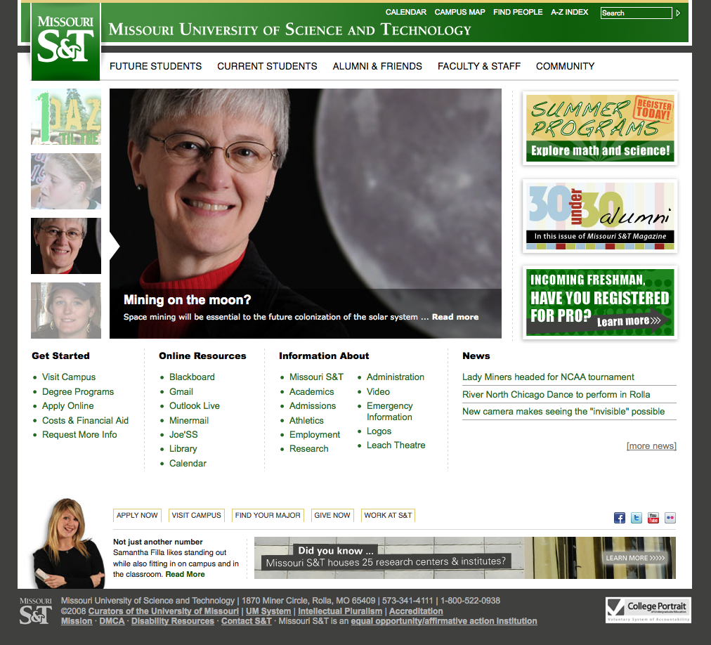

Slide 6
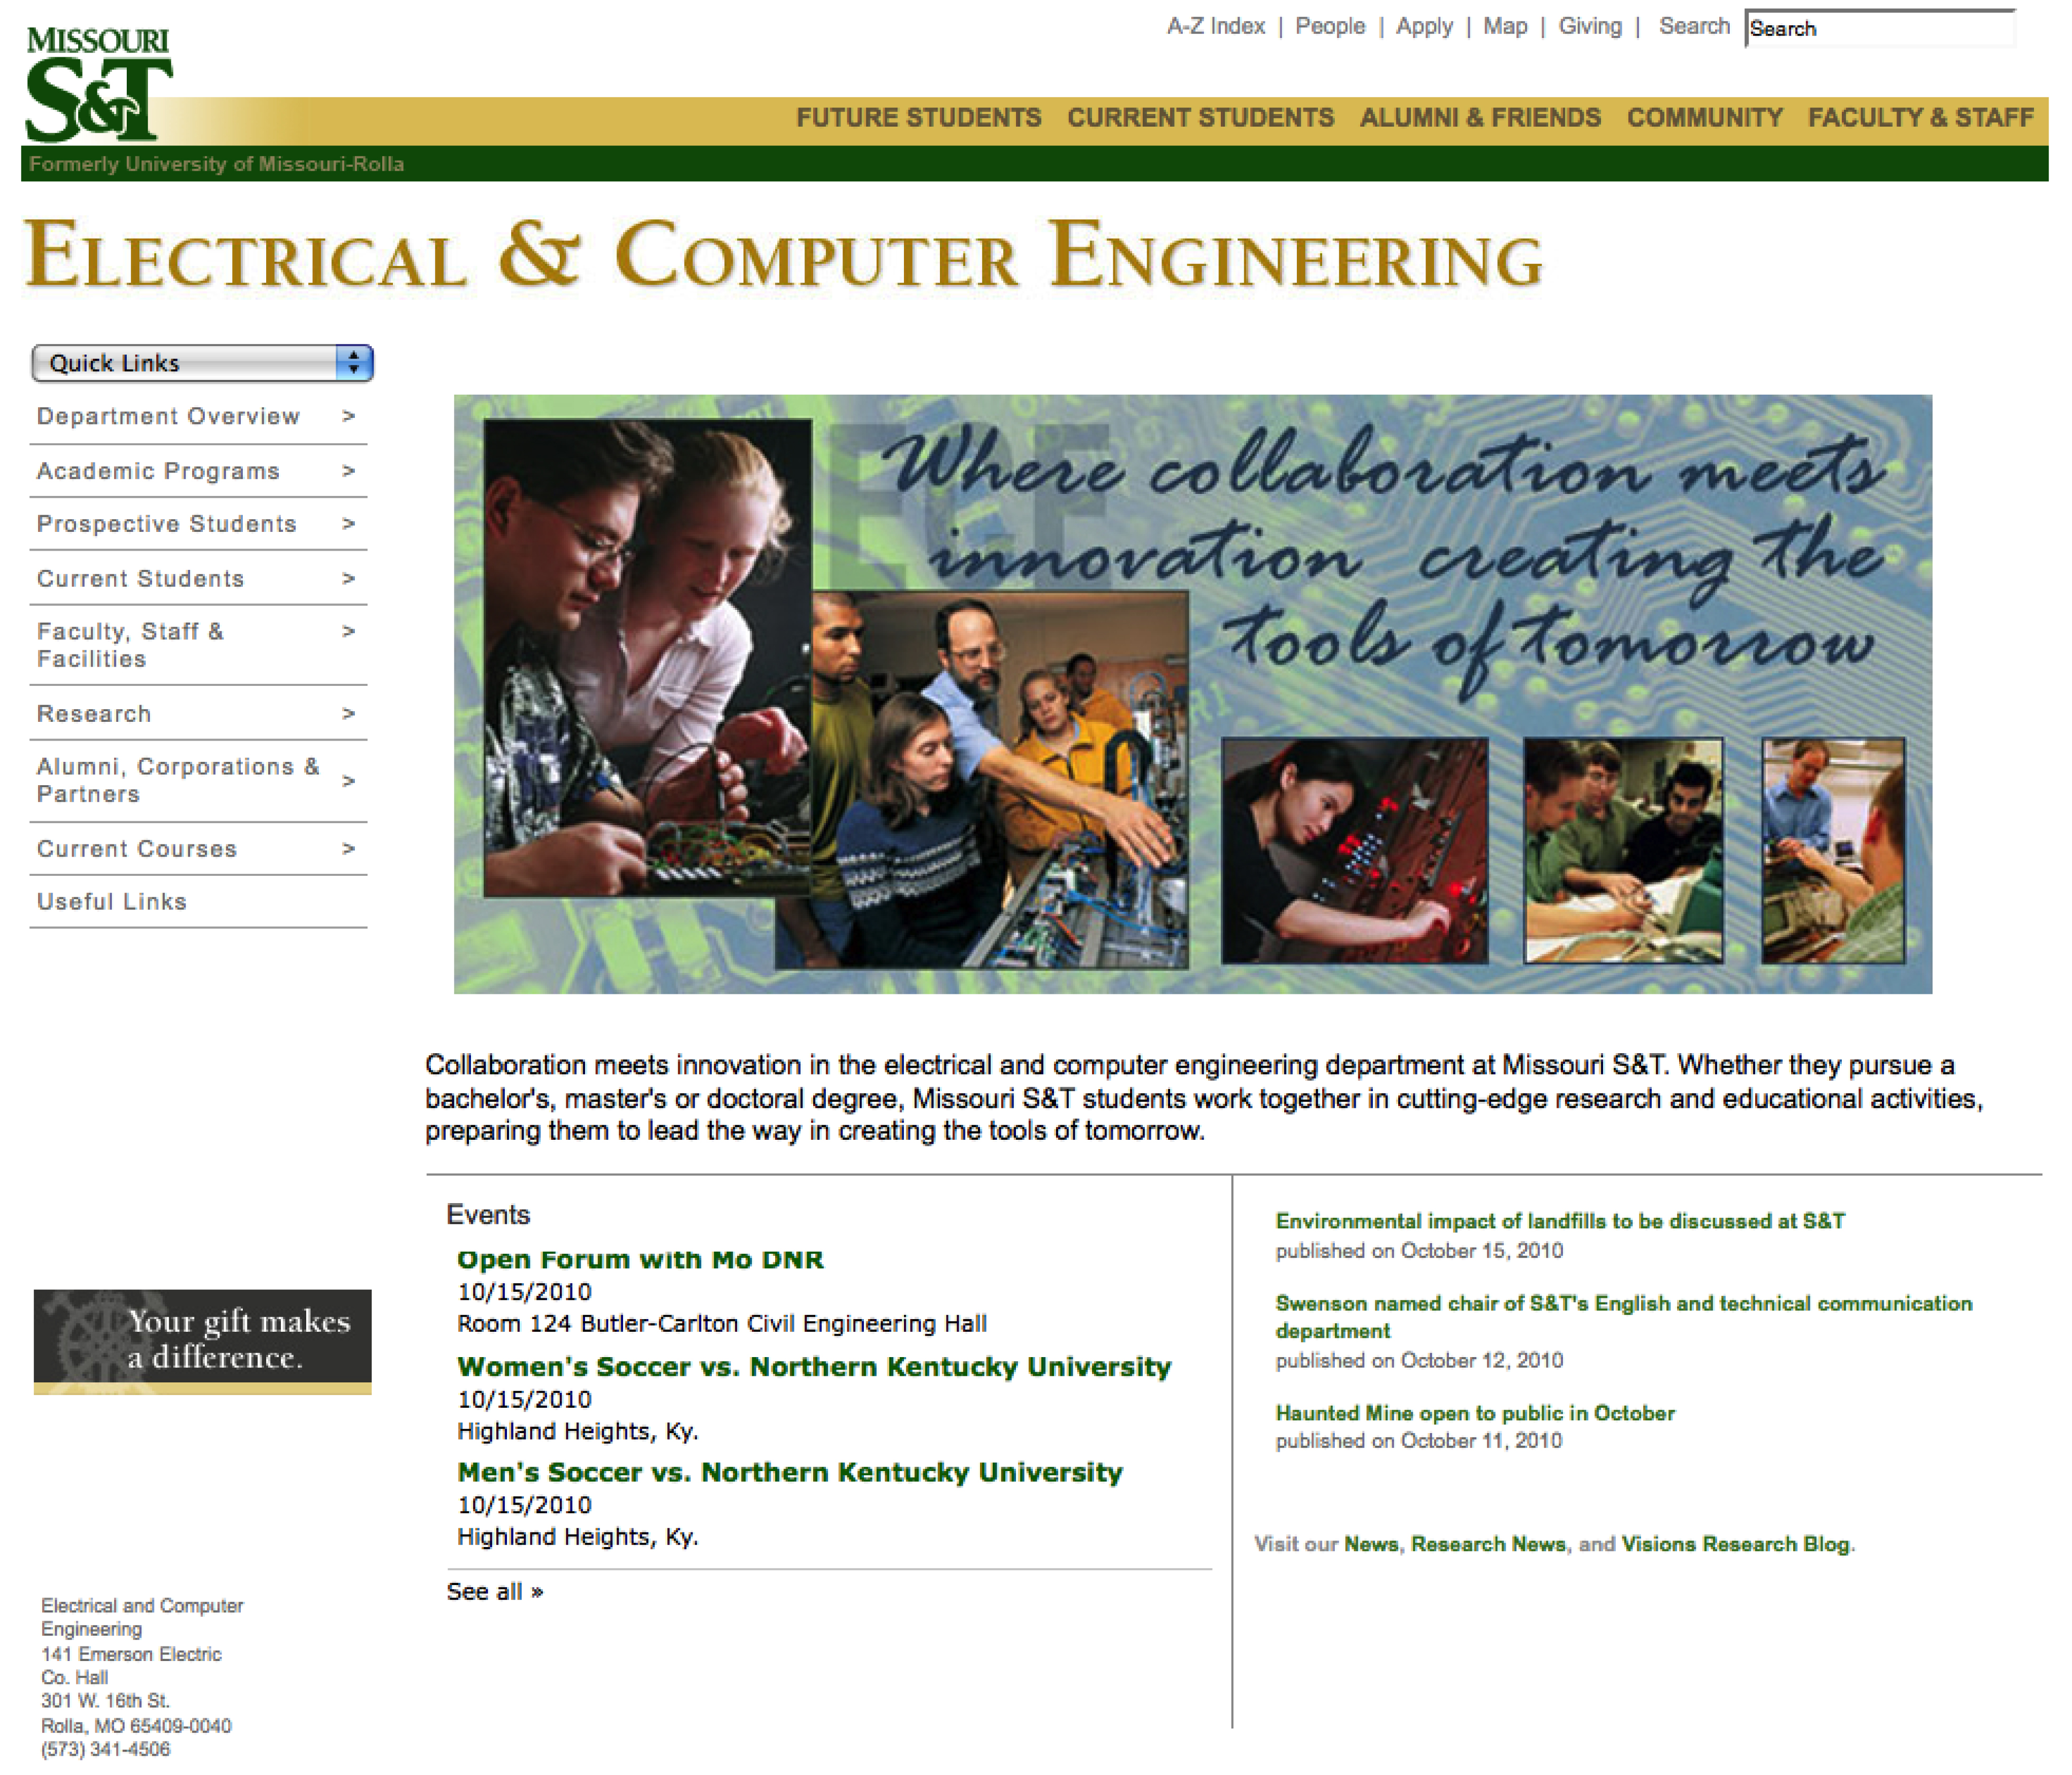

Slide 8
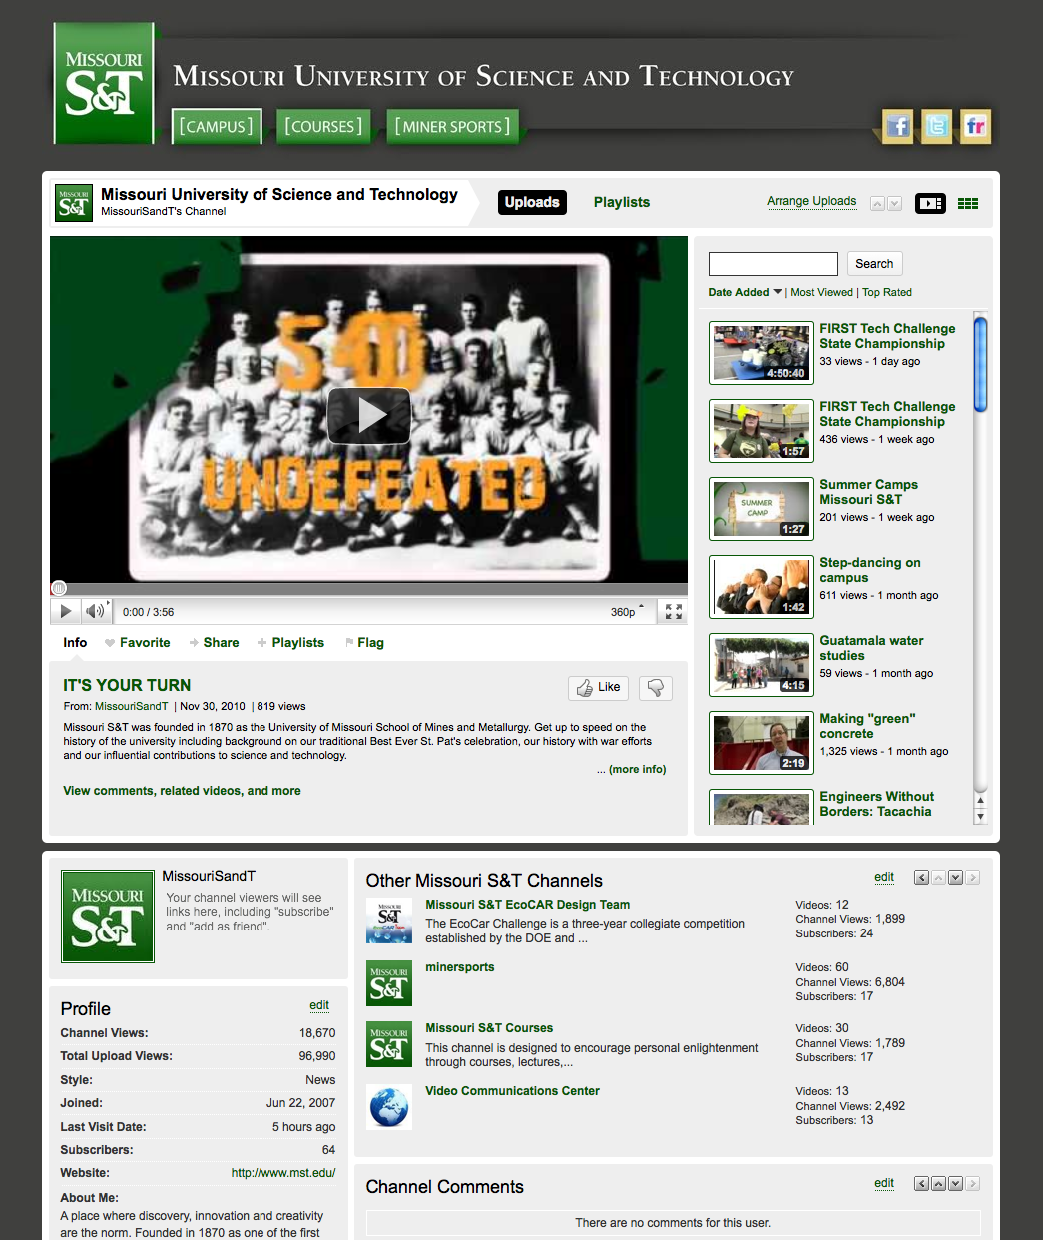
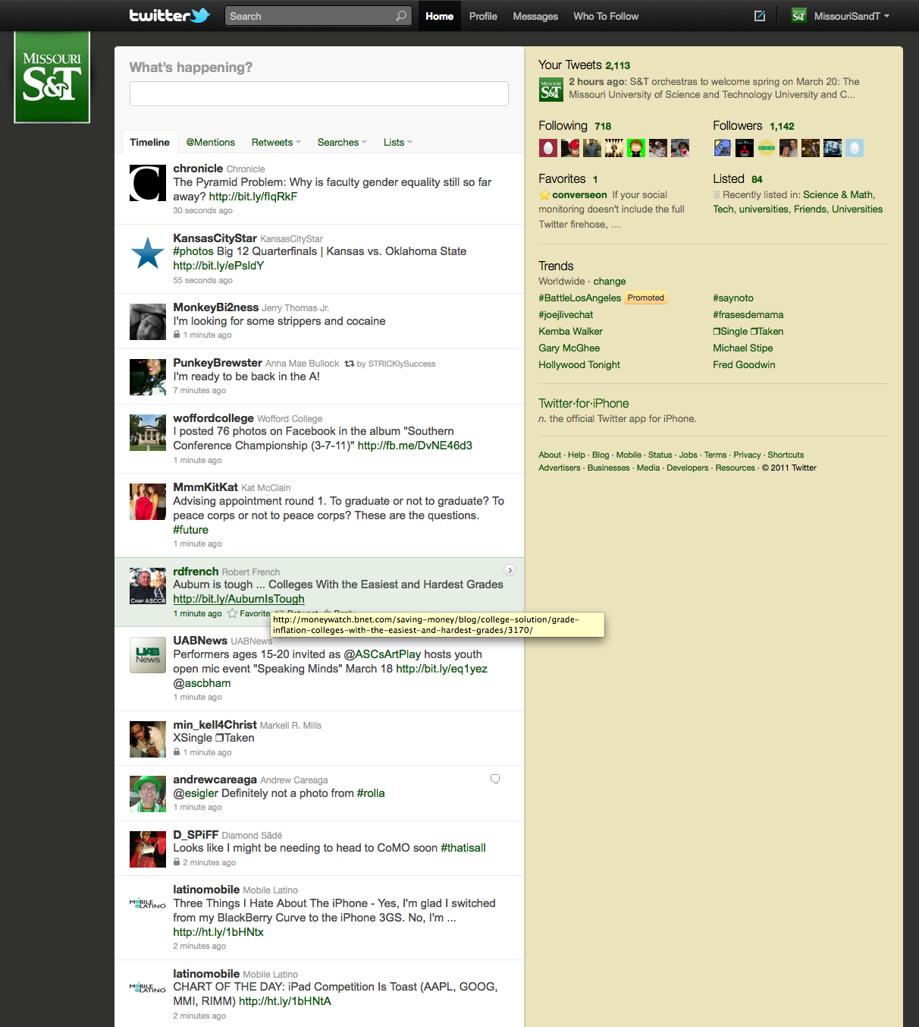
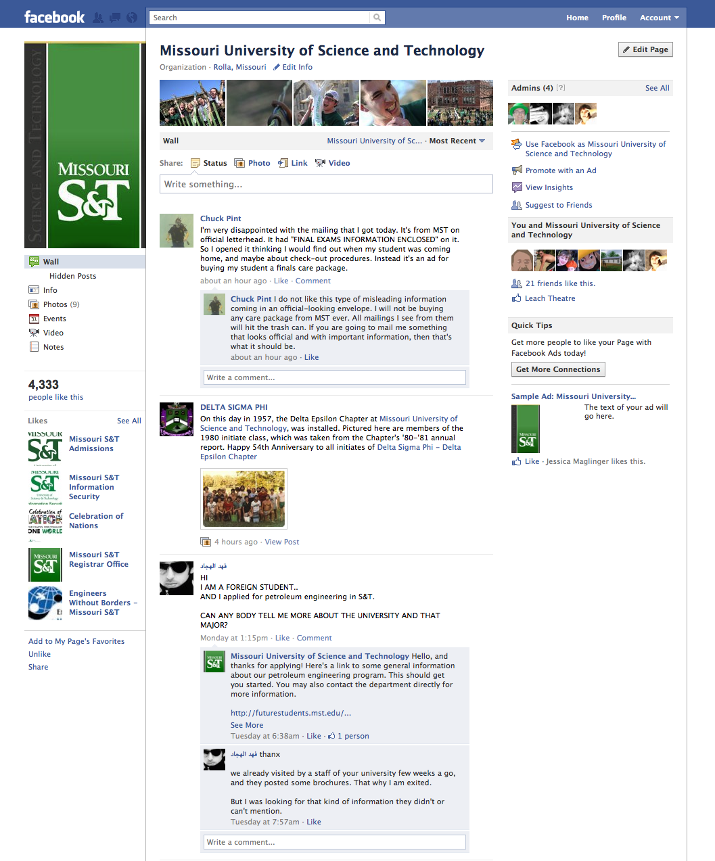

Slide 9
PHASE TWO
Content & Page style
Timeline: January 1st – July 1st 2011

Slide 12
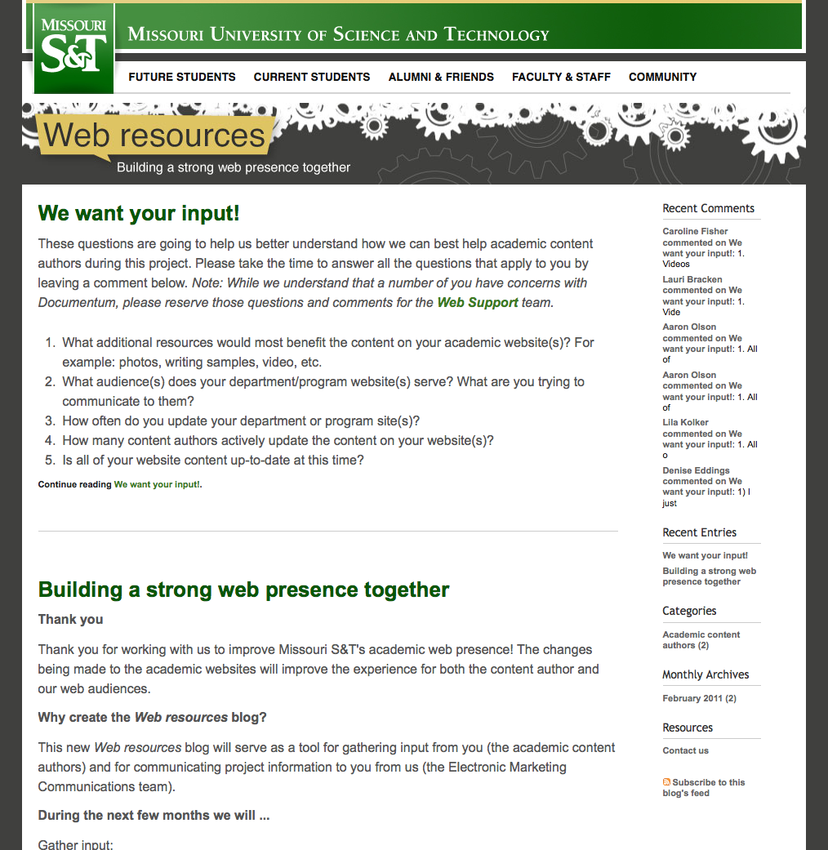
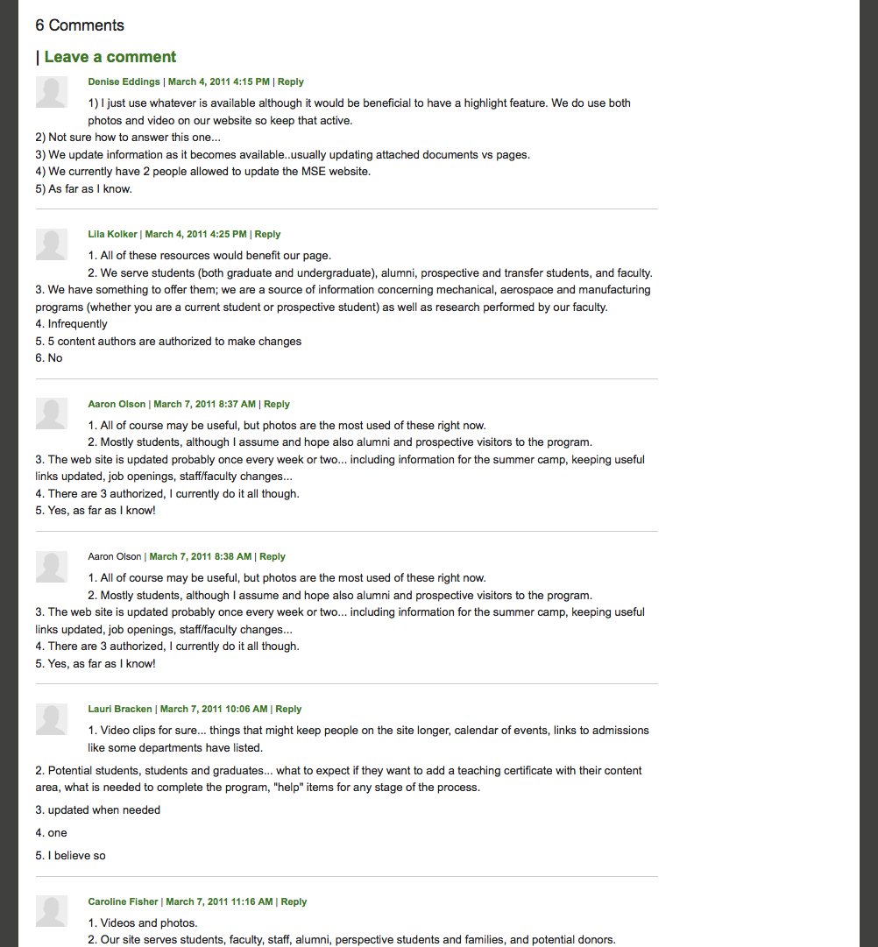

Slide 13
BENEFITS

Slide 14
QUESTIONS?

