Slide 1
Research Support Services
ITCC Update, 10 April, 2013

Slide 2
Academic Cluster Upgrades
2013 upgrades are in progress
Dell C6220 servers (compute nodes)
Mellonox FDR infiniband interconnect
Redundant UPS (100KVA chassis)
In process
Switching from hosted equipment to committed compute/core hours

Slide 3
Academic Cluster Upgrades
At Semester Start:
746 Cores configured in queue system
1563 Cores available in cluster
Now
942 Cores configured in queue system
1759 Cores available in the cluster.
End of Semester
1198 Cores Configured in queue system
2015 Cores available in the cluster

Slide 4
Customers Served This Semester
Services provided by 2 FTE, 11 students
Support Requests: 158
Different Customers: 77
Different Departments: 32

Slide 5
V4DiR
Focus shifted to display systems
Wrap-around environment
Mobile high res
Demo negotiations in progress
Faculty input requested
Use of large flat-panel display
Quad resolution
70-84” diagonal

Slide 6
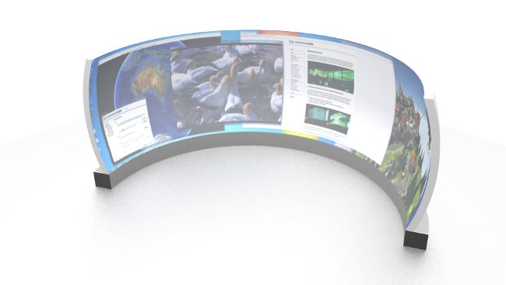
Wrap Around Screen

