Slide 1
President’s Report
Dr. Michael Bruening, Faculty Senate President

Slide 2
Intercampus Faculty Council (IFC)
Last IFC meeting, April 16 (President Choi was not present)
Process for recording the last day of academic activity for students who fail or withdraw
Required by Title IV federal law on financial aid
Proposal to pull dates automatically from Canvas. Faculty member can override but in all cases must provide a LDA (last date of attendance) for failing students
Emeritus CRR change proposals forthcoming
Want to adjust to include NTTs
We requested additional changes to limit non-faculty administrative emeritus titles

Slide 3
eLearning Task Force

Slide 4
IFC
Data-driven assessment
Presentation to Curators to use more data for academic program review, using Academic Analytics
Discussion of improvements to Academic Analytics
Consensual Romantic Relationships
Discussion on whether to revise CRR 330.065 to prohibit relationships between faculty and any undergrad, and between faculty and any graduate student in the same dept. (U. Michigan has recently done this) – no consensus

Slide 5
Update on Referrals/Committee action
Bylaws revision: to be continued…
New referral to Budgetary Affairs and Student Awards and Financial Aid
Use of Department scholarship funds
New referral to Personnel Committee
Faculty annual review confidentiality agreement: available to deans again?

Slide 6
Budget
Not pretty, budget cut proposals coming next week
Shifting state budget scenario
State budget based on +1.6%
Prediction reported last month: -1.5% to -3.5%
Early April: -4.26%
This week: +.06%
Interest in a resolution giving up 2% merit raise pool to save staff jobs?

Slide 7
Chancellor Search Update
2 finalists interviewed on campus over the last week
Hope for an agreement in “10-14 days” (from Tues.)

Slide 8
Upcoming Events
May 7: General Faculty Meeting, President Choi present to discuss budget, chancellor’s search
May 13: Deadline for FERRC (Faculty External Rewards and Recognitions Committee) nominations (see Barb’s email of April 19)
May 17-18: Commencement
From Student Council:
Today, 4:45pm, Fitness Center Dedication
CET evals open this weekend. Dinner for dept with highest response rate

Slide 9
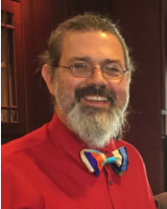
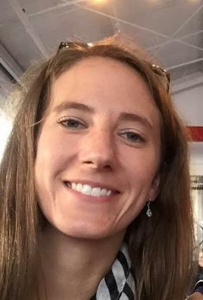
Recent Recognitions
Mark Fitch, President’s Award for University Citizenship—Service
Kate Sheppard, S&T’s Woman of the Year

Slide 10
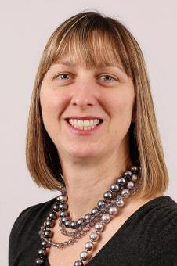
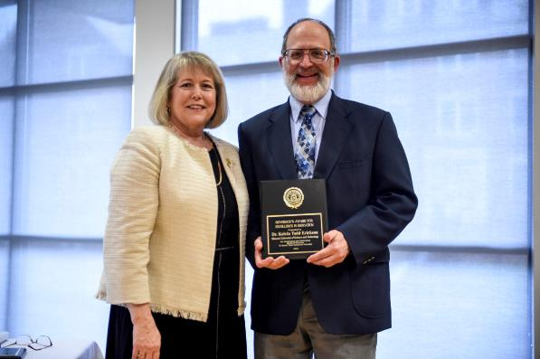
Recent Recognitions
Katie Shannon, Women’s Advocate of the Year Award
Kelvin Erickson, Governor’s Award for Excellence in Teaching

Slide 11
Department Chair CRR
Curators passed revision of CRR 20.110 and annulled the section of our bylaws on chair searches
In response to feedback:
Final version requires 50% of chair search committee to be department faculty
Requires department faculty input on chair reappointment
Acknowledges role of chair as “liaison” between department and administration

Slide 12
Moving Forward on Chair Searches
Need feedback on temporary proposal (below) and ideas for long-term proposal (Bylaws revision? Policy memorandum? Other?)
1. The Department chair shall be appointed by the Dean, with the approval of the Provost and Chancellor (per CRR 20.110) after consultation with a duly appointed search committee.
2. When the Dean becomes aware of an impending department chair vacancy, s/he shall meet with the department faculty to discuss the search process, including the question of whether the search should be internal or external.

Slide 13
Chair Search Draft Proposal
3. With the department’s input, the Dean will make the final decision on whether the search will be internal or external. Internal searches require the approval of the Provost and Chancellor (per CRR 20.110).
4. The Dean will then appoint a search committee. The search committee will consist of a majority of department faculty (per CRR 20.110), chosen by the voting faculty members of the department (per AAUP guidelines). The faculty shall endeavor to assemble a diverse and inclusive set of representatives.
5. The Dean may add faculty, staff, and other relevant constituents to ensure shared governance and diverse input on candidates (per CRR 20.110).

Slide 14
Chair Search Draft Proposal
6. The Chief Diversity Officer will be asked to review the composition of the search committee, and if the composition does not meet an appropriate representation, may seek or provide alternative or additional nominations for the Dean’s consideration, while ensuring that the department faculty remain a majority of the committee.
7. The search committee shall meet and receive its charge from the Dean.
8. The Dean shall appoint a search committee chair selected from the department faculty representatives at the time the charge is delivered to the search committee. The committee may forward up to three committee member names for consideration by the Dean in the selection of a chair.

Slide 15
Chair Search Draft Proposal
9. The search committee and the committee charge shall follow an established, approved faculty/academic hiring process.
10. At the conclusion of the search process, the search committee will submit its recommendations to the voting faculty members of the department, who will vote on the acceptability of all finalist candidates. Candidates who receive support from a majority of voting faculty members will be considered acceptable.
11. The department faculty will then submit an unranked list of all acceptable candidates, noting their strengths and weaknesses, to the Dean.

Slide 16
Chair Search Draft Proposal
12. The Dean will either select the new department chair from the department’s list of approved candidates, or will extend the search.
13. In cases when an interim chair needs to be appointed for any reason, the Dean will consult with the full department faculty, who may recommend one or more candidates for the position.

