Slide 1
President’s Report
Dr. Michael Bruening, Faculty Senate President

Slide 2
Chancellor Search Update
New candidates were interviewed by the search committee via telepresence
Campus visits being arranged for 3 finalists for April
Same plan for campus visits as last time

Slide 3
Intercampus Faculty Council (IFC)
Title IX Legislation
Dept. Ed. guidelines coming , but Missouri legislation has also been introduced
UM concern about potential negative effect on reporting
Budget outlook
Governor’s budget based on 1.6% revenue growth, but probably looking at -1.5 to -3.5% decline
Benefits allocation
New method of calculation, based more on FTE head count than salary

Slide 4
IFC
Department Chair CRR: Faculty from the system campuses have submitted feedback, waiting to see revisions
Library Task Force
UC system cancelled Elsevier.
Growing disconnect between ever-rising database/journal costs and budget constraints
Growing push for open access
UM System librarians working together to form system-wide task force with faculty representation on open access/continued subscriptions

Slide 5
Committee Update
Department Creation/Realignment: Report today
Policy II-26/Graduate Student Funding: Report delayed until next month
Bylaws revision: Tom Schuman (chair) compiling individual section revisions
Committee Elections for 2019-2020 at next meeting

Slide 6
NTT Executive Order
Changes to CRR 310.035
Contract Length (§H): “Upon promotion to Associate Teaching Professor or Associate Research Professor, it is recommended that NTT faculty receive a two-year appointment except where there are budgetary or performance concerns. Upon promotion to Teaching Professor or Research Professor, it is recommended that NTT faculty receive a three-year appointment except where there are budgetary or performance concerns.”
Reappointment (§J): “NTT faculty with two to five years of consecutive service with positive annual evaluations will receive six months’ notice of nonrenewal. After five consecutive years, with positive annual evaluations, NTT faculty will receive a minimum of a one-year notice of nonrenewal.”

Slide 7
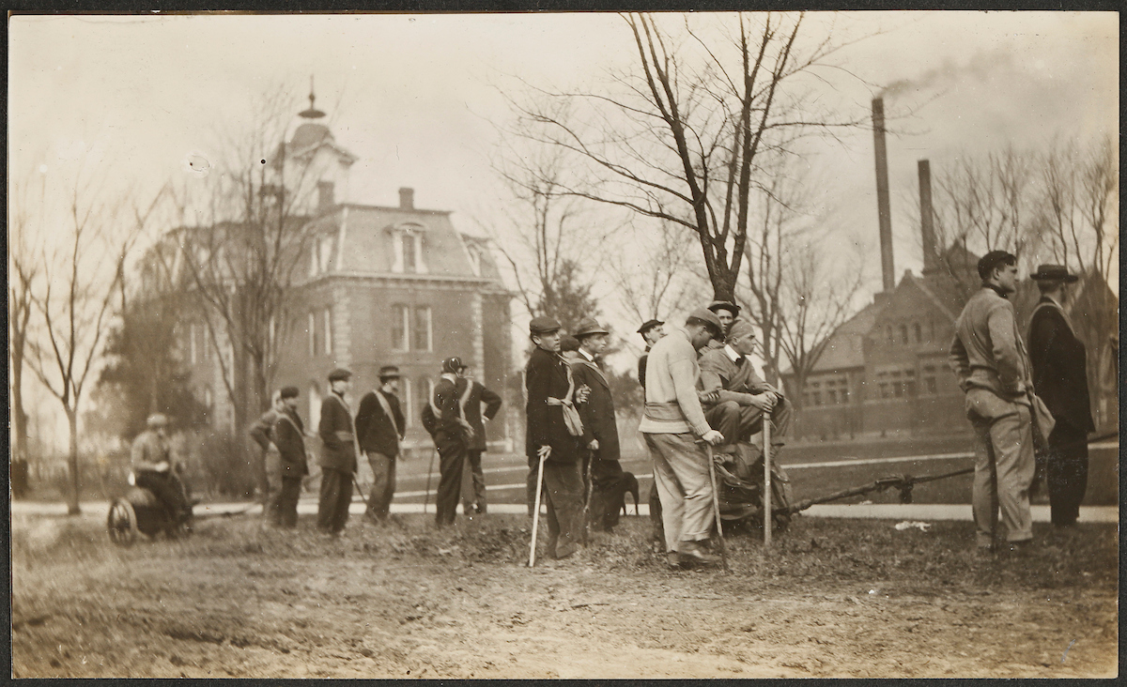
Recent and Upcoming Events
Women’s Hall of Fame Awards Luncheon (this morning)
Woman of the Year, Wed., April 24, Hasselmann, noon
S&T 150th Anniversary Open Forum, Mon., April 2, 1:30-3:00, Havener, St. Pat’s A

