Slide 1
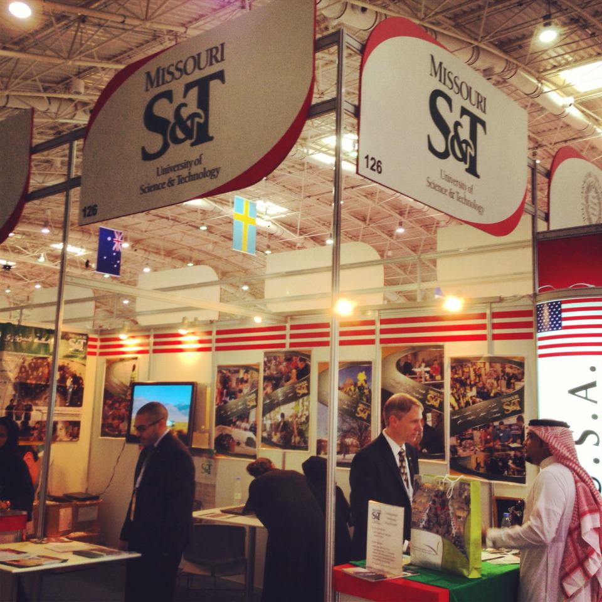
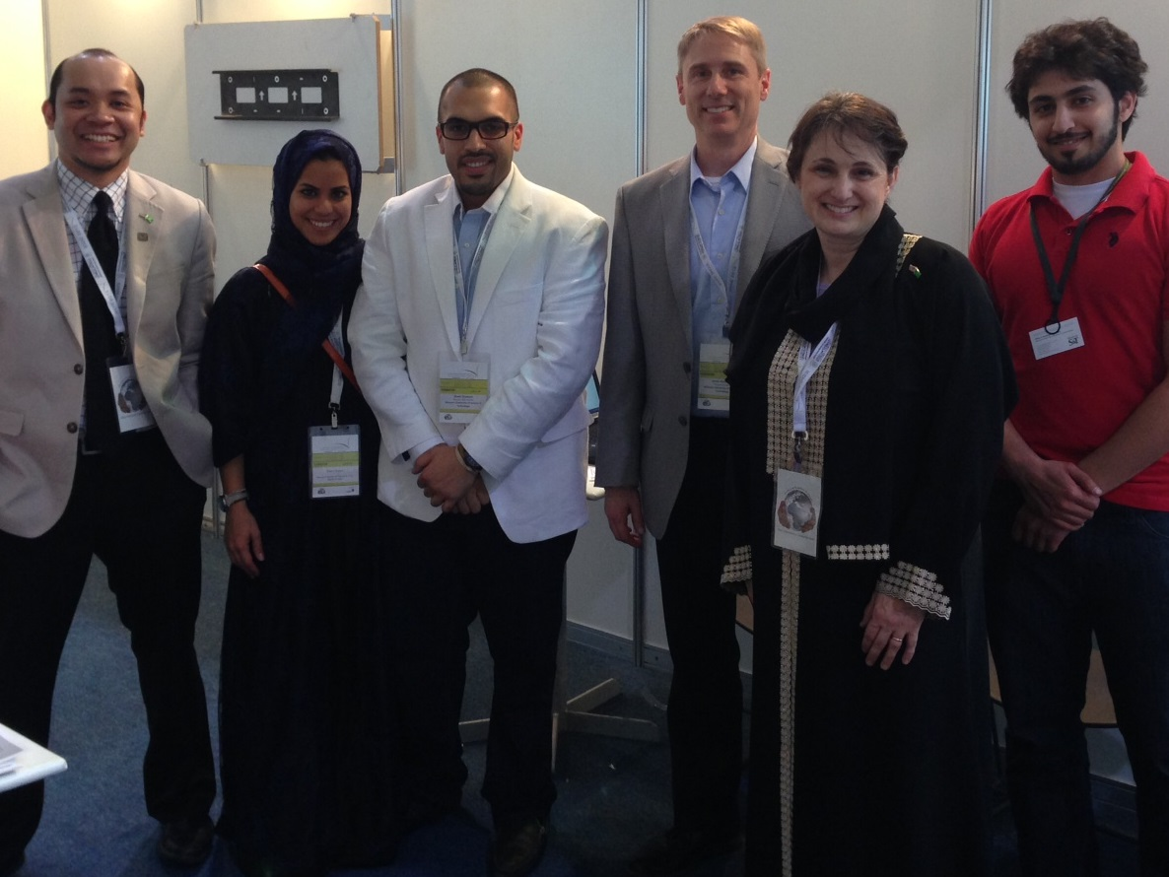
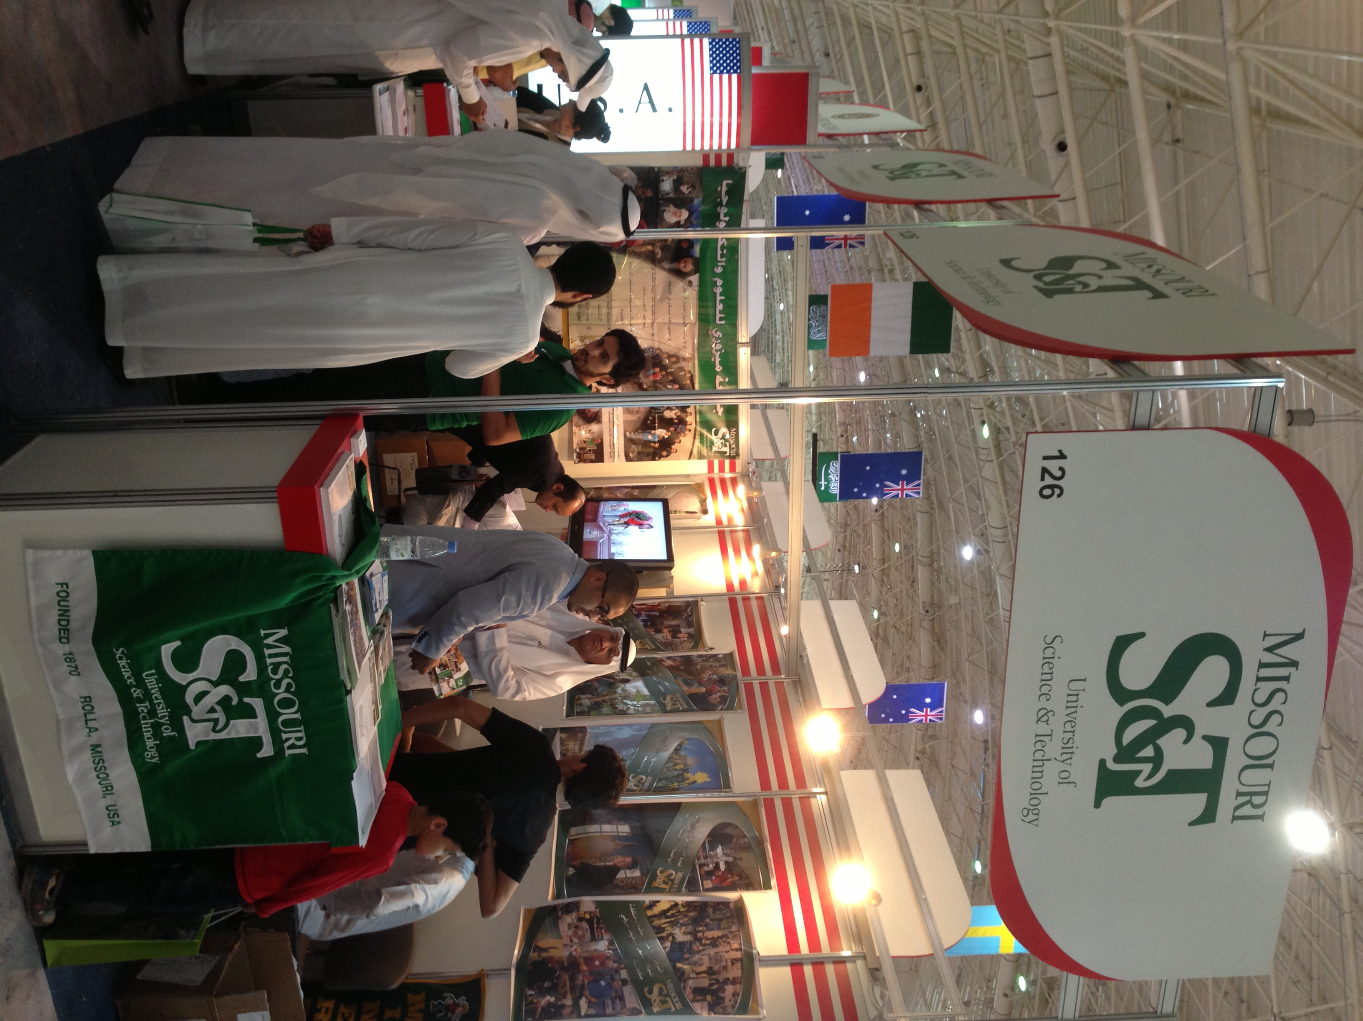
Office of International Affairs
A Team from Missouri S&T’s Office of International Affairs attended the International Exhibition and Conference on Higher Education held in Riyadh, Saudi Arabia from April 16th-19th.
Thousands of potential students asked questions about attending S&T, and over 420 individuals provided contact information in order to receive additional information regarding the application process.

Slide 2
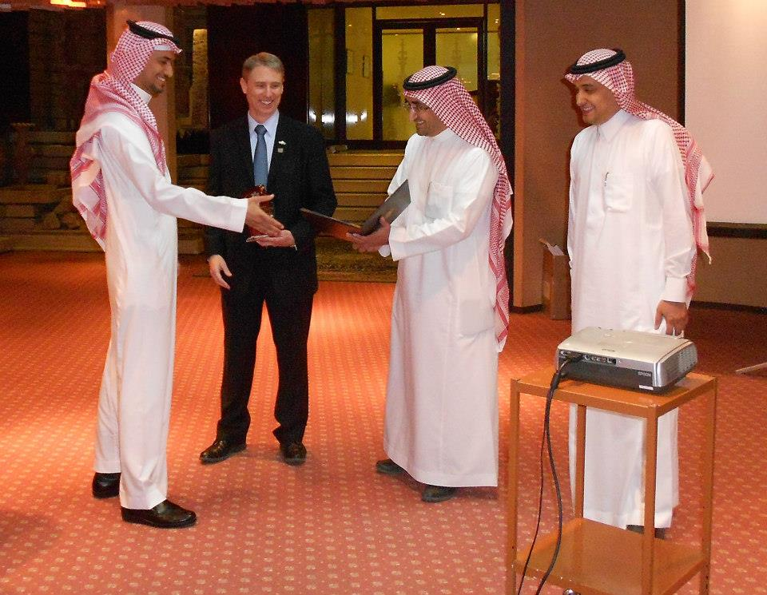
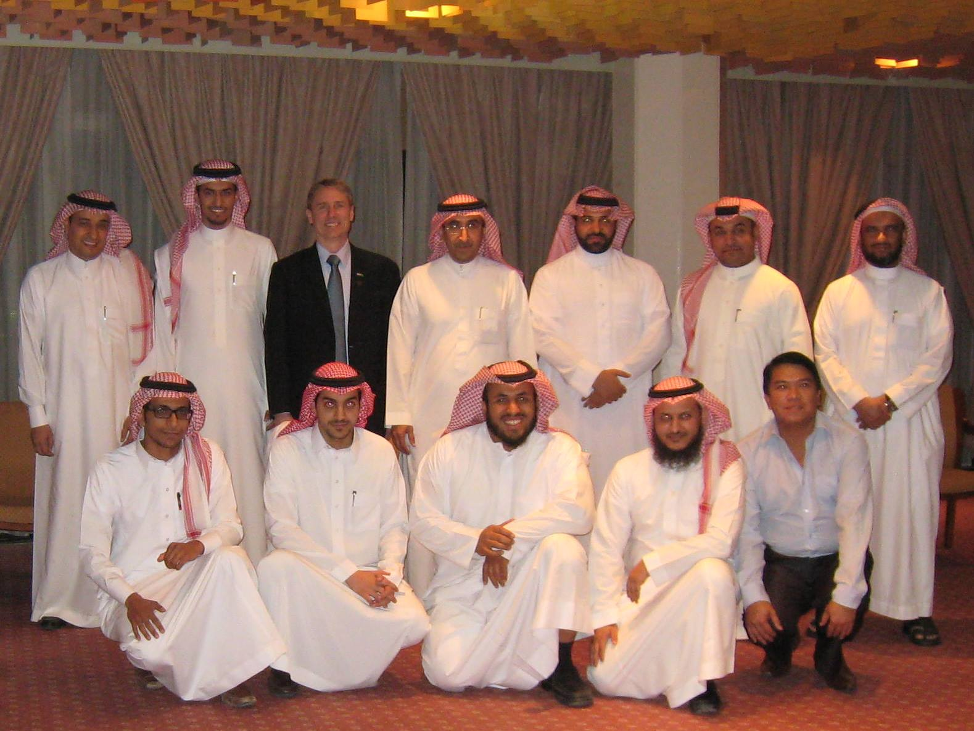
Office of International Affairs
On April 15th, Missouri S&T and its partner, King Saud University, held a recognition ceremony and reception for the first graduating class of the Applied Engineering Management Program at the Riyadh Palace Hotel.
The event was attended by current students, as well as graduates.
Administrative professionals from both schools lauded the successful partnership between our universities on this innovative project.

Slide 3
Office of International Affairs
As of 4.24.13 we have issued 296 I-20’s/DS-2019’s for fall semester 2013 enrollment. Last year at this time we had issued 288 such documents.
Laura Stoll, Dr. Venkata Allada, Dr. Jerry Tien and Emma Heithold traveled to China in March to visit current and potential China partner universities from which we recruit undergraduate transfer students. As of 4.24.13 we have issued I-20’s to 37 students as a result of the delegation’s visit.
Several staff members attended the national NAFSA Conference in St. Louis. This annual conference addresses a broad spectrum of international education issues and topics.

Slide 4
Enrollment Management
Preregistration numbers for Fall 2013 are up about 1.7%. New freshmen class estimated at 1,221 compared to 1,125 last year.
Tim Albers is the new Director of Recruitment Marketing & Enrollment Development.

Slide 5
Global Learning
With more students asking for classes during the summer, departments are encouraged to examine summer distance course schedules to insure that students have sufficient choices to still make progress toward one of S&T’s 15 on-line degrees.
Year Number of courses offered
2011 10
2012 10
2013 13
The following slides represent summer enrollment growth in the last three years.

Slide 6
Global Learning
Summer Enrollment in Distance Courses at Close of Registration

Slide 7
Global Learning

Slide 8
Office of Sponsored Programs
FY13 activities through the end of May and a year-over-year comparison are as follows:
Proposals awarded in total dollars: $48.4M (up 113.2%)
Number of proposals awarded and amendments: 239 (down 3.6%)
Proposals submitted in total dollars: $125M (down 13.3%)
Number of proposals submitted: 441 (down 3.5%)
Research expenditures: $37.1M (up 0.7%)
F&A recovered: $5.7M (down 1.5%)
Number of active awards: 568 (up 1.4%)
Notes:
8

Slide 9
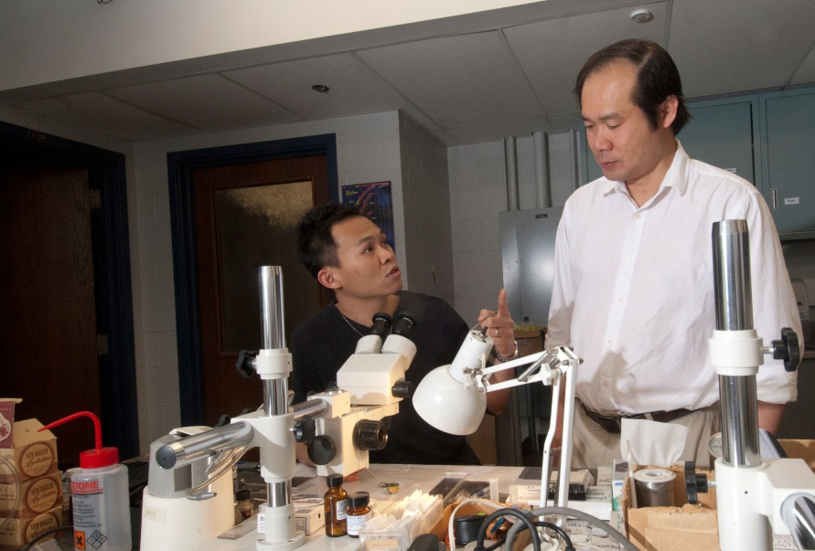
Congratulations to …
Yew San Hor, “CAREER: Surface State Studies of Topological Insulators/ Superconductors,” National Science Foundation, $538,000.

