Slide 1
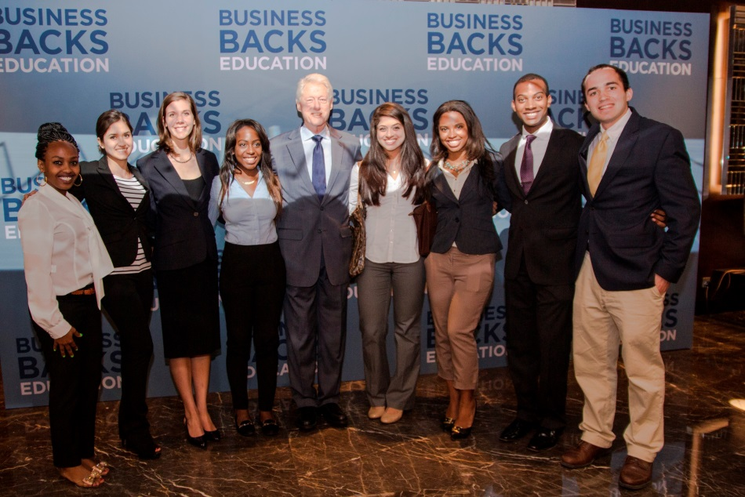
Office of International Affairs
On April 21, 2014 the International Affairs Associate Director, James Monahan, visited American University in Dubai (AUD)
to strengthen our cooperative agreement with them.
David Zdvorak (Jr., Civil Engineering – pictured far right)
received a Clinton scholarship for a semester abroad at AUD and met the former U.S. President while studying in Dubai.

Slide 2
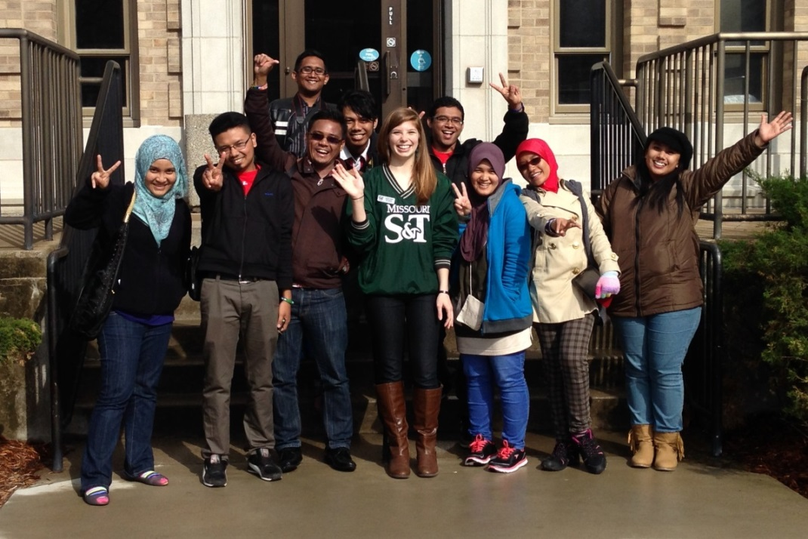
Office of International Affairs
In April, S&T hosted nine students from the
Universiti Malaysia Pahang for a Student Mobility Program. Top students were chosen for the program to introduce them to graduate studies at an American university.
UMP students pose with S&T student ambassador Sarah Pavlowsky outside Parker Hall.

Slide 3
Enrollment Management
Preregistration numbers for Fall 2014 are up about 6%. Largest increase is at the master’s degree level.
New Fall 2014 freshmen class estimated at 1,294 compared to 1,263 last year (+2.4%). Academic index anticipated to rise:
ACT average increase from 27.9 to 28.3.
High school GPA increase from 3.81 to 3.84.

Slide 4
Office of Graduate Studies
Technical Editing:
Sixteen more documents (a 26% increase) were submitted for technical editing during the Spring 2014 semester (46) than were submitted during the Spring 2013 semester (62).
Fifteen of seventeen respondents rated the editing services we provide as either “Excellent” or “Great.” (Two did not respond.)
Tutoring:
35 of 36 respondents either “Strongly Agree” or “Agree” that they would recommend our tutoring services to others.

Slide 5
Office of Graduate Studies
The “Parent Program” of the Geotechnics Graduate Certificate was successfully changed from the Geological Engineering Program to the Geotechnics ME Program.
Over 475 admission files were processed during the month of May, 2014.

Slide 6
Office of Undergraduate Studies
Hit the Ground Running (HGR)
Program runs from July 13th – August 1st
Student Design and Experiential Learning Center (SDELC)
FSAE: Formula Car, 12th place overall in Michigan out of 120 teams.
HPV: Human Powered Vehicle, 3rd place at HPVC West in California, 4th Place at HPVC East in Orlando.
AAVG: Advanced Aero Vehicle Group, Heavy Lift Airplane, 4th place at SAE West in Ft. Worth
Steel Bridge: First place at Regional Competition in Stillwater, OK. 2nd fastest build time and 3rd best cost at Nationals but only 35th overall out of 47 teams.
MRDT: Mars Rover Design Team: 2nd place overall at the International University Rover Challenge in Hanksville, UT. First place was taken by the Hyperion Team from Poland – So S&T has the best rover in North America!

Slide 7
Office of Undergraduate Studies
South-Central Regional Professional Development Center (SC RPDC)
New Buildings in Collaborative Initiative
SC RPDC has increased regional buildings in this project for the 2014-15 year from 32 to 46.
The initiative is designed to improve learning outcomes for all students.
The focus is on collaborative data teams, assessment, and instructional practice.
New Director for SC RPDC
Mary Ann Burns has been hired as the new Director at SC RPDC.
She was previously employed at the Department of Education, and led the statewide implementation of the Missouri Professional Learning Project.
She began her duties June 1.

Slide 8
Office of Sponsored Programs
Summary of FY14 activities through the end of April
Proposals awarded in total dollars: $24.2M (down 47%)
Number of proposals awarded and amendments: 235 (up 9%)
Proposals submitted in total dollars: $109.6M (down 9%)
Number of proposals submitted: 462 (up 11%)
Total expenditures: $35M (up 4%)
Net grant and contract expenditures: $28.2M (up 3%)
F&A recovered: $5.6M (up 8%)
Number of active awards: 627 (up 16%)
Notes:
8
Net grant and contract expenditures is calculated as total expenditures - federal student financial aid.

Slide 9
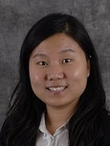
Congratulations to …
Jie Gao, a member of Mechanical & Aerospace Engineering is one of 34 junior faculty members in the nation to win the Oak Ridge Associated Universities Ralph E. Powe Junior Faculty Enhancement Award for the proposal entitled “Spontaneous Emission Engineering with Optical Metamaterials.”

