Slide 1
Faculty Senate Meeting
June 9, 2022

Slide 2
Meeting procedure
The same rules apply over virtual meetings as over in-person meetings
Only Senators may debate motions
Only Senators can vote
If you are not a Senator, or a proxy, you cannot vote or debate
Do not speak over someone, or out of order
Raise your hand within the Zoom app
The President will call on you and then you will have the floor
Unless you have been recognized (been told you have the floor), you may not speak
Per Robert’s Rules, each Senator is entitled to only speak twice on each motion.

Slide 3
Meeting Minutes
Robert's Rules of Order say that meeting minutes are simply a summary of what happened at the meeting.
They are not a play by play of everything that happened or what members said.
We will be using Robert's Rules to guide our recording of minutes.
If needed, Faculty Senators may request access to the audio recording of the meeting. Please email facsenate@mst.edu with justification.

Slide 4
Agenda
Call to Order and Roll Call
D. Westenberg, Secretary

Slide 5
Agenda
Approval of Minutes
April 28, 2022

Slide 6
Agenda
III. President’s Report
K. Homan

Slide 7
President’s Report: UM System
IFC (Intercampus Faculty Cabinet): 18 May 2022 Mtg
In-person meeting, held in Columbia, MO
State-level funding for higher education (R. Rapp, Exec VP)
No reductions anticipated over next 3 years
MO Governor has 3yr investment plan for HigherEd
Important to hold enrollment stable
UM System – Academic Affairs re-organization
New position: Assoc VP for Academic Affairs
Split duties between UM System and MU Campus
Flagship terminology (flagship vs non-flagship campuses)

Slide 8
President’s Report: S&T Campus
Call for nominations: Equity Resolution Hearing Panel
Seeking nomination of 20 faculty members
Chancellor to provide slate to UM System from nominations
Ideally, nominees reflect diversity of faculty interests and backgrounds
Provide nominations (self or colleagues) by June 16.
Please send nominees to Kelly Homan (khoman@mst.edu)

Slide 9
President’s Report: Faculty Senate
Bylaw Revisions
Revisions approved (Y=49/N=4/NC=2, Total = 55).
Will be submitted to UM Counsel for review
Chancellor will submit to BoC, after legal review
Sincere thank you to the Revision Committee, led by T. Schuman
Thank you and be prepared for additional round next year!
Administrative Reviews (2021-22)
Reviewed to ensure anonymity, comments provided to officer being reviewed and their direct report, by Past-President Steve Raper
Summary results being presented today by ARC
Thank you to faculty for your participation

Slide 10
President’s Report: Faculty Senate
Faculty-Staff Climate Survey
Survey closed on April 30, with approximate 50% response rate
Survey generated, and raw data held, by Institutional Research alone.
No analysis, have or will be conducted, other than endorsed by Personnel Committee and Faculty Senate Officers
Cleaned data provided by IR obeys cell size standards of COACHE.
Initial findings have also been previewed to campus administration.
Graduate, Distance and Continuing education (GDCe) Cmte
Intent: provide coordination between Faculty Senate and Graduate Faculty Council, including matters related to non-traditional degrees
Direct interaction with Vice Provosts.
Provide nominations (self or colleagues) to Faculty Senate officers

Slide 11
Agenda
IV. Administrative Reports
A. Provost’s Report C. Potts

Slide 12
College of Arts, Science and Education
Renamed College effective July 1
Dean appointed, effective July 1
Mehrzad Boroujerdi,
Director, School of Public and International Affairs (SPIA), Virginia Tech
Formerly O'Hanley Faculty Scholar and Professor of Political Science at Maxwell School of Citizenship & Public Affairs, Syracuse University
Kate Drowne appointment to be announced shortly

Slide 13
CASB books since April, 2021

Slide 14
College of Engineering and Computing
Interim Dean announced shortly
Rich Wlezien will return to DARPA in the Fall
Dr. Kyle Perry, associate professor of explosives engineering, was awarded $1 million from the U.S. Army to investigate a blast-resistant curtain wall and anchoring system.
Dr. William Fahrenholtz, Curators’ Distinguished Professor of ceramic engineering, is collaborating with UC Davis and University of Pittsburgh to develop consistency in ultra-high-temperature ceramics for hypersonic vehicles with support from a $1.4 million Air Force grant. Two nuclear engineering students, Markus Baur and Nathaniel Guy, will receive $10,000 scholarships from the U.S. Dept. of Energy’s University Nuclear Leadership Program.

Slide 15
Kummer College
College will commence operations, effective July 1
Acting Dean announced shortly
Founding departments
Business and Information Technology
Economics
Engineering Management and Systems Engineering

Slide 16
Ongoing Chair Searches
Business & IT
Kummer chair. Search pause. Interim chair, Cassie Elrod
Computer Science
Kummer chair. Search ongoing. Three finalists, summer 2022
Electrical & Computer Engineering
Kummer chair. Search ongoing. Final interviews just completed
Geosciences and Geological & Petroleum Engineering
Final interviews ongoing
Materials Science and Engineering
Internal search ongoing (Summer, 2022)
Mining & Explosives Engineering
Kwame Awuah-Offei appointed
Nuclear Engineering & Radiation Science
Kummer Chair. Search pause. Interim chair, Ayodeji Alajo

Slide 17
Research & Admin Position Updates
Kummer Research Center Directors
Advanced Manufacturing
Rick Billo, since Q1 2022
Intelligent & Automated Systems
Don Wunsch, effective Q4 2022
Resilient Infrastructure
Search ongoing
Resource Sustainability
Search restarting after unsuccessful negotiation
Academic Affairs
Graduate Education
Rainer Glaser, effective July 1
Assessment, Accreditation and Academic Operations
Steve Raper, effective summer 2022

Slide 18
Library and Learning Resources
06/01/2022

Slide 19
Library and Learning Resources
This semester the library will actively promote our new Self-Check System. This system will enable library users to checkout most materials at anytime regardless of service-desk hours.
Implementation across all four campuses is underway for a new integrated library system. This will improve discovery of resources and other services. We expect the new system to be fully functional by July 1.
MOBIUS did not shut off on April 15, 2022, as previously announced. UM System users will be able to keep privileges at all MOBIUS libraries. As of June 1, 2022, there is a link to the MOBIUS catalog in each UM System Library Catalog.
Self-Checkout Kiosk

Slide 20
Agenda
V. Campus Reports
A. Staff Council
M. Fowler
No Report

Slide 21
Agenda
V. Campus Reports
B. Student Council
W. Retzlaff

Slide 22
Event planning Orientation week
Connecting campus activities through MinerLink
Establishing contacts on campus
Interfacing instructions for MinerLink
General Executive Meeting week of June 12-18
Planning for a team building retreat

Slide 23
Agenda
V. Campus Reports
C. Council of Graduate Students
M. Nabi

Slide 24
Agenda
Special Topic
The Path and Progress to R1
M. Dehghani

Slide 25
Our North Star Goals
… What will it take to become a top-research university?
Research Activity
Current | Desired
Carnegie Research 2 (high activity) | Carnegie Research 1 (very high activity)

Slide 26
Carnegie Classification of Higher Education
… Where would S&T rank in each category among 131 R1 schools ranked in 2018?
Research Expenditures – based on NSF HERD data
Total STEM research expenditures = 130th ranked school
Per capita STEM research expenditures = 105th ranked school
Total Non-STEM research expenditures < 131th ranked schools
Per capita non-STEM research expenditures < 131th ranked schools

Slide 27
Expenditures by faculty in engineering disciplines
… Note that CEC tenure and tenure-track faculty is only 145

Slide 28
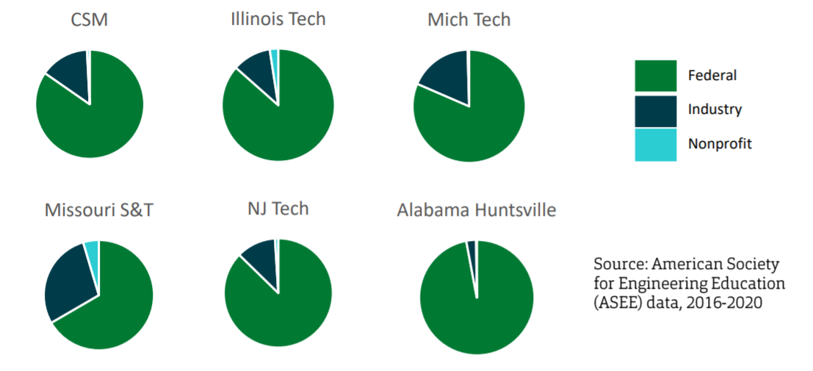
Types of research funding
… S&T receives larger portion from industry partners than peers

Slide 29
Carnegie Classification of Higher Education
… Where would S&T rank in each category among 131 R1 schools ranked in 2018?
Doctoral graduates
STEM doctoral graduates = 88th ranked school
Non-STEM doctoral graduates < 131th ranked schools (lack of doctoral level research)
NTT research staff (research profs, post-docs) = 126th ranked school

Slide 30
Thank you! Questions?

Slide 31
Agenda
VII. Reports of Standing Committees
A. Public Occasions
S. Sedigh-Sarvestani

Slide 32
Public Occasions Committee Report
Dr. Sahra Sedigh Sarvestani, Chair
Motion to approve Public Occasions dates for the 2022-2023 academic year

Slide 33
Public Occasions Dates for AY 2022-2023
Open House Saturday, Sept. 10, 2022
Open House Saturday, Oct. 15, 2022
Homecoming Friday-Saturday, Oct. 21-22, 2022
Open House Friday, Nov. 11, 2022
Open House Monday, Feb. 20, 2023
Open House Friday, Apr. 7, 2023

Slide 34
Agenda
VI. Reports of Standing Committees
B. Campus Curricula M. Davis

Slide 35
Campus Curricula Committee Report
09 June 2022
CCC Meeting -03 May 2022
Total Committee Activity
17 Course Change Requests (CC Forms)
18 Program Change Forms (PC Forms)
5 Experimental Course Requests (EC Forms)

Slide 36
Campus Curricula Committee Report
09 June 2022
Course Changes (CC) Requested
File: 4779.1 BIO SCI 5393 : Immunology
File: 140.1 BIO SCI 5493 : General Virology
File: 1633.2 CHEM 5220 : Physical Organic Chemistry
File: 1040.14 CHEM ENG 2100 : Chemical Engineering Material & Energy Balances
File: 2041.4 CHEM ENG 2110 : Chemical Engineering Thermodynamics I
File: 4280.9 CHEM ENG 3101 : Fundamentals of Transport in Chemical and Biochemical Engineering
File: 4279.27 CHEM ENG 3111 : Numerical Computing in Chemical and Biochemical Engineering
File: 436.6 CHEM ENG 3120 : Chemical Engineering Thermodynamics II
File: 4282.14 CHEM ENG 3131 : Separations in Chemical and Biochemical Engineering
File: 4281.9 CHEM ENG 3141 : Process Operations in Chemical and Biochemical Engineering
File: 1038.12 CHEM ENG 3150 : Chemical Engineering Reactor Design
File: 4285.18 CHEM ENG 4091 : Chemical Process Design I

Slide 37
Campus Curricula Committee Report
09 June 2022
Course Changes (CC) Requested
File: 4290.6 CHEM ENG 5250 : Isolation and Purification of Biologicals
File: 4269 COMP SCI 5701 : Experiential Entrepreneurship for Computer Scientists
File: 502.1 ECON 4430 : Cost-Benefit Analysis
File: 1714.1 LATIN 2001 : Special Topics
File: 4872 STAT 4210 : Introduction to Statistical Data Science

Slide 38
Campus Curricula Committee Report
09 June 2022
Program Changes (PC) Requested
File: 142.58 AP MATH-BS : Applied Mathematics BS
File: 146.32 BIO SC-BA : Biological Sciences BA
File: 147.20 BIO SC-BS : Biological Sciences BS
File: 16.36 CHEM-BS : Chemistry BS
File: 28.67 CMP SC-BS : Computer Science BS
File: 344.27 EDUC-BS : Education BS
File: 374.13 ENGL TC-BS : English & Technical Communication BS
File: 156.66 GE ENG-BS : Geological Engineering BS
File: 234.28 INORGPS-MS : Industrial Organizational Psychology MS
File: 95.32 MI ENG-BS : Mining Engineering BS

Slide 39
Campus Curricula Committee Report
09 June 2022
Program Changes (PC) Requested
File: 188.10 PHILTCH-MI : Philosophy of Technology Minor
File: 121.7 PRE LAW-MI : Pre Law Minor
File: 123.9 PRE-MED-MI : Pre-Medicine Minor
File: 377.7 PROPOSED : Biological Sciences BS with Emphasis area in Medical Laboratory Scientist
File: 390 PROPOSED : Human Factors Psychology CT
File: 305.8 PSYMTRP-CT : Statistical Methods Psych CT
File: 345.8 WATERSC-MS : Water Science and Engineering MS
File: 304.13 WORKPSY-CT : Applied Workplace Psych CT

Slide 40
Campus Curricula Committee Report
09 June 2022
For Informational Purposes; No Senate Approval Required
Experimental Course (EC) Requested
File: 4871 ART 2001.001 : Marvel Cinematic University – Media, Culture, and Philosophy via the Superhero
File: 4794 CHEM ENG 5001.015 : Colloid Chemistry and Interfacial Engineering
File: 4870 COMP ENG 4001.001 : Practicum in Computer Engineering
File: 4869 ELEC ENG 4001.001 : Practicum in Electrical Engineering
File: 4873 TCH COM 3001.002 : Video Design and Editing

Slide 41
Campus Curricula Committee Report
09 June 2022
Curriculum committee moves for FS to approve the 17 CC and 18 PC form actions.
Discussion: Questions or comments?

Slide 42
Agenda
VII. Reports of Standing Committees
C. Information Technology & Computing
D. Stutts
No Report

Slide 43
Agenda
VII. Reports of Standing Committees
D. Budgetary Affairs
M. Fitch

Slide 44
Budgetary Affairs Committee
Jun 9, 2022
Referrals
(None)
Continuing referrals:
Report on the “big picture balance sheet”
Current and next FY budget

Slide 45
Budget this year (no change)
Current FY budget
Enrollment revenue $820k less than budgeted
$2.2 million deficit =
$1 million enrollment contingency +
$1.35 million unallocated State funds, expected withheld wasn’t

Slide 46
Budget next year
Revenue ~3.6% increase expected
+ 4.27 million state: Governor 5.4% = $2.92 MM + $1.35 MM used for shortfall FY 2022
+ 2.6 million tuition increase (+4.5% MO UG, +2.0% Non-MO UG, +5.0% MO Grad, +3.1% Non-MO Grad, -4.0% Int’l UG, -2.9% Int’l Grad; student count slight decrease expected)
Costs (unchanged from April)
Faculty and Staff
F&O working on staff salaries to increase retention and decrease long fill times, pay compression possible
Identified three major problem areas: Office Support, Custodians and Groundskeeping, and Childcare
Other UM campuses pay more for same title
Existing positions = raise base and credit years of service, but compression an issue
20% of S&T workforce below $15/hr. Meeting $15/hr cost > revenue gain, gradual increase planned
IT and OSP targeted for investments

Slide 47
General Revenue Budget
 | FY20 | FY 21 (actual*) | FY 22 (planning) | FY 23 (guesstimated)
Tuition and Fees | $126,853,439 | $119,477,148 | $119,592,425 | $121,310,729
Scholarship Allowance | (37,848,888) | (36,149,411) | (38,164,248) | (38,164,248)
Net Tuition & Fees | $89,004,551 | $83,327,736 | 81,428,177 | 82,598,177
State Appropriation | 43,543,499 | 45,690,941 | 53,026,096 | 55,942,531
Grant and Contract | 0 | 0 | 0 | 0
Gift Revenues | 385,737 | 471,909 | 345,000 | 345,000
Recovery of F & A | 6,802,499 | 6,496,349 | 6,493,100 | 6,493,100
Endowment & Investment Income | 2,035,737 | 1,935,710 | 3,120,243 | 3,120,243
Sales & Services Income | 1,177,479 | 709,380 | 1,065,880 | 1,065,880
Other Incomes | 2,872,553 | 2,209,518 | 2,958,389 | 2,958,389
Revenue Contingency | - |  | - | -
Total Revenues | $145,822,055 | $140,841,544 | $148,437,385 | $152,523,320
Enrollment: -66 UG, +62 grad
Tuition up
+$1.17 million
+$2.92 million
+$4.09 MM, +1.35 MM not withheld FY 22

Slide 48
General Revenue Budget: costs
Total Revenues | $145,822,055 | $140,841,544 | $148,437,385 | $153,873,320
+$5.44 million
Transfers | FY20 | FY 21 (actual) | FY 22 (planning) | FY 23 (guessing)
Intra Unrestricted CurrentFund | $4,442,960 | $1,988,391 | $1,581,686 | $1,581,686
Mandatory Transfers | (3,930,896) | (3,483,219) | (3,197,402) | (3,197,402)
NonMandatory Transfers | (6,885,979) | (7,114,077) | (3,446,690) | (3,446,690)
Total Transfers | ($6,373,915) | ($8,608,905) | ($5,062,406) | ($5,062,406)
Expenditures
Salaries & Wages | $80,232,396 | $75,195,068 | $79,426,854 | $79,426,854
Benefit Expense | 25,029,887 | 24,209,899 | 26,626,149 | 26,626,149
Compensation | $105,262,283 | $99,404,966 | $106,053,0030 | $106,053,0030
Other Expenses | 33,205,855 | 32,471,617 | 37,256,650 | 38,700,000
Total Expenditures | $138,468,138 | $131,876,584 | $143,309,653 | $144,756,135
 |  |  | Increase | $4,054,779
1.247 M increase
Maintenance +485k
Utilities +437k
IT (from IT fee) + 26.5k
Insurance, etc. +250k
Summer session + 48k
Enroll. contingency +200k

Slide 49
$4.05 million
Strategic Investments ~$1.37 million recurring:
Post tenure awards, P&T, NTT
Positions: SAP/ERP, OSP, CDO, IT staff, HR restructure, EHS, Enrollment Management, Marketing
Desktop enhancement, Gradescope, Sanvello app
Athletics
Salary increases ~$3.7 million = 3-3.5% range, merit-based

Slide 50
Agenda
VII. Reports of Standing Committees
E. Administrative Review
K. Liu

Slide 51
Administrative Review Committee
2011-2022 Members
Kelvin Erickson
Wayne Huebner
Bih-Ru Lea
Kelly Liu, Chair

Slide 52
Administrative Review Committee
Positions Approved by FS for Review
Provost (Potts)
Center of Advancing Faculty Excellence (Ivliyeva)
Chief Information Officer (Tang)
Timeline and process
Action | Time
Review list to faculty senate for approval | January 20
Job descriptions | January 28
Development of questionnaires | 1/29-2/16
Questionnaires to FS for review/approval | February 17
Statement of accomplishments due | February 25
Review of administrations | March 11 - March 25
Results to FS officers | April 28
Final report to FS | June 9

Slide 53
Administrative Review Committee
The Review Process
The surveys were loaded onto Qualtrics after being tested extensively to ensure that the surveys worked on all platforms, maintained confidentiality, and could only be completed once by an individual.
The surveys were conducted between March 11 and March 25. Multiple reminders were sent out via email and eConnection.
The reports were downloaded and reviewed by the ARC and FS Officers to identify any languages that could reveal the identity of the person completing the review.
The reports were delivered by FS officers in May to the individuals reviewed.
The reports were also delivered by FS officers in May to their respective supervisor.

Slide 54
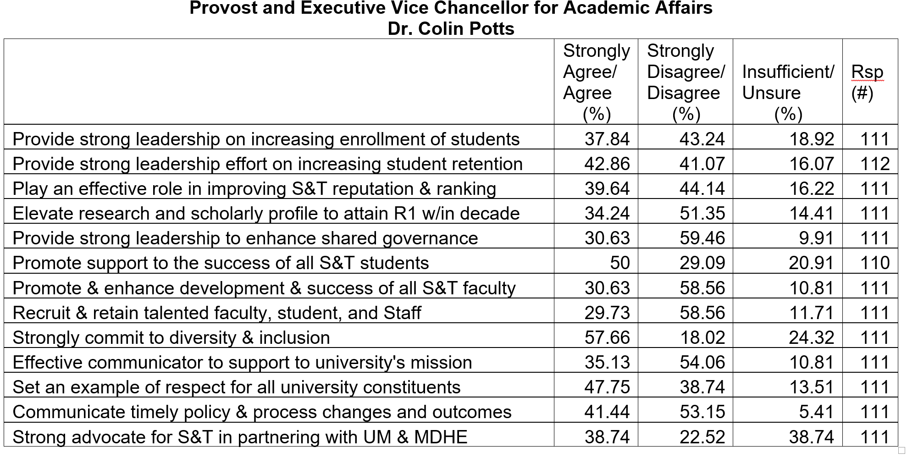
Response Rate = 34%

Slide 55
Provost Colin Potts (60 provided comments)
Strength
Considered affable and pleasant to work with
Demonstrated positive attitudes toward faculty and students
Tried to make changes in order to improve campus culture
Suggestions
Listen more and listen to diverse voices including the ones he disagrees with
Meet and engage with faculty & staff, involve faculty more in decision making
Build trust and begin to address faculty moral issues

Slide 56
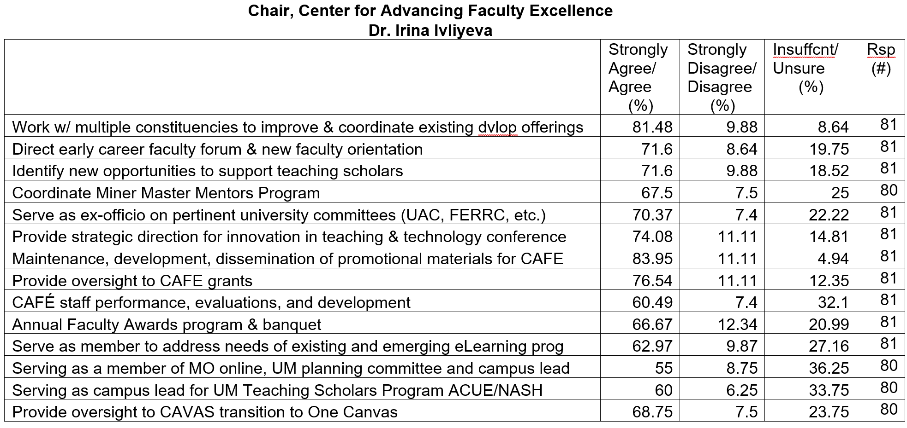
Response Rate = 24%

Slide 57
Café Chair Irina Ivliyeva (27 provided comments)
Strength
Considered a strong manager
Led CAFÉ well with limited staff
Provided support for faculty teaching especially new faculty
Suggestions
Obtain more resources
Rebuild the office
Strengthen faculty development beyond teaching

Slide 58
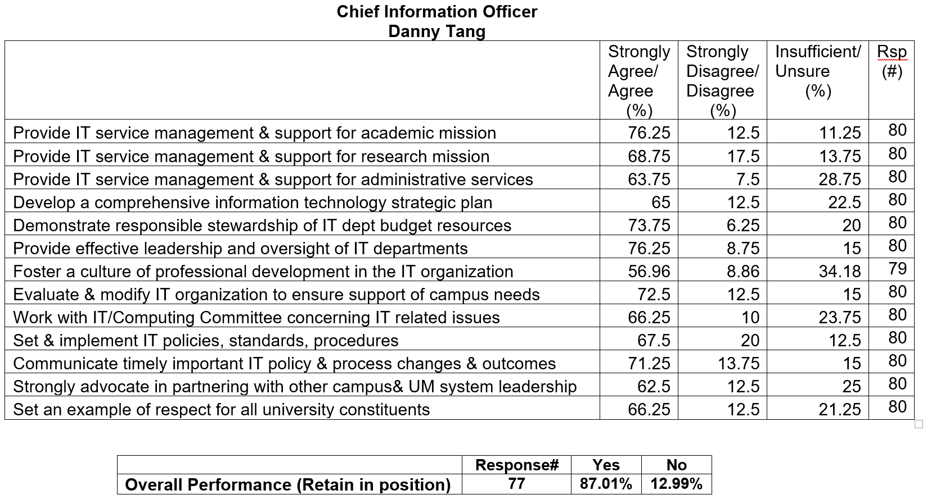
Response Rate = 24%

Slide 59
CIO Danny Tang (42 provided comments)
Strength
Provided effective and transparent leadership to address campus needs
Communicated effectively with ITCC and other groups
Positively influenced the IT team
Suggestions
Obtain more resources to improve support for research
Continue meeting with departments and faculty, learning more
about their concerns and needs
Further improve the moral level of the IT team
Continue addressing campus concerns on the system centralization

Slide 60
A copy of the confidential reports will be archived at the library.

Slide 61
Agenda
VIII. Unfinished Business

Slide 62
Agenda
IX. New Business
A. RP&A:Faculty Staff Climate Survey
K. Homan

Slide 63
Faculty-Staff Climate Survey
AY 2021-22: Initial Findings

Slide 64
Involved:
Faculty Senate (oversight):
Dave Westenberg (Personnel Cmte, Chair)
Kelly Homan (President)
Institutional Research:
R. Wayne Jones – data collection, data cleaning, and initial data summaries
Psychological Science:
Clair Kueny – data analyses, interpretation, & reporting
Devin Burns – assist with data management & analyses

Slide 65
Data Overview
After data cleaning (removing missing data, short duration responders, potential repeat/careless responders) usable data from 582 participants
164 Faculty, 346 Staff, 72 did not report role
63 CASB faculty, 64 CEC faculty, 35 preferred not to respond (PNR)
253 identify as Female, 172 identify as Male, 61 did not report, 96 preferred not to respond (PNR)

Slide 66
Overall Concerns
Organizational justice: critically low perception.
How pay/raises/etc. are distributed (m = 1.14, 0-5)
How procedures are followed (m = 2.14, 0-5)
Treated with respect from upper administration (m = 2.76, 0-5)
Compared to direct supervisor (m = 4.02, 0-5)
Communication from upper administration (m = 1.95, 0-5)
Compared to direct supervisor (m = 3.48, 0-5)
Terminology: perception of fairness in the workplace.

Slide 67
Overall Concerns
Organizational support and commitment: less than ideal.
Organizational support (m = 3.15, scale = 1-7)
Score translates to slight disagreement [4=neutral, 3=slight disagreement]
Terminology: belief the organization values one’s contributions and cares for employee well-being
Affective commitment (m = 3.93, 1-7)
Score translates to slight disagreement side of neutral
Terminology: committed due to strong emotional attachment to organization
Continuance commitment (m = 4.03, 1-7)
Score translates to neutral
Terminology: need to stay committed because there are no better alternatives

Slide 68
Differences: Faculty vs Staff
Faculty report greater exhaustion and greater constraints
Faculty/Staff: m=4.01/3.49 [3=sometimes, 4=often]
Faculty report greater procedural justice
Faculty/Staff: m = 2.55/2.03
Terminology: fairness of decision-making processes
Staff report greater interpersonal justice
Staff: supervisor and upper administration (m = 4.15/3.83)
Faculty: supervisor and upper administration (m = 3.83/2.44)
Terminology: how an employee is treated - with politeness, dignity, and respect - by those executing procedures or determining outcomes.

Slide 69
Differences: College (Faculty)
CASB vs CEC Faculty
higher in continuance commitment (CASB/CEC: m = 4.58/3.32)
lower in affective commitment (CASB/CEC: m = 3.47/4.18)
Commitment terminology: continuance = need to stay, affective = want to stay
CASB Faculty higher in perceptions of organizational justice
Distributive justice (CASB/CEC/PNR: m = 1.69/1.00/0.69)
Interpersonal justice from upper administration (m = 3.51/1.74/1.90)
Informational justice from upper administration (m = 2.70/1.13/1.06)
Categories of organizational justice (perception of fairness)
Distributive = fairness of outcomes for effort
Interpersonal = fairness of interpersonal interactions and treatment
Informational = timeliness, specificity and truthfulness of explanations for decisions

Slide 70
Differences: Gender
Gender (Faculty & Staff): Male vs. Female vs. PNR
PNR significantly lower in:
Perceived organizational support
Affective organizational commitment
Engagement
Distributive justice
Interpersonal and informational justice from upper administration
PNR significantly higher in:
Exhaustion
Depersonalization/cynicism
Constraints

Slide 71
Other Key Findings
Perceptions of interpersonal and informational justice
significantly higher for direct supervisor (m = 4.02/3.48)
lower for upper administration (m = 2.76/1.95)
Heavy workload, conflicting job demands, and interruptions by other people most frequent constraints
Correspondence between scores follows generally-observed (i.e., meta-analytic) trends

Slide 72
Qualitative Feedback Overview
Randomly selected 25% (n = 75) open-ended responses to:
“What additional comments (positive or negative) do you have for Missouri S&T leadership to consider?”
63 (84%) were negative, 7 (9%) were neutral, 2 (3%) were positive
Negative comments balanced across college and faculty/staff
When asked to list 3-5 supportive actions S&T has taken, 809 responses were given
When asked to list 3-5 actions one wished S&T would do, 1171 responses were given

Slide 73
Next Steps
More thoroughly analyze qualitative data for specific themes
Design specific, evidence-based recommendations based on trends in data
Send requests to Personnel Committee for other analyses of interest (Dave Westenberg, Chair)
Summary report at October Faculty Senate Mtg

Slide 74
Agenda
X. Adjourn
74

