Slide 1
Faculty Senate Meeting
Innovation Lab and Online
12 February 2026

Slide 2
Meeting procedure
Only Senators (or their proxies) present in person count toward a quorum
Two-thirds of the voting membership constitutes a quorum
Only Senators (or their proxies) present in person may vote
The chair will recognize members of the Senate (including proxies and ex-officio members) for the purposes of motions and debate
Members are requested to wait for recognition before speaking
Please wait for the microphone

Slide 3
I. Call to Order
P. Runnion, President
Notes:
Gavel: Two taps

Slide 4
II. Roll Call
F. Han, Secretary

Slide 5
III. Consent Agenda
P. Runnion

Slide 6
Consent Agenda – 2/12/2026
Curriculum Committee Report
*) Approval of CC and PC forms
Approval of the 18 December 2025 Minutes

Slide 7
CCC Meeting - 13 Jan 2026
Total Committee Activity
- 26 Course Change Requests (CC Forms)
8 Program Change Requests (PC Forms)
5 Experimental Course Requests (EC Forms)

Slide 8
CCC Meeting – 13 Jan 2026
Course Change Requests (1)
File: 216 BIO SCI 1201 : Biological Sciences First Year Seminar
File: 964 BIO SCI 2213 : Cell Biology
File: 10362 BIO SCI 4020 : Senior Service Project
File: 5637 BIO SCI 6202 : Problems In Applied And Environmental Biology
File: 5728 CER ENG 6310 : Sintering And Microstructure Development
File: 1074 CIV ENG 2200 : Statics
File: 1451 CIV ENG 2601 : Fundamentals of Environmental Engineering and Science
File: 110 COMP SCI 1200 : Discrete Mathematics for Computer Science
File: 4038 COMP SCI 1972 : Introduction to MATLAB Programming
File: 2507 COMP SCI 2500 : Algorithms
File: 2097 COMP SCI 3200 : Introduction To Numerical Methods
File: 10229 ECON 6030 : Contemporary Issues in Energy Economics
File: 10358 GEOLOGY 2917 : Climate Change and Society

Slide 9
CCC Meeting – 13 Jan 2026
Course Change Requests (2)
File: 116 MATH 1214 : Calculus I
File: 1695 MATH 1215 : Calculus II
File: 340 MATH 2222 : Calculus III
File: 2255 MATH 5737 : Financial Mathematics
File: 8928 MET ENG 1017 : Introduction To Metallurgical Engineering
File: 8929 MET ENG 1027 : Computer Application In Metallurgical Engineering
File: 8964 MET ENG 5110 : High Temperature And Corrosion Resistant Alloys
File: 8965 MET ENG 5160 : Mechanical Metallurgy
File: 8967 MET ENG 5171 : Nuclear Materials II
File: 8973 MET ENG 5460 : Metal Coating Processes
File: 8975 MET ENG 5515 : Nondestructive Testing Laboratory
File: 9075 MS&E 5517 : Materials Selection in Mechanical Design
File: 9085 MS&E 6230 : Nanomaterials

Slide 10
CCC Meeting – 13 Jan 2026
Program Changes (DC) Requested
File: 147 BIO SC-BS : Biological Sciences BS
File: 177 CRTVWR-MI : Creative Writing Minor
File: 401 ES&P-CTU : Environmental Policy and Sustainability CTU
File: 170 NU ENG-MS : Nuclear Engineering MS
File: 211 NU ENG-PHD : Nuclear Engineering PhD
File: 429 PROPOSED : Creative Writing CTU
File: 192 PSYCH-BA : Psychological Science BA
File: 193 PSYCH-BS : Psychological Science BS

Slide 11
CCC Meeting – 13 Jan 2026
For Informational Purposes; No Senate Approval Required
Experimental Course (EC) Requested
File: 547 BUS 5001.016: Services Marketing and Innovation
File: 548 COMP ENG 5001.007: Explainable Machine Learning (XAI)
File: 518 COMP SCI 5001.080: Internet Security
File: 549 GEO ENG 2001.005: Hacking Planet Earth
File: 550 HISTORY 3001.022: The Cold War - A Global History

Slide 12
CCC Meeting – 13 Jan 2026
Curriculum committee moves for FS to approve the 26 CC form, and 8 PC form action requests.
Discussion: Questions or comments?

Slide 13
IV. Special Topics A. Wellness Update
J. Gargus and W. Smith

Slide 14
Health and Well-Being Collective: Supporting Student Success
Academic Integration
Co-Chairs - Jessica Gargus and Amber Henslee

Slide 15
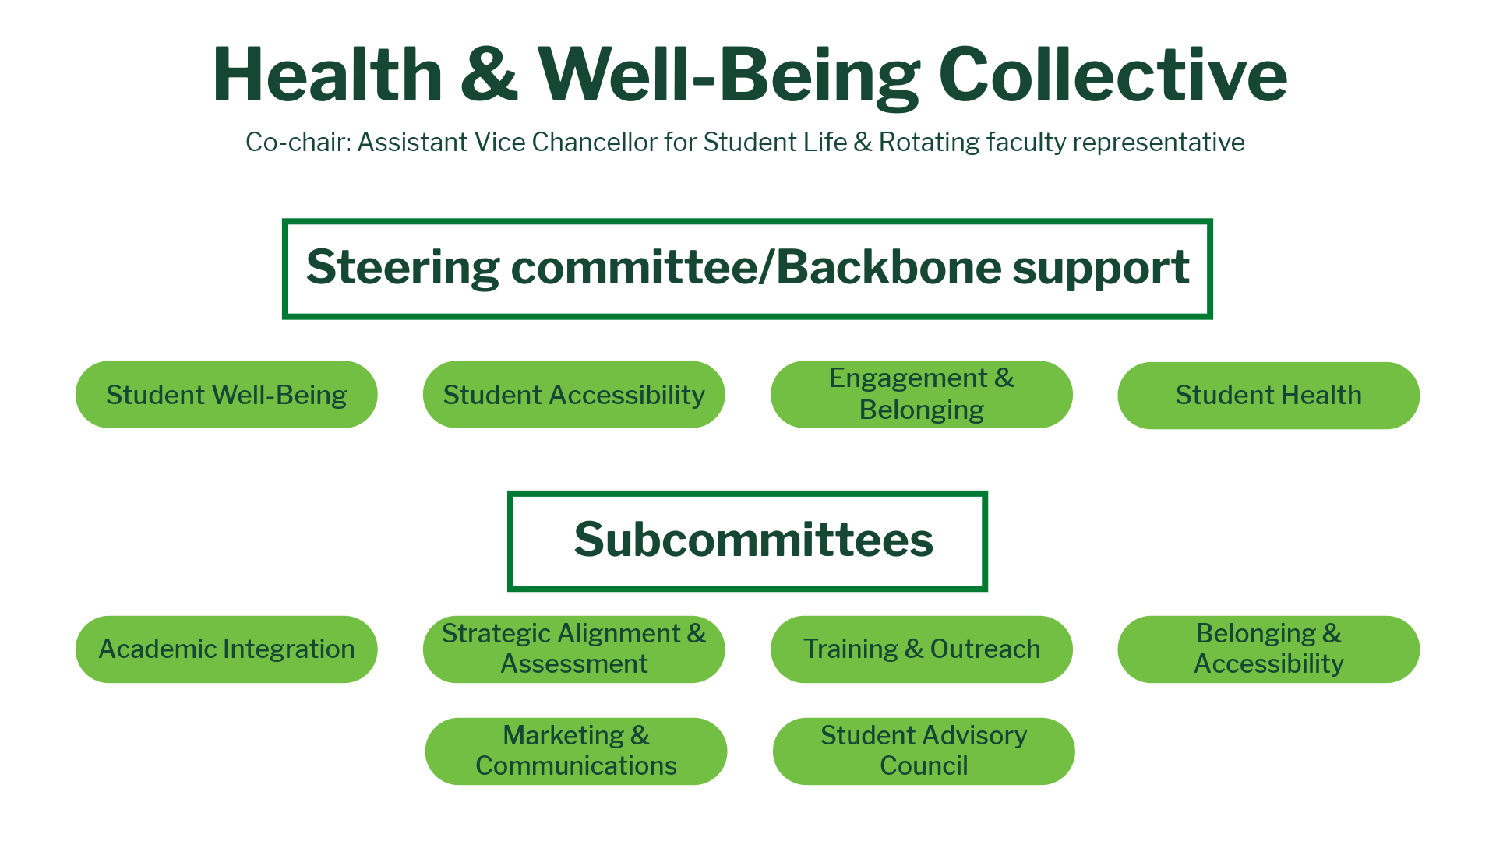

Slide 16
Academic Integration
Charge: Promote the integration of well-being into the academic culture by engaging faculty and enhancing the classroom environment to support student well-being, foster connection and belonging, and contribute to the holistic success of all.
Strategic Alignment: SFA2 Student Well-Being and Success; Strategy Group 1: Embed well-being into all facets of campus culture and across organizational boundaries

Slide 17
Role of Faculty in Supporting Student Well-Being
“We must not lose sight of faculty members’ primary responsibility
to students: effective teaching that leads to meaningful learning.
Faculty are experts in their disciplines and, for most, mental health
is not their field. Although faculty cannot (and should not) be
expected to replace the role of mental health professionals, they
can take action as helpers, not clinicians, to support
struggling students.”​
Association for College and University Educators

Slide 18
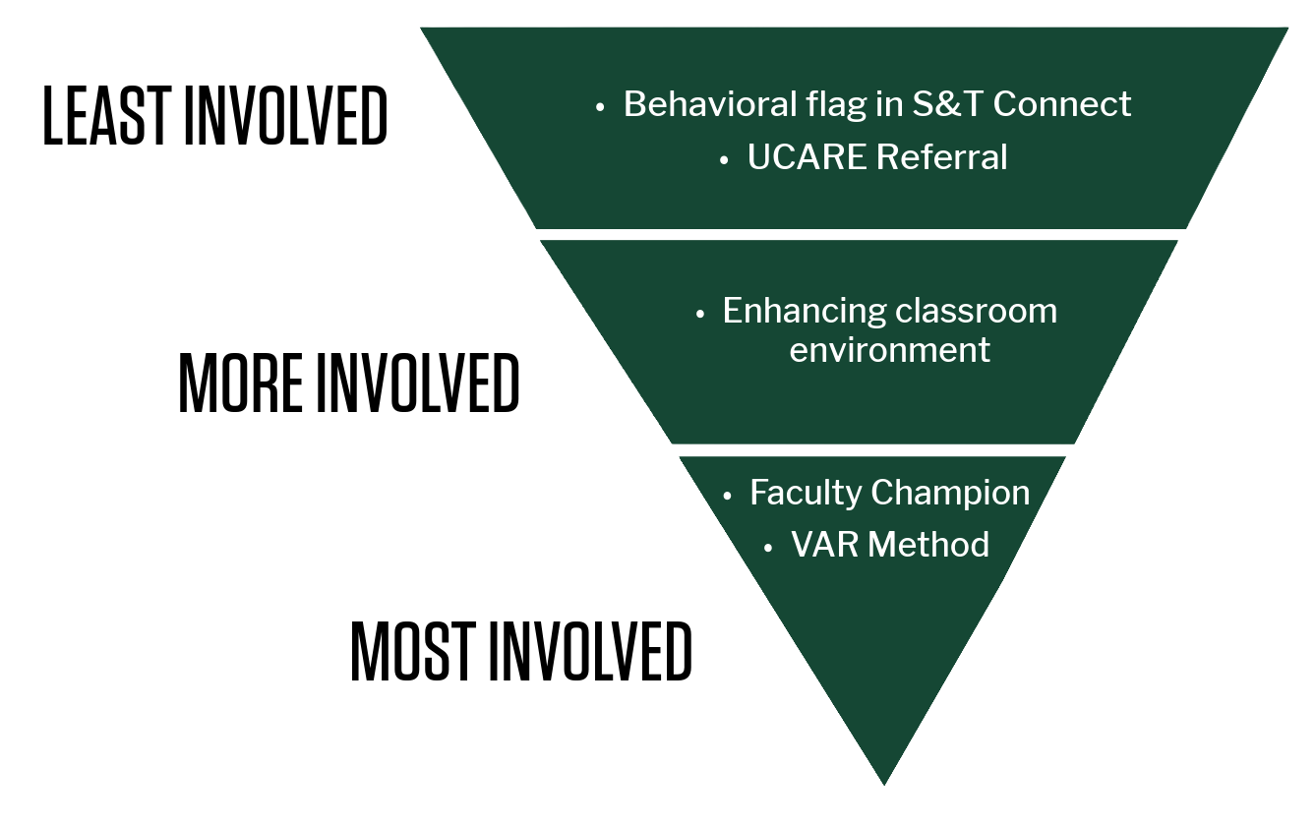
Integrating Well-Being into the Academic Culture

Slide 19
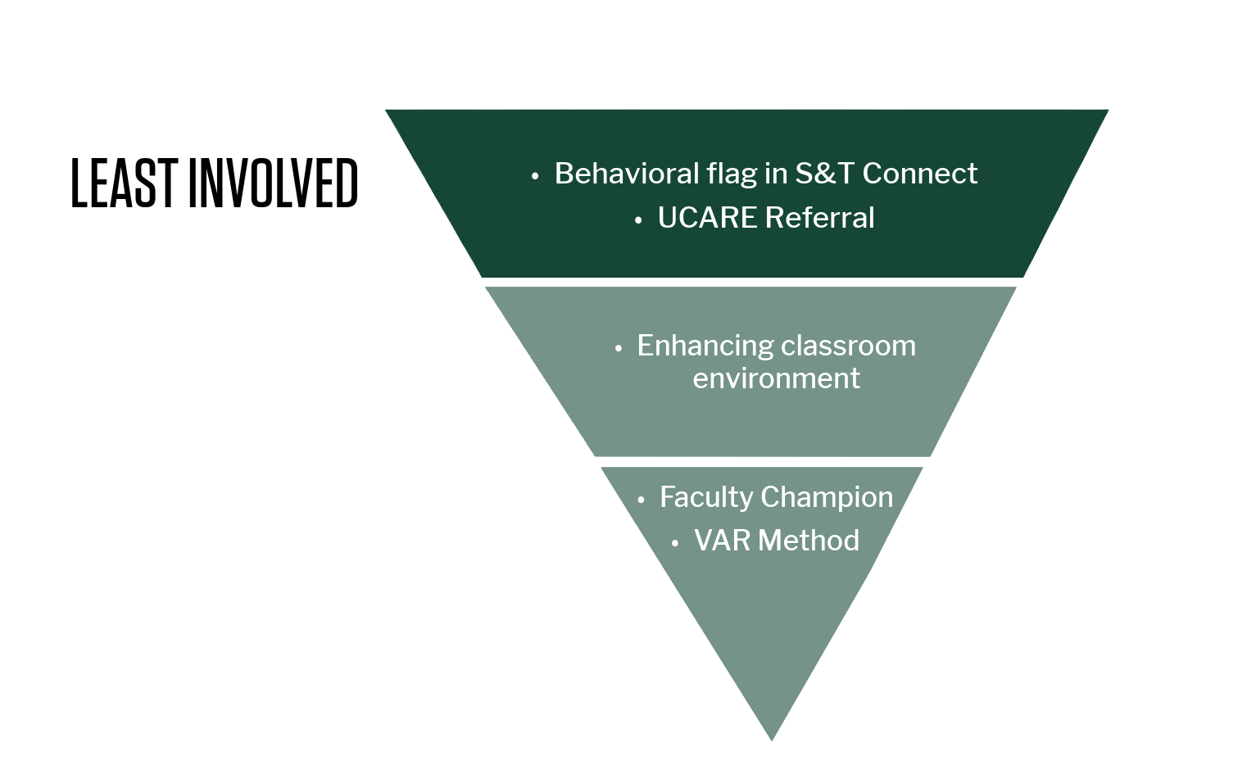
UCARE
Least involved. Most important. Requested of everyone.​

Slide 20

UCARE – Just Notice and Refer
UCARE ucare.mst.edu
Behavioral Flag in S&T Connect – goes to UCARE
UCARE IS: | UCARE IS NOT:
For any type of concern Centralized, coordinated support Safety Well-being Academic success | Punitive Mandated Only for isolated/acute situations

Slide 21
Recognizing Concerns – Just Notice and Refer
Missed assignments
Repeated absences
Decline in academic performance
Poor personal hygiene
Inappropriate or exaggerated behavior
Alarming or worrisome content in speech or assignments

Slide 22
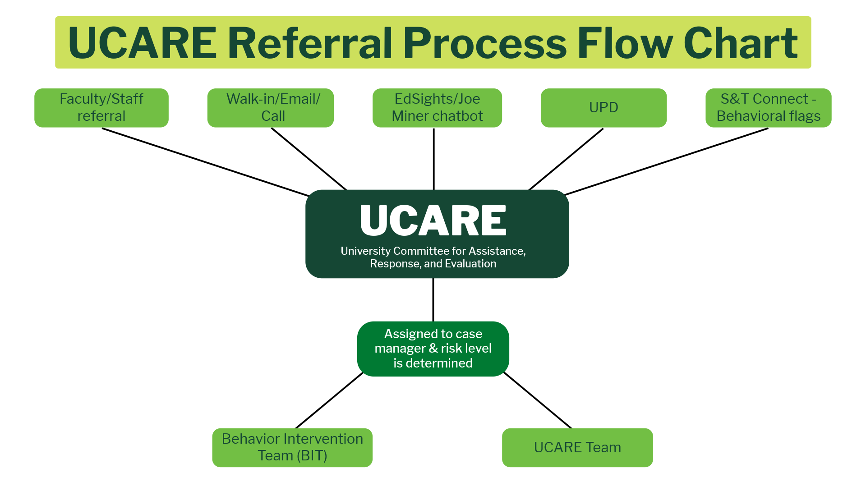

Slide 23
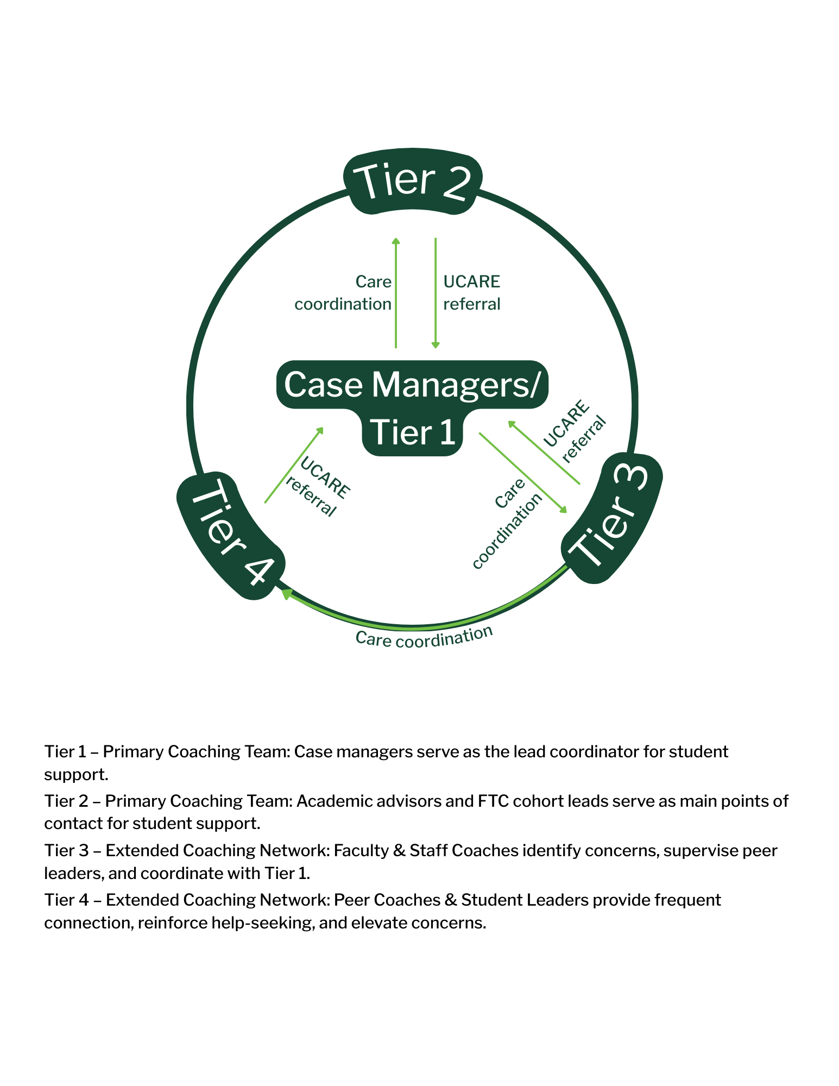
Tier 1: Case Managers
Tier 2: Academic advisors and FTC cohort leads
Tier 3: Faculty & Staff
Tier 4: Student Leaders
Notes:
Tier 3 – Faculty and Staff – Res Hall coordinators, Student Success Staff, RSO advisors – provide coaching advising, mentoring

Slide 24
Data - UCARE Referral
07/01/25 - Current
TYPE OF REFERRAL
Academic Concerns | 241
Adjustment Issues/College Transition | 91
Basic Needs (food or housing insecurity) | 28
Death of a Family Member or Friend | 22
Excessive Absences from Class | 74
Extreme Change in Mood or Behavior | 58
Financial Concerns | 57
Injury/Illness | 37
Other (please describe) | 71
Physical Health Issues | 45
REFERRAL SOURCE
Advisor | 58
Colleague | 12
Faculty | 108
Family Member | 13
Friend | 73
Self-Referral | 15
Staff | 99
Student Employee | 86
Notes:
Last year - 19% faculty referrals
This year - 23% faculty referrals

Slide 25
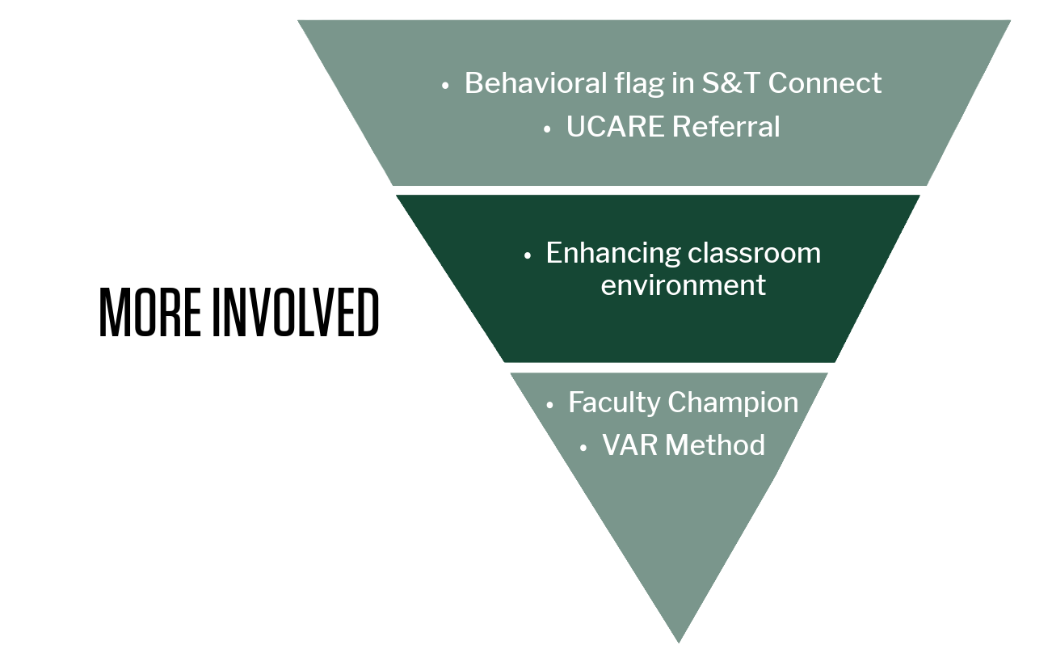
Enhancing the Classroom Environment

Slide 26
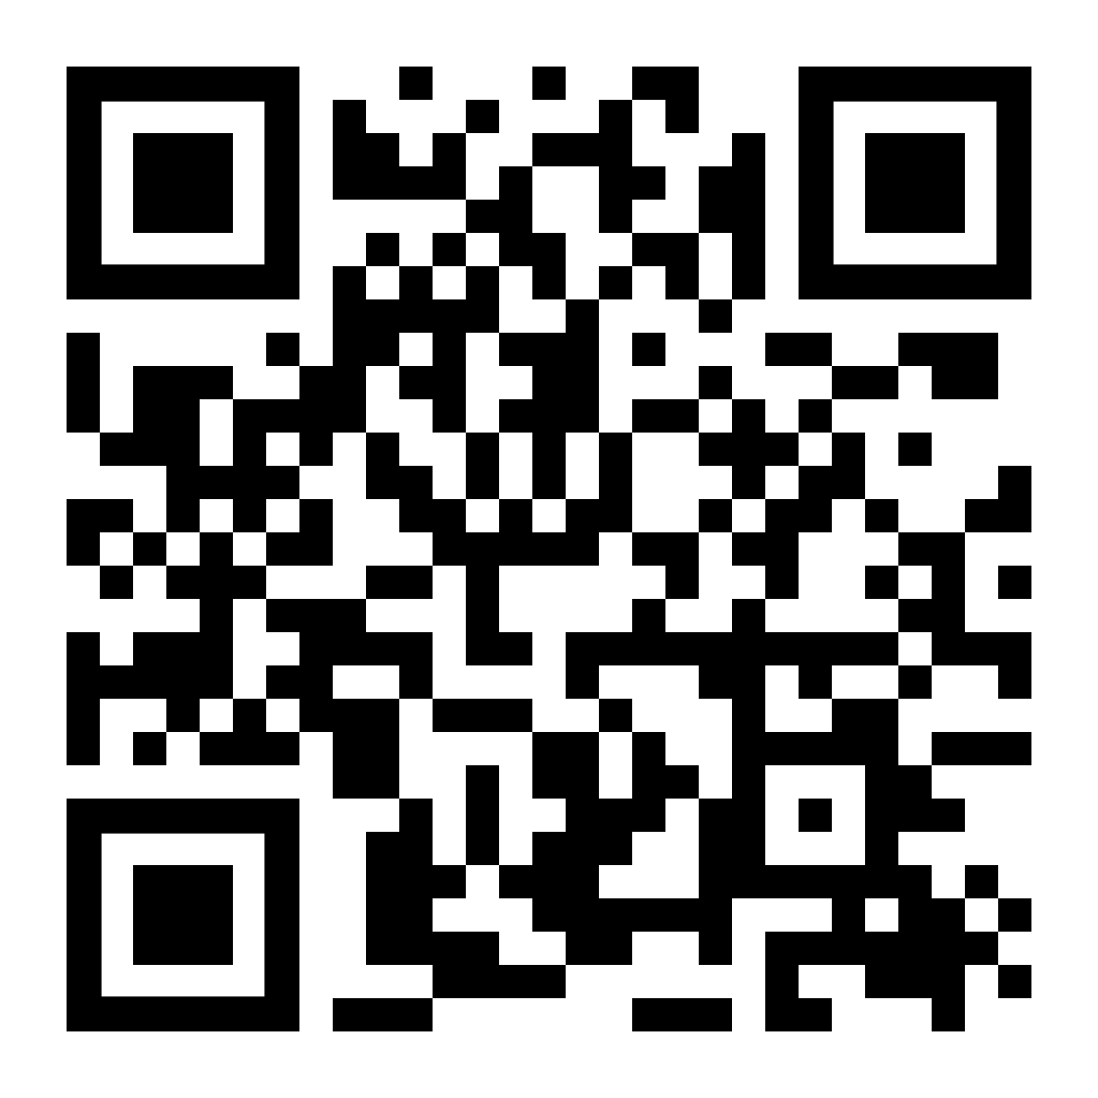
Well-Being in the Classroom Webpage
https://hwb.mst.edu/classroom-wellbeing/
Classroom Strategies
Faculty Spotlights
Resources

Slide 27
Well-Being in the Learning Environment
Learning and using students' names
Mood check/temperature check for students - "how are you doing?"
Acknowledging stress (for students and faculty)
Normalize asking for help and sharing resources
Adding UCARE and well-being statement to syllabus

Slide 28
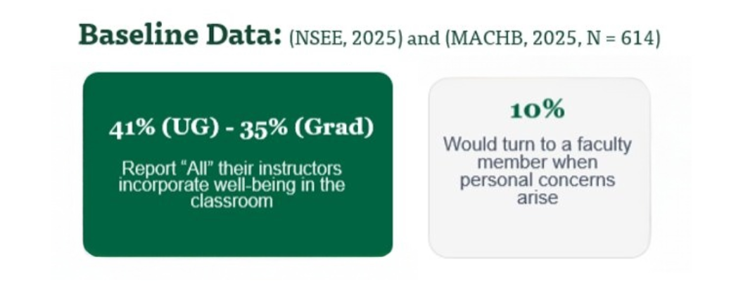
Data - MACHB and NSSE

Slide 29
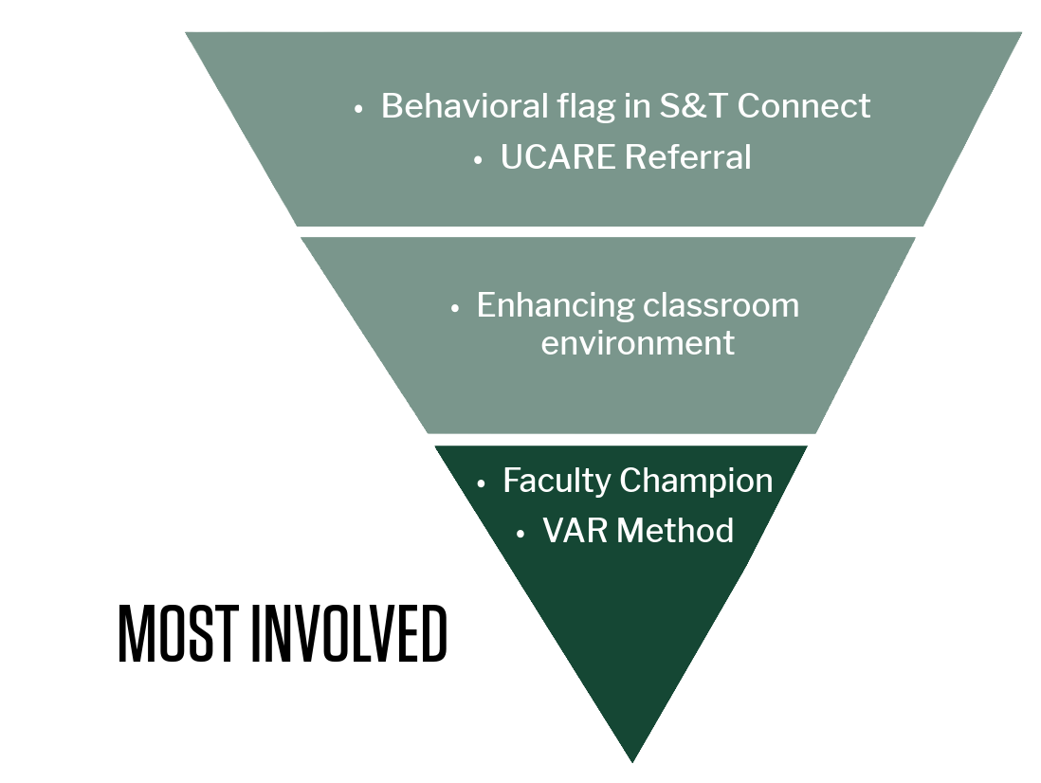
ENCOURAGED ACTIONS TO SUPPORT STUDENTS

Slide 30
VAR Method
When A Student Approaches You with a Concern
Validate: Validate their concerns and feelings
Appreciate: Appreciate them opening up to you; this can be difficult!
Refer: Provide resources and refer to UCARE

Slide 31
Faculty Well-Being Champions
Faculty Well-Being Champions are a network of faculty dedicated to embedding well-being into the everyday culture of their college, unit, or department.
Guiding Principles:
Share • Model • Train • Support
Notes:
14 departments, over 200 faculty

Slide 32
Integrating Well-Being into the Academic Culture

Slide 33
Thank You!

Slide 34
V. President’s Report
P. Runnion

Slide 35
CRR Changes: Academic Calendar Revisions (CRR 20.140)
Approved by Board of Curators on February 5, 2026
The 43/29 rule goes away, effective Fall 2026
Fall 2026 start date will remain August 24, 2026
Beginning in Fall 2027, the fall semester will start on the third Monday of August (August 16, 2027)
Thank you for your robust discussion and input on this matter!

Slide 36
IFC Updates – January 26 (virtual)
Travel to countries of concern
Both personal travel and official travel must be authorized
Particular concerns were expressed about use of University computing resources
At least one University-owned device was tampered with internationally and now resides in an evidence locker
Working on an RFP for a potential MyVita replacement
Watch for upcoming CRR/policy changes regarding controlled substance use in research

Slide 37
IFC Updates – January 26 (virtual)
State funding of public 4 year institutions in Missouri and SEC on a per-FTE basis

Slide 38
4-Year Public State Funding
 | FY26 Total | FY26 FTE | FY26 Per FTE
Lincoln University | $36,545,702 | 1,777 | $20,567
Truman State University | $50,936,492 | 2,843 | $17,916
Harris-Stowe State University | $13,290,587 | 924 | $14,377
Missouri Western State University | $27,200,263 | 2,484 | $10,952
Missouri Southern State University | $31,740,162 | 3,024 | $10,495
S&T | $64,658,445 | 6,239 | $10,364
University of Missouri | $274,626,972 | 28,541 | $9,622
University of Central Missouri | $67,661,616 | 7,109 | $9,517
University of Missouri-Kansas City | $95,498,903 | 10,643 | $8,695
University of Missouri-St. Louis | $71,623,566 | 8,247 | $8,685
SEMO | $56,095,083 | 6,835 | $8,207
Missouri State University | $114,931,523 | 16,206 | $7,092
NW Missouri State University | $38,130,079 | 5,733 | $6,651
Total | $942.939.393 | 100,605 | $9,373
Notes:
Enrollment Data is from “2025.12.22 Missouri HE Funding and Enrollment” sheet provided by Steven Chaffin (original source is state: https://dhewd.mo.gov/media/file/enrollment-report-missouri-public-comprehensive-independent-institutions)
Appropriations data was provided by Leroy Wade at the State of Missouri (see Higher Education Institution Funding 2016-2026 spreadsheet). Amounts for UM System campuses were tied back to appropriations schedules on our website: https://www.umsystem.edu/ums/fa/budget/appropriation-history
The appropriations data on this table is core funding, which includes Education (Undergrad & Grad non-professional), Professional (Medical Students), Research, and Extension.
For FY16, FY18, and FY20, appropriations for UWIDE, UMSYS, and the Unallocated Withholding were spread to campuses based on an allocation rate that was calculated based on the amount of appropriations each campus received divided by the total amount of appropriations received by the four campuses. In FY25, appropriations for UWIDE and Unallocated withholding were spread using the aforementioned allocation rate.

Slide 39
SEC State Funding | FY24 Total | FY24 FTE | FY24 Per FTE
University of Florida | $1,128,759,000 | 48,475 | $23,285
Texas A&M | $1,226,189,915 | 63,515 | $19,306
University of Georgia | $666,354,113 | 41,453 | $16,075
University of Tennessee | $500,925,044 | 34,104 | $14,688
Ole Miss | $305,714,505 | 22,290 | $13,715
Auburn University | $391,067,312 | 29,989 | $13,040
Mississippi State | $245,317,631 | 20,713 | $11,844
University of Kentucky | $319,669,300 | 27,182 | $11,760
University of Missouri | $255,920,760 | 26,114 | $9,800
University of South Carolina | $330,156,238 | 34,054 | $9,695
Louisiana State | $326,659,725 | 34,646 | $9,429
University of Texas | $420,755,427 | 46,855 | $8,980
University of Arkansas | $235,548,000 | 28,867 | $8,160
University of Alabama | $229,905,984 | 35,828 | $6,417
University of Oklahoma | $143,562,000 | 25,272 | $5,681
Total | $6,726,504,954 | 519,357 | $12,952
Notes:
Source: IPEDs State Approps per 12-month FTE; Enrollment and Approps data not available beyond FY24.
12-month FTE Enrollment includes Undergraduate & Graduate Non-Professional (Graduate Professional exluded).

Slide 40
IFC Updates – January 26 (virtual)
HR Updates
Defined Contribution opt-in packets arriving soon for those who requested
As of January 26, ~20% of eligible employees had requested a packet
Working (slowly) on an RFP for a new ERP system (finance/HR)
New SRS (student records) system will come later
Next IFC meeting: March 9, Columbia

Slide 41
Search: Founding Dean of the Graduate School
Candidate 1: Earlier this week
Candidate 2: Open forum on Monday February 23
2:30 PM, Innovation Lab Forum
Candidate 3 (tentative): Open forum on Thursday February 26
2:30 PM, B10 Bertelsmeyer
Please be an active participant in this important search
Feedback is the breakfast of champions

Slide 42
Classroom Technology
A proposal is being considered by IT and campus administration to eliminate classroom computers and require faculty to bring laptops

Slide 43
High School Dual Enrollment
High School Dual Enrollment Curriculum Task Force
First meeting on Monday Feb. 9
Limited faculty representation
The administration is eager to try to break in to the dual enrollment market
Market seems to be very saturated
The administration wants instructors to be ready for more hand-holding with the high school students and also to be ready for some mandatory reporting requirements (grades, attendance, etc.) to high schools.

Slide 44
Referrals
Foundational AI
General Education policies
Distance Ed compensation model
Admissions deadlines

Slide 45
Foundational AI
Friday January 16 – Provost forum on possible AI Mastery Requirement
Opinions on the success of this event are widely varied
Referral regarding Foundational AI and Gen Ed was sent to Senate in response
Saturday January 24 – Follow up email from Provost to AllFac
CEC – Survey of departments regarding AI messaging, current AI initiatives/requirements, and future plans
Original plan for today was to ask Senate if we wanted to continue pursuing a foundational AI requirement, but…

Slide 46
Governor’s Executive Order 26-02
The Commissioner of the Department of Higher Education and Workforce Development, in collaboration with the Department of Economic Development, shall undertake initiatives to prepare Missouri’s workforce and education systems for the AI-driven economy: a. Evaluate the AI Education and Training Ecosystem: Evaluate the status and delivery of AI-related programming, both in specialized programs and across the broader curricula, by Missouri public higher education institutions. Conduct a landscape analysis of existing industry partnerships. Leverage regional education and labor force data to examine which programs are AI-workforce-aligned. b. Launch AI-Focused Training Programs: Develop best practices related to AI education, and recommend and establish new degree programs, including certifications, apprenticeships, and rapid retraining initiatives focused on high-demand AI-related skills (e.g. data science, security, and maintenance of AI systems).
All reports, policy recommendations, and findings related to this Order shall be delivered to the Governor’s Office by November 30, 2026.

Slide 47
Foundational AI
How do we wish to proceed?
Let the administration do as it pleases
Not the recommended solution
Form a working group to explore how to appropriately meet the demands of the EO
We should probably do this

Slide 48
General Education Policies
Two formal referrals
One in conjunction with Foundational AI concerns
One from the Acting Registrar
One additional concern regarding interpretation of current catalog language
All can likely be addressed simultaneously

Slide 49
General Education Policies
Referral from Acting Registrar
“I think we need to add a specific statement which allows programs to specify/require a given course in a foundational knowledge area.”
Proposal: “While General Education requirements are organized by knowledge areas, individual degree programs may require a specific course within a knowledge area when necessary to meet accreditation standards or to ensure essential foundational learning for the program. Such requirements are clearly identified in program curricula to ensure transparency for students, including those transferring from other institutions.”
Notes:
This simply clarifies that departments are allowed to do what they are already doing.

Slide 50
General Education Policies
Referral in conjunction with Foundational AI concerns
“This referral is on behalf of multiple individuals with concerns about the General Communication Requirements in the catalog, as expressed in the AI summit or as concerns about the possible ways to integrate "AI fluence/mastery/literacy." The Communication Intensive and Communications Emphasized courses do not have definitions for the designated courses. As the campus has held this up as a model of how we could integrate AI, these designations and the requirement for these courses should be re-examined and updated. The catalog language, copied below, mentions the general education requirement of communications, but that has changed since this was written.”

Slide 51
General Education Policies
Additional concern regarding interpretation of current catalog language:
S&T general education requirements may be completed at S&T or are considered completed for students who:
Transfer to S&T with an AA degree from a regionally-accredited Missouri institution or
Complete CORE 42 at S&T or at another CORE 42 signatory Missouri institution or
Complete general education at a CORE 42 signatory Missouri institution
Transfer credits for other students are evaluated on a course-by-course basis. All students must complete University graduation requirements beyond the University General Education Requirements.
Gen Ed has been interpreted as being completed based on an AS degree, and thus we have a student who could potentially graduate without ENGL 1120.

Slide 52
General Education Policies
Need to form a working group to address these concerns
We knew that Gen Ed would likely need tweaking after such a major change

Slide 53
Distance Ed Compensation Model
Referral: “I would like Faculty Senate to discuss the issue of distance education classes being attached to in-person classes. Currently, the procedure is to require faculty to add the distance section without any additional compensation or adjustment to the teaching load. There is a considerable amount of effort required to manage the additional section (e.g., separate website, recording in-person lectures, running discussion threads, etc.) and it negatively impacts the quality of both sections. The other institutions that I've been affiliated with in the past either count distance sections as "on-load", or they consider it "off-load" and provide additional compensation based on a scale that benefits the university, college, department, and faculty member. Most research faculty in our department have a 2-2 course load in the workload agreement but, in reality, are teaching as much as a 4-4 load with the additional distance sections. Again, it is misleading and unfair to faculty, and it results in an inferior product for students.”
Notes:
Concerns about workload in general This week’s candidate for Graduate Dean mentioned that his junior faculty do not teach in their first semester, and most are on a 1-1 load.

Slide 54
Admissions Deadlines
Referral from RP&A to Student Affairs
Multiple students have been admitted to S&T [during the second week of the semester] as new students, and it seems that by admitting students after the start of the semester that we are setting them up for frustration (if we can’t get them a schedule) and/or failure (if they are too far behind in their courses by the time the add). RP&A is in favor of implementing a policy which, in some manner, establishes a last date for application and/or admission for a given semester, and we would be in favor of such a deadline being prior to the first day of classes. We are not proposing specific language – we will leave that up to your committee. We request that your committee develop a formal proposal that can be voted on at the April Faculty Senate meeting.

Slide 55
VI. Campus Reports A. Staff Council
M. Evans

Slide 56
VI. Campus Reports B. Student Council
A. Pickett

Slide 57
VI. Campus Reports C. Council of Graduate Students

Slide 58
VII. Committee Reports

Slide 59
VIII. Committee Reports A. Bylaws Revision
M. Bruening

Slide 60
Bylaws Revision Committee

Slide 61
Bylaws revisions
Committee: Mike Bruening (chair), Steve Corns, Mike Gosnell, Kelly Liu, Melanie Mormile, Paul Runnion, Dave Westenberg
Objective today: get feedback and possibly approve document for forwarding to General Faculty
Addressing issues brought up last time and privately in the interim:
Department voting rights
Department creation and realignment
The Parking and Environmental Safety and Security committees

Slide 62
Department Voting
Issue raised at last meeting: Who decides when exceptions can be made to standard department voting?
New proposed language (compared to old proposed language):
Voting members of the department shall include the full-time, ranked faculty members whose primary appointment is in that department and who do not hold full-time administrative appointments. Departments maintain discretion to extend The full-time, ranked faculty members of each department shall establish policies on situations when voting rights are to be either extended (e.g., to administrators, post-docs, emeritus, visiting, or adjunct faculty) or restricted (on particular issues related to, e.g., tenure, curriculum, hiring, etc.) voting rights as appropriate.

Slide 63
Department Reorganization
Senate officers making progress with administration on a single procedure
Current bylaws require 2 separate procedures
New proposed language (compared to existing bylaws):
There shall be separate procedures for reorganization of departments The process shall address reorganization of departments as defined in b(1) above both in the case where the Faculty/Units are the impetus for the change or and in the case where the Administration are is the impetus for the change. For purposes of this procedure, Administration refers to Chancellor, Provost, or Vice‐Provost and Dean.

Slide 64
Parking and Environmental Safety
Previous proposal combined Environmental Health, Safety, and Security Committee and the Parking, Security and Traffic Committee into
Received feedback from staff that these should be kept separate since they deal with very different things (e.g., Parking deals with things like ticket appeals; EHSS deals with things like lab safety)
New proposal: keep them as 2 separate committees, but
Move EHSS to a judicial committee
Reduce size of both committees

Slide 65
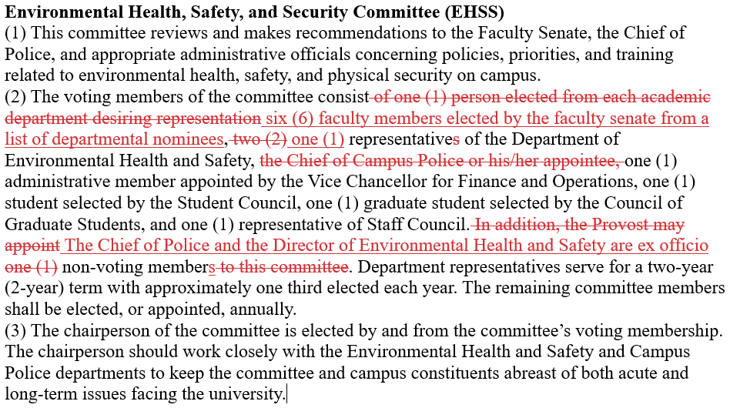
EHSS New language

Slide 66
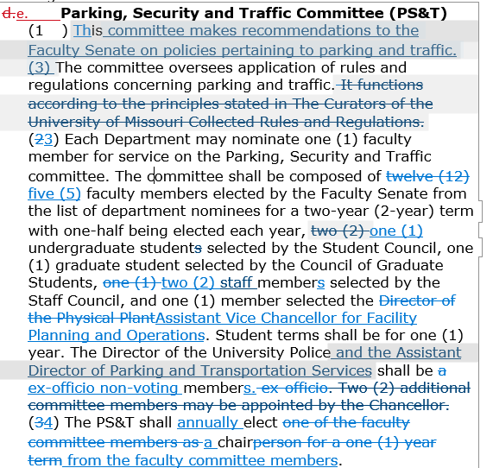
Parking Committee new language

Slide 67
VII. Committee Reports B. ITCC
M. Zawodniok

Slide 68
VII. Committee Reports C. Personnel
K. Northcut

Slide 69
Personnel Committee
Fall ‘25 referral: we consider it to be resolved, and our involvement in it was minimal.
Current referrals
NTT Rolling Contracts
Miscellaneous Instruction Funding/Problematic Budget Model
Hi-Flex Instructional Model: 3 for the price of one? Or the worst of all worlds?

Slide 70
VII. Committee Reports D. Administrative Review
K. Erickson

Slide 71
VI. Reports of Standing Committees
Administrative Review
K. Erickson

Slide 72
2025-2026 Members
Kelvin Erickson, Chair
Bih-Ru Lea
Kelly Liu
Jorge Porcel
Matt Thimgan

Slide 73
Tentative Timeline and Process
Action | Time
Review list to faculty senate for approval | November 20, 2025
Job descriptions | Nov/Dec 2025
Development of questionnaires
Questionnaires to FS for review/approval | December 18, 2025
Statement of accomplishments due | February, 2026
Review of administrators | March 9 - March 20
Results to FS officers | Early May
Results shared with reviewees | Late May
Final report to FS | June 18

Slide 74
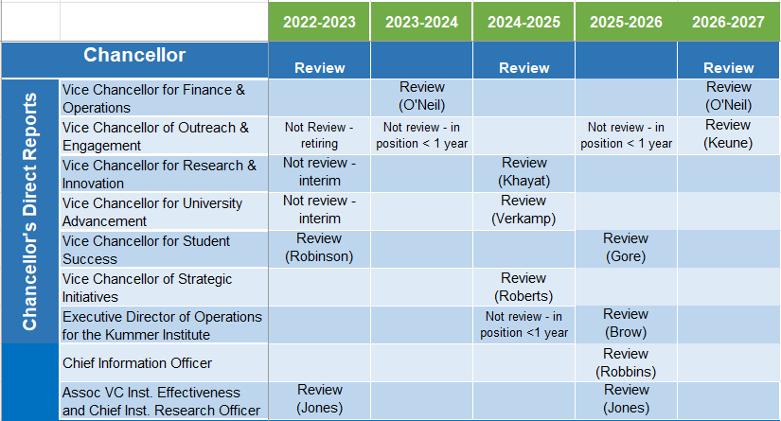
Administrative Review Schedule

Slide 75
Revised Questions for One Position
Assoc. Vice Chancellor for Institutional Effectiveness and Chief Institutional Research Officer (Jones)
Position duties changed and were not noticed by the committee in Dec.
When Dr. Jones was asked to prepare his statement of accomplishments, he pointed out the discrepancies.

Slide 76
Faculty Senate Motion
The Administrative Review Committee requests approval of the questionnaire on the succeeding pages for:
Assoc. Vice Chancellor for Institutional Effectiveness and Chief Institutional Research Officer (Jones)

Slide 77
Questionnaire for Assoc. VC of Institutional Effectiveness and Chief Institutional Research Officer
Effectively provides strategic leadership for a comprehensive institutional effectiveness program that integrates planning, institutional research, analytics, continuous improvement, and business intelligence.
Effectively designs, implements, and communicates data-informed strategies that integrate analytics, organizational tactics, and stakeholder collaboration to advance institutional priorities.
Effectively collects, analyzes, interprets, and presents institutional data, providing actionable recommendations to support planning, assessment, administrative decision-making, grant development, and overall institutional effectiveness.
Scale: Strongly Agree, Agree, Disagree, Strongly Disagree, Insufficient Information/Unsure (each question)

Slide 78
Questionnaire for AVC Inst. Eff. & CIRO (Contd.)
Effectively designs and implements frameworks to assess and continually improve the quality and effectiveness of campus programs and services in alignment with the institution’s mission, vision, goals, and strategic priorities.
Effectively collaborates with institutional and college-level committees to design, collect, and analyze data that informs decision-making and continuous improvement.
Effectively interacts and communicates with faculty, staff, Committee members, and other on- and off-campus constituents in a collegial manner.
Scale: Strongly Agree, Agree, Disagree, Strongly Disagree, Insufficient Information/Unsure (each question)

Slide 79
Questionnaire for AVC Inst. Eff. & CIRO (contd.)
Overall Assessment
Dr. R. Wayne Jones should be retained in the position as the Associate Vice Chancellor of Institutional Effectiveness and Chief Institutional Research Officer.
 Yes  No

Slide 80
VII. Committee Reports E. Budgetary Affairs
B. Lea

Slide 81
Budgetary Affairs Committee
Academic Year: 2025 - 2026
Report To Faculty Senate: 02-12-2026

Slide 82
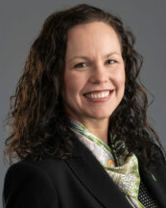
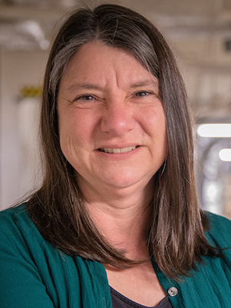
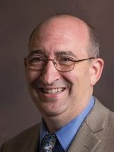
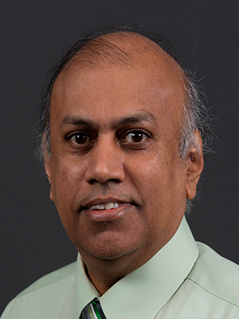

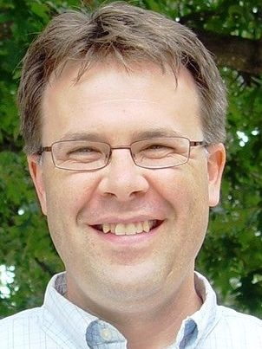
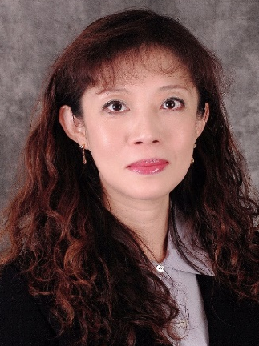
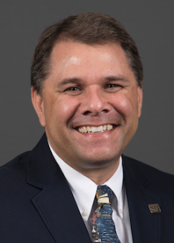
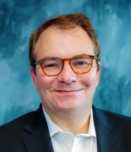
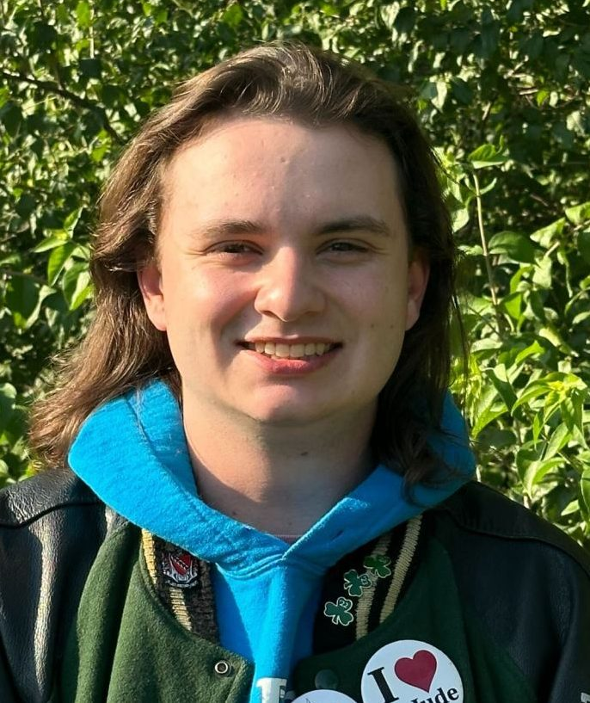
Budgetary Affairs Committee (BAC) Members
2-12-2026 Report
Referrals
Faculty & Department Enrollment Insensitive Program
GRA Funding in Capital Construction Projects
Supplemental Instructional Funding
Faculty Workload & Distance Education Classes
In-progress Tasks
VCFO Financial Updates
E
D
D
D
D
CFO Alysha O'Neil alysha.oneil@mst.edu
Finance & Operations
Dr. Melanie Mormile mmormile@mst.edu CASE
Dr. David Bayless dbayless@mst.edu, CEC
Dr. Jag Sarangapani sarangap@mst.edu, CEC
Dr. Michael Meagher
mmeagher@mst.edu, CASE
FS
FS
G
G
StuC
Dr. Kelly Homan khoman@mst.edu CEC
Dr. Bih-Ru Lea leabi@mst.edu Kummer
Dr. Michael Moats
moatsm@mst.edu
CEC
Dr. Amaury Lendasse
alendasse@mst.edu
Kummer
Mr. Jason Gough
jlgwt4@mst.edu
Student Council, EMSE

Slide 83
Referral 1: BAC memos to Provost Harris on (1) Faculty Incentive Program and (2) Department Enrollment Incentive Program
Background Info
BAC Memo to Provost Harris
Strengths:
Strong alignment with the university’s research growth objectives
Budget-neutral structure that supports research-active faculty through externally funded salary release without creating new recurring costs for the university.
Issues to consider
Doctoral degree completion benchmarks required to sustain R1 research university status
Potential instructional workload and budgetary impacts at the departmental level.
Feedback to Provost Harris on (1) Faculty Incentive Program and (2) Department Enrollment Incentive Program Per 11-5 BAC meeting with Provost Harris
Originated from the faculty salary and hiring trends in FY 24-2
Relevant BAC Reports
(slides 29-33) Faculty Senates 3-20-24
(slides 68-71) Faculty Senates 4-24-24
(slides 53-55) faculty Senates 9-18-25
(slides 57-64) faculty Senates 11-20-25

Slide 84
Referral 1: BAC memos to Provost Harris on (1) Faculty Incentive Program and (2) Department Enrollment Incentive Program
Responses from Provost Harris:
Doctoral degree completion in reference to Sustain R1 Status
Fairness concerns exist for applying PhD-related expectations in departments without PhD programs; department chairs will evaluate research productivity, including doctoral supervision, by discipline and faculty rank.
A university-level PhD student recruitment task force is developing proposals to address doctoral enrollment and completion.
Potential instructional workload and budgetary impact
Instructional workload impacts are acknowledged; workload and course buyouts are being examined in parallel.
Any additional course releases are expected to be funded through buyouts, with funds returning to departmental instructional budgets.
Background Info
Feedback to Provost Harris on (1) Faculty Incentive Program and (2) Department Enrollment Incentive Program Per 11-5 BAC meeting with Provost Harris
Originated from the faculty salary and hiring trends in FY 24-2
Relevant BAC Reports
(slides 29-33) Faculty Senates 3-20-24
(slides 68-71) Faculty Senates 4-24-24
(slides 53-55) faculty Senates 9-18-25
(slides 57-64) faculty Senates 11-20-25

Slide 85
Referral 1: BAC memos to Provost Harris on (1) Faculty Incentive Program and (2) Department Enrollment Incentive Program
Background Info
Feedback to Provost Harris on (1) Faculty Incentive Program and (2) Department Enrollment Incentive Program Per 11-5 BAC meeting with Provost Harris
The Budgetary Affairs Committee would like to recognize and sincerely appreciate Provost Harris for his openness, collaborative leadership, and genuine willingness to seek, thoughtfully consider, and incorporate the Committee’s feedback into plan revision. His responsiveness and engagement are deeply valued and appreciated.
Originated from the faculty salary and hiring trends in FY 24-2
Relevant BAC Reports
(slides 29-33) Faculty Senates 3-20-24
(slides 68-71) Faculty Senates 4-24-24
(slides 53-55) faculty Senates 9-18-25
(slides 57-64) faculty Senates 11-20-25

Slide 86
Referral 1: BAC memos to Provost Harris on (1) Faculty Incentive Program and (2) Department Enrollment Incentive Program
Given the complexity and long-term implications of this issue, the BAC will undertake the following actions:
Continue its systematic review of the proposed incentive plan to ensure effective implementation and alignment with the university’s strategic priorities.
Evaluate the interdependencies between the incentive structure and related institutional factors, including the sustainability of Tenured/Tenure-Track (T/TT) faculty ranks, Ph.D. student mentoring, and the long-term vitality of graduate programs.
The Committee’s review will focus on identifying potential unintended consequences and ensuring that financial incentives support a balanced and sustainable academic research ecosystem that maintains R1 status.
Background Info
Feedback to Provost Harris on (1) Faculty Incentive Program and (2) Department Enrollment Incentive Program Per 11-5 BAC meeting with Provost Harris
Originated from the faculty salary and hiring trends in FY 24-2
Relevant BAC Reports
(slides 29-33) Faculty Senates 3-20-24
(slides 68-71) Faculty Senates 4-24-24
(slides 53-55) faculty Senates 9-18-25
(slides 57-64) faculty Senates 11-20-25

Slide 87
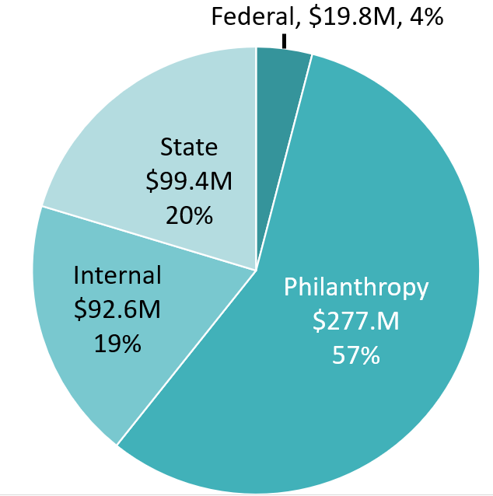
Referral 2 GRA funding in Capital Building Projects
Funding Source for Capital Projects (FY22 – September, 2025)
Background Info
FS Referral 1-5-2026:
Is GRA money being used for capital building projects like the Protoplex, Bioplex, etc?
If so, those projects already received special state funds designated for their construction. I would suggest discussing the practice of using GRA funds exclusively for academic faculty and staff, rather than to bridge the funding gap for new buildings.
Total: $446M
Relevant Reference:
Slides #55 Faculty Senate 9-18-2025.

Slide 88
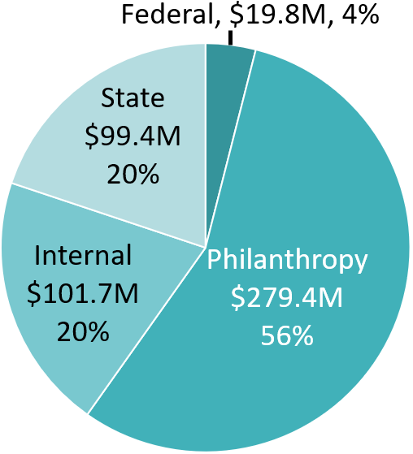
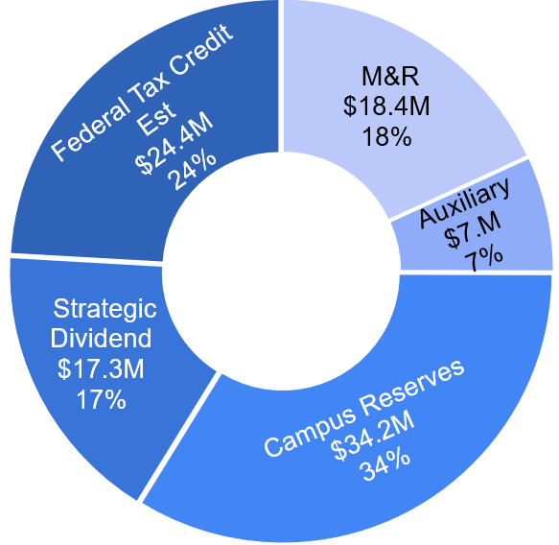
Referral 2 GRA funding in Capital Building Projects
FY 22 – current
101.7M
GRA funds

Slide 89
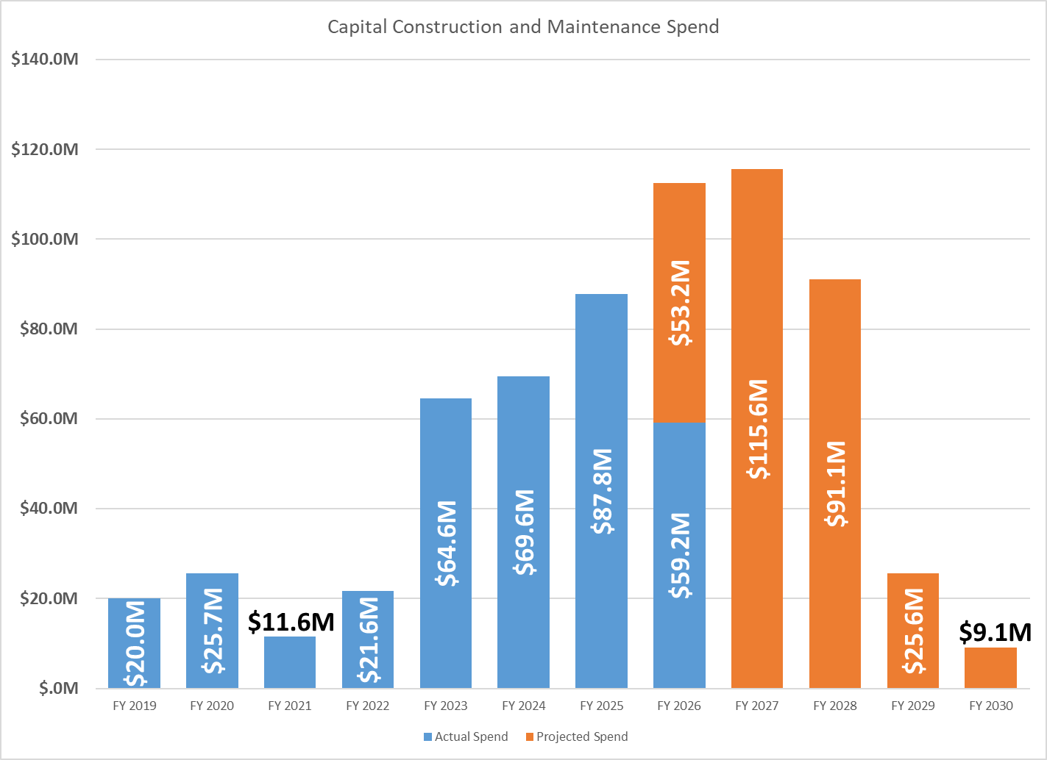
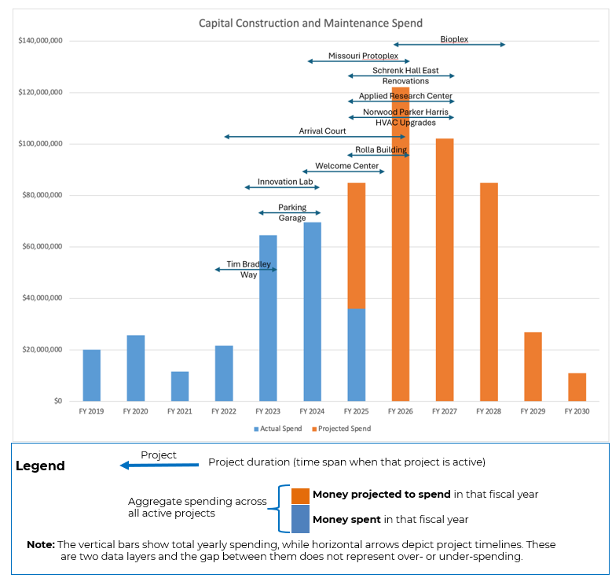
Referral 2: Capital Construction and Maintenance Spend
FY 22 – current
FY 22 – Sept. 2026
Total Spend (Spent + Projected) decreases in 2026
Projected to spend increases in 2027

Slide 90
Referral 3 Supplement Instruction Funding
FS Referral 1-15-2026:
The Department Chairs Council (DCC) would like to refer to the issue of the funding gap for miscellaneous instruction.
The provost reported that there is a $1.3M gap between the requested amount for miscellaneous instruction funds and the available funds, even with contributions from the provost's budget and reallocations.
…the gap is about 162 classes that cannot be taught. Class sizes are getting larger. Courses are getting cut from the schedule; students can't take electives. This will impact time-to-degree. Why should we work to recruit new students when we don't have enough funding to teach the classes we need for our existing levels of student enrollment? Funding that was previously used by CEC for teaching was diverted to Student Affairs for advising, for example.

Slide 91
FY26 Supplement Instructions Budget Allocation
Total Requested |  | $6,000,000
College GRA | $3,000,000
Additional Commitments | 370,000
Provost GRA** | 1,100,000
Strategic Cash | 300,000 | $4,770,000
College Discretionary Required |  | $ 1,230,000
CASE and Kummer College provided 100% of what was requested by the departments
CEC provided $1.2M (slightly less than requested) and invited chairs to consult the Dean if additional support was needed
*
$1.4 M
(Provost)
* Mainly from course buyout
** Consistent with prior years, the Provost’s Office provided Supplemental Instruction support through GRA funding in both FY25 and FY26
Notes:
In FY26, the Provost provided $1.4M, which included the $300k in Strategic Reallocation for Supplemental Core Instruction. The Colleges already have about $3M GRA dedicated to their Supplemental Instruction and then access to Addt’l Commitments (course buyouts mostly) amounting to about $370k. T colleges find discretionary cash to fund the “hole” of about $1.3M.
It's important to note that GRA funds were directed to the Provost for Supplemental Instruction support in the last two fiscal years (FY25, FY26) – which has allowed for the burden of funding to reduce on the College Discretionary cash required (despite costs not going down). In addition, the Provost Office has, for several years now, provided a good portion of support.

Slide 92
Referral 3 Supplement Instruction Funding
Key Concerns with the Current Departmental Budget Model
Insufficient instructional funding: Departments have canceled needed courses due to limited miscellaneous instruction funds, negatively affecting student progress, recruitment, and retention.
Misaligned incentives: Departments are rewarded primarily for their own enrollment and graduation metrics, encouraging siloed course offerings at the expense of cross-departmental student needs.
Historic (non-variable) funding model: Department budgets are not aligned with actual instructional costs, requiring ad hoc support from deans’ offices rather than systematically funding required instruction.
Staffing expectations and workload equity: Course staffing optimization lacks consistent guidelines, training, and transparent application; existing SCH expectations do not adequately reflect graduate teaching, research, and mentoring responsibilities.
Lack of budget transparency: Limited visibility into how instructional revenue is allocated obscures diversions from the academic mission and contributes to underfunding of instruction
The current department budget model prioritizes historical allocation and does not consistently align instructional funding with student needs or actual teaching costs.

Slide 93
Referral 3 Supplement Instruction Funding
Ongoing actions
Efforts have been made to establish the Supplemental Instruction Fund as a recurring budgeted item (i.e., a GRA item).
Additional funding was allocated to expand supplemental instruction in FY25, with continued support planned for FY26.
Recognizing the importance of this funding, the VCFO has worked with the Deans to exclude the supplemental instruction account from budget reduction actions.
Budgetary Affairs Committee (BAC) Recommendations to the VCFO
Rename the account in PeopleSoft to a more descriptive title, such as “Mission Critical Instruction Support,” to clarify its purpose.
Formally exclude the account from future budget reduction measures to protect instructional support.
Continue efforts to establish the account as a recurring GRA-funded line item.
Convene focused meetings with (1) the Provost and (2) college budget officers to address timing, transparency, and process concerns raised in the referral.
Communicate outcomes and an action plan to stakeholders, including the DCC that submitted the referrals.

Slide 94
Referral 4 Distance Education Classes and Faculty Workload
To be included in the special topic meeting with Dr. Debra Bourdeau, VP Online & Education Innovation on March 11
FS Referral 1-29-2026:
I would like the Faculty Senate to discuss the issue of distance education classes being attached to in-person classes.
Currently, the procedure requires faculty to add the distance section without any additional compensation or adjustment to the teaching load.
There is a considerable amount of effort required to manage the additional section (e.g., separate website, recording in-person lectures, running discussion threads, etc.), and it negatively impacts the quality of both sections.
The other institutions that I've been affiliated with in the past either count distance sections as "on-load“ or consider them "off-load" and provide additional compensation based on a scale that benefits the university, college, department, and faculty member.
Most research faculty in our department have a 2-2 course load in the workload agreement, but, in reality, are teaching as much as a 4-4 load with the additional distance sections. Again, it is misleading and unfair to faculty, and it results in an inferior product for students.

Slide 95
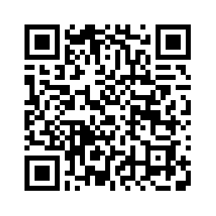
Referral 4 Distance Education Classes and Faculty Workload
BAC Special topic meeting with Dr. Debra Bourdeau, VP Online & Education Innovation on March 11
Proposed Discussion Topics
Strategic positioning and enrollment growth
Faculty workload and financial sustainability
Tuition structure and revenue allocation
Target student populations and program strategy,
Meeting Objectives
Gain a clear understanding of the current financial framework supporting online programs.
Examine the alignment between faculty workload, tuition structure, and revenue allocation.
Clarify enrollment growth patterns and their budgetary implications.
Review key financial and performance indicators used to assess online program financial sustainability.
Identify areas where additional transparency, data, or policy clarification may strengthen long-term fiscal stewardship.
Key financial and performance metrics used to assess program effectiveness and long-term viability
Provide your input by 5 pm, Monday, 2-16
https://tinyurl.com/FS-referrals

Slide 96
In Progress Referrals and Tasks
Referral 4 and Net Revenue per Student Distance Tuition Model
Provide Dr. Debra Bourdeau with historical distance-education enrollment and FTE data, including off-campus vs. distance splits, demographics, Distance Education Classes and Faculty Workload, and additional questions or feedback received before her March 11 special topic meeting so she can review and develop plans
In-progress financial/BAC Power BI reporting tool that will improve transparency and effective communication
Department Health Index/Pressure Index

Slide 97
VCFO Updates: Missouri Governor’s 2026 Legislative Agenda
Maintains funding for mandatory obligations (e.g., Medicaid match, childcare subsidies) and avoids cuts to K-12 foundation formula/core higher education funding.
FY 2026 Budget summaries (the foundation for 2027 planning):
A 1.5% increase in base funding for all public four-year universities, community colleges, and the State Technical College of Missouri.
Earlier budget summaries for FY 2026 (the foundation for 2027 planning) included:
The Department of Higher Education & Workforce Development’s recommended total budget was approximately $1.42 B
Continued support for Fast Track Workforce Incentive Grants that help working adults retrain in high-demand fields (about $6.7 M).
Re-entry and advising support programs linked with postsecondary access (about $500,000)
University of Missouri System received significant appropriations (~$559 M)
Legislative priorities:
2026 Legislative & Budget Priorities.pdf

Slide 98
VCFO Updates: Missouri Governor’s FY 2027 Budget Recommendation
Funding is essentially held at current levels with no cut to core funding for higher education compared to FY 2026
Emphasize maintaining higher education funding and workforce development support while trimming other budget areas
Work & Workforce Emphasis
Continued focus on connecting postsecondary education to workforce needs (e.g., Missouri One Start job training programs recommended at ~$17.7 M) — much of which interfaces with higher education pathways.
Legislative priorities:
2026 Legislative & Budget Priorities.pdf

Slide 99
VCFO Updates: The Missouri Governor proposed a phased elimination of the individual income tax over a five-year period
Background Information
Timeline: If the proposal passes the General Assembly, the potential voter approval is likely in a future election date (August or November 2026)
Revenue Replacement: To offset the lost revenue (which accounts for over half of Missouri's general revenue), the plan
expands the sales tax base to include certain services like online advertising, e-books, and AI platforms
would not extend to agriculture, healthcare, or real estate.
Missouri's Governor Mike Kehoe has proposed a plan for the phased elimination of the individual income tax (five years)
Text of speech: EMBARGOED 2026 State of the State Address.pdf

Slide 100
VCFO Updates: The Missouri Governor proposed a phased elimination of the individual income tax over a five-year period
Background Information
Potential Impact on Higher Education
Reduced General Revenue: The individual income tax accounts for about 60-70% of Missouri's general revenue fund, which supports public services including education. The estimated budget shortfall is around $9 billion.
No Planned Cuts for core funding: Governor Mike Kehoe's administration has stated that the current budget plan avoids cutting core funding for higher education.
Potential funding cuts that could lead to tuition hikes
Missouri's Governor Mike Kehoe has proposed a plan for the phased elimination of the individual income tax (five years)
Text of speech: EMBARGOED 2026 State of the State Address.pdf

Slide 101
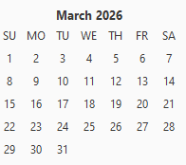
Information: Next Topic Request Due Date: 11:59 pm, 3-9-2026
All topics or questions submitted by Mar. 9 will be reviewed at the Mar. 11 BAC meeting, where the BAC will assess the following
Urgencies and priorities of topics/questions
data collection timeline
Approach(es) to addressing each topic
communication plans
Findings will then be communicated to the faculty during the March Faculty Senate meeting, another future meeting, or an appropriate communication channel.
https://tinyurl.com/FS-referrals
Faculty Senate Meeting
Budgetary Affairs Meeting
RP&A Meeting
** last day of a semester

Slide 102
VIII. Q&A with CFO
A. O’Neil
Notes:
First topic – update on Jaggi School of Business

Slide 103
IX. Unfinished Business
P. Runnion

Slide 104
X. New Business
P. Runnion

Slide 105
XI. Announcements
P. Runnion

Slide 106
XII. Adjourn
Notes:
Gavel: One tap

Slide 107
Thank You
P. Runnion
President, Faculty Senate
facultysenate.mst.edu

