Slide 1
Faculty Senate Meeting
Innovation Lab and Online
19 March 2026

Slide 2
Meeting procedure
Only Senators (or their proxies) present in person count toward a quorum
Two-thirds of the voting membership constitutes a quorum
Only Senators (or their proxies) present in person may vote
The chair will recognize members of the Senate (including proxies and ex-officio members) for the purposes of motions and debate
Members are requested to wait for recognition before speaking
Please wait for the microphone

Slide 3
I. Call to Order
P. Runnion, President
Notes:
Gavel: Two taps

Slide 4
II. Roll Call
F. Han, Secretary

Slide 5
III. Consent Agenda
P. Runnion

Slide 6
Consent Agenda – 3/19/2026
Curriculum Committee Report
*) Approval of CC and PC forms
Approval of the 12 February 2026 Minutes

Slide 7
CCC Meeting - 18 Feb 2026
Total Committee Activity
- 21 Course Change Requests (CC Forms)
- 12 Program Change Requests (PC Forms)
1 Experimental Course Requests (EC Forms)

Slide 8
CCC Meeting – 18 Feb 2026
Course Change Requests (1)
File: 5712 CER ENG 4510 : International Engineering and Design
File: 5755 CHEM 4000 : Special Problems
File: 5761 CHEM 4310 : Selected Topics In Inorganic Chemistry
File: 2518 CHEM 4410 : Chemical Thermodynamics II
File: 1492 CHEM 4420 : Chemical Kinetics II
File: 688 CHEM 4510 : Instrumental Methods Of Chemical Analysis
File: 5766 CHEM 5000 : Special Problems
File: 5769 CHEM 5310 : Introduction to Inorganic Chemistry
File: 1467 CHEM 5410 : Advanced Chemical Thermodynamics
File: 2436 CHEM 5430 : Advanced Chemical Kinetics
File: 398 CHEM 5630: Biochemical Nanotechnology
File: 235 CHEM 6450 : Spectroscopy

Slide 9
CCC Meeting – 18 Feb 2026
Course Change Requests (2)
File: 2328 EDUC 5370 : Teachers Academy : Effective Instructional Strategies
File: 164 ENG MGT 4907 : Engineering Management Senior Design
File: 10366 MATH 5670 : Scientific Programming with Python
File: 4866 MATH 5680 : Mathematics of Machine Learning
File: 8943 MET ENG 3330 : Metallurgical Thermodynamics I
File: 1290 MET ENG 4450 : Steelmaking
File: 8968 MET ENG 5220 : Recent Advances In Extractive Metallurgy
File: 1455 MET ENG 5450 : Advanced Steelmaking
File: 2193 MUSIC 1150 : Music Understanding And Appreciation

Slide 10
CCC Meeting – 18 Feb 2026
Program Changes (DC) Requested
File: 141 AE ENG-BS : Aerospace Engineering BS
File: 146 BIO SC-BA : Biological Sciences BA
File: 372 CHEMPRO-CT : Chemical Process Engineering CT
File: 45 ENG MGT-MI : Engineering Management Minor
File: 288 ENT&TEC-CT : Entrepreneur & Tech Innovat CT
File: 382 ENV SCI-BS : Environmental Science BS
File: 388 INTRCU-CTU : Intercultural Studies CTU
File: 377 MED LAB : Biological Sciences BS with Emphasis area in Medical Laboratory Scientist
File: 291 MGTLEAD-CT : Management and Leadership
File: 430 PROPOSED : Entertainment Technologies and Theatre (ET&T) CTU
File: 130 STU ART-MI : Studio Art Minor
File: 378 TEACH-CTU : Teaching and Learning Undergraduate Certificate

Slide 11
CCC Meeting – 18 Feb 2026
For Informational Purposes; No Senate Approval Required
Experimental Course (EC) Requested
File: 551 SPANISH 4001.007: Scientific Spanish

Slide 12
CCC Meeting – 18 Feb 2026
Curriculum committee moves for FS to approve the 21 CC form, and 12 PC form action requests.
Discussion: Questions or comments?

Slide 13
IV. Special Topic A. Digital Accessibility
A. Cheek, K. Crull, S. Murray, C. Tohlen

Slide 14
Digital Accessibility
UM System Alignment, Campus Responsibilities and What Faculty Should Know
March 19, 2026

Slide 15
Overview
Introductions
UM System updates
Campus-level progress
Compliance landscape
Support and resources

Slide 16
Introductions
Amber Cheek – UM/MU Director of Accessibility and ADA for the Office of Institutional Equity
Kimber Crull – S&T Manager of Internal and Executive Communications
Susan Murray – S&T Associate Provost for Teaching and Curricular Excellence
Carol Tohlen – S&T Director of Student Accessibility and Testing

Slide 17
UM System updates
Amber Cheek

Slide 18
The New Digital Accessibility Regulations
The federal government has released regulations focused on making web content and applications we access through a computer or mobile screen digitally accessible. These regulations take effect on April 24, 2026.
The updated regulation sets Web Content Accessibility Guidelines (WCAG) 2.1, Levels A and AA, as the required standard for measuring the accessibility of content online.
What this means: We have always provided accommodations under the ADA and 504, but now proactive accessibility is expected for online content. Just like there are ADA standards that provide concrete details for making a physical building accessible proactively (requiring an accessible entrance, requiring that a door be at least 32 inches wide, etc.), WCAG provides detailed requirements for making online content accessible (for example, providing alternative descriptions for images and captions for videos).

Slide 19
This is a Transition Period
This is the biggest shift in ADA compliance since 1990, and the scope of the impact will be massive, as it was in the 1990s. We should encourage everyone to view this as an ongoing transition period to a new normal for accessibility, not a short-term compliance initiative.
Going forward, we will need to think of the accessibility of our online content as just as important - and just the same under the ADA - as the accessibility of our physical buildings and programs.

Slide 20
Digital Accessibility Structure System-Wide
Since 2024:
Creation of Digital Accessibility Task Forces at each University.
System-Wide Action teams focused on key areas, such as Websites, IT applications, academic course content, and libraries, as well as a system-wide meetings to collaborate.
Establishing of key infrastructure: Ally, DubBot, IT compliance processes
This Spring and Summer:
Restructuring of the System-wide Digital Accessibility Committee, which will continue as a standing committee in the long term after Task Forces disband.
Creation of a robust exceptions process, involving subject matter experts from all four Universities.

Slide 21
CRR Updates, Forthcoming April 2026
Changes to align with the Digital Accessibility Regulations, including setting a new standard for accessibility.
Adding an Exemption Request Process to the policy, which will create a new mechanism for the University to make a determination and plan for alternative accommodation measures when compliance with the accessibility standards would cause undue burdens, constitute a fundamental alteration, be technically infeasible, or where no accessible option is available for a particular form of technology.

Slide 22
Prioritization of Academic Course Content – Factors to Consider
Ally accessibility score in Canvas
Enrollment size
Whether students with disabilities are likely to enroll given known participation, data on past enrollment, etc.
Course type – required vs. elective
Complexity of content

Slide 23
S&T Progress
Susan Murray and Kimber Crull

Slide 24
S&T Digital Accessibility Task Force
Each university in the University of Missouri System has launched a digital accessibility task force. S&T’s co-chaired by Kimber Crull and Carol Tohlen with action teams focused on:
Academic Course Content – Susan Murray
IT Procurement and Applications – Brooke Durbin
Website Accessibility – Josh Woehlke
Libraries – Christina Thompson

Slide 25

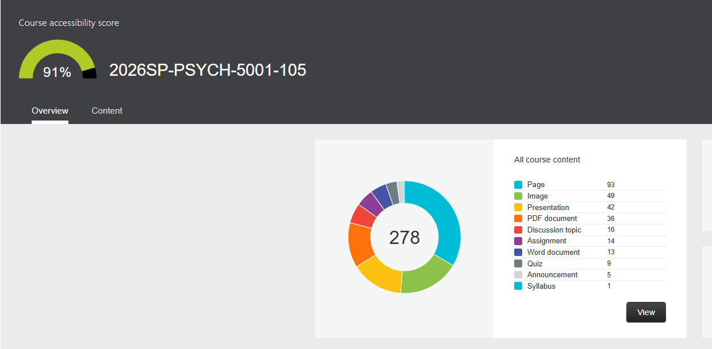
Course Content Accessibility
Faculty have been asked to achieve an 80% Ally score.
Training available and department workshops on request.
Reach out to CAFE if you need assistance in making course content accessible.
Adobe and MathPix free access ends in July.
Ally scores by college:
CASE = 73%
CEC = 55%
Kummer College = 77%

Slide 26
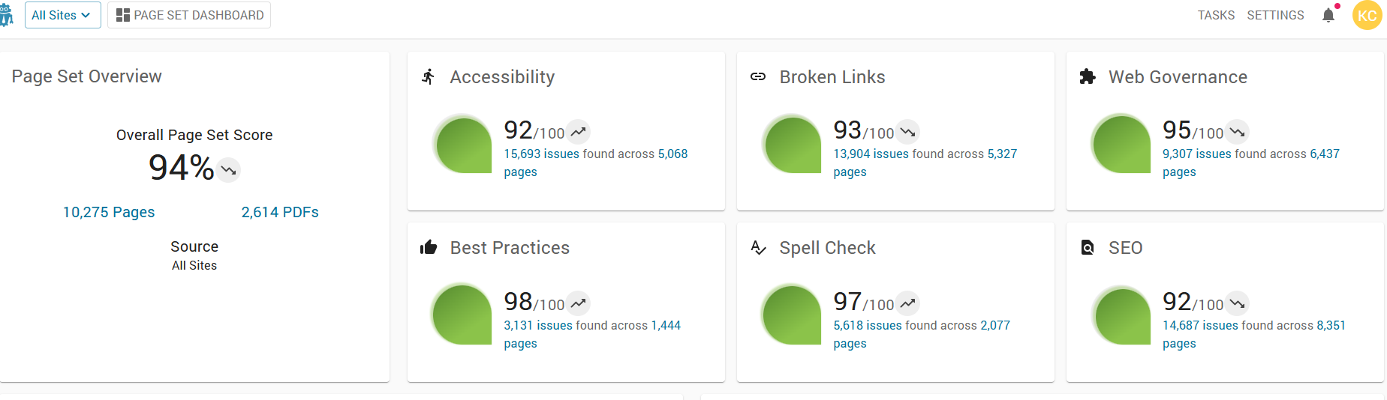
Web Content Accessibility
Digital marketing began reaching out to content authors in T4 in Aug. 2025.
75% T4 websites have been remediated.
Legal counsel at the UM System level collaborated to craft approved language for WordPress-powered sites.

Slide 27
Compliance landscape: Q&A
Amber Cheek and Carol Tohlen

Slide 28
Support and Resources
Kimber Crull

Slide 29
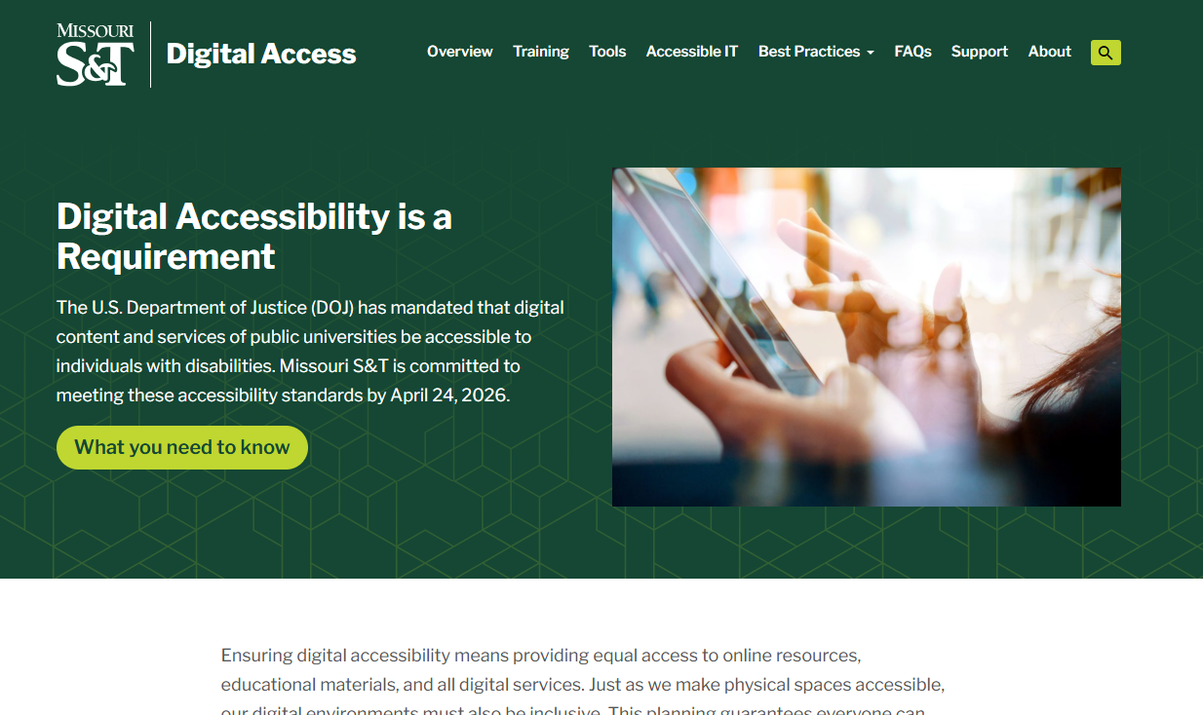
Digital Accessibility Resources at S&T
Digital Accessibility Website
digitalaccess.mst.edu
Learn what digital accessibility means at Missouri S&T
Access guidelines, tools, and best practices
Find campus contacts and support pathways

Slide 30


Digital Accessibility Training
Percipio – Digital Accessibility Trainings
On‑demand, self‑paced learning
Topics include:
Accessibility fundamentals
Creating accessible Word, PDF and PowerPoint documents
Ally and Canvas content accessibility
Access training through Percipio
S&T Digital Accessibility Training Channel
UM System Digital Accessibility Basics

Slide 31
Digital Accessibility Support by Area
Stuck? Can’t figure something out? Reach out!
Course Content and Canvas Accessibility
Contact the Center for Advancing Faculty Excellence – cafe@mst.edu
Web Content and Website Accessibility
Contact the digital marketing team in marketing and communications at websupport@mst.edu.
Submit requests at marketing.mst.edu using the marketing request form.
Purchasing IT and Digital Tools
Use the Accessible IT Purchasing Website to:
Review accessibility requirements
Ensure accessibility is considered before purchase.
digitalaccess.mst.edu/accessible-it

Slide 32

Contact the S&T Task Force
Have a question but not sure where to go?
Email digitalaccess@mst.edu
Visit the support page on digitalaccess.mst.edu

Slide 33
Thank you
digitalaccess.mst.edu

Slide 34
V. President’s Report
P. Runnion

Slide 35
COACHE Survey
Current response rates are trending above those of other institutions
This is both good and not good at the same time
If you received the COACHE survey invite and have not taken the survey, please do!
Administered by Harvard Graduate School of Education
Allows comparison with other institutions nationwide
Allow about 30 minutes to take the survey
Deadline: April 7

Slide 36
Leadership Update: Planned Network Outage
When: March 21st and 22nd
Saturday 8 am to Sunday 12 pm
What: Planned cut over to new network core
All network traffic between buildings and the internet pass though this set of network equipment.
Impact: All campus network services, including internet, phones, access systems, and alarms, will be temporarily unavailable
Multiple cascading outages are planned to be 5-10 minutes per building
But may exceed 10 minutes per building

Slide 37
Special Event Considerations
IT Status page will be updated with relevant public updates
https://status.mst.edu
Additional Coordination has been made for the following events occurring during the maintenance
BCH - Robotics 9 am – 2 pm
Gale Bullman - Track/Field & Volleyball 9 pm – 7 pm
Castleman/Leach - Fiddler on the Roof 2 pm & 7 pm
These locations will be migrated and validated outside of event hours to prevent disruption

Slide 38
Bylaws – Voting In Progress!
Per CRR 300.030.G, voting must take place by mail ballot.
Thank you to Misty House and Melissa Yetkin for preparing all the ballots
If you don’t want to do mail ballots again, note that the proposed amendments would allow for modern voting methods.
Ballots are being distributed via department chairs
Deadline: 4:30 PM on Wednesday April 15, 2026
Return ballots to Faculty Affairs, Norwood 209

Slide 39
IFC Updates – February 20 “emergency” (virtual)
Remote Work policy
Scheduled for 30 minutes, lasted over 60
The draft policy was revised based on feedback from this meeting

Slide 40
IFC Updates – March 9 (virtual)
Originally scheduled in person, moved to Zoom
President Choi did not attend
HR updates
Discussion about timing of paychecks for new faculty hires
Remote Work Policy
Mid-Probationary Review Executive Order
Distributed to Senate for feedback prior to the IFC meeting
Seems to impact other campuses more than S&T

Slide 41
Remote Work Policy
Draft shared with IFC on 2/20 was highly contradictory and unclear
Formal policy (HR-522) distributed on 3/2 is an improvement
Revised again on 3/11/2026
Policy: https://www.umsystem.edu/ums/rules/hrm/hr500/hr522
Q&A document: https://www.umsystem.edu/ums/rules/hrm/hr522_qas
Notes:
We are punishing everyone by creating a policy rather than addressing the misdeeds of a few.

Slide 42
Remote Work Policy
Question from Provost Harris: Where should the line be drawn between what can be handled between a faculty member and the department chair versus what needs to involve the Deans, Provost, Chancellor, and/or President?
Goal: Come up with guidance for this campus which falls within the bounds of the system policy
Notes:
We are punishing everyone by creating a policy rather than addressing the misdeeds of a few.

Slide 43
Foundational AI
A small number of people have expressed interest in working on foundational AI requirements
If you’re interested and haven’t already reached out, please do so
I will be reaching out to those who have expressed interest soon to set up an initial meeting

Slide 44
Jaggi School of Business
This continues to be a hot topic
Chancellor’s Policy Memorandum II-18 gives the procedure for departmental name changes.
II-18 does not seem to be guiding actions at this time
Key date: April 1, 2026
How will the Jaggi School impact P&T processes?

Slide 45
Test-Optional Undergraduate Admissions
Pandemic restrictions caused a temporary test optional policy
ACT/SAT availability was not good during the pandemic
Pandemic necessity morphed into a test-optional pilot
Currently operating under a one-year extension of the test-optional pilot
This is not the first one-year extension
We are being asked to consider endorsing another extension of the pilot

Slide 46
Test-Optional Undergraduate Admissions
February 2, 2026 – FS Officers meet with Provost/Chancellor
Asked if we should expect this sort of request, in an attempt to plan ahead
Provost and Chancellor were non-committal
March 5, 2026 – RP&A sets agenda for today’s meeting
March 9, 2026 – When discussing bylaws amendments with UM System, it was mentioned that a request was forthcoming
Received the request later that day from A. Crilly

Slide 47
Test-Optional Undergraduate Admissions
Request from A. Crilly: “I have been asked by Steven Chaffin with the UM System to secure Faculty Senate approval for a 1-year extension to the test optional undergraduate admissions pilot prior to the April Board of Curators meeting.”
April BOC meeting is April 16, 2026 (same day as April Senate meeting)
Senators were requested to poll their departments regarding test-optional
If a Senator wishes to bring this issue up for a vote, I will entertain a motion during New Business.

Slide 48
VI. Campus Reports A. Staff Council
M. Evans

Slide 49
VI. Campus Reports B. Student Council
A. Pickett

Slide 50
VI. Campus Reports C. Council of Graduate Students

Slide 51
VII. Committee Reports

Slide 52
VII. Committee Reports A. Rules, Procedures, and Agenda
D. Westernberg

Slide 53
Resolution
Whereas a comprehensive revision of the bylaws is currently pending and may substantially restructure multiple standing and judicial committees; and Whereas the proposed revisions are expected to be presented to the Board of Curators for approval at its regular meeting on June 25, 2026; Now, therefore, be it resolved that: 1. The Senate endorses a one-time suspension of the April 30, 2026 deadline for committee organization set forth in CRR 300.030.D.5.g for the 2026–2027 academic year;

Slide 54
Resolution (continued)
2. The Senate authorizes the Senate Officers to conduct any affected committee elections by electronic ballot in early July 2026, after final determination of the bylaws that will govern for the 2026–2027 academic year; and 3. Any elections not impacted by the pending bylaws revisions shall proceed in accordance with the existing April schedule.

Slide 55
Motion
The Rules, Procedures, and Agenda Committee moves that Faculty Senate adopt the preceding resolution.

Slide 56
VII. Committee Reports B. Personnel
K. Northcut

Slide 57
Resolution
Whereas the teaching mission of the University is Missouri S&T’s primary obligation to the State of Missouri and to all the students and instructional faculty in our community, and Whereas CRR 310.035 describes non-tenure-track faculty positions and policies concerning them, and Whereas the Faculty Senate of the Missouri University of Science and Technology acknowledges the vital importance of non-tenure-track faculty to the University and its teaching mission, and

Slide 58
Resolution (continued)
Whereas existing contract structures and renewal timelines can be a source of stress and uncertainty for our non-tenure-track faculty who desire and merit long-term employment, and Whereas non-tenure-track faculty who feel supported and appreciated will be able to engage more confidently with the institution, the entire campus community, and their profession at large, now therefore be it

Slide 59
Resolution (continued)
Resolved that the Faculty Senate requests that the Provost work to champion and implement rolling contracts for all full-time Associate Teaching Professors, Teaching Professors, and Librarian/Archivist II, III, and IV (as described in CRR 310.035 sections B.2 and B.5) in a uniform, campus-wide manner.

Slide 60
Motion
The Personnel Committee moves that Faculty Senate adopt the preceding resolution.

Slide 61
VII. Committee Reports C. Effective Teaching
J. Schramm

Slide 62
Motion
The Committee for Effective Teaching moves that student evaluations of teaching (SET) will be conducted during the summer semester, as is done in the fall and spring semesters, consistent with existing policies and procedures.

Slide 63
VII. Committee Reports D. Budgetary Affairs
B. Lea

Slide 64
Budgetary Affairs Committee
Academic Year: 2025 - 2026
Report To Faculty Senate: 02-12-2026

Slide 65
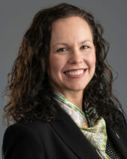
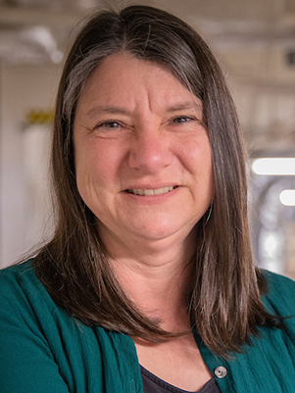
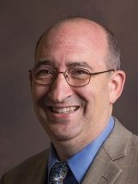
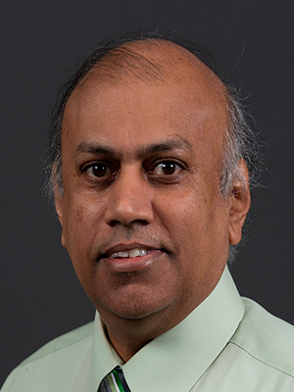
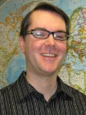
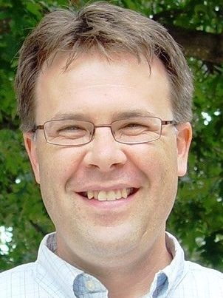
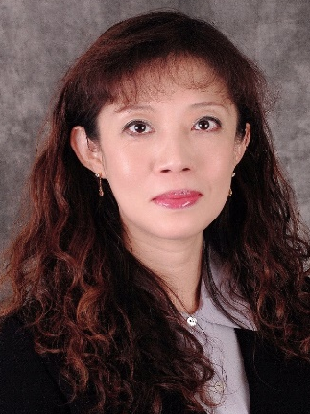
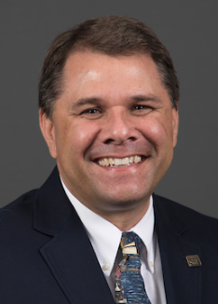
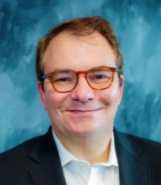
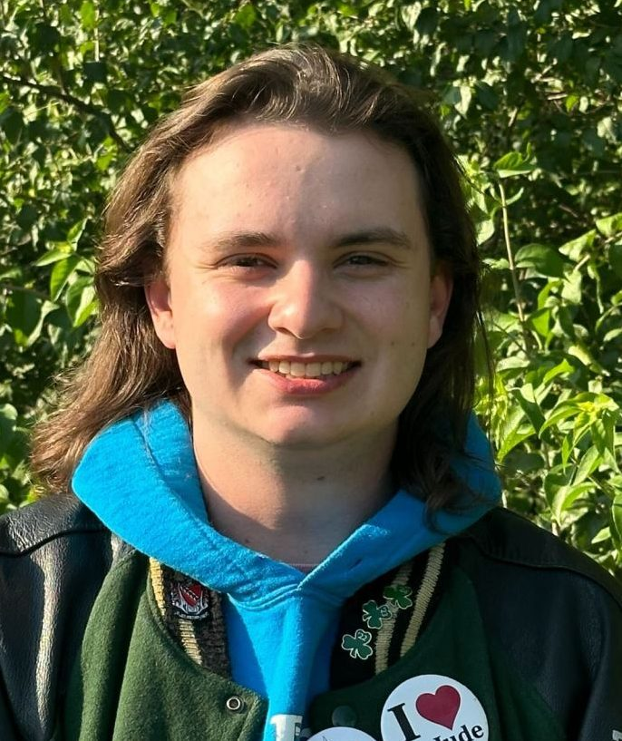
Budgetary Affairs Committee (BAC) Members
3-19-2026 Report
Referrals
Update: Supplemental Instructional Funding
Update: Faculty Workload & Distance Education Classes
In-progress Tasks
E
D
D
D
D
CFO Alysha O'Neil alysha.oneil@mst.edu
Finance & Operations
Dr. Melanie Mormile mmormile@mst.edu CASE
Dr. David Bayless dbayless@mst.edu, CEC
Dr. Jag Sarangapani sarangap@mst.edu, CEC
Dr. Michael Meagher
mmeagher@mst.edu, CASE
FS
FS
G
G
StuC
Dr. Kelly Homan khoman@mst.edu CEC
Dr. Bih-Ru Lea leabi@mst.edu Kummer
Dr. Michael Moats
moatsm@mst.edu
CEC
Dr. Amaury Lendasse
alendasse@mst.edu
Kummer
Mr. Jason Gough
jlgwt4@mst.edu
Student Council, EMSE

Slide 66
Referral Update: Supplement Instruction Funding
Budgetary Affairs Committee (BAC) recommendations to the VCFO Reported in 2-12 Faculty Senate Meeting
Rename the account in PeopleSoft to a more descriptive title, such as “Mission Critical Instruction Support,” to clarify its purpose.
Formally exclude the account from future budget reduction measures to protect instructional support.
Continue efforts to establish the account as a recurring GRA-funded line item.
Convene focused meetings with (1) the Provost and (2) college budget officers to address timing, transparency, and process concerns raised in the referral.
Communicate outcomes and an action plan to stakeholders, including the DCC that submitted the referrals.
Background Information
Faculty Senate Referral 1-15-2026
The Department Chairs Council (DCC) raised concerns about (1) miscellaneous instruction and (2) the current departmental budget model

Slide 67
Referral Update: Supplement Instruction Funding
Updates on BAC recommendations to the VCFO reported in the 2-12 Faculty Senate Meeting
Rename the account in PeopleSoft to a more descriptive title, such as “Mission Critical Instruction Support,” to clarify its purpose.
A commitment from the Provost to improve planning for miscellaneous instruction. The name will remain unchanged, as both the Provost and Deans recognize its importance.
Formally exclude the account from future budget reduction measures to protect instructional support.
No formal exemption is considered currently, as funding needs may decrease if courses are delivered more efficiently.
Continue efforts to establish the account as a recurring GRA-funded line item.
Convene focused meetings with (1) the Provost and (2) college budget officers to address timing, transparency, and process concerns raised in the referral.
A meeting was convened to address timing, transparency, and process improvement.
Communicate outcomes and an action plan to stakeholders, including the DCC that submitted the referrals.
The Provost’s Office is working on all three listed above and has been communicating with Deans.

Slide 68
Referral Update: Distance Education Classes and Faculty Workload
Special Topics with VP Dr. Debra Bourdeau, Online Learning & Educational Innovation (OLEI) on March 11.
Topics addressed in the meeting
Faculty Workload & Support
Tuition Model & Revenue Alignment
Strategic Direction of Online Learning & Education
Target Student Population & Program Strategies
Key Financial and Performance Indicators
Background Information
Faculty Senate Referral
1-29-2026
Address the practice of attaching distance sections to in-person classes without compensation or workload adjustment. Managing separate materials and activities increases faculty workload and reduces instructional quality.
BAC 3-19
BAC 4-16
Note: All data and plans presented are provided by Dr. Debra Bourdeau

Slide 69
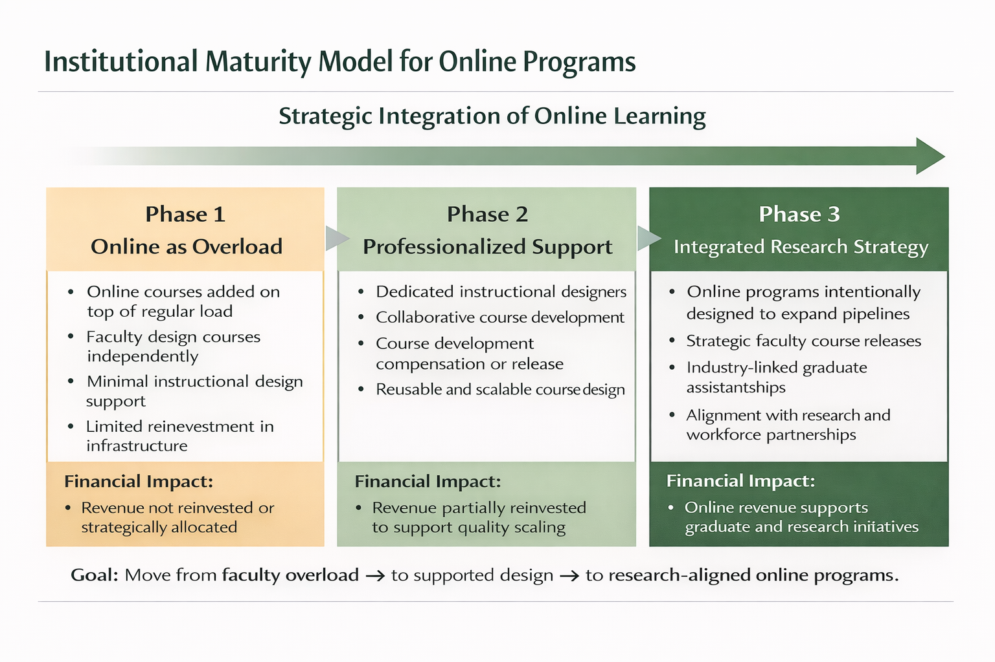
Referral Update: Distance Education Classes and Faculty Workload
Workload and Financial Impact
Institutional Maturity Model for Online Programs

Slide 70
Referral Update: Distance Education Classes and Faculty Workload
Workload and Research Impact
Institutional Maturity Model for Online Programs
Research Impact: Research productivity may dip, but not because of modality. It's because of unmanaged labor redistribution. These institutions have not yet aligned their policies, workloads, and support structures.
Research Impact: Research productivity stabilizes because faculty aren't reinventing materials every term. The strain disappears because faculty effort becomes front-loaded and supported rather than improvisational
Research Impact: Alignment of workload policy, instructional design infrastructure, industry partnerships, etc. Allows online delivery to become a mechanism for diversifying graduate pipelines.

Slide 71
Referral Update: Distance Education Classes and Faculty Workload
How Online Programs Support the R1 Research Mission
Additive Enrollment → Revenue → Research Capacity
Working Professional Students
• Age 25+
• Employer-supported or self-pay
• Additive enrollment
Online Master's Programs
• 30-credit asynchronous programs
• Scalable design
Example: 25 students ≈ $900K tuition
Research Ecosystem Support
• PhD assistantships
• Faculty startup packages
• Lab infrastructure & stipends

Slide 72
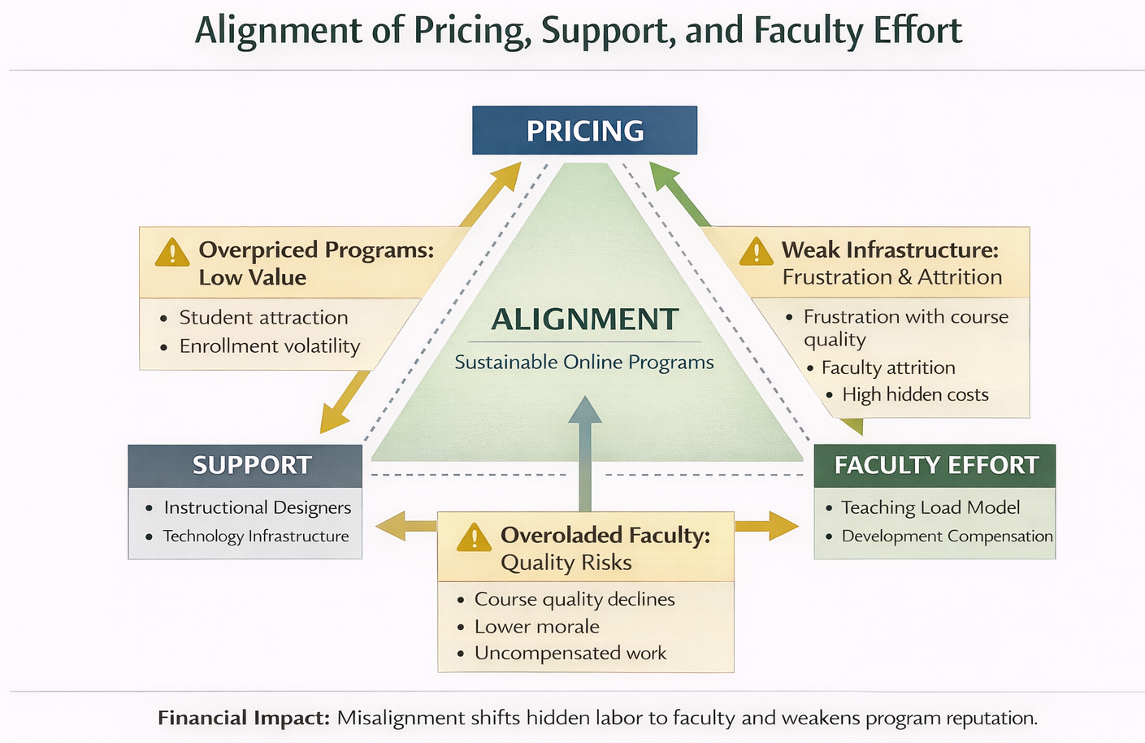
Referral Update: Distance Education Classes and Faculty Workload
Pricing Sets Expectations
Support Enables Faculty
Faculty Effort Must Be Recognized
Alignment Matters Financially

Slide 73
Tuition Model & Revenue Alignment
Referral Update: Distance Education Classes and Faculty Workload
Tuition parity vs. differential pricing strategy?
Current model is tiered pricing: $1200/credit hour, except:
$950 for psychology, mechanical engineering, aerospace engineering, manufacturing engineering, business/information sciences, and economics
$795 military rate
$675 mathematics and statistics
$600 technical communication online program
$500 teacher's academy
Potential tuition reduction example:
MS in Engineering Management, currently $1200/credit hour
Ranked #7 USNWR for Online Engineering Management Programs
#1 Purdue: $950/credit hour
#2 Arizona State: $1,007/credit hour
#3 Johns Hopkins: $1818/credit hour
#4 Duke: $2900/credit hour
#5 Penn State World Campus: $1,037/credit hour
#6 George Washington: $1200/ credit hour
Feedback Welcome!
Other matters to consider when making pricing decisions: see Campus Distance Tuition Scenarios FY2026

Slide 74
Basic Course Creation and Operation Costs*
Referral Update: Distance Education Classes and Faculty Workload
ID time (120 hours @ $25) | $3,000
Faculty Developer | $8,000
QCR payment | $300
Total | $11,300
The Challenge is …
OLEI does not have a General Revenue Fund (GRA) or a consistent revenue stream to invest in infrastructure that builds programs; growth becomes difficult to sustain.
*Excluding any special software costs
At $950/gsh, we pay for the class with 4 students.
At $1200/gsh, we pay for the class with 3.14 students.
Assuming instructional costs of $8500, future offerings are paid by 2.36 students.

Slide 75
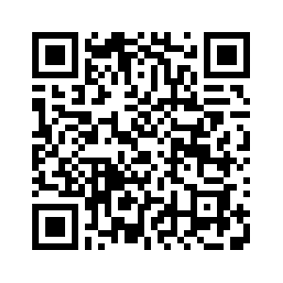
Referral Update: Distance Education Classes and Faculty Workload
Proposed Reinvestment Model for Online Programs
Category | Current | Proposal 1 | Proposal __
Campus General Budget | 80% | 65–70%
Department | 20% | 20–25%
OLEI | 0% | 10%
Category | Current | Proposal 1 | Proposal __
Campus General Budget | 80% | 65–70%
Department | 20% | 20–25%
OLEI | 0% | 10%
?
Feedback Welcome!
OLEI can use its share for:
Course development and redevelopment
Instructional design capacity
Platform tools/learning technology infrastructure
Quality assurance
Without reinvesting a small share into the infrastructure that builds programs, growth becomes difficult to sustain.
https://tinyurl.com/FS-referrals

Slide 76
In Progress Referrals and Tasks
Department Expense and Equipment (E&E) operating and its budget model (referral from Department Chair Council (DCC))
(continue) Online Education: Tuition Model, Enrollment Strategies, and Performance Indicators
Department Health Index/Pressure Index
In-progress financial/BAC Power BI reporting tool
that will improve transparency and effective communication
input
VCFO Alysha O’Neil Special Topic Report at April 16 Faculty Senate Meeting.
Submit Questions
https://tinyurl.com/FS-referrals

Slide 77
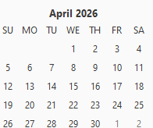
Information: Next Topic Request Due Date: 11:59 pm, 4-6-2026
All topics or questions submitted by April 6 will be reviewed at the April 8 BAC meeting, where the BAC will assess the following
Urgencies and priorities of topics/questions
data collection timeline
Approach(es) to addressing each topic
communication plans
Findings will then be communicated to the faculty during the March Faculty Senate meeting, another future meeting, or an appropriate communication channel.
Faculty Senate Meeting
Budgetary Affairs Meeting
RP&A Meeting
** last day of a semester
https://tinyurl.com/FS-referrals

Slide 78
VIII. Q&A with Provost
J. Harris
Notes:
First topic – update on Jaggi School of Business

Slide 79
IX. Unfinished Business
P. Runnion

Slide 80
X. New Business
P. Runnion

Slide 81
XI. Announcements
P. Runnion

Slide 82
XII. Adjourn
Notes:
Gavel: One tap

Slide 83
Thank You
P. Runnion
President, Faculty Senate
facultysenate.mst.edu

