Slide 1
Virtual Desktops
(or, how I learned to stop worrying and love the “cloud”)
Eric Sigler, IT

Slide 2
What is a “Virtual Desktop”?

Slide 3
In essence, it’s a normal desktop computer running inside “the cloud”.
Everything a “real” computer can do, a Virtual Desktop can do…though not always quite as fast.
What is the “cloud”? Accessible anywhere, always available, scalable on demand …

Slide 4
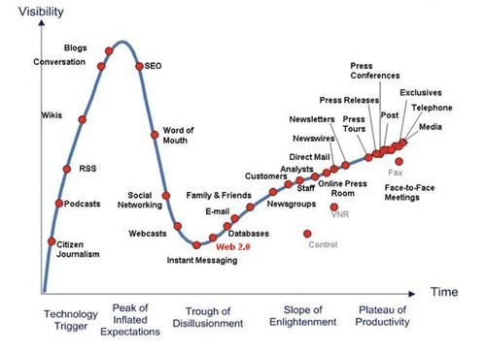

Slide 5
Previous Efforts:
Using “Remote Desktop” to your personal machine
Requires power, VPN, a remote desktop client
Pilot in Fall of 2007 used “home brew” infrastructure (VMware + Remote Desktop + Mappings)
Pilot was extremely successful

Slide 6
Current Capability:
Using multiple Dell R805 servers, Equallogic storage, VMware VDM 2.0, Alteon SSL offload
Pilot in fall of 2008 (so far, so good!)
Also hosting 10 Linux machines
This has proven the technology, shown us where we need to change practices, and that this is a viable path forward

Slide 7
Benefits:
Faculty & Staff desktop alternative:
Not everyone needs a 8 CPU, latest and greatest, with 64GB of RAM
But they can get it when they need it now
Desktop for every student:
~96% of incoming students have PCs
But not all of them have access to the software they need (Distance Ed, Mac OS or Linux, etc)…

Slide 8
And of course, the usual litany of “enterprise class” features:
Protected via generator & UPS
Redundant network connections
Redundant disk storage
Can be backed up (“Previous Versions” for your whole machine)
On demand capability to add and remove resources (CPU, RAM, Disk, Networking, etc)

Slide 9
Future Possibilities:
Offline Desktop
Check out your desktop to any supported device, roam around the world, and bring it back when you need more computing power
Desktop Management
Self-service software installation
“Green Computing”
Lower the energy used

Slide 10
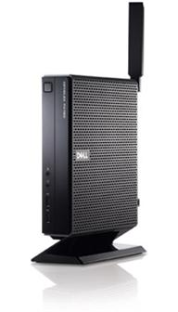
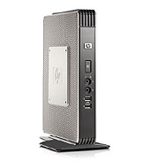
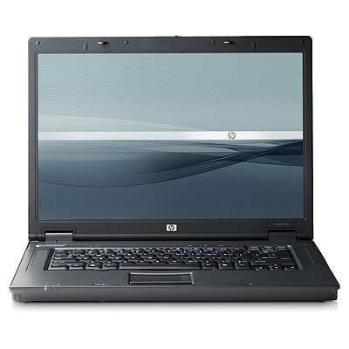
Thin Clients
Low cost ($150 - $400)
Reusable from generation to generation
Which means more funds can be spent on “horsepower”
Soon able to draw power from Ethernet (like your phones)

Slide 11
DEMO

Slide 12
Surprise!

Slide 13
Q&A
Angie Hammons, hammonsa@mst.edu
Eric Sigler, esigler@mst.edu
Sarah Welch, sarah@mst.edu

