Slide 1
Faculty Senate Meeting
April 16, 2020
Zoom Meeting

Slide 2
Agenda
Call to Order and Roll Call
K. Homan, Secretary

Slide 3
Agenda
Approval of Minutes
March 19, 2020
April 2, 2020

Slide 4
Agenda
III. Campus Reports
A. Staff Council, B. Spencer
No Report

Slide 5
Agenda
III. Campus Reports
B. Student Council, K. Kessinger

Slide 6
Student Council Report
Faculty Senate
April 16, 2020

Slide 7
Student Council
Student Council met on Tuesday to discuss a refund recommendation.
Thank you for your swift action on the grading system changes for this semester.
Students can continue to fill out a form on Student Council’s website (stuco.mst.edu) if they are having difficulties with the transition to online instruction.

Slide 8
Student Council
Student Leaders Awards
Student Council will announce the award winners in a video format across social media and its website.
More information coming soon!
New Officers
President - Lawrence Hierlmeier
Vice President, Academic Affairs - Anthony Watson

Slide 9
Agenda
IV. President’s Report
S. Corns

Slide 10
President’s Report
Dr. Steven Corns, Faculty Senate President

Slide 11
COACHE Survey
Survey has closed out
Should have results at Summer Senate meeting

Slide 12
Intercampus Faculty Cabinet (IFC)
Last IFC meeting, April 8*
Discussion of impact of moving to online and how long it will be in place
Possible administrator furloughs
Discussed expanded paid leave for those who cannot telecommute
Working on a process on how we are going to re-open campus

Slide 13
Intercampus Faculty Cabinet (IFC)
Last IFC meeting, April 8*
ACUE-NASH grant has been awarded to UM System.
Helps with teaching distance/online
Will likely be rolled out virtually with cohorts of faculty (16 or so?)
Budget outlook

Slide 14
Faculty Senate Resolution for Mark Mullin
Dr. David Westerberg

Slide 15
Faculty Senate Resolution for Mark Mullin
Whereas Mark Mullin has served the Faculty, Staff, Students, and Alumni of the Missouri University of Science and Technology as Athletics Director from 1992 to 2020; and

Slide 16
Faculty Senate Resolution for Mark Mullin
Whereas, as Director of Miner Athletics, Mark Mullin has led Miner Athletics to fourteen conference championships, ten additional titles, over seventy NCAA championship competition appearances with nearly one hundred student athletes named Academic All-Americans, nearly 80 All-Americans and over 350 All-Conference selections; and

Slide 17
Faculty Senate Resolution for Mark Mullin
Whereas, Mark Mullin‘s leadership skills and diligence have led to many facility improvements for Miner Athletics including construction of the student recreation center, multiple renovations of Allgood-Bailey Stadium, construction and expansion of fitness center facilities, multiple renovations of the Gale-Bullman multi-purpose building including Gibson Arena; and

Slide 18
Faculty Senate Resolution for Mark Mullin
Whereas Mark Mullin has served diligently as a Senator of the Faculty Senate of the Missouri University of Science and Technology (1992-2020)

Slide 19
Faculty Senate Resolution for Mark Mullin
Therefore, be it resolved that the Faculty Senate of the Missouri University of Science and Technology does hereby sincerely thank Mark Mullin for every job well done and wish him continued success in his future endeavors. Adopted this 16th day of April, 2020, at the meeting of the Faculty Senate of Missouri University of Science and Technology.

Slide 20
Agenda
V. Administrative Reports
A. Chancellor’s Report
M. Dehghani

Slide 23
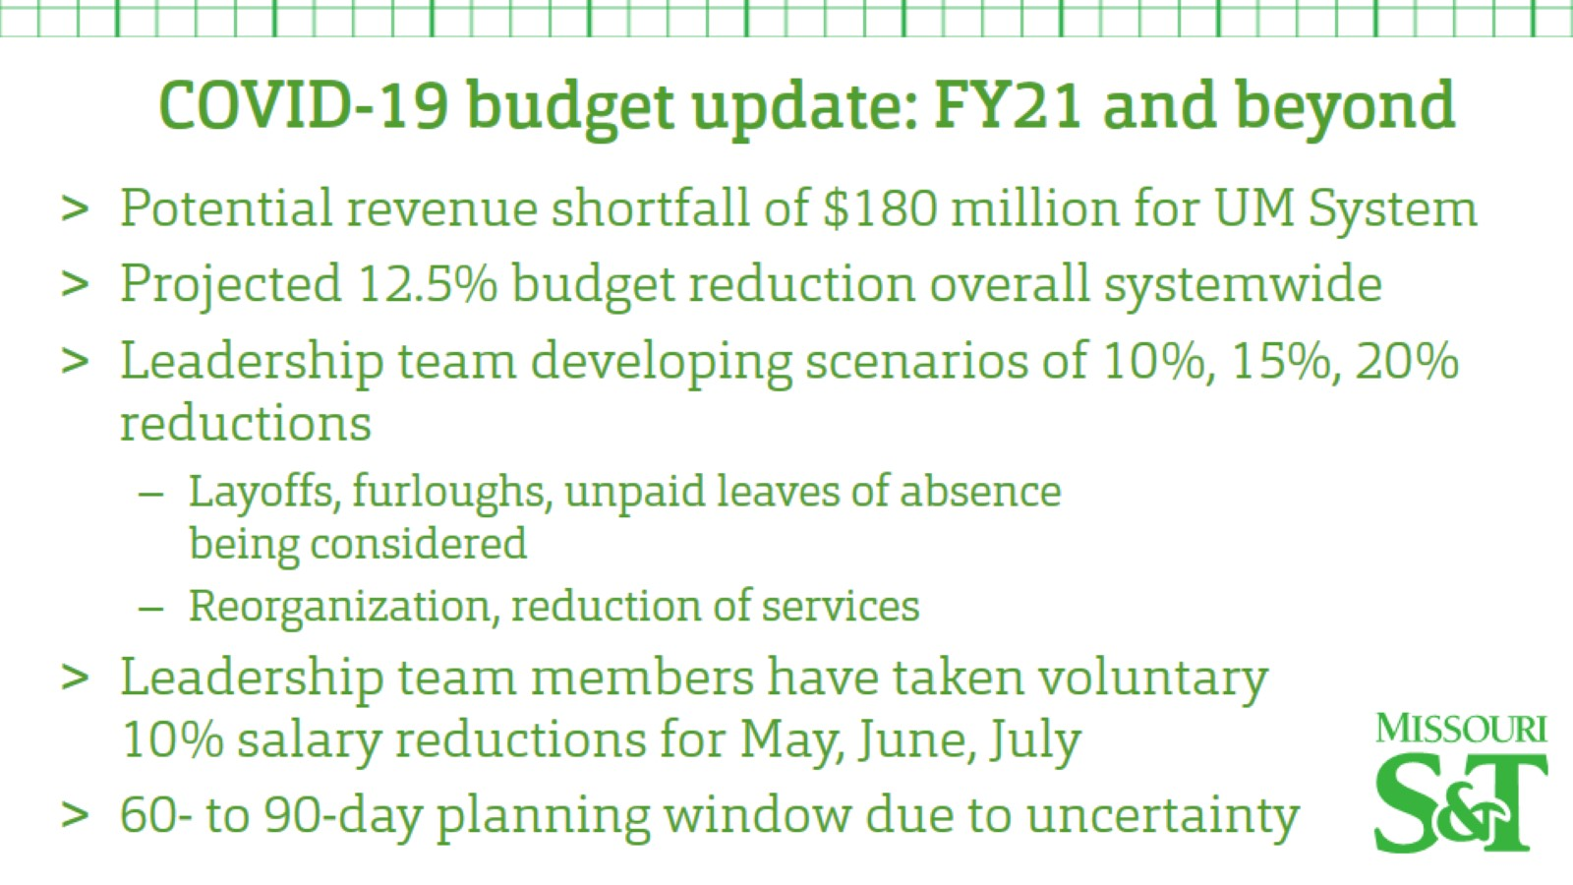

Slide 24
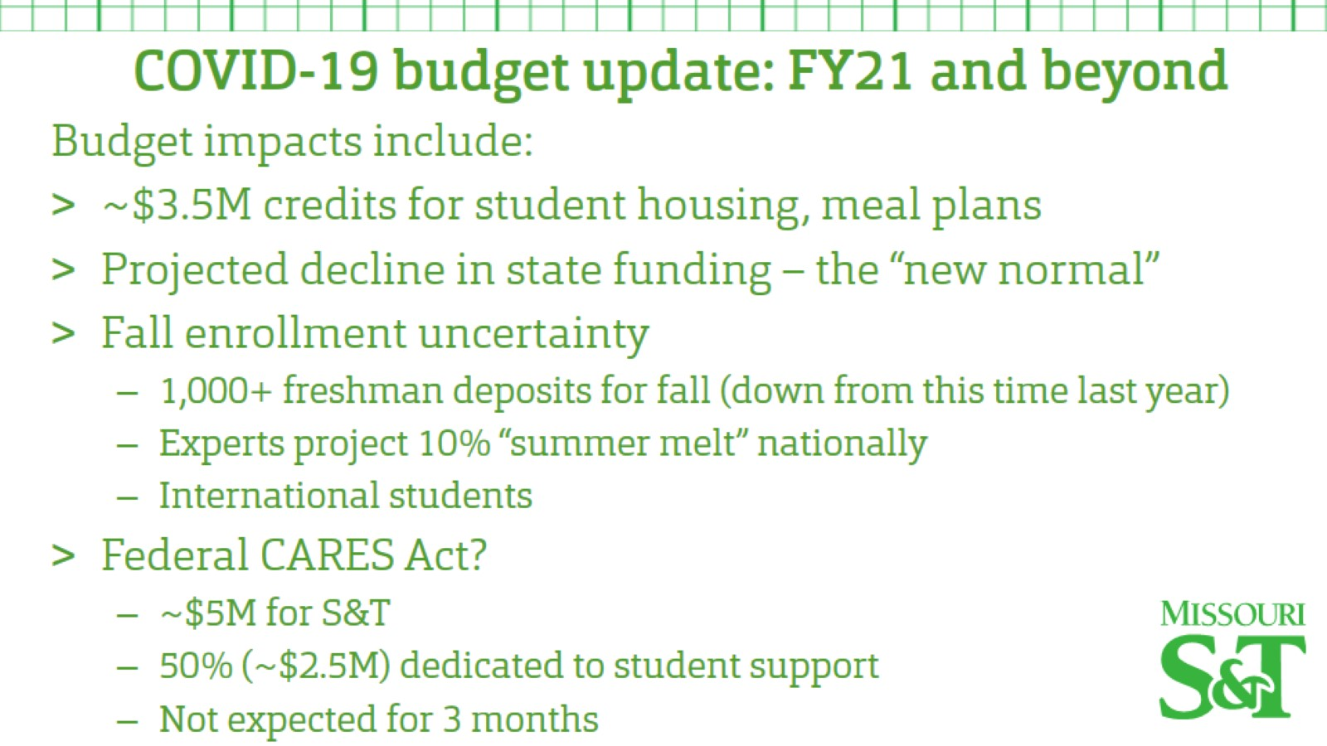

Slide 27
Agenda
V. Administrative Reports
B. Provost’s Report
S. Roberts

Slide 28
Agenda
VI. Reports of Standing Committees
A. Budgetary Affairs
M. Fitch

Slide 29
Agenda
VI. Reports of Standing Committees
B. Curricula
S. Raper

Slide 30
CCC Meetings
1 April
6 May (upcoming)
Total Committee Activity
1 Certificate program (PC forms)
3 Degree change request (DC forms)
23 Course change requests (CC forms)
5 Experimental course requests (EC forms)

Slide 31
Certificate Programs (PC) Requested
File: 349 PROPOSED: BioInnovation CTU
Degree Program Changes (DC) Requested
File 147.17 BIO SCI-BS: Biological Sciences BS
File 123.6 PRE-MED-MI: Pre-Medicine Minor
File: 135.13 TCH COM-MS: Technical Communications MS

Slide 32
Course Changes (CC) Requested
File 4413.5 CER ENG 4410: Introduction to Integrated Computational Materials Engineering
File 2048.1 CHEM ENG 5305: Hazardous Materials Management
File 475.4 COMP ENG 3110: Computer Organization and Design
File 1353.2 COMP ENG 5110: Principles of Computer Architecture
File 848.3 COMP ENG 6110: Advanced Computer Architecture I
File 2051.7 COMP ENG 6220: Design Automation of VLSI Systems
File 1662.1 ENG MGT 6112: Leadership for Engineers
File 1250.3 GEO ENG 5331: Subsurface Hydrology
File 1052.5 GEO ENG 5381: Intermediate Subsurface Hydrology And Contaminant Transport Mechs
File 2063.1 GEOLOGY 4411: Hydrogeology

Slide 33
Course Changes (CC) Requested
File 1532.4 MIL AIR 1110: Air Force Heritage and Values I
File 1390.3 MIL AIR 1120: Air Force Heritage and Values II
File 418.4 MIL AIR 2110: Team and Leadership Fundamentals I
File 1092.4 MIL AIR 2120: Team and Leadership Fundamentals II
File 419.3 MIL AIR 3110: Leading People & Effective Communication I
File 1093.3 MIL AIR 3120: Leading People & Effective Communication II
File 420.3 MIL AIR 4110: National Security Leadership Responsibilities & Commissioning Preparation I
File 748.3 MIL AIR 4120: : National Security, Leadership Responsibilities & Commissioning Preparation II
File: 751.5 MIL ARMY 1250: Leadership and Personal Development
File: 421.5 MIL ARMY 1500: Introduction to Tactical Leadership

Slide 34
Course Changes (CC) Requested
File 1734.4 MIL ARMY 2250: Innovative Team Leadership
File 1395.3 MIL ARMY 2500: Foundations of Tactical Leadership
File 1956.1 MIL ARMY 2750: Basic Leadership Laboratory

Slide 35
Curriculum committee moves for FS to approve the DC and CC form actions
Discussion: Questions or comments?

Slide 36
For Informational Purposes; No Senate Approval Required
Experimental Course (EC) Requests
File: 4689 BIO SCI 4001.007: Freshwater Ecology Laboratory
File 4687 CHEM ENG 5001.011: Chemical Engineering Instrumentation using Microcontrollers
File 4688 CHEM ENG 5001.012: Senior Assessment Review
File 4697 COMP ENG 6001.001: Adaptive Resonance Theory and Applications
File: 4692 ELEC ENG 5001.007: Process Control System Safety, Security and Alarms

Slide 37
Agenda
VI. Reports of Standing Committees
C. Information Technology/Computing
J. Singler
No Report

Slide 38
Agenda
New Business
Elections

Slide 39
VIII. Adjourn
39

