Slide 1
Council of Graduate Students
Department Representatives (30/50)
Biological Sciences (0/1)
Business and Information Technology (4/4)
Chemical Engineering (2/2)
Chemistry (0/3)
Civil, Architectural, & Environmental (4/4)
Computer Science (3/4)
Electrical & Computer (11/11)
Engineering Management & Systems Engineering (2/2)
Geological Sci & Eng (6/7)
Materials Sci & Eng (2/2)
Mathematics & Statistics (2/2)
Mechanical & Aerospace (4/6)
Mining & Nuclear (4/4)
Physics (1/2)
Psychological Sciences (0/1)

Slide 2
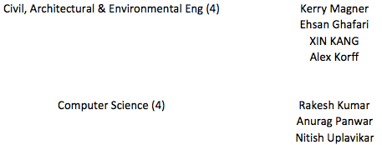
Council of Graduate Students

Slide 3
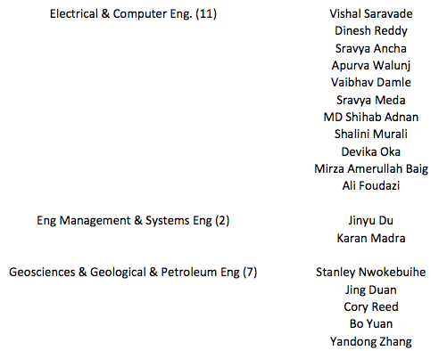
Council of Graduate Students

Slide 4
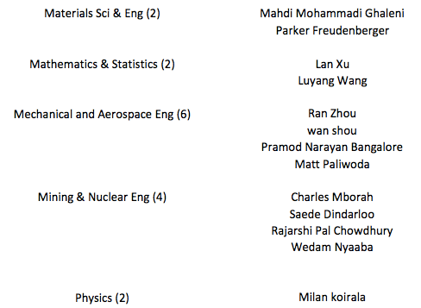
Council of Graduate Students

Slide 5
Council of Graduate Students
Current Endeavors
Strategic Plan
Seminar Series
Identify transferable skills graduate students need
Establish a list of Graduate Welfare Concerns
Revising the CGS Constitution
Conquering the Career Fair (September)
Healthcare Education (October)
Library and Research Skills (November)
Ignite Rolla (November)

Slide 6
Council of Graduate Students
Travel Grants
Application period during both Fall and Spring semesters
Available to help cover student travel costs to conferences
Conference must be during the semester of application
Maximum award of $200
Application window for the fall will be in October

