Slide 1
Campus Update
Cheryl B. Schrader, Ph.D.
Faculty Senate
March 20, 2014

Slide 2
Student Affairs
Fall 2014 housing
New testing facility in Norwood
Increased activity in COER

Slide 3
Finance and Administration
Master Plan status
Bertelsmeyer, Geothermal
Travel project

Slide 4
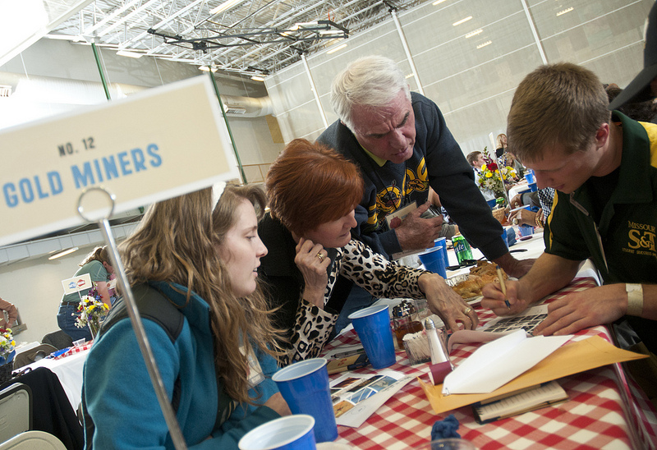
University Advancement
Hasselmann Alumni House
Charitable giving and alumni participation
Battle of the Brains

Slide 5
Human Resource Services, Affirmative Action, Diversity & Inclusion
Newsletter
Diversity and inclusion training
Faculty recruiting

Slide 6
Strategic Planning
Significant early progress
Six strategic initiative proposals
Semi-annual report, one-pager available

Slide 7
Thanks!
Any questions?

