Slide 1
Faculty Senate Update
Cheryl B. Schrader, Chancellor
April 17, 2014

Slide 2
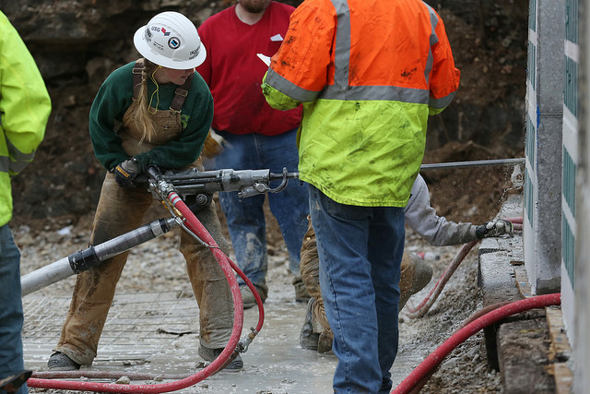
Intercollegiate Mining Champs

Slide 3
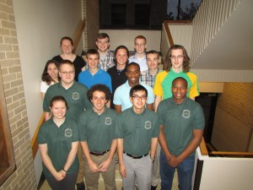
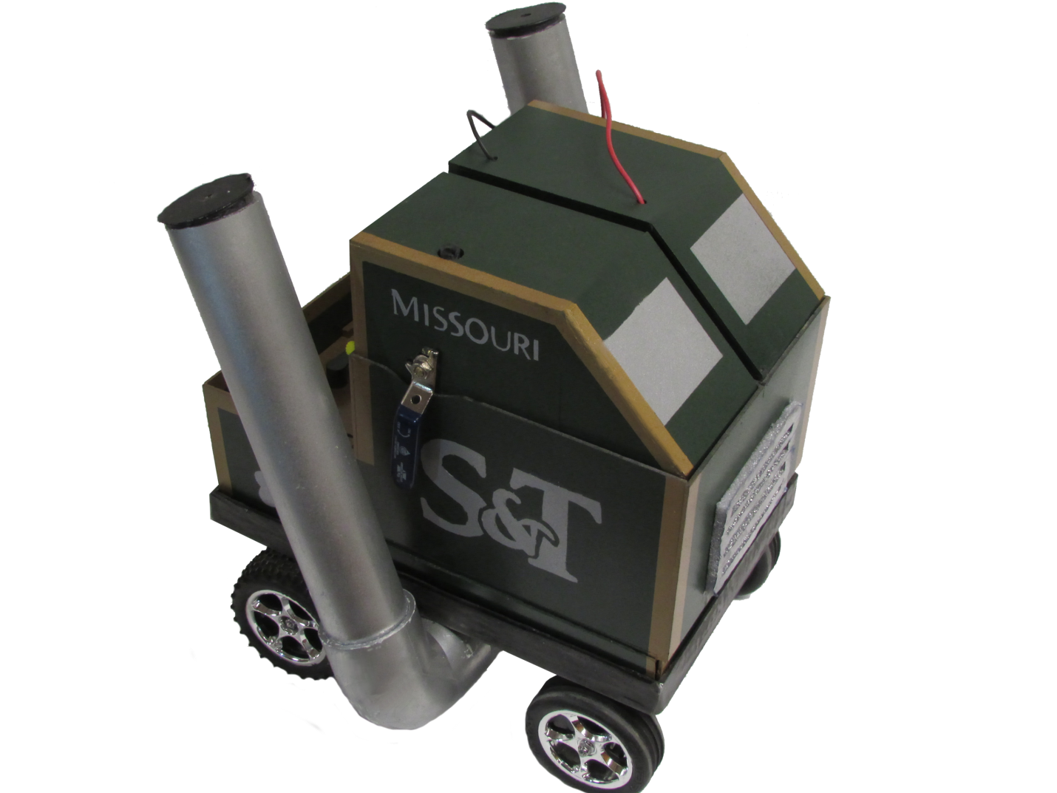
ChemE Car: Regional Champs

Slide 4
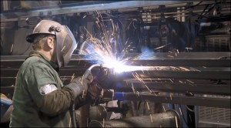
‘The Real Steel’ Video Champs
The Art of Steelmaking
Scott T. Pisarik and Jessica Randall
(Watch online at http://rol.la/therealsteel)

Slide 5
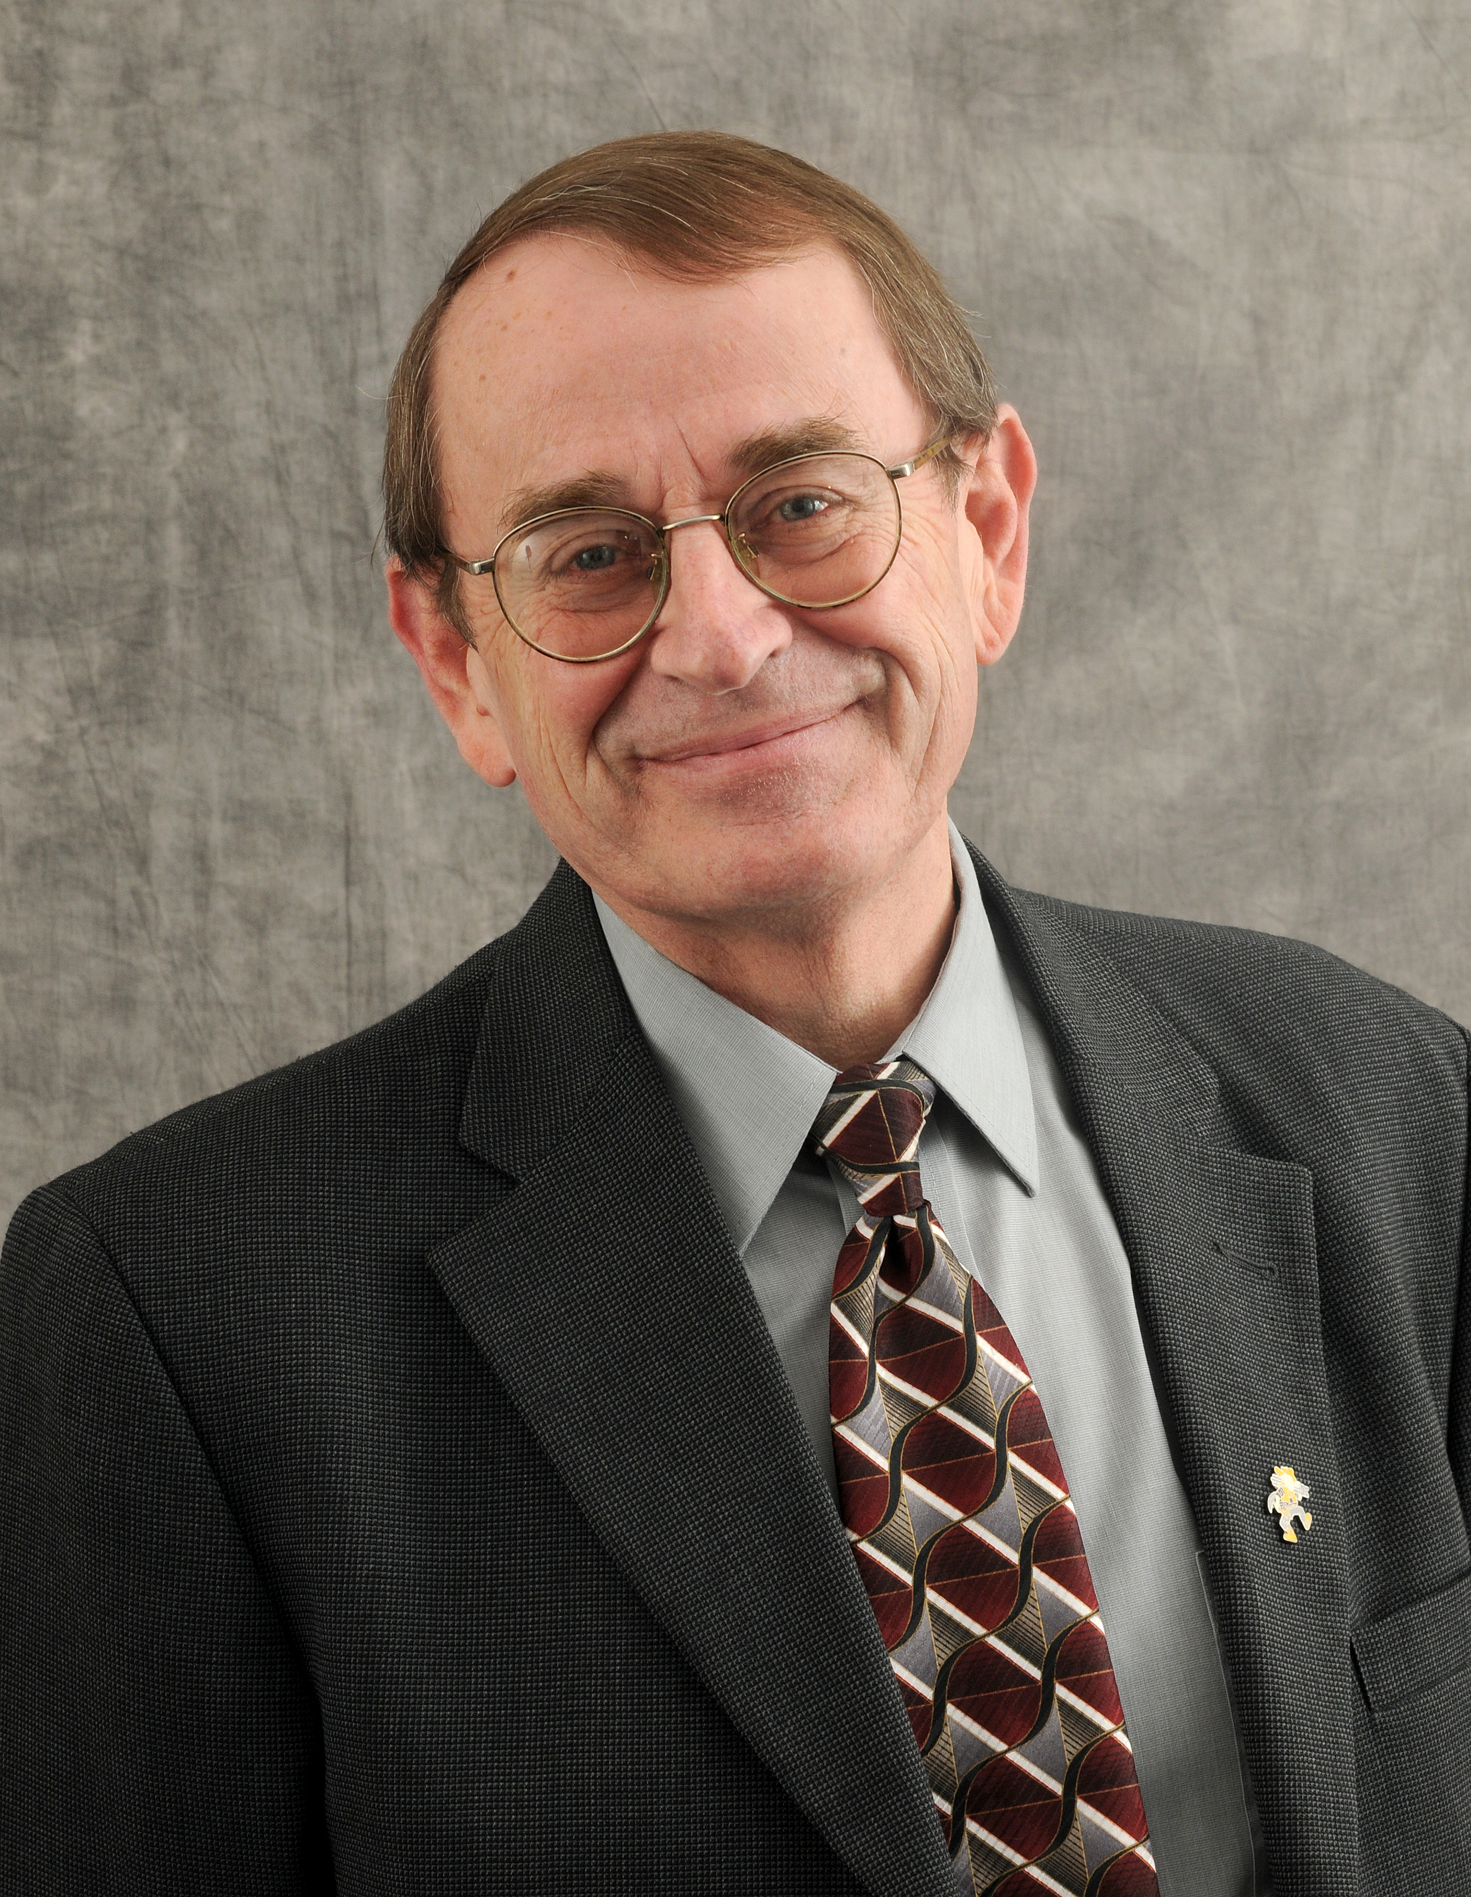
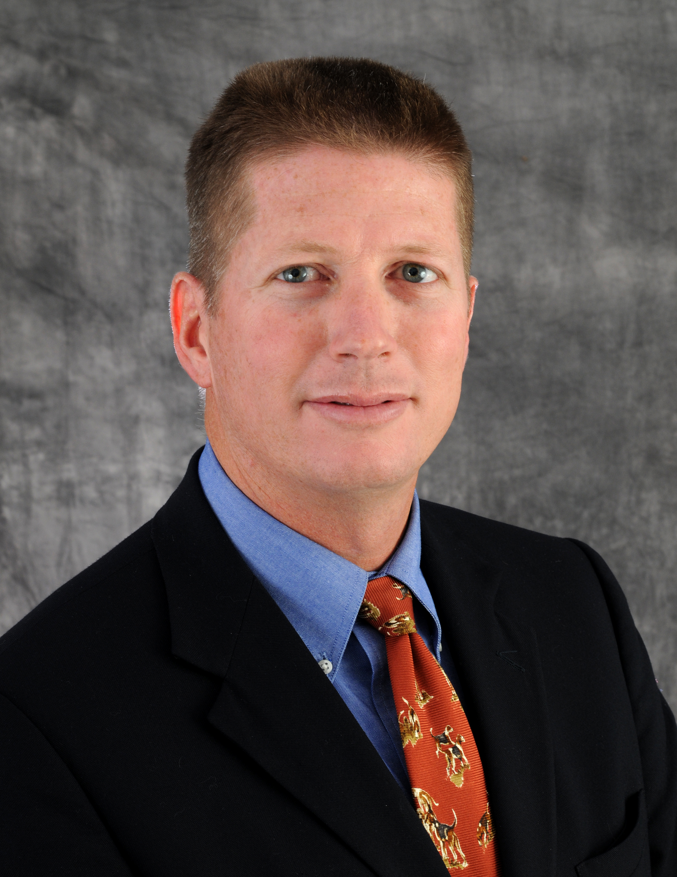
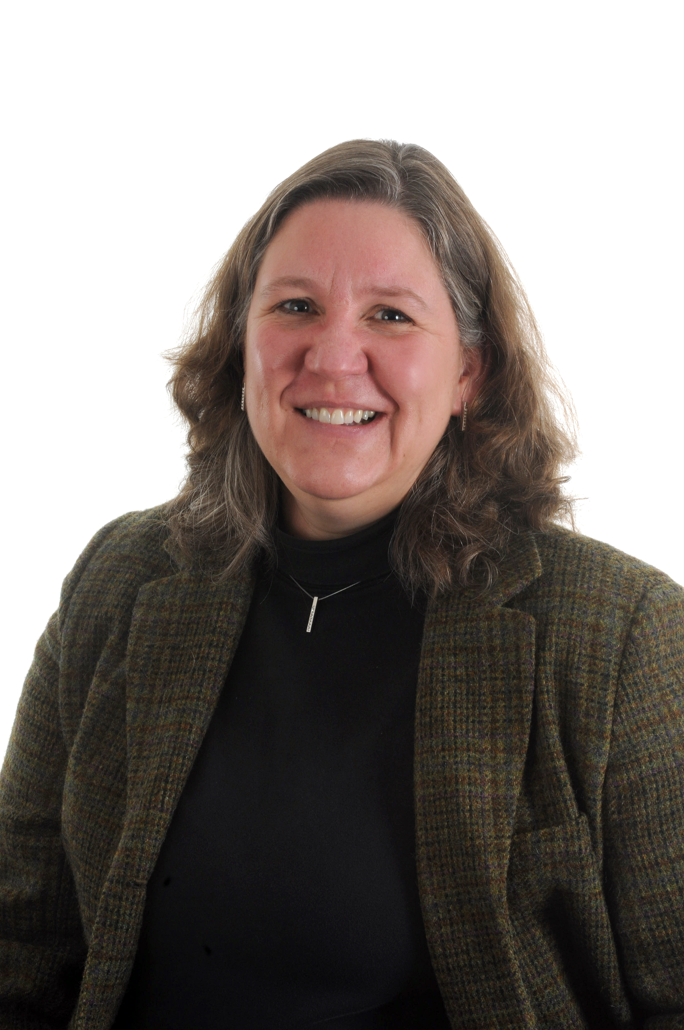
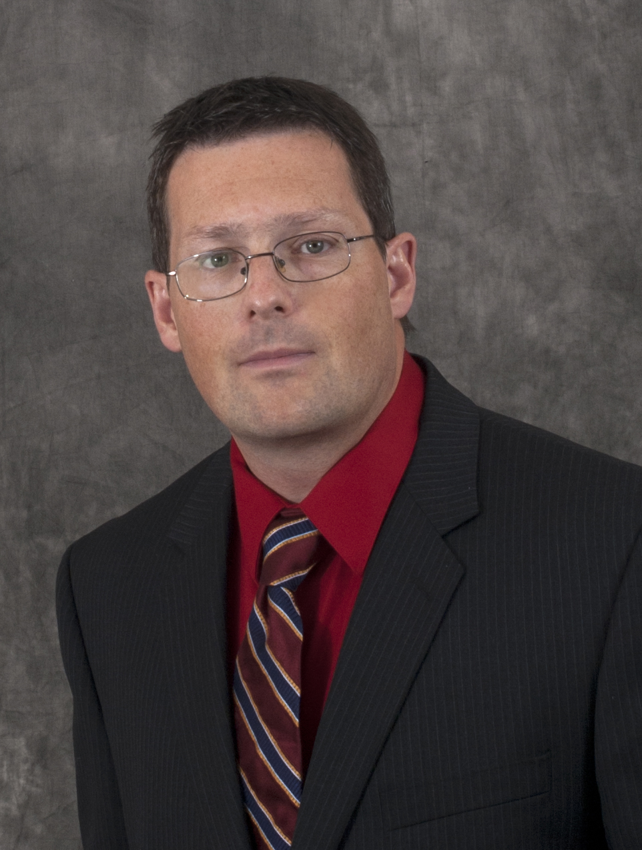
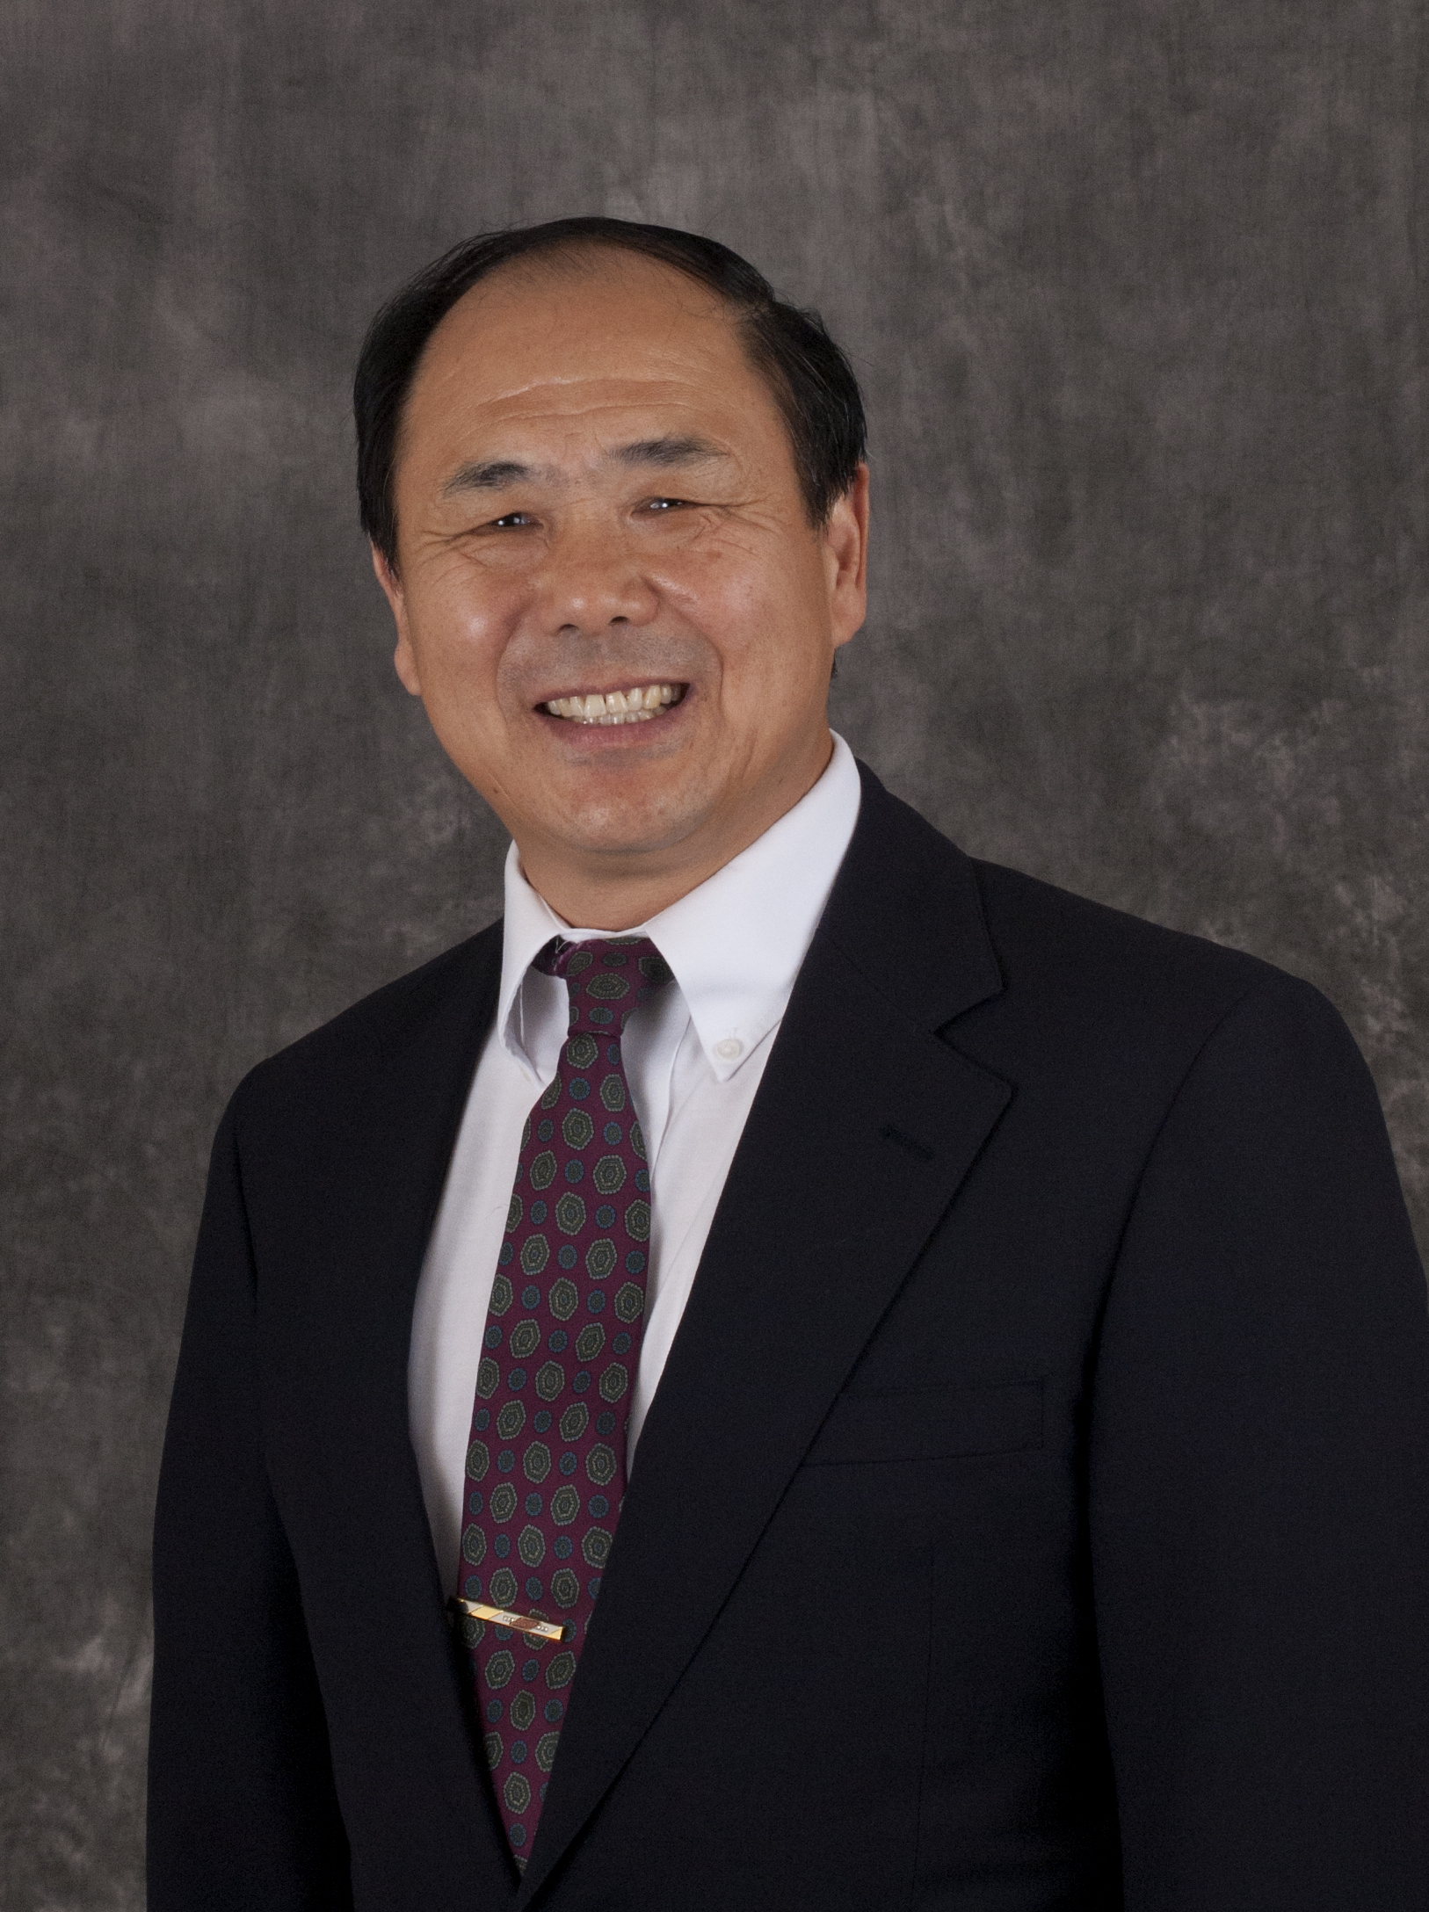
President’s Award Recipients
Larry Gragg | Curt Elmore | Mariesa Crow | Richard Dawes | Yinfa Ma

Slide 6
ROI U
Top 5 ROI among public universities
No. 20 on Forbes ROI list
No. 10 most ‘underrated’ university

Slide 7
Philanthropy Month
Woman of the Year
Board of Trustees
Battle of the Brains
Academy Meetings
http://rol.la/minersgiveback

Slide 8
State Funding
2% to 5% for performance funding
STEM funding discussion
Scholarship enhancements possible
Capital improvements
Bonding
50/50 projects

Slide 9
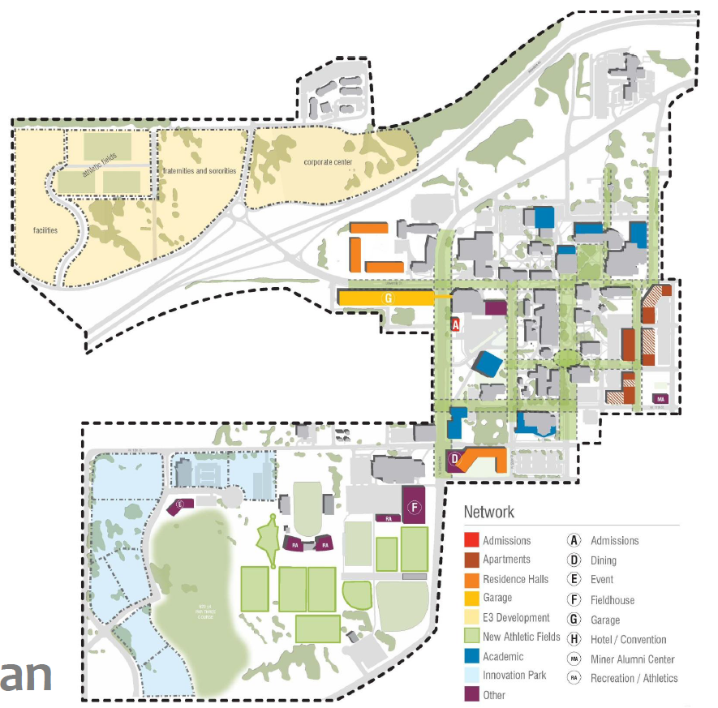
Campus Master Plan
Endorsed by the Board of Curators
Arrival district
Focuses activity at the heart of campus
Open Forum: 10:30 a.m. Monday, May 5, Havener Center, St. Pat’s A & B

Slide 10
Thanks!
Any questions?

