Slide 1
CHANCELLOR’S REPORT

Slide 2
2018 NEW FACULTY

Slide 3
2018 NEW FACULTY

Slide 4
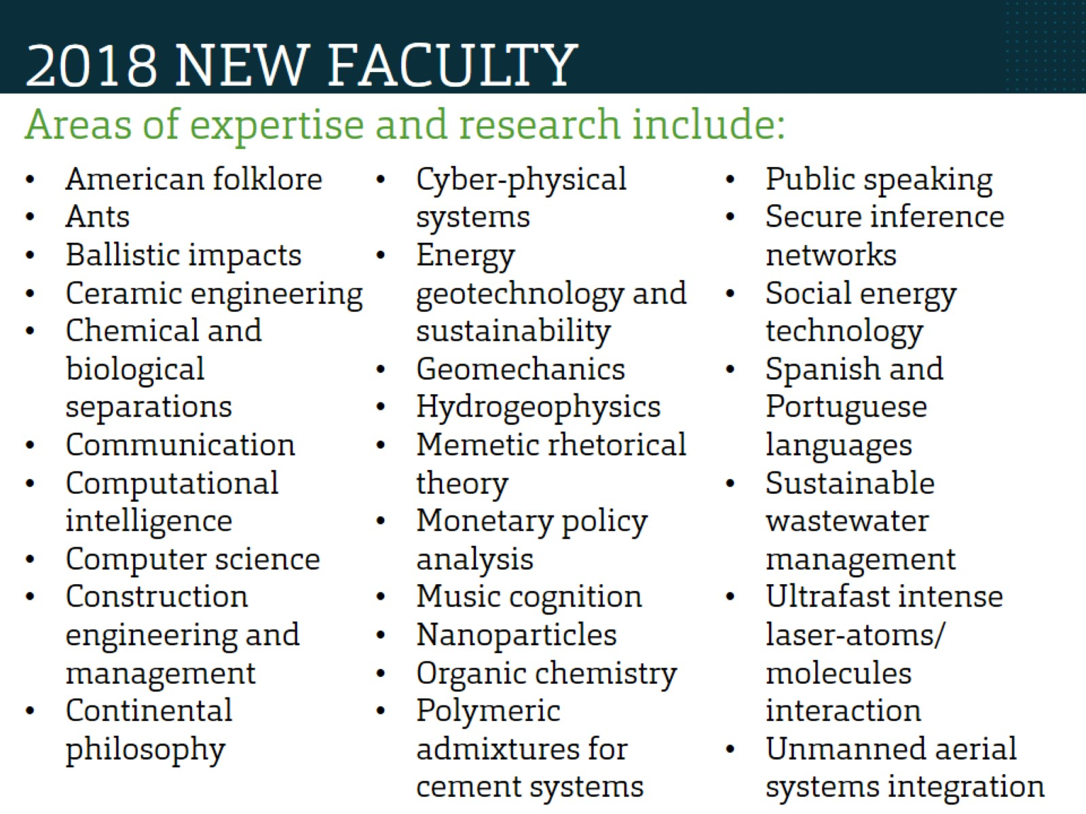
2018 NEW FACULTY

Slide 5
RECENT ACCOMPLISHMENTS

Slide 6
RECENT ACCOMPLISHMENTS

Slide 7
NEW LEADERSHIP

Slide 8
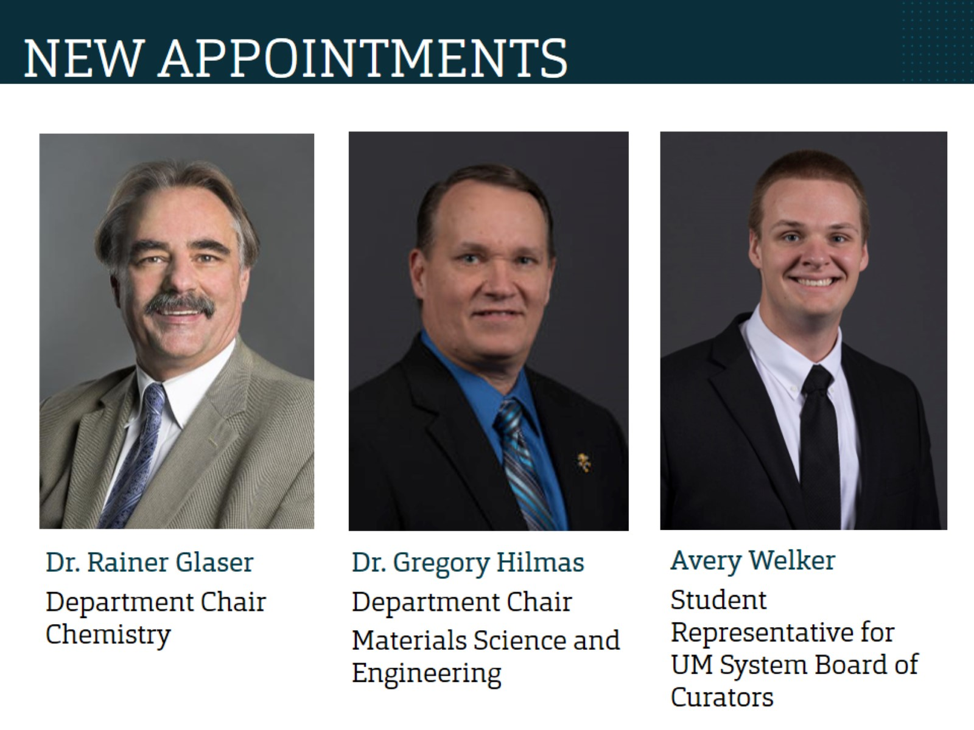
NEW APPOINTMENTS

Slide 9
ORGANIZATIONAL CHANGES

Slide 10
ORGANIZATIONAL CHANGES

Slide 11
ORGANIZATIONAL CHANGES

Slide 12
PROPOSED CAPITAL PROJECTS

Slide 13
STRATEGIC PLAN

Slide 14
UNIVERSITY TASK FORCE

Slide 15
UPCOMING EVENTS

Slide 16
THANK YOU! QUESTIONS?

