Slide 1
S&T IT Research Support
11 March, 2011
ITCC

Slide 2
Fast Facts
Team of 4 positions
3 positions filled
Focus on technical support of researchers
Not “IT” for researchers

Slide 3
Mission Focus
HPC operations
Cluster consulting & hosting
Electro Mechanical support and consulting
Linux support and consulting
Data acquisition consulting

Slide 4
Year’s Accomplishments
Cluster News
3 New clusters installed and operating
Academic NIC facility substantially upgraded
Supercomputing white paper in development

Slide 5
Year’s Accomplishments
Direct Support news
3 user groups launched
Linux migration planning started
Operational Transition for Fall 2011

Slide 6
Year’s Accomplishments
Team Development
One new staff member hired
National Instruments Certified LabVIEW Associate Developer in training
Junior Level Linux Professional in training

Slide 7
Challenges Ahead
Hiring suitable staff
Retaining existing staff
Growing user communities
Refining mission within resource constraints
Continuing HPC upgrades

Slide 8
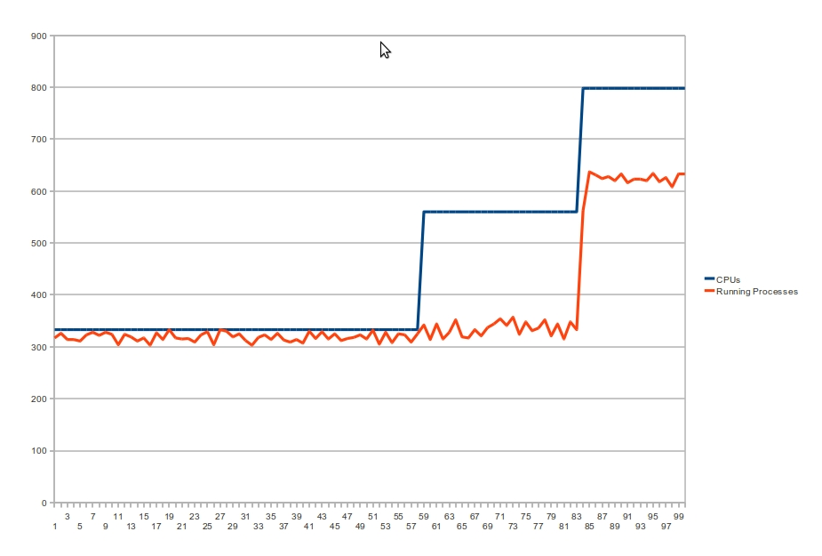
HPC - Running Processes vs. CPUs

Slide 9
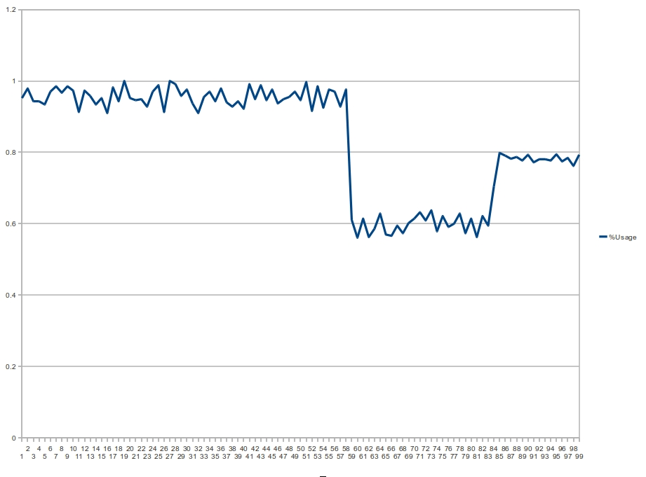
HPC - Percent CPU Utilization

Slide 10
Dr. Wunsch Cluster
4 Nodes
each node has
2 - 4 Core Xeon X5620 CPUs
7 Tesla C2050 GPUs
24 GB RAM
Resulting in a total of
32 Processor Cores
28 GPUs resulting in 28 Tflops of Processing Power
96 GB of RAM

Slide 11
Dr. Dawes Cluster
13 Nodes
each node has
2 - 6 Core Xeon X5680 CPUs
96GB RAM
6 - 15,000RPM SATA Drives in RAID 1 for 2.3 TB of high speed scratch space.
Resulting in a total of:
156 Processor Cores
1248GB of RAM
29.9TB of high speed scratch space.

Slide 12
User Group Info
LabVIEW Users Group
website: https://groups.google.com/a/mst.edu/group/it-rss-labview-users-grp/topics?hl=en
email: it-rss-labview-users-grp@mst.edu
HPC Users Group
website: https://groups.google.com/a/mst.edu/group/it-rss-hpc-grp/topics?hl=en
email: it-rss-hpc-grp@mst.edu
Linux Users Group
website: https://groups.google.com/a/mst.edu/group/it-rss-linux-users-grp/topics?hl=en
email: it-rss-linux-users-grp@mst.edu

