Slide 1
UM IT Strategic Plan Development Framework December 14, 2011
Draft

Slide 2
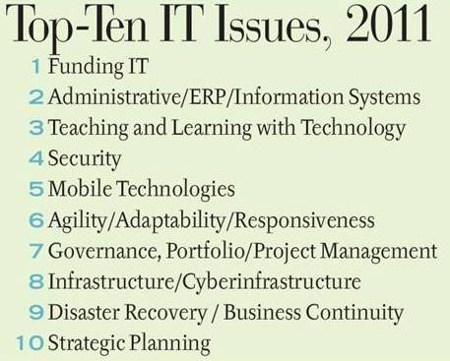
Introduction
The University of Missouri System’s Division of Information Technology (DoIT) and the IT Groups from UMKC, UMSL and MS&T met in Columbia on December 1st and 2nd to begin to develop a common strategic plan for the University of Missouri System’s information technology function.
The following pages present a snapshot of the higher education and higher education IT landscape, and a summary of the workshop outcomes.
This document will serve as the basis for continued consultations, discussions, analyses and planning in order to develop a five-year University of Missouri System Information Technology Strategic Plan.
Source: EDUCAUSE

Slide 3
UM IT Context: Changing Tires @ 70mph
Key Projects:
eLearning
PS-Student Upgrade
PS-Finance & PS-Human Resources Optimization, Bundles & Patches
Common Ticketing System
Focus & Culture Change:
More Customer-Centric
Improved Usability
Operational Excellence
More Vanilla Implementations
Shared Services:
Intercampus Network
Data Center Consolidation
Research Network
Continuous Availability
Reorganization:
Enterprise Applications
Strategic Project Management Office
New skills: Architecture, Consulting, Testing and Project Management
Leadership Changes:
UMS President
MS&T Chancellor
No UMS-Level Student Leadership
EAS Leader

Slide 4
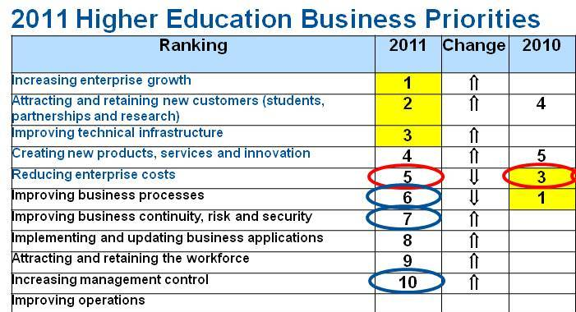
Higher Education Context
Education Inflation
Society
In the face of “macroforces,” such as higher demand and reduced funding, institutions must increase revenues and continue to reduce operating costs.
Retreating Responsibility
Technical Turmoil
Political
Technology
Education Ecosystem
Energy Uncertainty
New Normal
Environment
Economy
Source: “Enabling and Disrupting Macroforces Affecting the Expanding Learning Education Ecosystem” by Dr. Jan-Martin Lowendahl, Gartner

Slide 5
Key UM IT Strengths
Education Technologies
Support for Academic Mission
Developing Mobile Applications for Students
Advanced Student Services (Tegrity, Wimba/BB Collaborate)
Streaming Remote Labs
Customer Service
Quality Service to Customers
Responsive Customer Service
Customer Service to Students
Helpdesk
Commitment
Meeting Needs Cost Effectively
Put in the Time Required to Get Job Done
Dedicated IT Staff
Purchasing
Collective We
Volume IT Purchasing Agreements
HP Contract
Dell Contract
Collaboration
Work well together
Informally share product process information
LTIC Collaborative Projects/Support
IT Standards Committee
IT Security
Campus Standardization
Developing Shared Services
Developing Governance
Special Event Coverage
Common Directory

Slide 6
Key UM IT Weaknesses
Usability and usefulness
Customer focus
Customer input
IT planning and budgeting across campuses
Push/pull of System efficiency vs Campus differentiation
UMS-level Leader for PeopleSoft Students
Collaboration
Communication
Too accommodating (+1,000 PeopleSoft modifications)
Project management
Project and resource portfolio management
Project execution
Planning
Costing
Testing
Upgrades
Solution evaluation, selection and costing
Funding
Multiple models
Legacy models
IT staff and resources outside of IT Groups

Slide 7
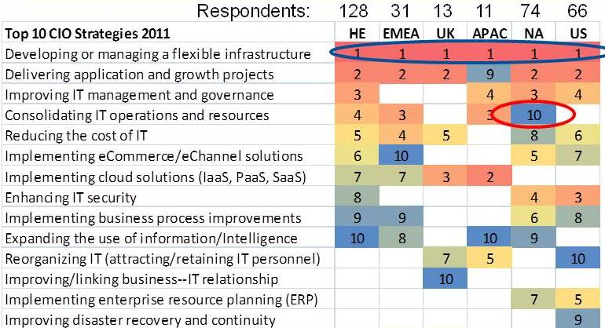
Higher Education IT Context
UM IT is either already implementing or is contemplating the implementation of nearly all these strategies.
Source: “Enabling and Disrupting Macroforces Affecting the Expanding Learning Education Ecosystem” by Dr. Jan-Martin Lowendahl, Gartner

Slide 8
Key Strategies, Key Initiatives* & Working Groups
1. Improve usability and usefulness of solutions | Andy Goodenow(L) Paul Pratte, Marilyn Reisenbichler, John Bax, Joanne Boomer, Brandon Hough, Tom Gittemeier
Develop enterprise architecture standards - Develop Cloud strategy - Review outsource opportunities | John Bax(L) David Crain, Brien Waage, Ken Voss, Jim Schonnemann, Hank Niederhelm
Restructure IT across the UM System - Centralize IT where appropriate - Increase collaboration | CIOs
* Additional key initiatives will be identified by Working Groups (L) Working Group Leader

Slide 9
Key Strategies, Key Initiatives* & Working Groups
Improve and coordinate budgeting and planning - Establish system-wide IT budgeting process - Establish common approach to IT planning - Coordinate technology purchases across the system | Margaret Cline(L) Karen Kirkwood, Nikki Witting, Janet Carnett, Meg Brady
5. Establish and empower a Strategic Project Management Office - Maximize use of common applications, services and resources - Deploy effective communications | Justin Guggenmos(L) Terry Robb, Vicki Callaway, David Johnston, Mary Fowler
6. Develop shared research computing support capability | Mark Bookout(L) Gordon Springer, Chip Byers, Mary Fowler, Andy Goodenow
* Additional key initiatives will be identified by Working Groups (L) Working Group Leader

Slide 10
Strategic Plan Development Schedule
Start 12/01
Workshop & Draft Framework
Strategic Plan Development:
Work Group Breakouts
Strategy definition and Initiative Planning
Draft Strategic Plan Development
Draft Review
Preliminary Framework Development:
Strategic Planning Session
Draft Framework Development
Group Leader Briefing & Assignment
Working Groups & Plan Development
Final Plan Development
Ongoing Stakeholder Consultations
Final Plan Development:
CIOs and VP Draft Review
Final Strategic Plan Development
GOs & President Review
General Officers & UM President Review:
Strategic Plan Presentation
1
2
3
4
5
6
7
8
9
10
11
12
13
14
15
16
Mid
February
December
January
February
March

Slide 11
Closing and Next Steps
The aim of the UM IT strategic plan is to enable the academic, research and business objectives of the University of Missouri System and its campuses.
Especially in this austere, yet demanding operating environment, we seek to enhance the usability, fitness and adaptability of our solutions.
We look forward to conferring with you as it is developed over the next two months.

Slide 12
Oscar Tshibanda
Managing Partner
(816) 916-7171
oscar@tshibanda.com
1717 Oak St.
Kansas City, Missouri 64108
www.tshibanda.com

