Slide 1
Old Business
Postponed motion from Student Affairs Committee:
“1. The period from 5:00 – 6:00 PM daily be reserved for common exams.
2. If a class or other required academic activity is scheduled during common exam time, the instructor of the class that conflicts with the common exam will provide accommodations for the students taking the common exam.”

Slide 2
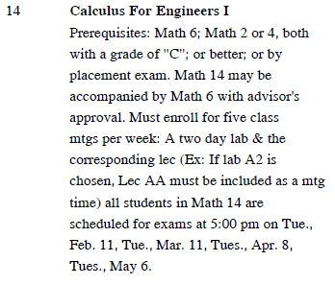
1. The period from 5:00 – 6:00 PM daily be reserved for common exams. 2. If a class or other required academic activity is scheduled during common exam time, the instructor of the class that conflicts with the common exam will provide accommodations for the students taking the common exam.
Common exams = listed in schedule of classes
Classes may be scheduled 5-6 pm
Accommodation not specified

